Slide 1
,,tick-tack-toe"
by Jonė Žemeckaitė

Slide 2
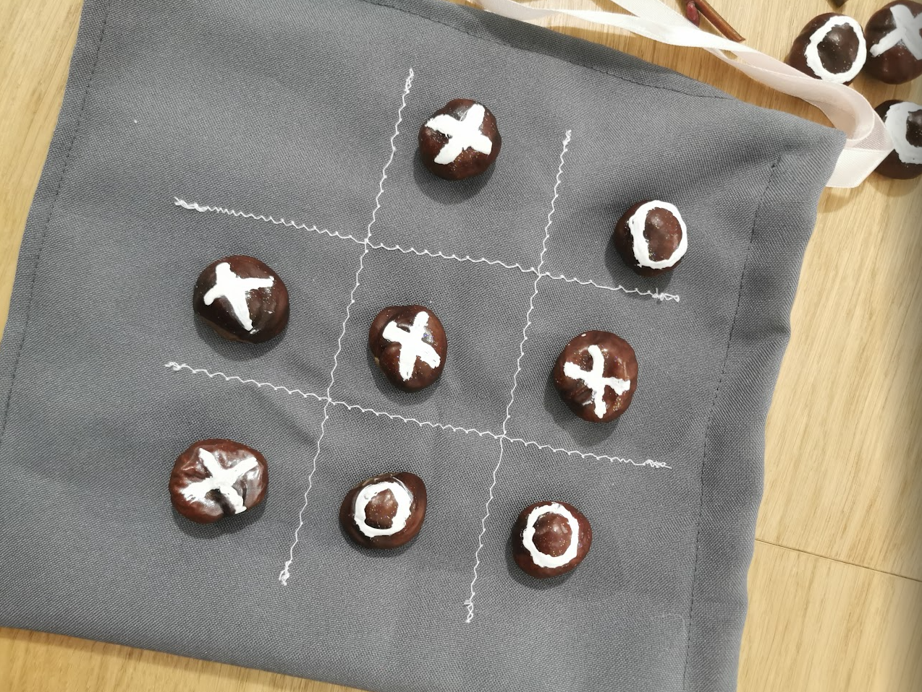
This is a board logic game that can be played by two players.
Place the crosses and zeros in a horizontal, vertical or diagonal row.

Slide 3
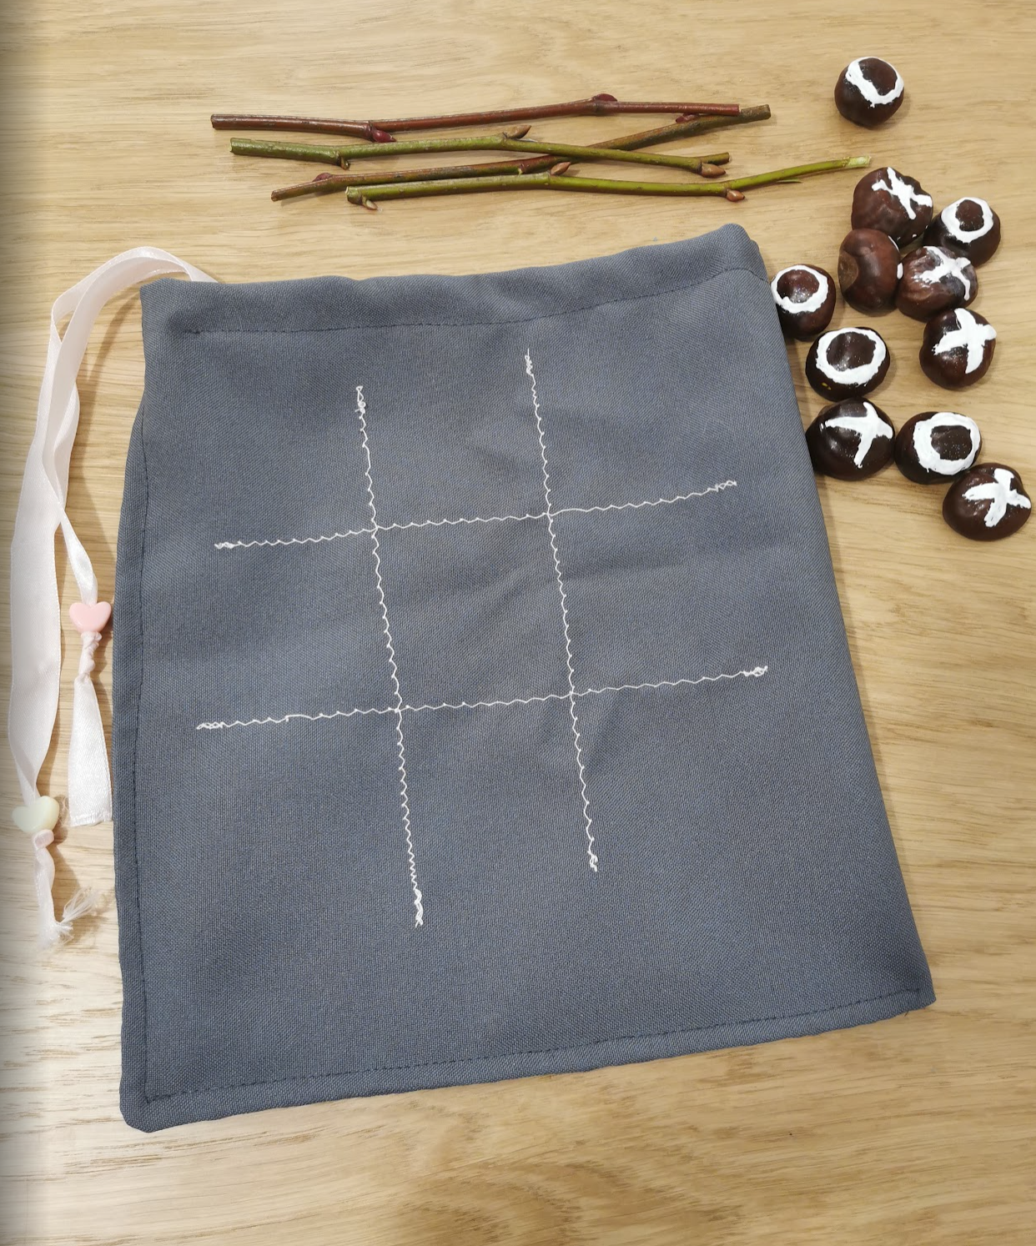
Resources
You will need:
6 chestnuts with crosses.
6 pieces with zeros.
4 wooden sticks to make the windows.

Slide 4
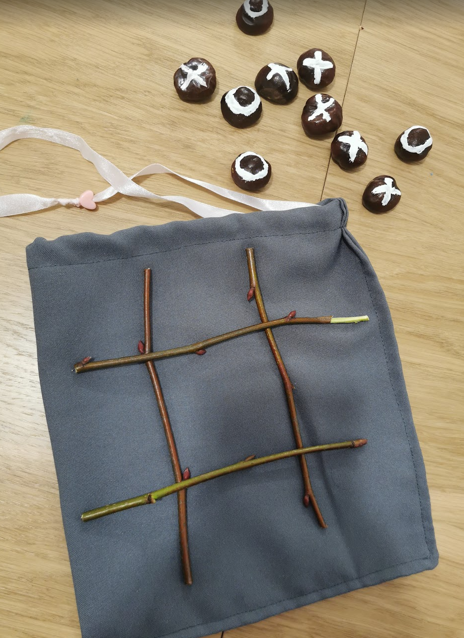
Arrange four lines of wooden sticks on the table to form the # sign.

Slide 5
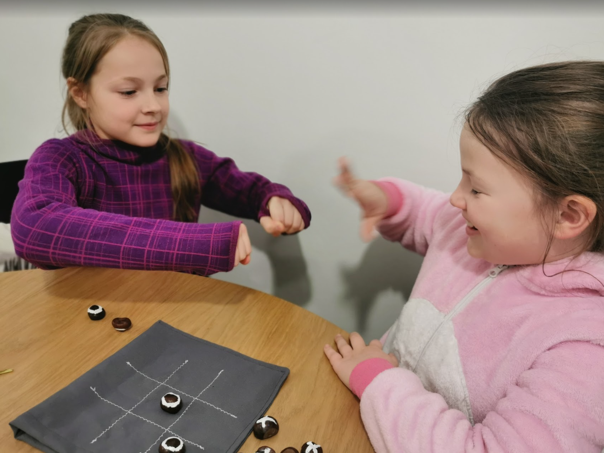
Draw lots to see who starts first.

Slide 6
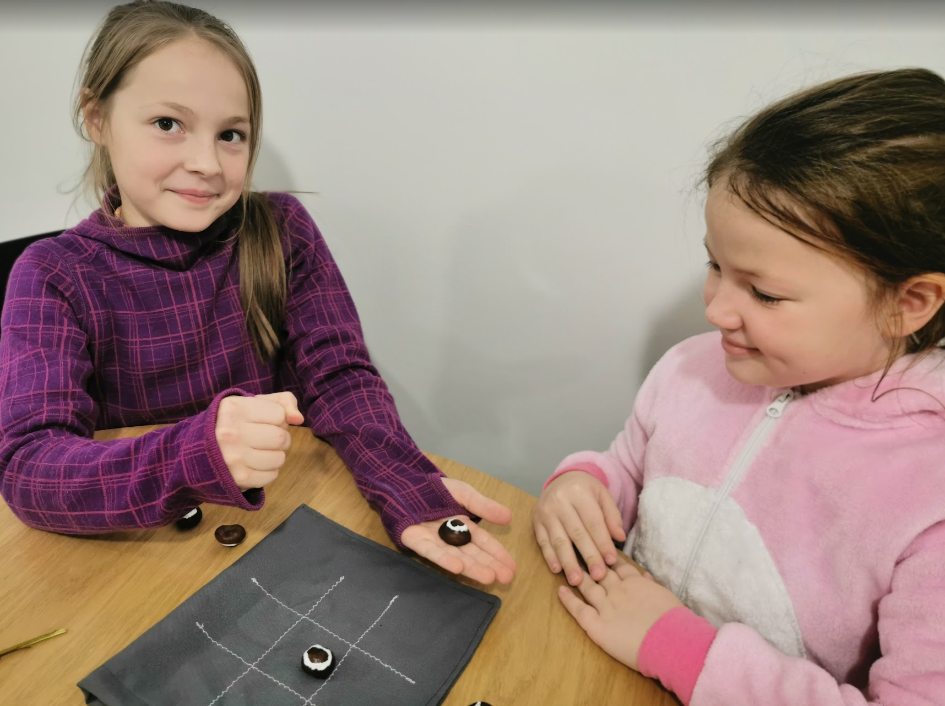
One player takes chestnuts with crosses and the other takes chestnuts with zeros.

Slide 7
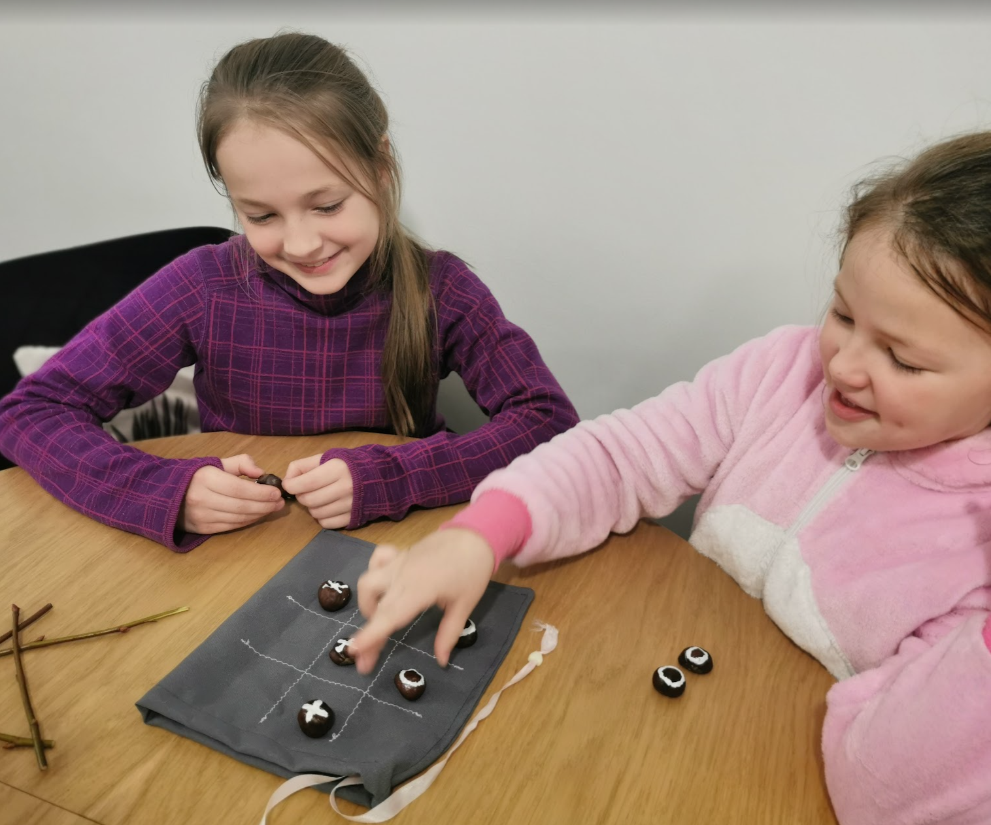
The first player places his mark in the desired box. The second player places their mark in the desired free box, and so on alternately.

Slide 8
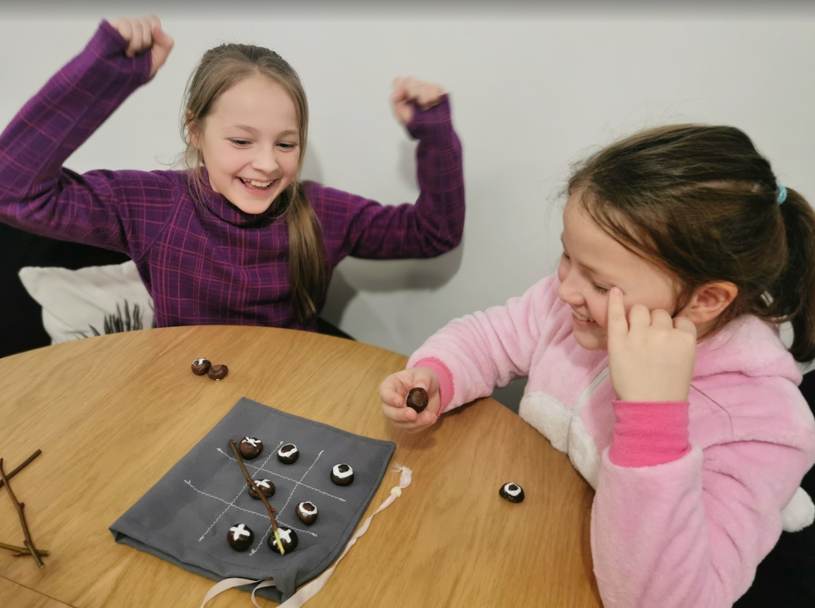
The aim of the game is to collect three identical marks on a line (horizontal, vertical or diagonal).
The first one to assemble a line of his/her own shapes wins.

Slide 9
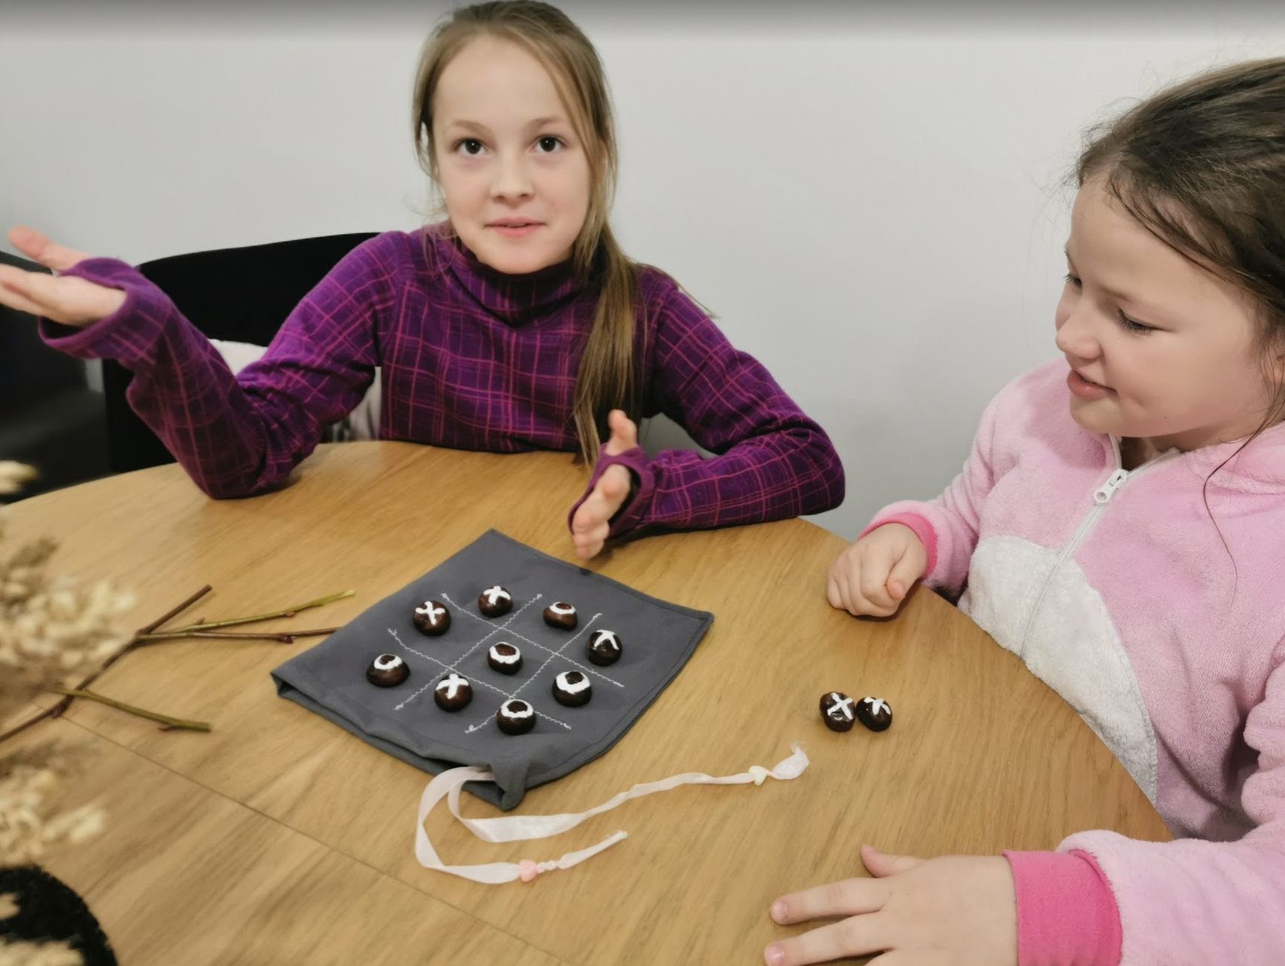
If no player is able to do so and all the boxes are occupied, then a tie is declared and a new game is played.

