Slide 1
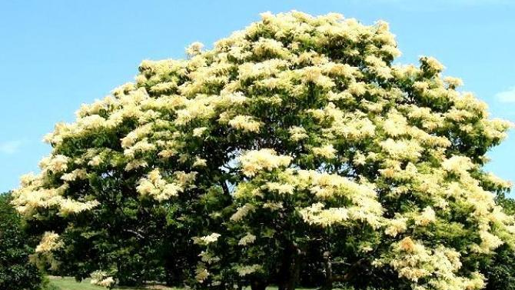
The most popular trees in Poland
Maja Dzięcielska i Julia Lewita

Slide 2
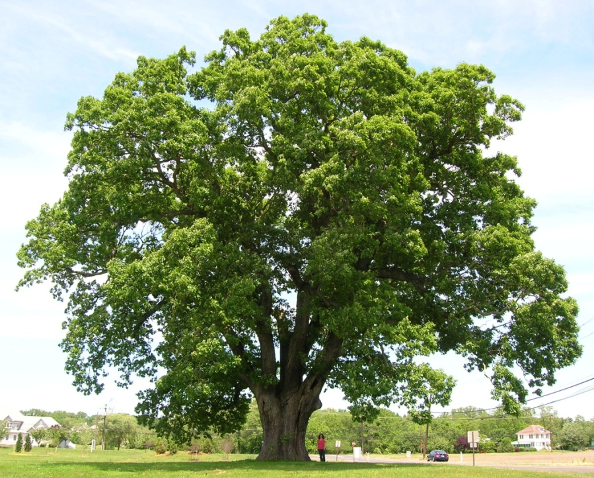
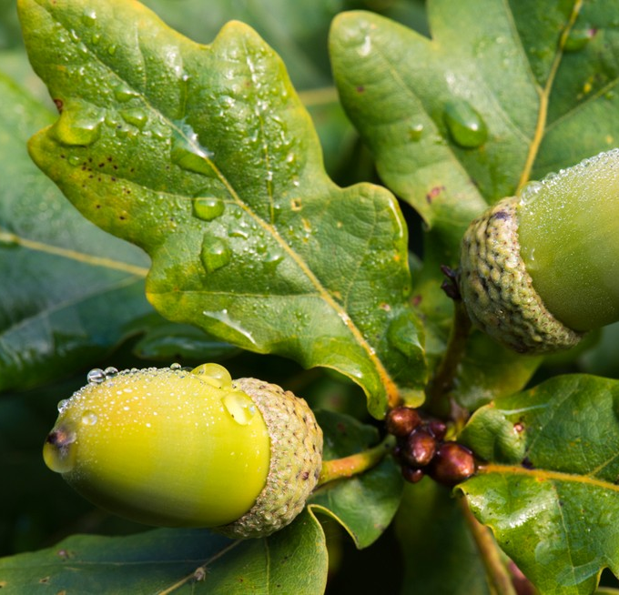
Oak tree
The thickest tree in Poland
They have strong roots
Magnificent trees
In Poland the oldest oaks name is „Bartek”

Slide 3
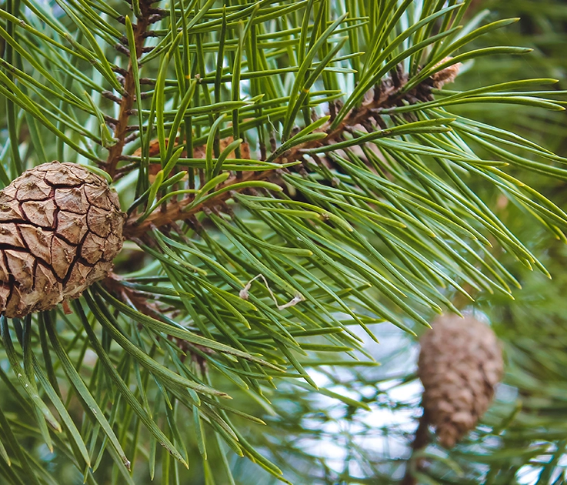
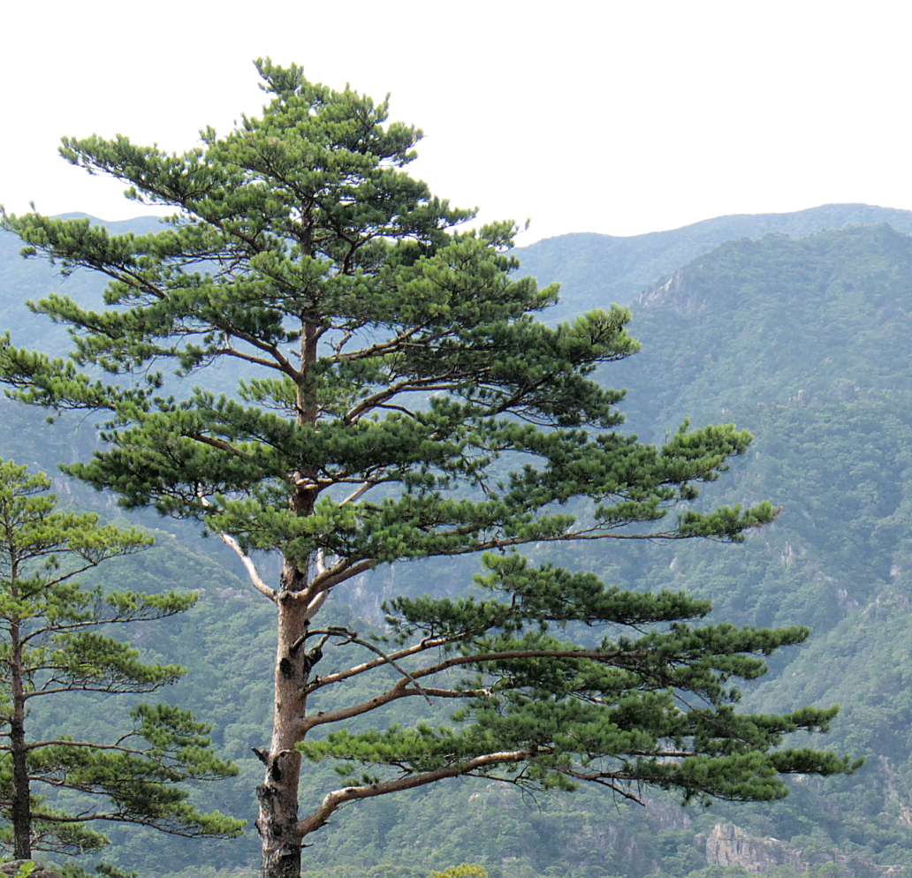
Pine
There are 3 types
-pine
-mountain pine
-limber pine
They occupy 70% of total forest area

Slide 4
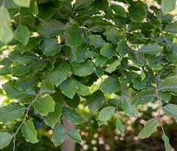
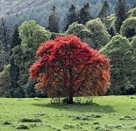
Beech
One of the most beautiful deciduous trees
In spring they are intensely green
It has a fruit called beech

Slide 5
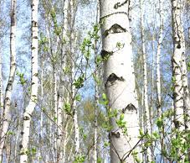
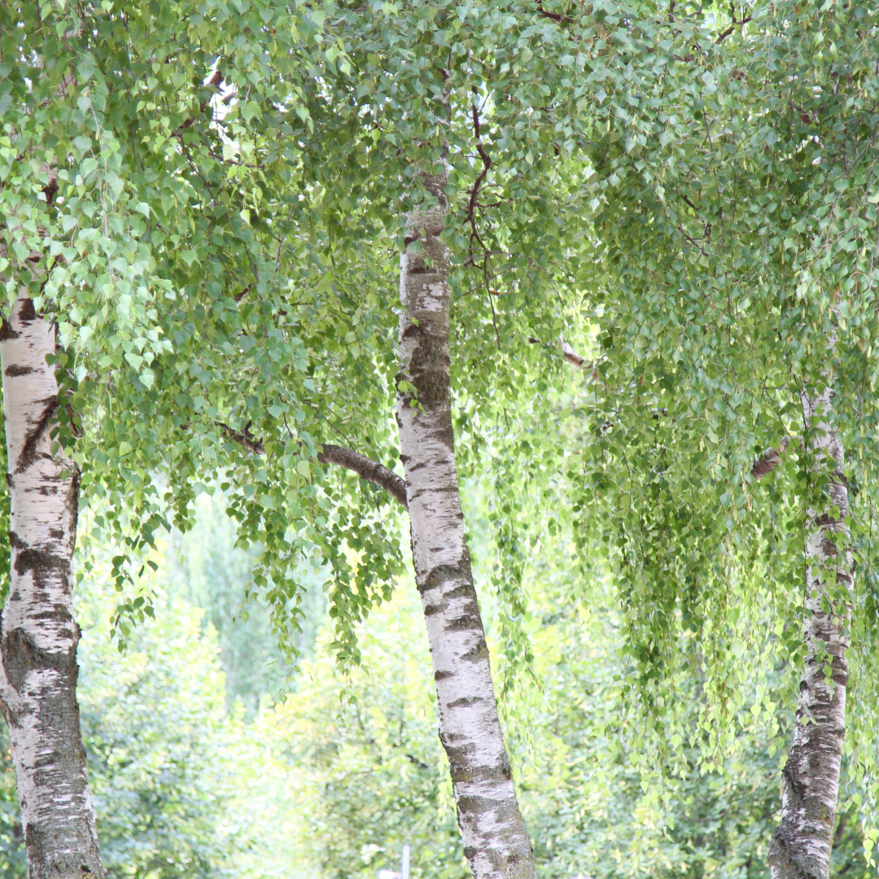
Birch
They live for about 120 years
Intense and rapid growth
Often used for fuel
Birch trees have a high energy value

Slide 6
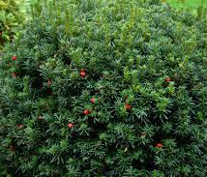
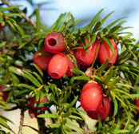
Yew
They can live up to 3000 years
Fruits are tiny balls
It intolerates frost

Slide 7
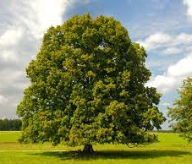

Linden
Used in medicine
Reaches 30 m
The tree is soft and easy to work with

Slide 8
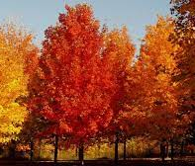
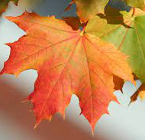
Maple
Maximal height- 30 m
They live up to 150 years

Slide 9

Thank you for your attention

