Slide 1
Comparison between a DECIDOUS TREE leaf and a conifer branch
By 1st grade student

Slide 2
SUMMARY
Let’s observe whether the maple leaf and pine needles change at room temperature.
SUBJECT OF THE STUDY
Maple tree leaf and pine branch.
AIM OF THE STUDY
The aim is to develop observational skills by comparing the changes in maple tree leaf and pine needles under the influence of room temperature over a period of 5 days.
HOW TO INVISTIGATE
Photos will be taken, observations will be recorded every day for 5 days.

Slide 3
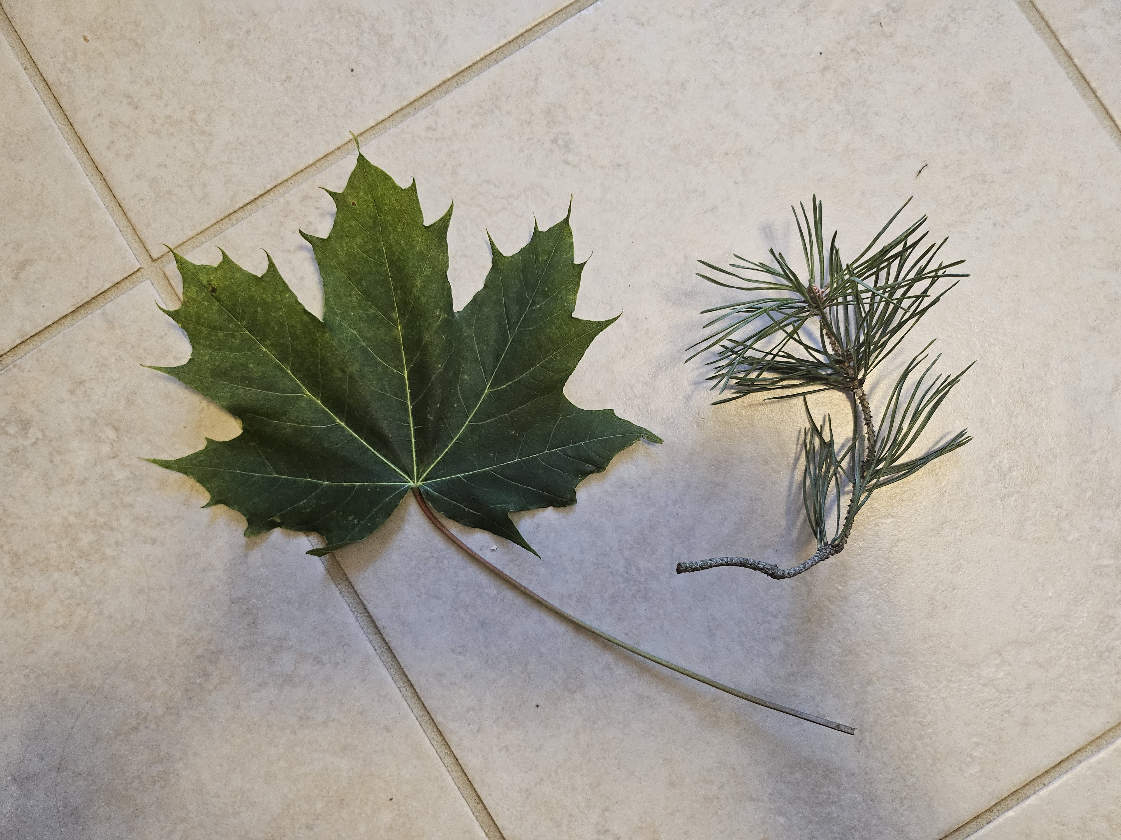
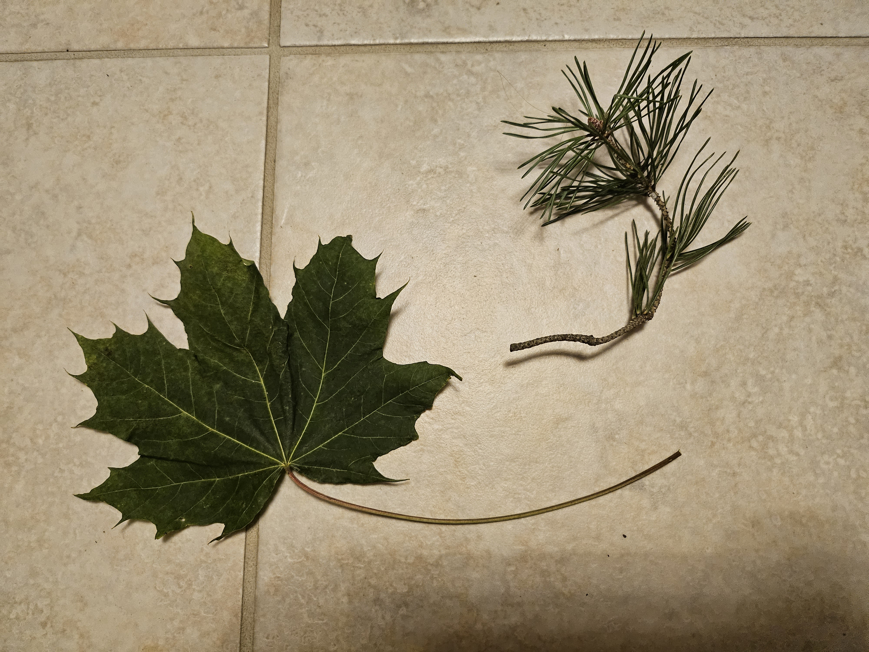
Project progress
Day 1
Maple leaF – green, smooth, just plucked from the tree. The leaf can be folded.
Pine branch – green, firm.
Day 2
Maple leaF – still green, a bit shrunk. Moisture starts to evaporate.
Pine branch – no changes.

Slide 4
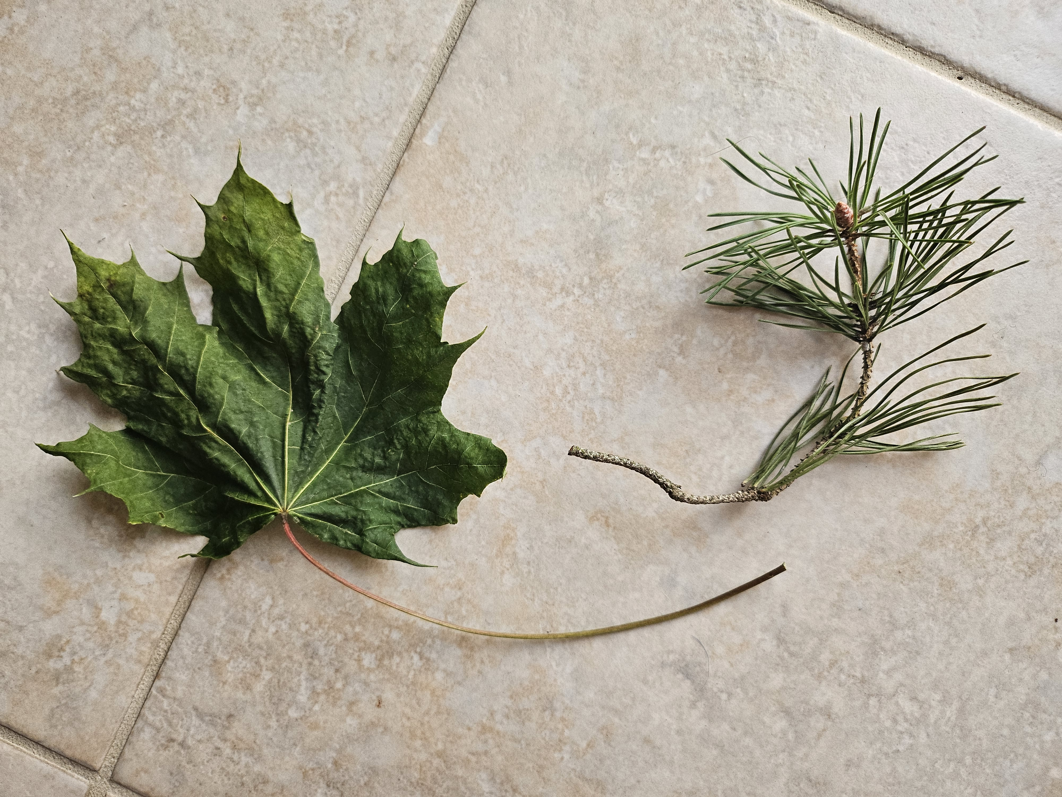
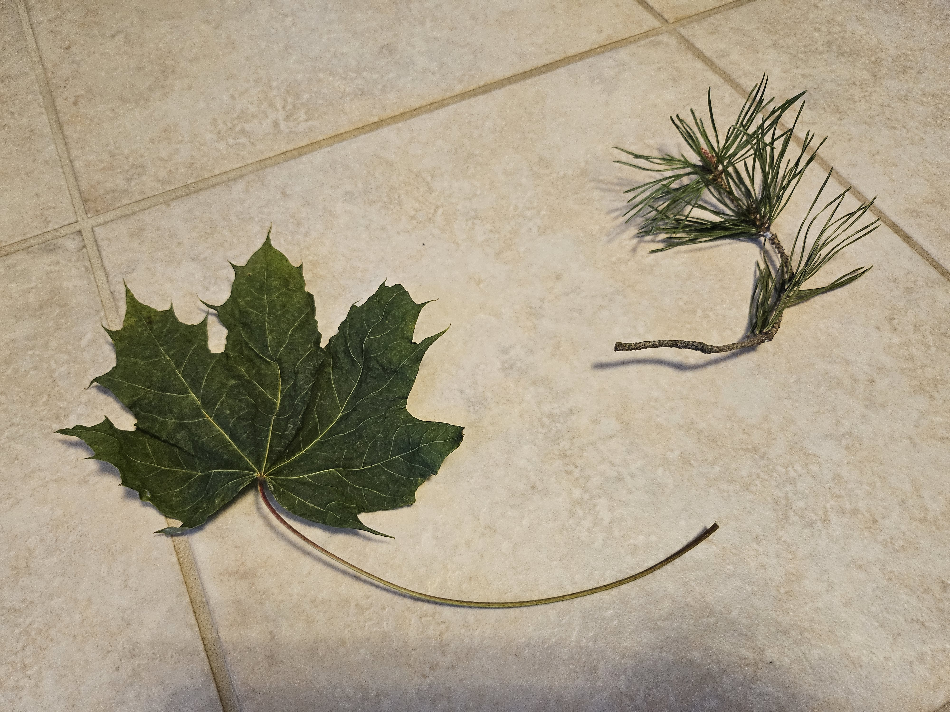
Project progress
Day 3
Maple leaF – green, shrunk more than previous day.
Pine branch – without changes.
Day 4
Maple leaF – green, shrunk much more than second day.
Pine branch – without changes.

Slide 5
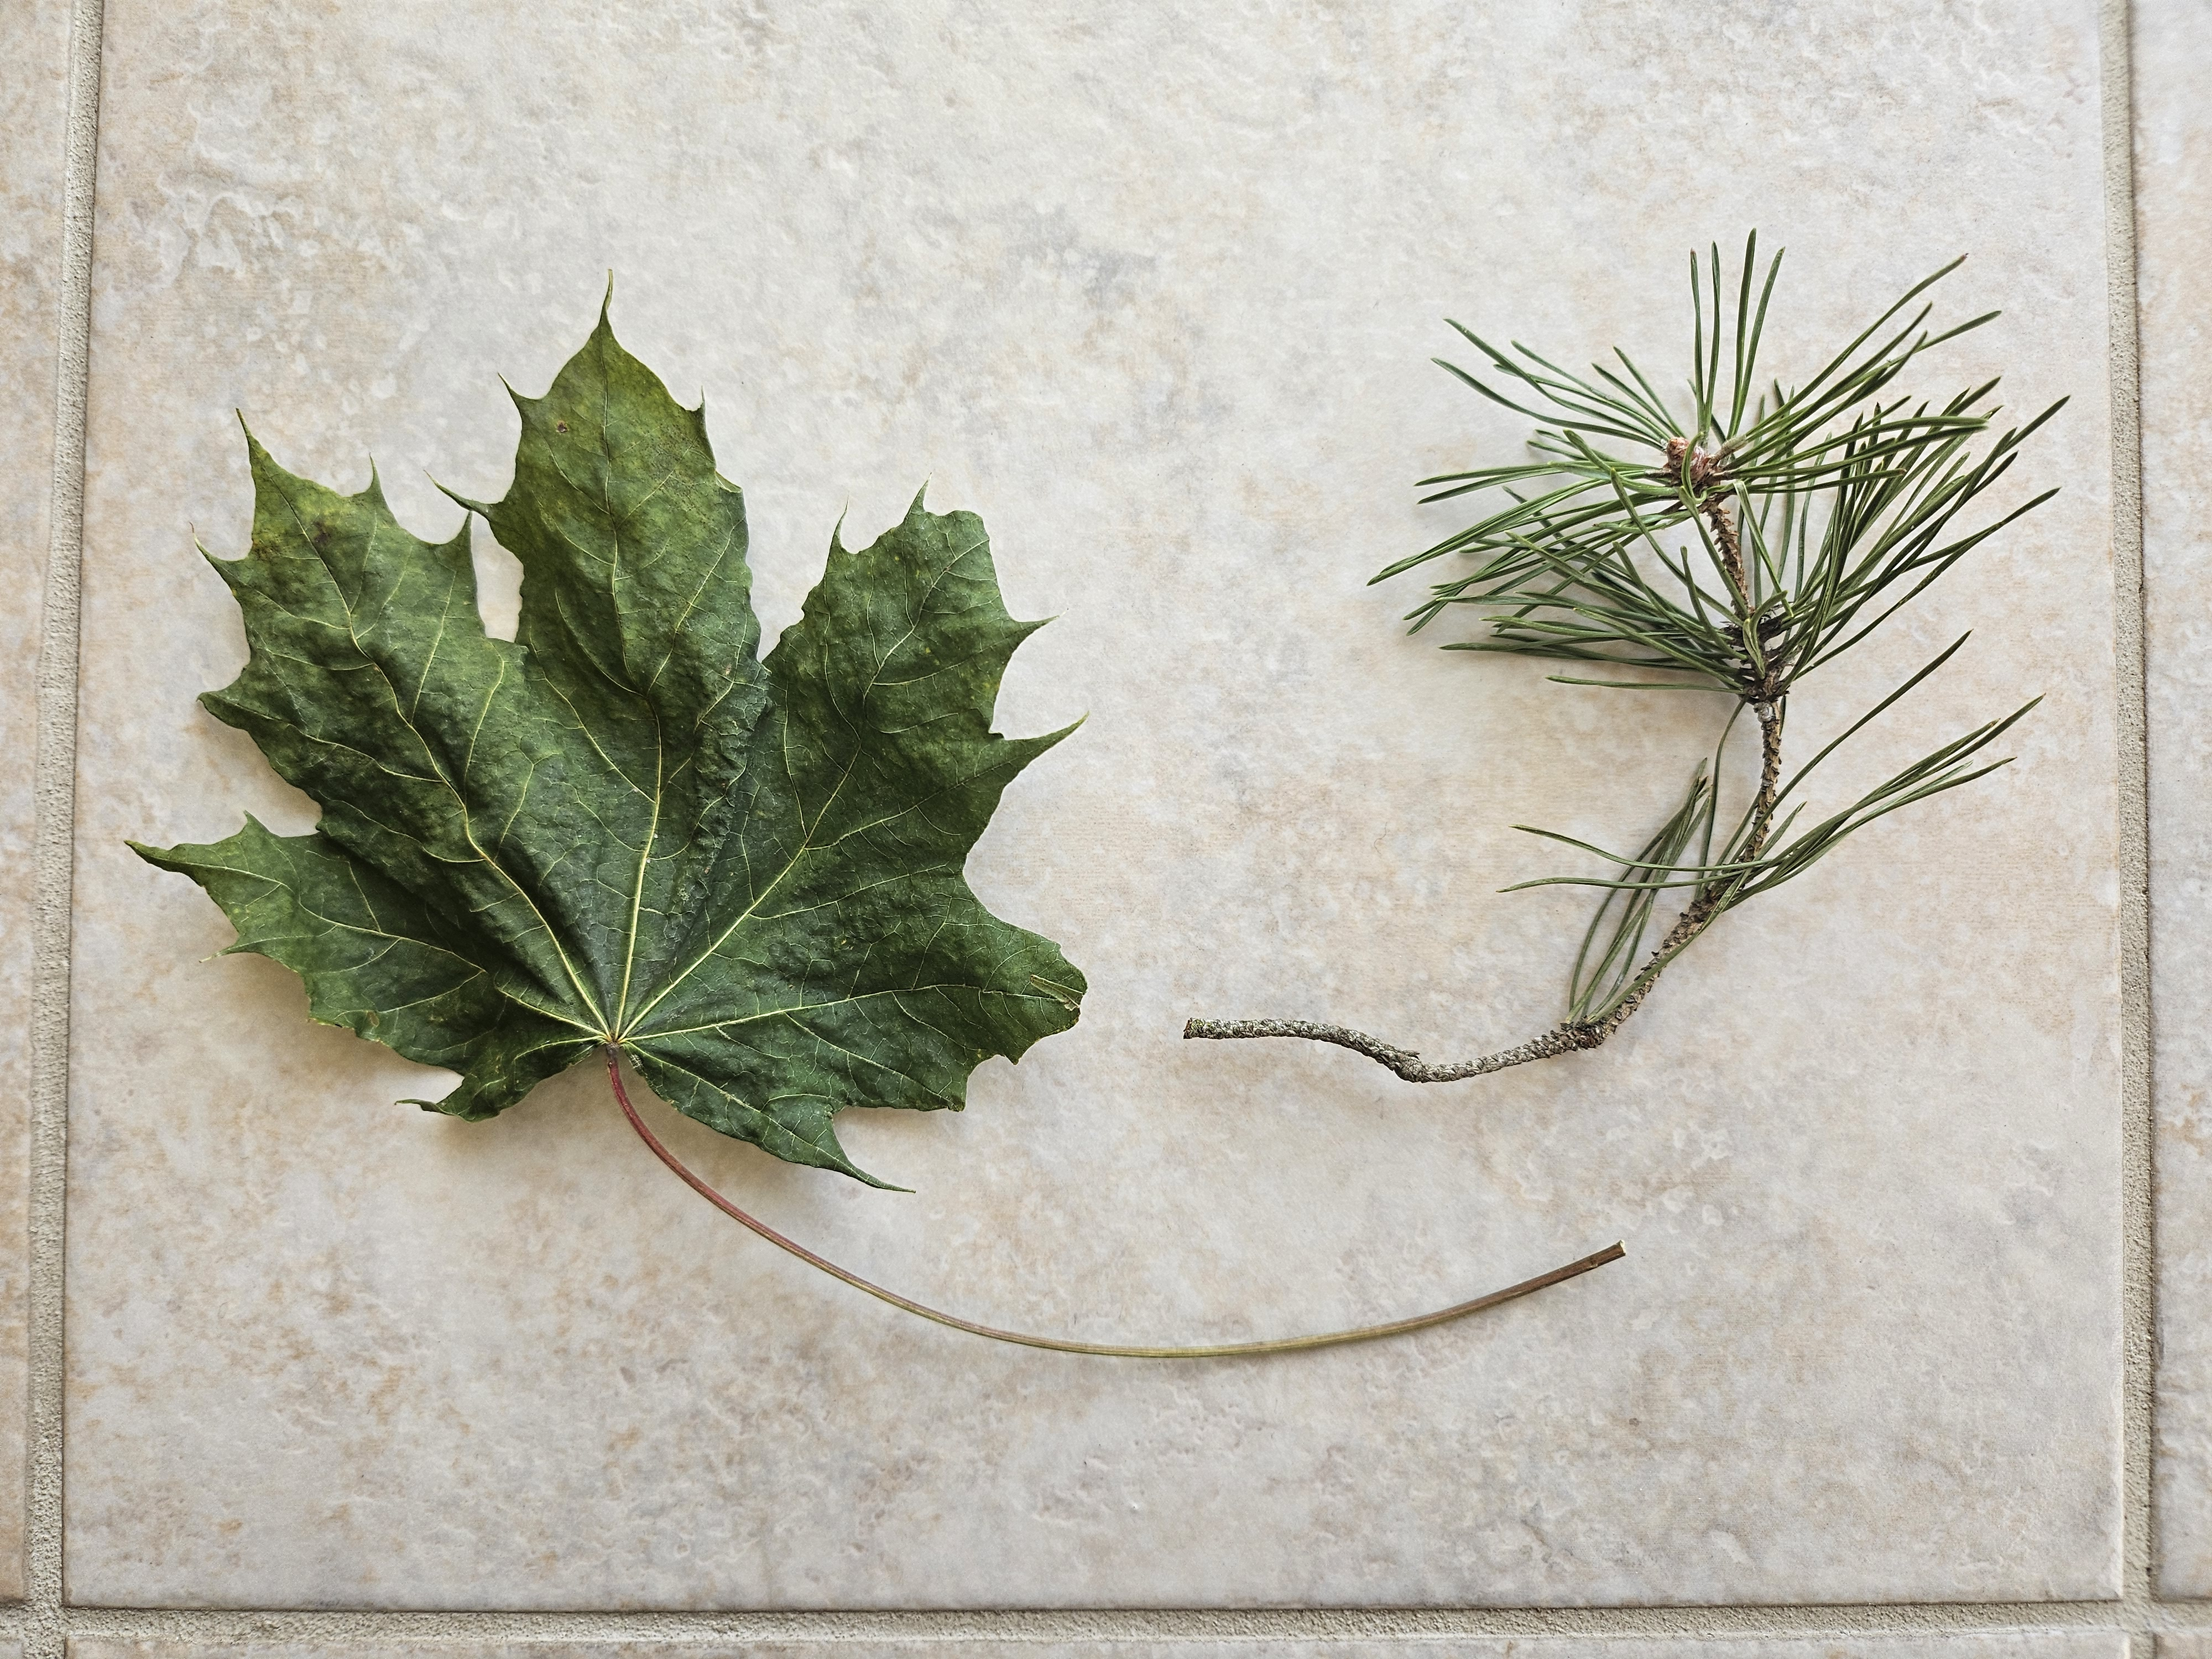
Project progress
DAY 5
MAPLE LEAF – GREEN, SHRUNK QUITE A LOT, REMAINED VERY LIGHT. ALL THE MOISTURE IN THE MAPLE LEAF HAS EVAPORATED. THE LEAF IS FRAGILE. IT WILL CRUMBLE IF CRUSHED.
PINE BRANCH – WITHOUT CHANGES.

Slide 6
conclusions
The maple leaf lost moisture when exposed to room temperature, leaving it dry, brittle and shriveled.
The pine needles did not change over five days.
The pine needles remained firm and did not dry out, so they can hold moisture for a long time. In contrast, the maple leaf lost moisture very quickly.
Within 5 days, both the stem leaf and the pine branch did not change color.

