Slide 1
CREATIVE WORK „Maple tree. Sheets from pages“
By Margiris Medeckis

Slide 2
I created a tree that grows from an ancient book. That tree is maple. Since the pages of the ancient book I used are yellowed, it was very well suited to get the effect of autumn. For this work, for the first time, I used an exclusive and rather complex papier-mache technique. It took me about a week of time to create this work. My mother helped me too.

Slide 3
TECHNOLOGY
Papier-mâché ('chewed paper') is a plastic raw material or mass in the form of pieces of paper, usually mixed with glue, gypsum, starch or other binders, used to make certain products. The finished thing becomes stronger as the mass dries out. Papje-mash is also called the material of products already made of plastic papier-mache (stiffened papier-mache). A traditional papier-mâché binder is made by mixing a mixture of water and flour or starch to the consistency of a thick cream. Any glue can be used if its consistency can be obtained as thick as, for example, PVA or wood glue, but glue from a mixture of flour and water is the most economical. By adding clove oil or other additives, it is possible to protect products from mold. The paper is cut or torn into strips and soaked in a binder paste until it is absorbed. Strips treated in this way are applied in layers to the mold and left to dry slowly. When dried in the oven, they can curl or otherwise deform. Treated strips can be placed on a reinforcement, skeleton or frame made of wire. They can also be laid on an object to take its shape. The atelier of the thing itself later more easily separates from the thing itself, having previously anointed it with oil or lard. The dried papier-mâché can be cut, polished and/or painted, it can be impregnated with suitable waterproof paint.

Slide 4
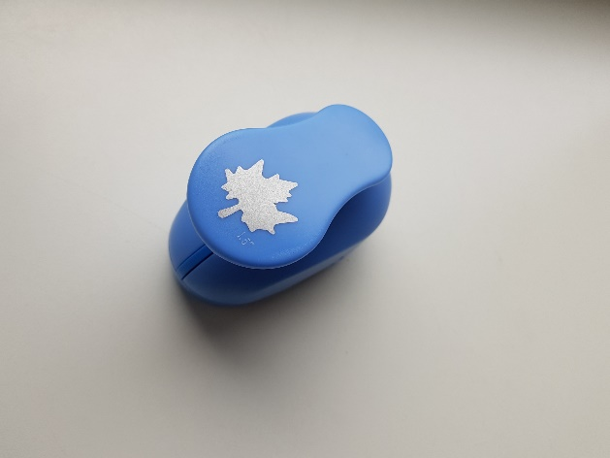
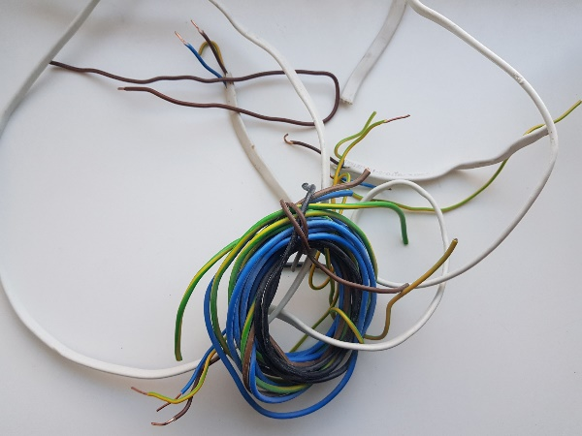
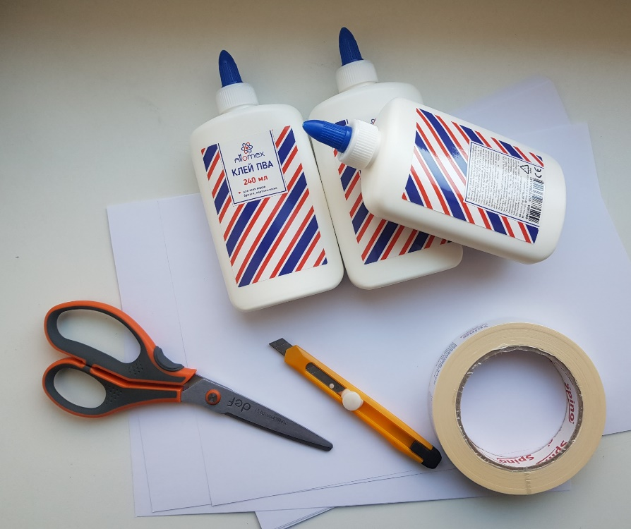
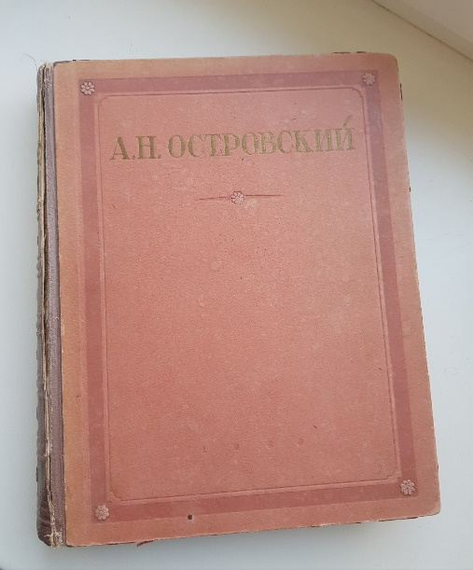
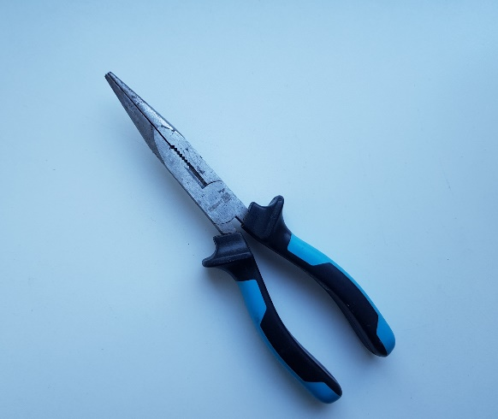
MEASURES
I needed wire, a blade, water, glue, a book, a few sheets of white paper, scissors, pliers, a decorative punch, a paper adhesive tape.

Slide 5
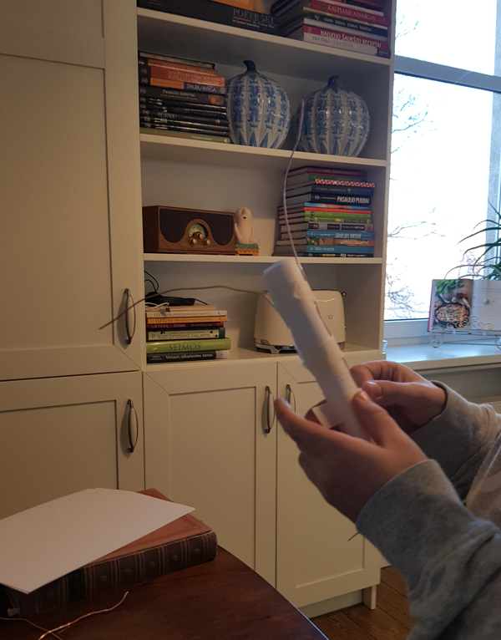
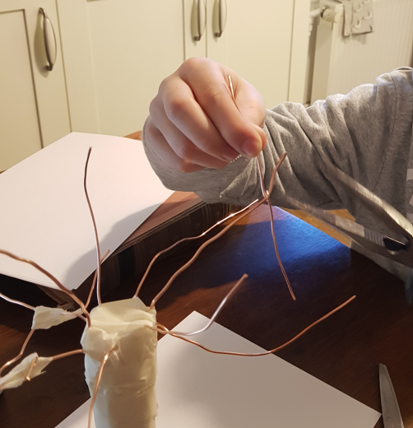
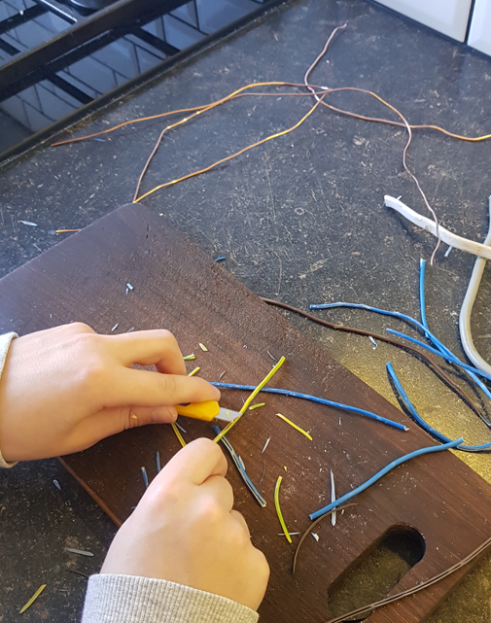
The working process
The first I cut the rubber off the wires and got the wire. I twisted a sheet of paper into a pipe and glued the wire with adhesive tape and unfolded the appropriate shape for the wire. Then I turned the paper around with the same adhesive tape. Next, I glued the wire and inside the pipe.

Slide 6
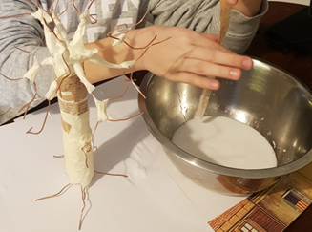
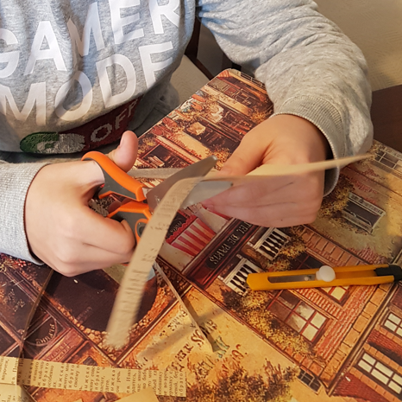
Then, from short pieces of wire about 12 cm long, I glued the twigs. Next, I cut the paper of the book into strips, after making a mixture of water and glue, I began to sheathe the tree with them.

Slide 7
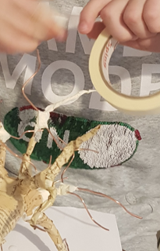
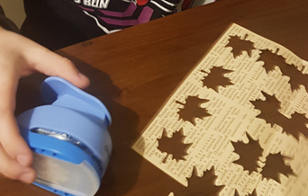
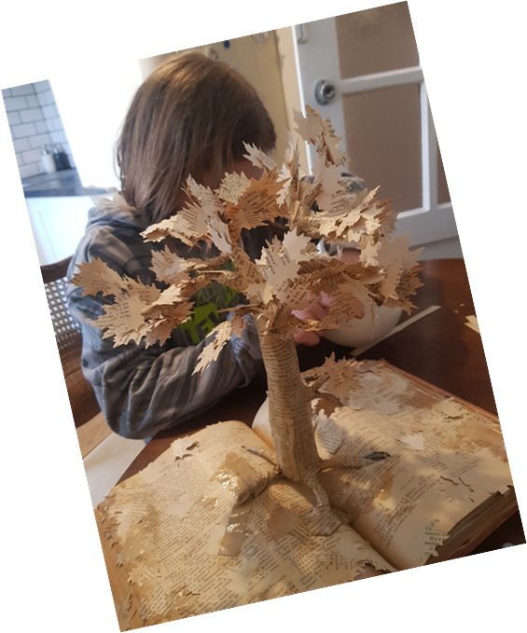
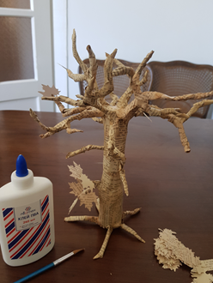
After that, I sheathed the remaining wire with adhesive paper tape. And I continued to cover everything again with soaked strips of the book's leaves. It was still necessary to make maple leaves with a punch. And glue them to the tree. The final stage is to glue the tree to the book itself, and to strengthen the book with glue.

Slide 8
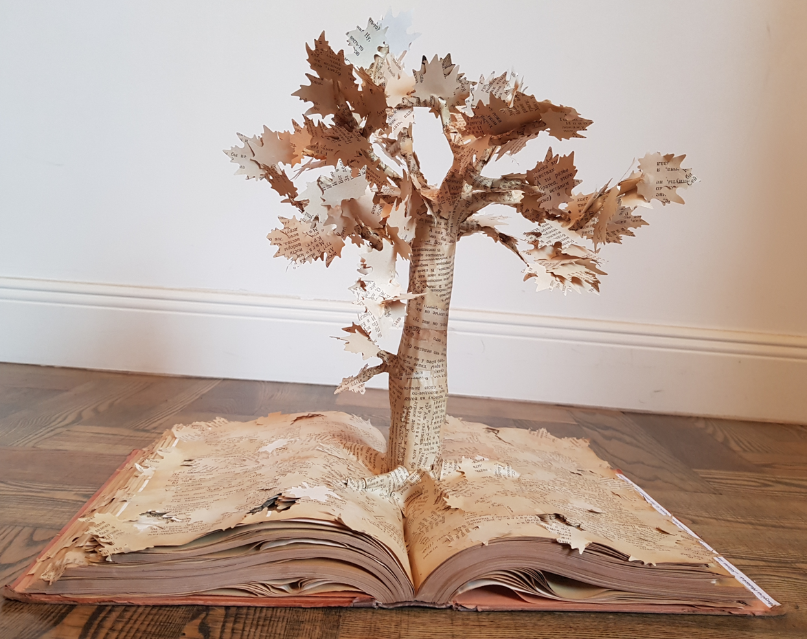
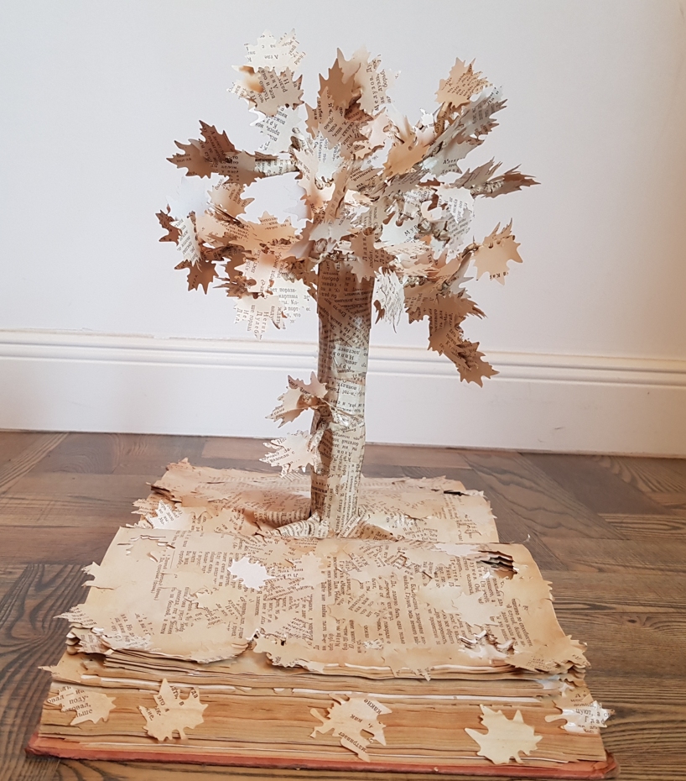
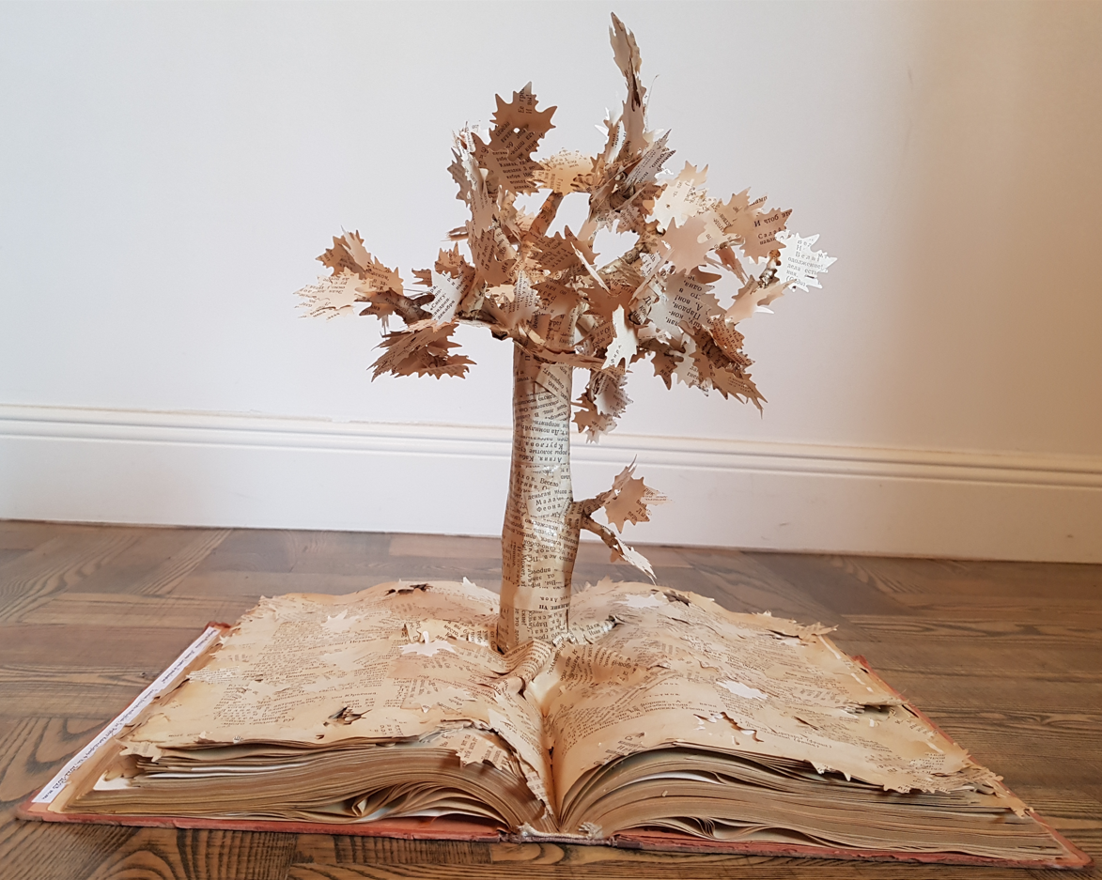
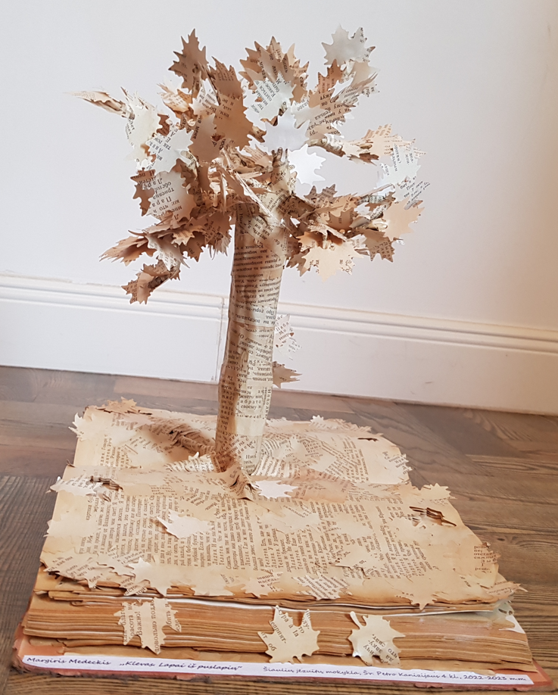
MY FINISHED JOB☺☺

