Slide 1
RESEARCH - COLOR CHANGING
By Mila, 3rd grade student from Riga Lithuanian Secondary School

Slide 2
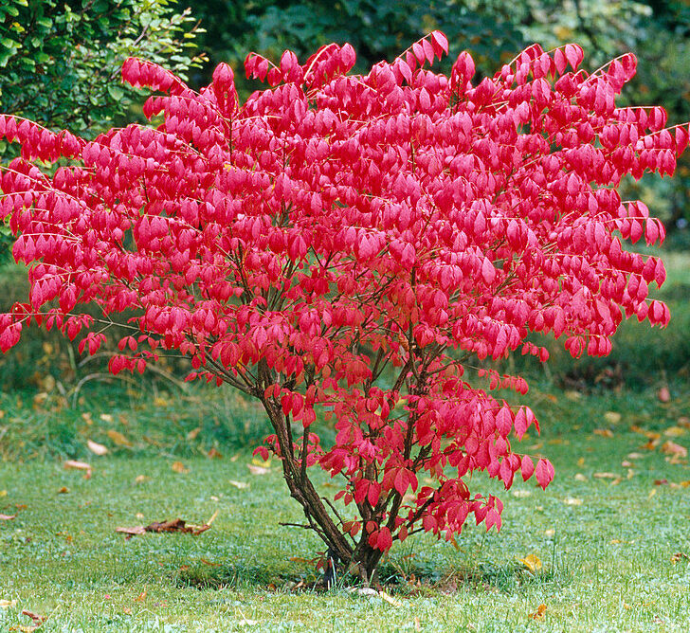
SUMMARY
I will observe an Euonymus alatus tree in my garden over autumn season and record changes.
Euonymus alatus, known variously as winged spindle, winged euonymus or burning bush.
Native to central and northern China, Japan, and Korea. The common name "burning bush" comes from the bright red (bright pink) fall color. I call it Barbie tree ☺

Slide 3
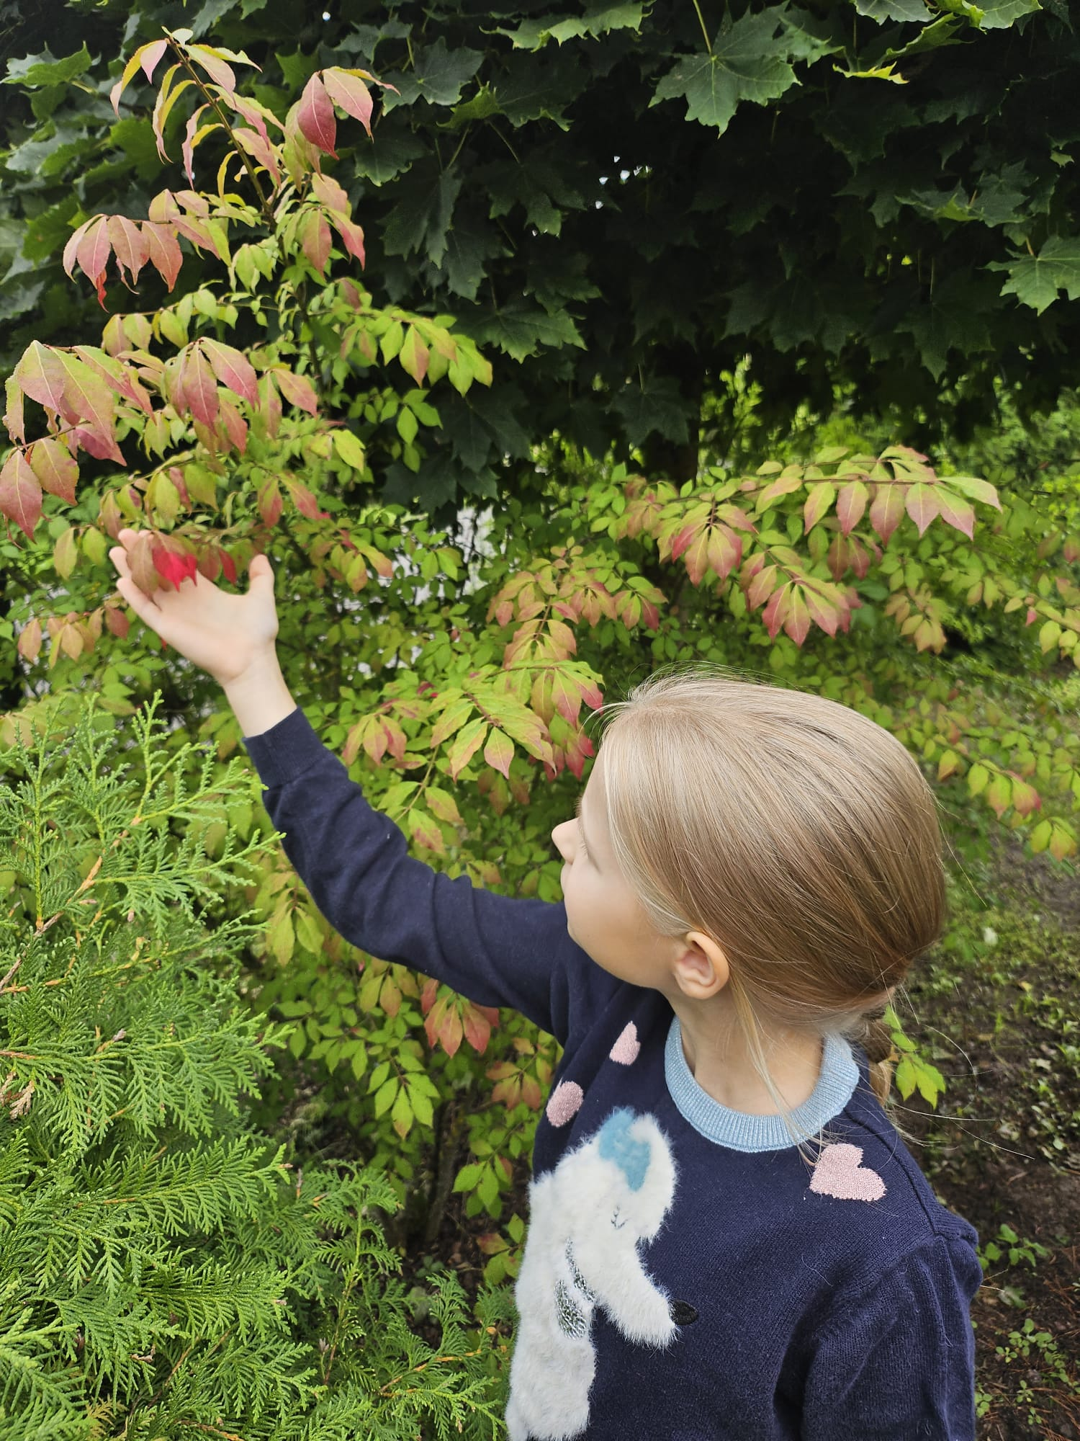
SUBJECT OF THE STUDY:
AIM OF THE STUDY:
Euonymus alatus in my garden.
Observing the color change of the tree leaves in the autumn season.

Slide 4
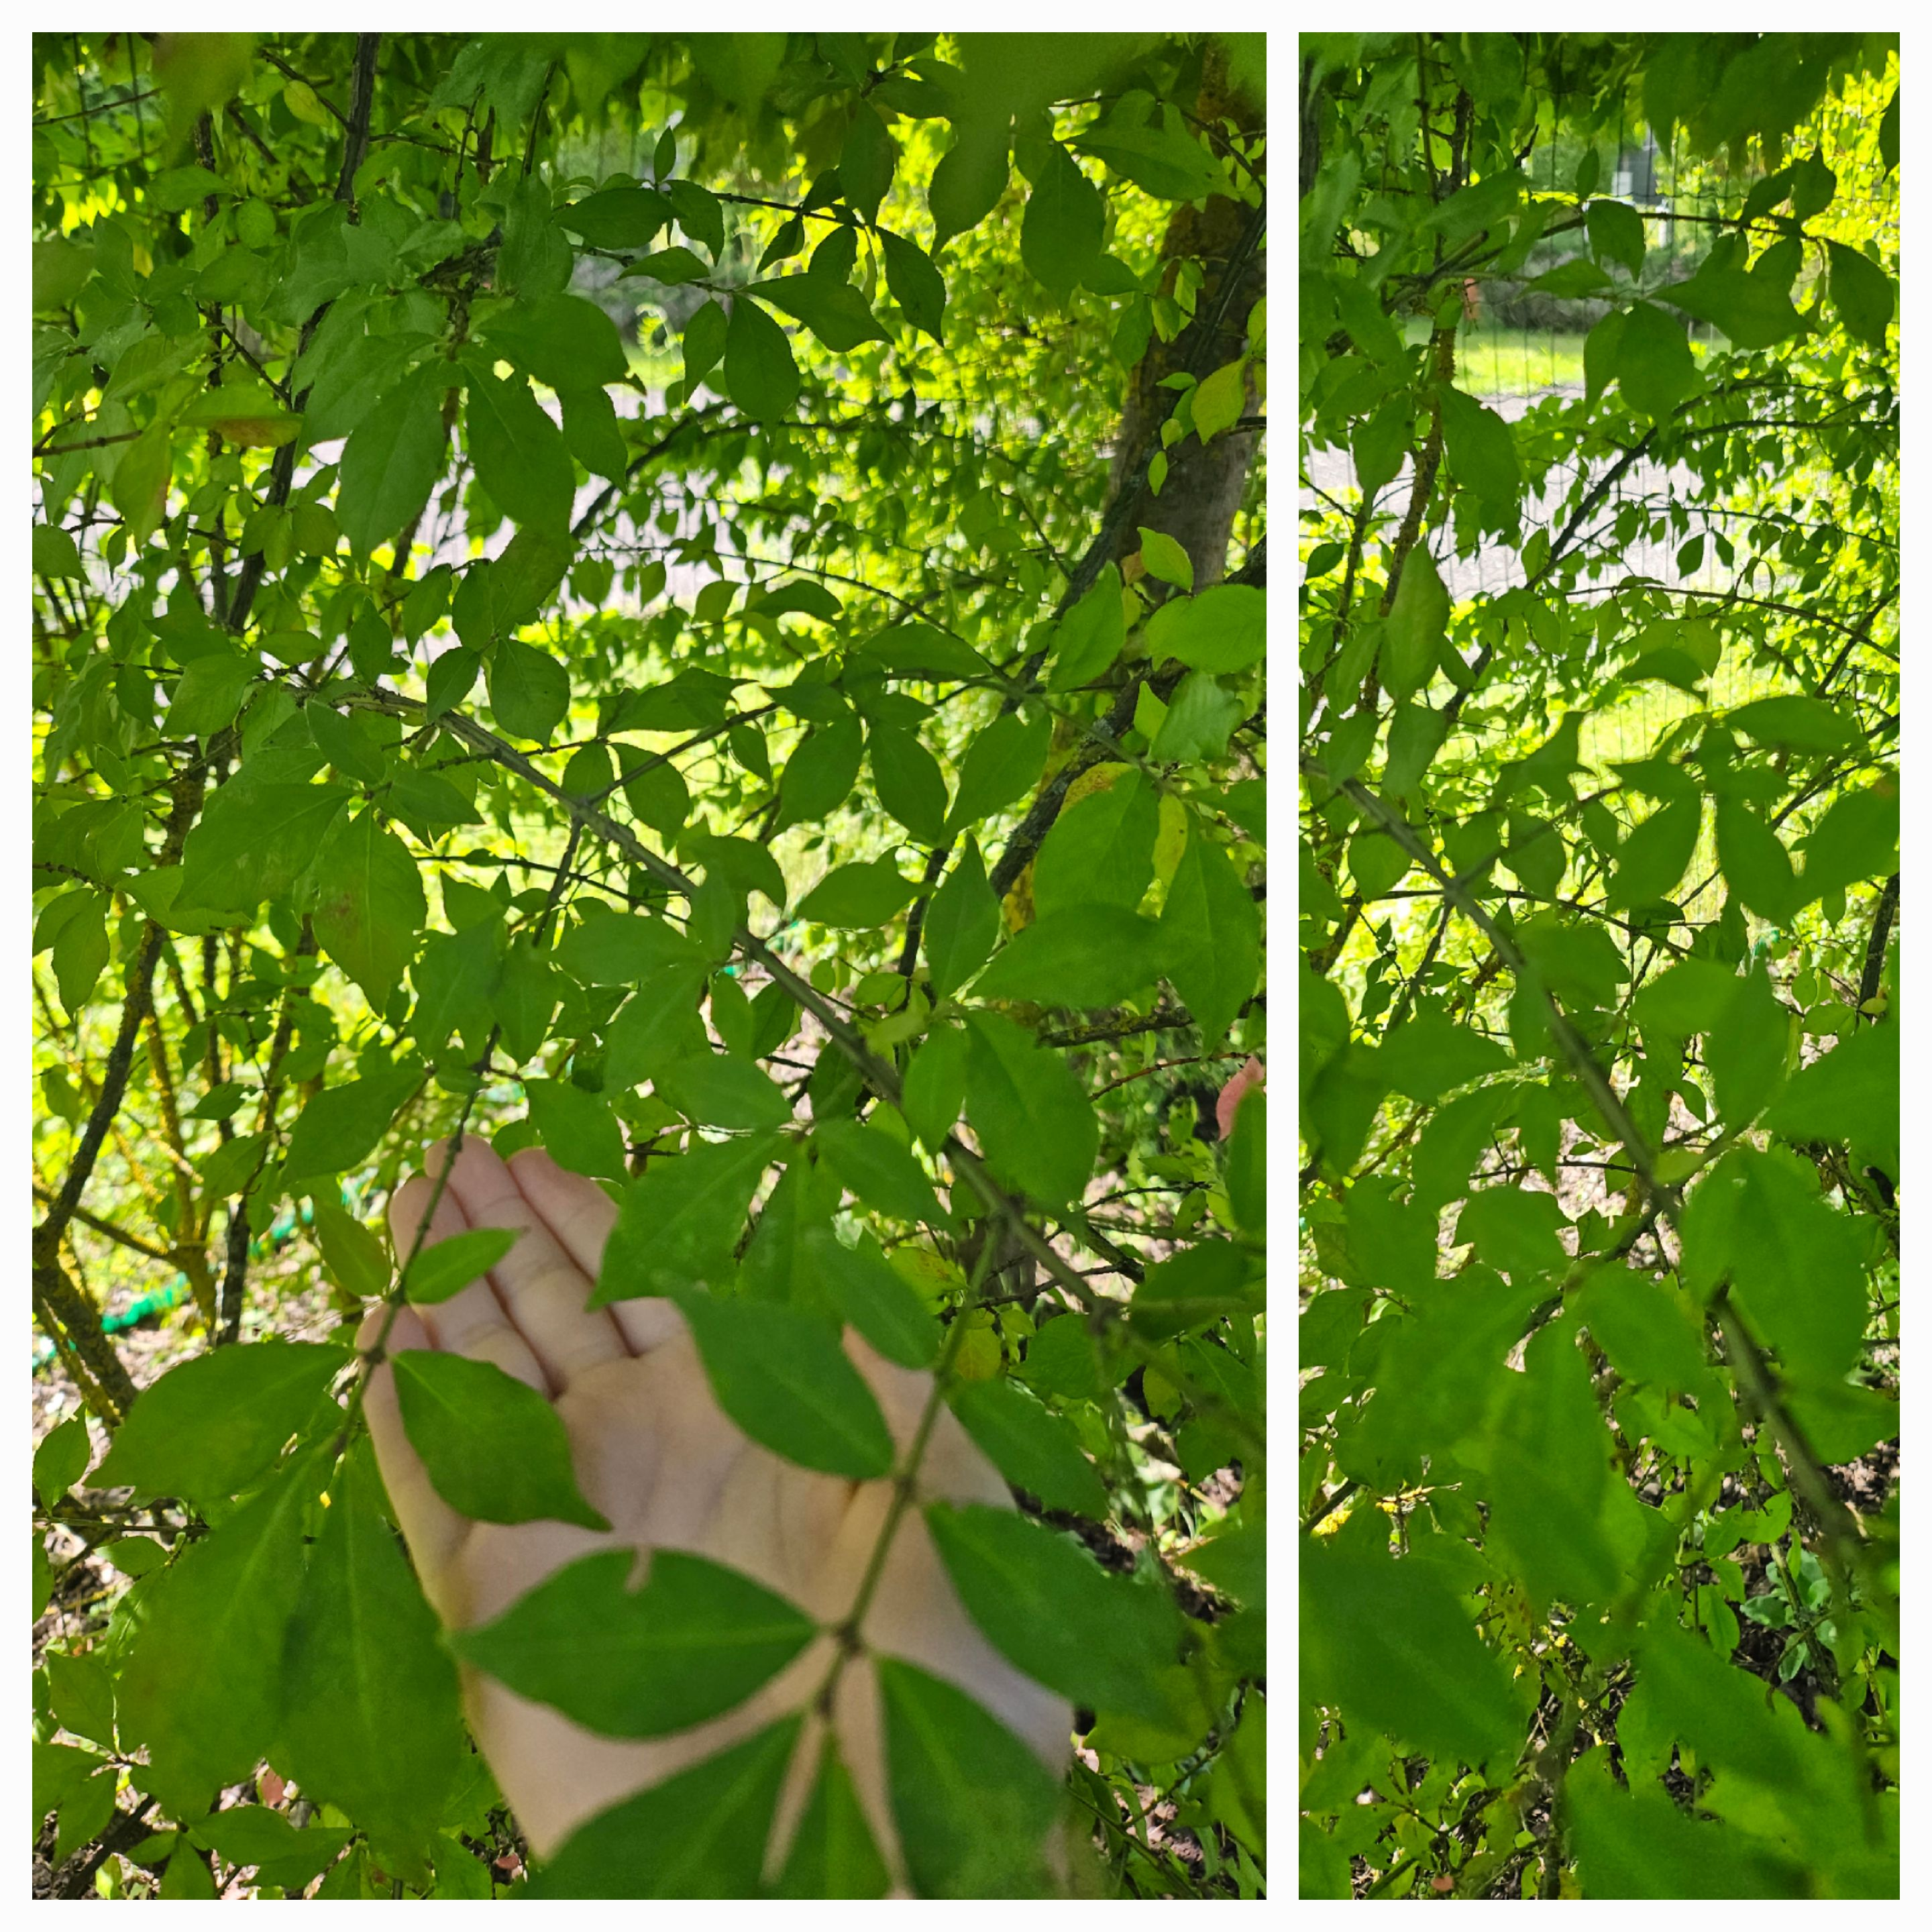
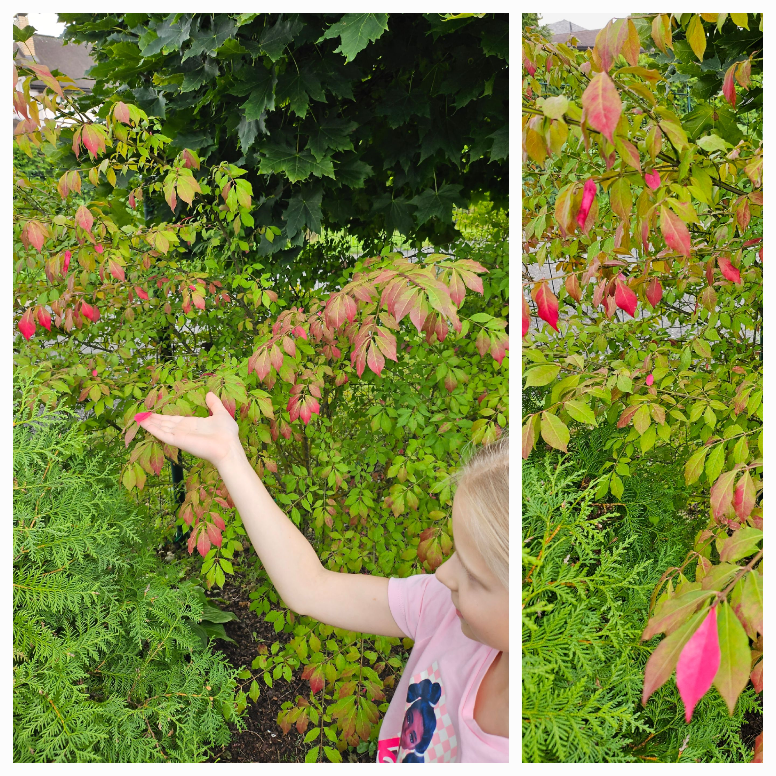
PROJECT PROGRESS
I started to observe the «burning blush» in the middle of September. The leaves looked green, like the leaves of most deciduous trees.
At the end of September I saw changes. The leaves of the tree began to change color. The tips of the leaves gradually started to turn bright pink.

Slide 5
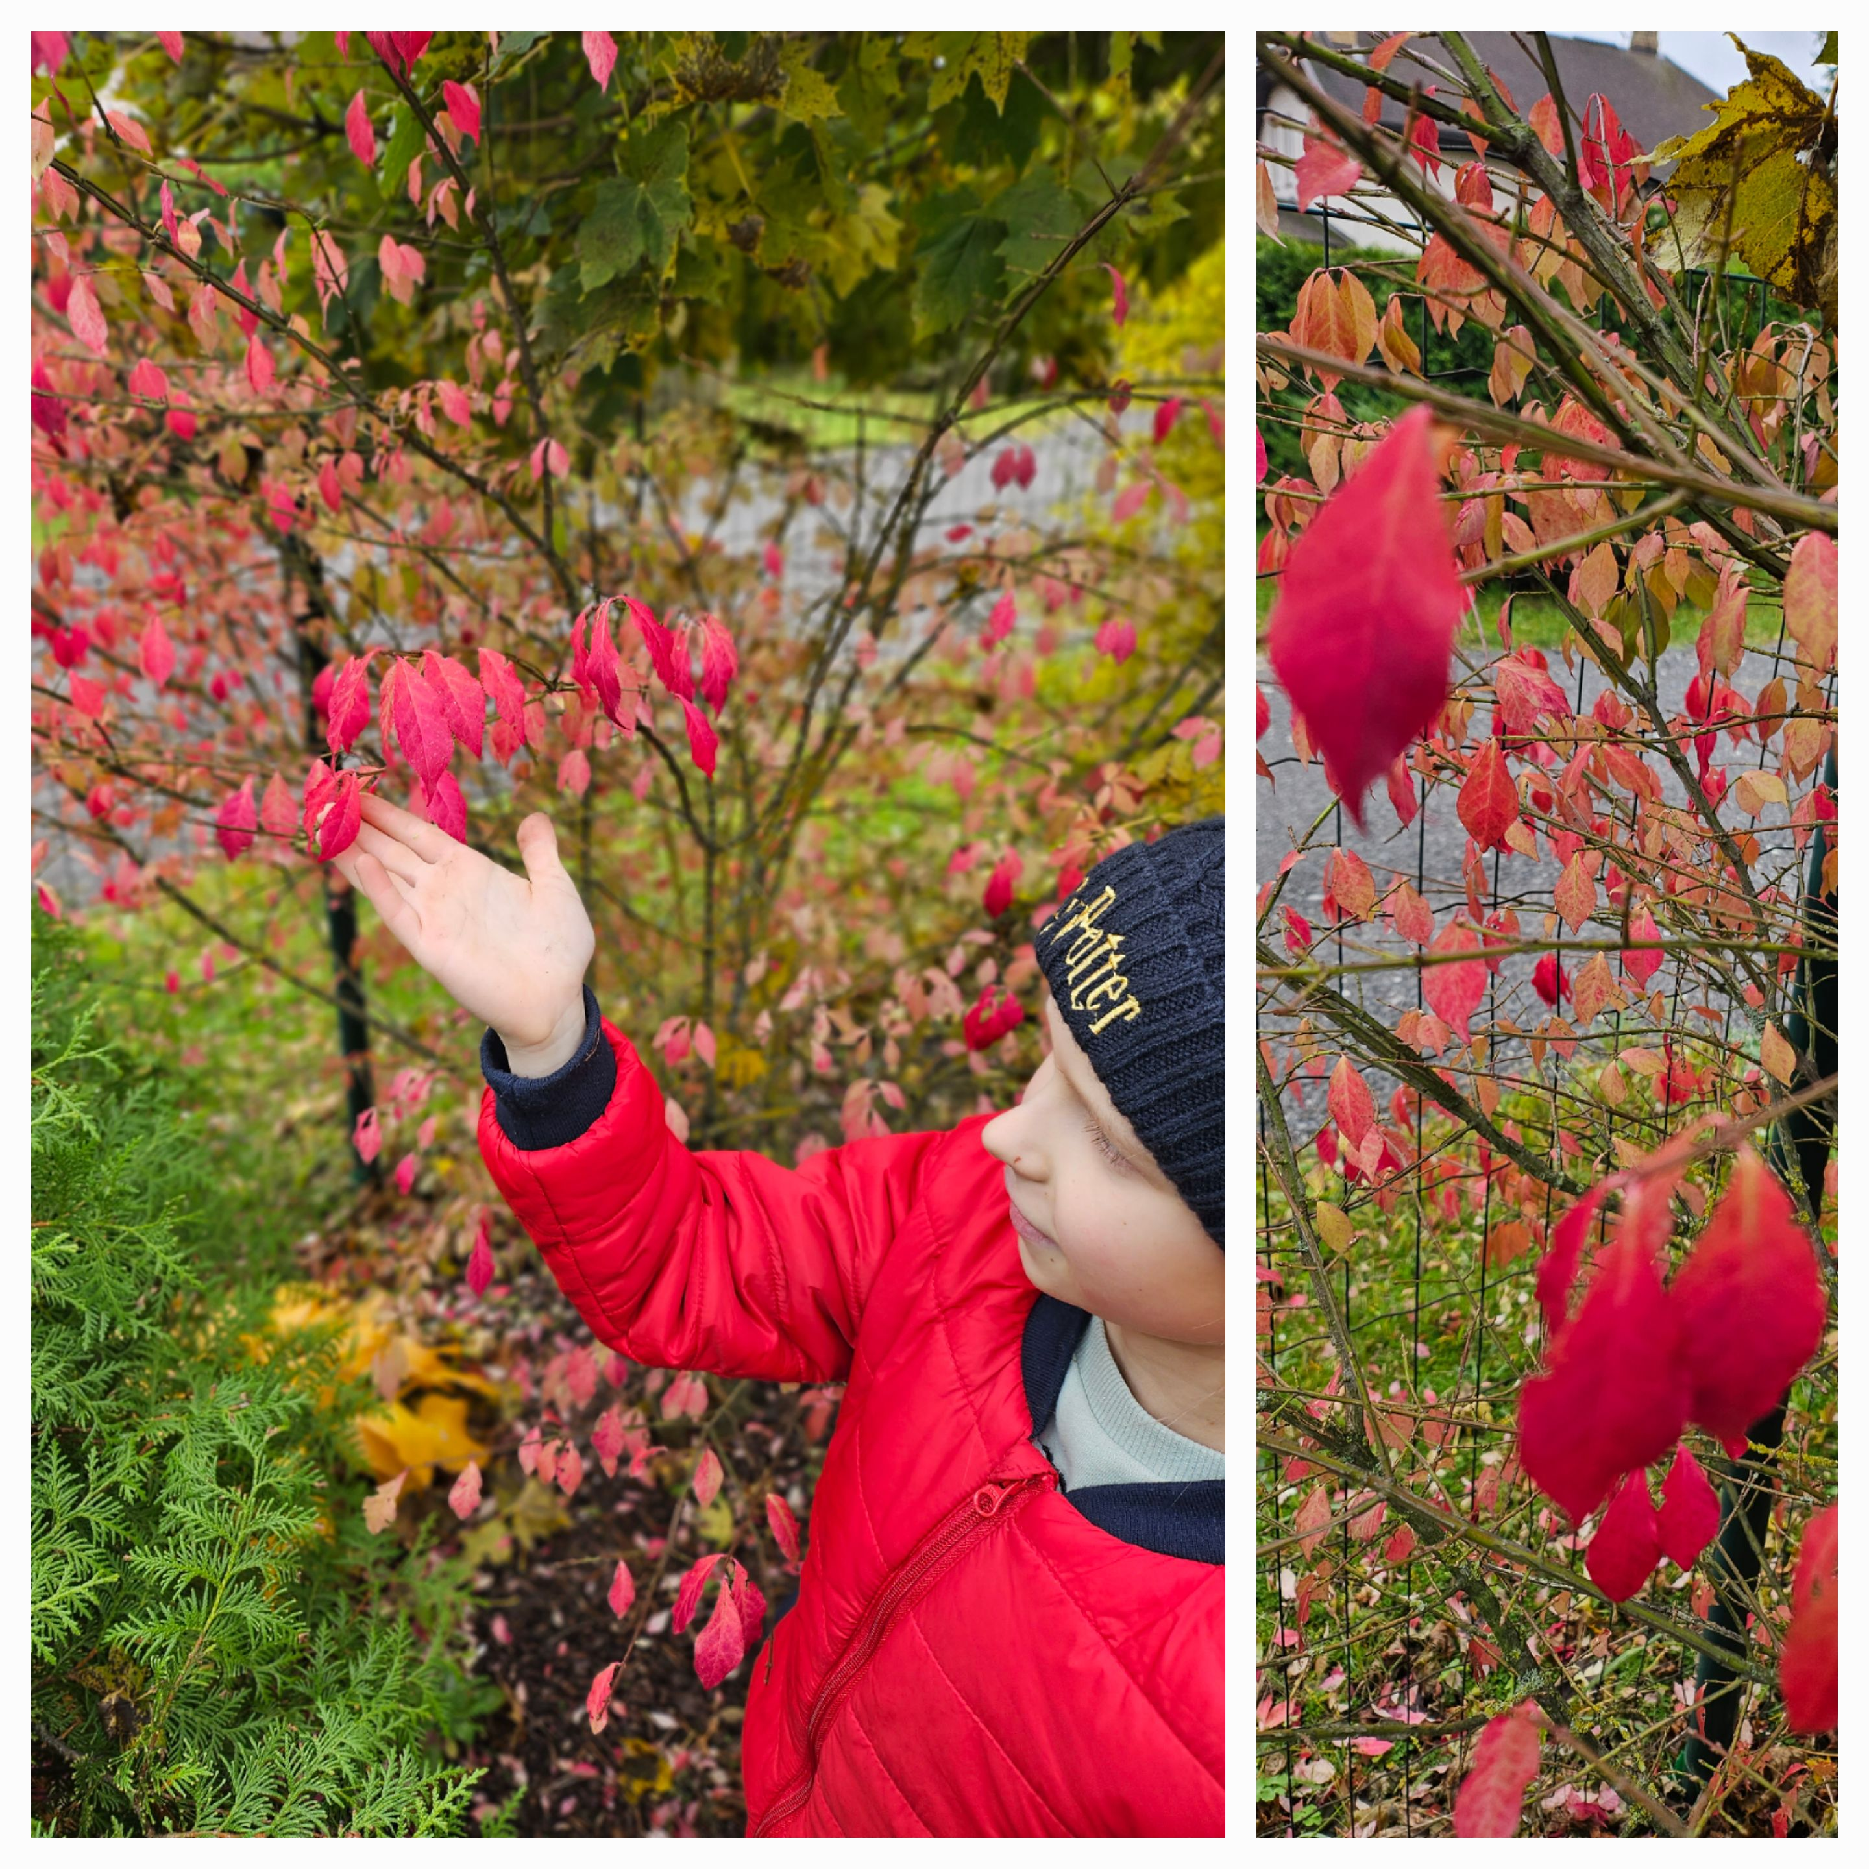
PROJECT PROGRESS
Finally, in the middle of October, I expected a complete change in the color of the leaves of the tree. They were all bright pink! It really was a Barbie tree!
Unfortunately, due to frequent strong gusts of wind, a large part of the tree leaves had fallen off. But that didn't stop me from marveling at the unusual color of the autumn leaves.

Slide 6
CONCLUSION
It was very interesting to observe Euonymus alatus tree leaves throughout the autumn season.
It turned out that natural conditions have a major impact on tree leaves:
  In my case, many leaves had fallen earlier than they should have because of strong winds and rain.
  The leaves of the trees changed color slowly because September in my country was warmer than usual.
I noticed that the color of leaves was unusual, it was not red, it was bright pink.

