Slide 1
Wood and ecology. Facts
By Aleksas Gečas

Slide 2
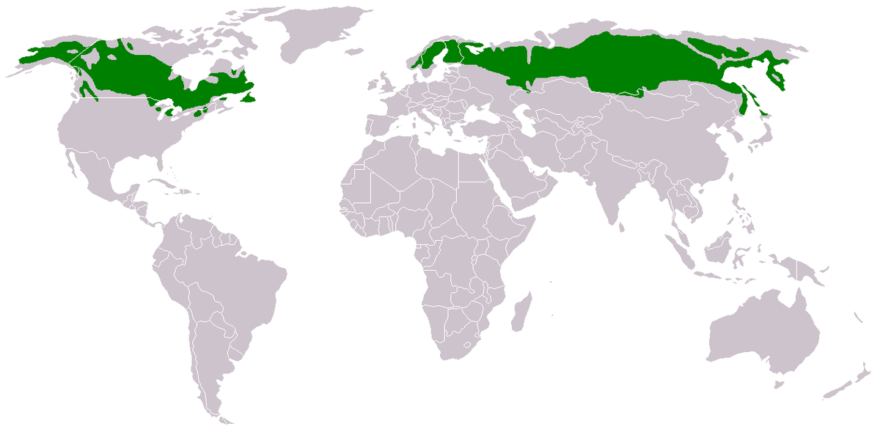
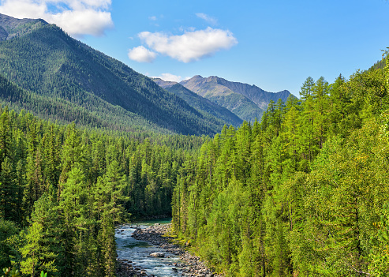
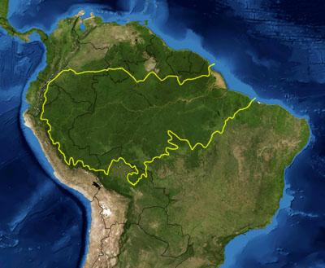
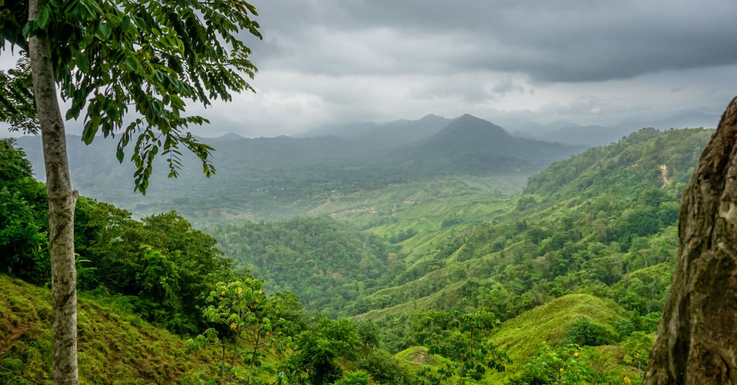
Planet and trees
Currently, an area of land of about 38 million square kilometers is covered by forests, but this figure is decreasing every year.
The largest forest areas on the planet are the taiga and the jungles of South America.

Slide 3
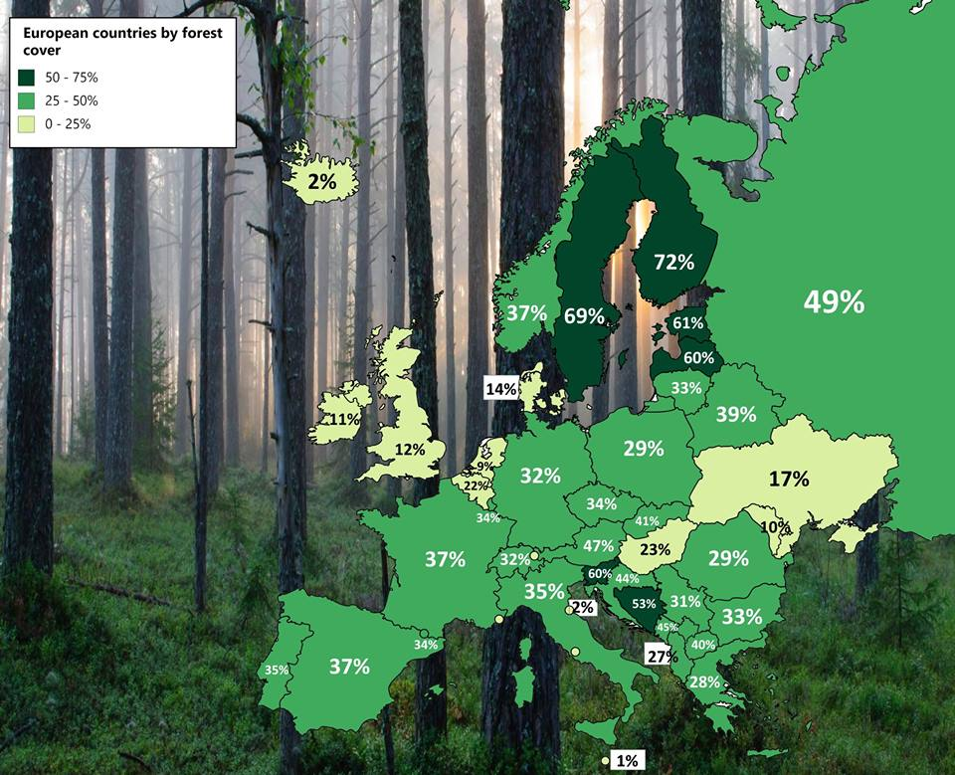
The most forested country in Europe
The most forested countries in Europe are Finland (72%), Sweden (69%) and Slovenia (60%).

Slide 4
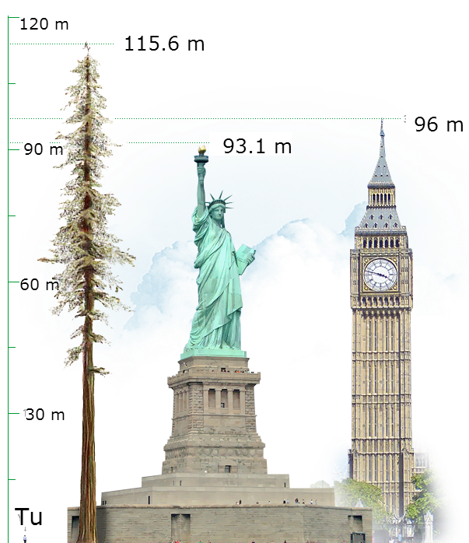
Tallest trees
The tallest known tree in the world is the 115.66-meter-high evergreen sequoia (Hyperion), California. This tree is twice as tall as the Statue of Liberty in New York.
The tallest tree in Lithuania is larch 49 m high, about 160 m old in degsnė botanical reserve, Prienai district.

Slide 5
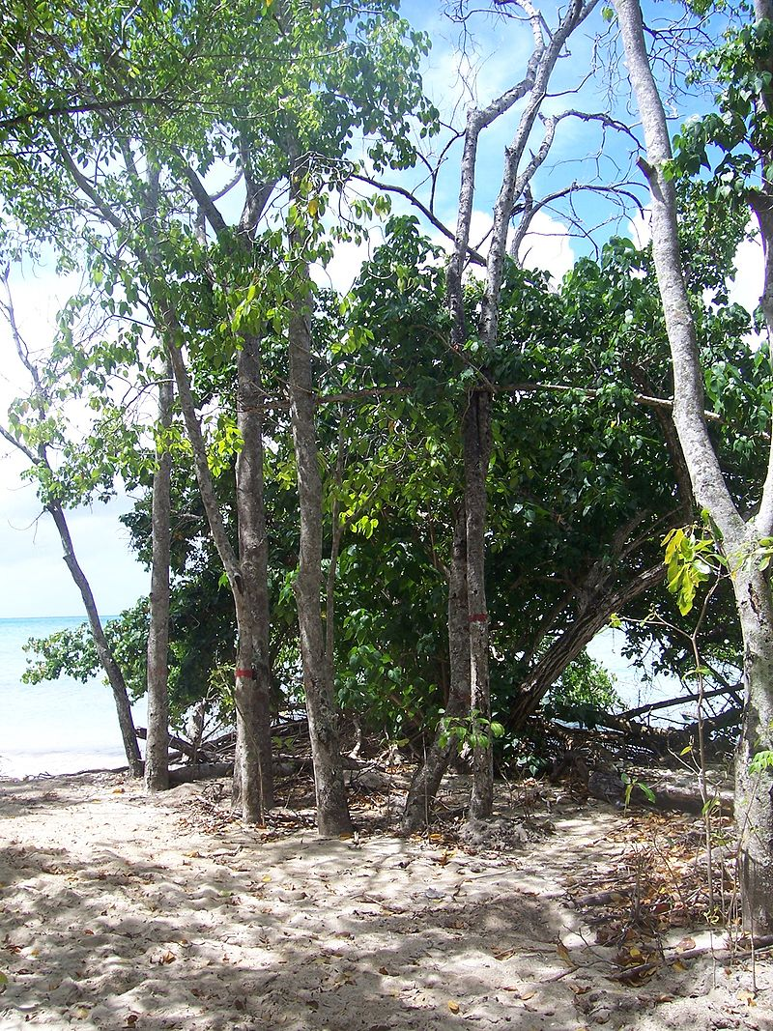
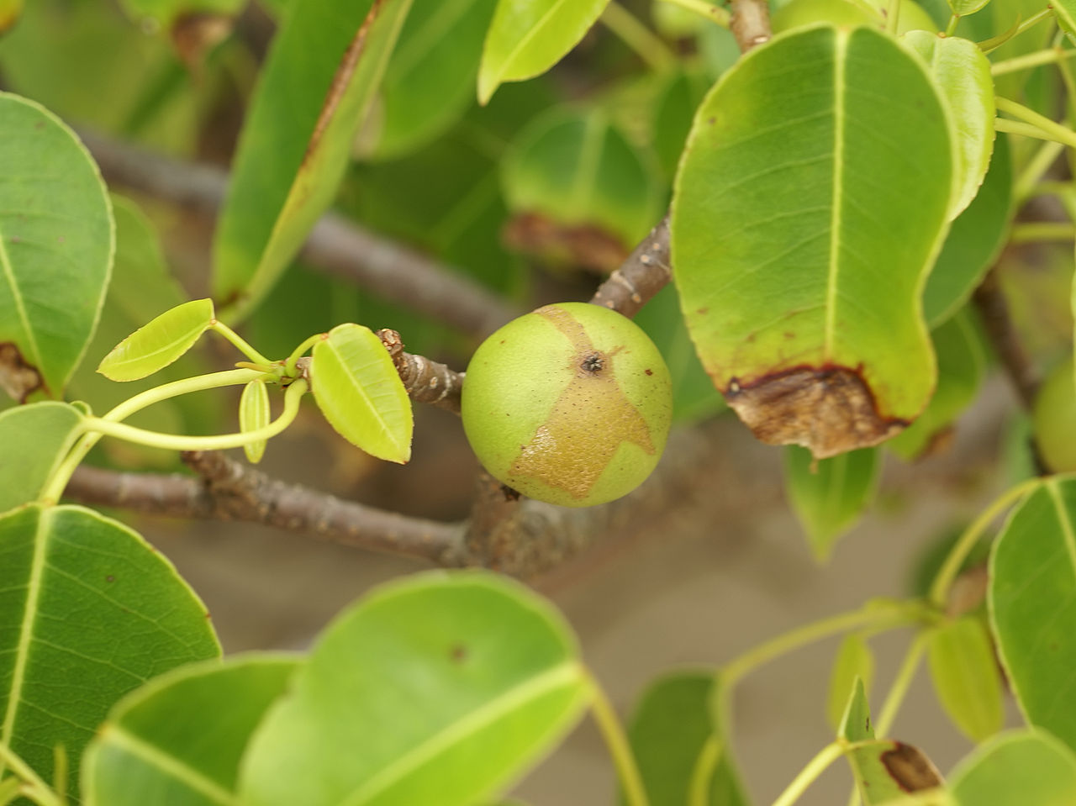
The most poisonous tree in the world
It is believed that hippomane mancinella is a species of the most poisonous tree in the world. If you eat the fruits of this tree, you can die. If you stand under this tree in the rain, large painful blisters will settle on your skin. Resin from this tree can cause non-healing wounds and even damage car paint. The smoke of the burning wood of Hippomane mancinella, which comes into the eyes, dazzles.
The good thing is that these trees do not grow anywhere near us - they are common only in the southern parts of North America and the northern part of South America.

Slide 6
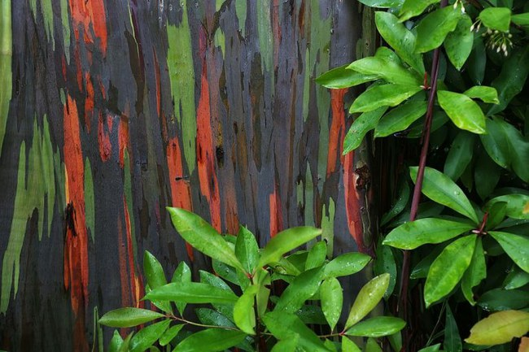
Rainbow eucalyptus
There is an eucalyptus species Eucalyptus deglupta, which is distinguished by a particularly colored bark. It is formed in a very interesting way. Patches of tree bark peel off every year and fall to the ground, opening a green undergrowth layer. It becomes blue, purple, and then red after a while. The patches of bark fall at different times, so the trunk of the same eucalyptus is painted in the most diverse colors.
By the way, rainbow eucalyptus itself is used to make paper.

Slide 7
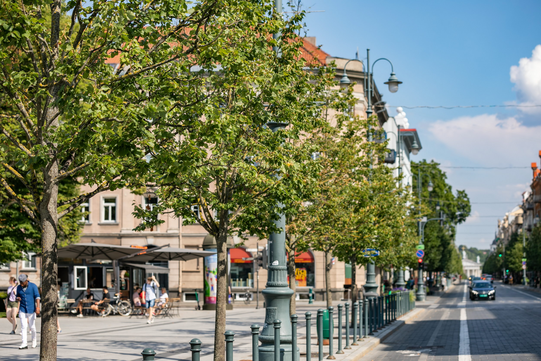
Trees cool cities
Trees not only provide shade – by evaporating, i.e. by absorbing the sun's rays and spreading moisture through the leaves into the air, they can slightly soften extremely high temperatures. In summer, cities can become stuffy "islands of heat".
A 2019 U.S. study found that tree foliage covering 40 percent or more can reduce temperatures by as much as 5 degrees.

Slide 8
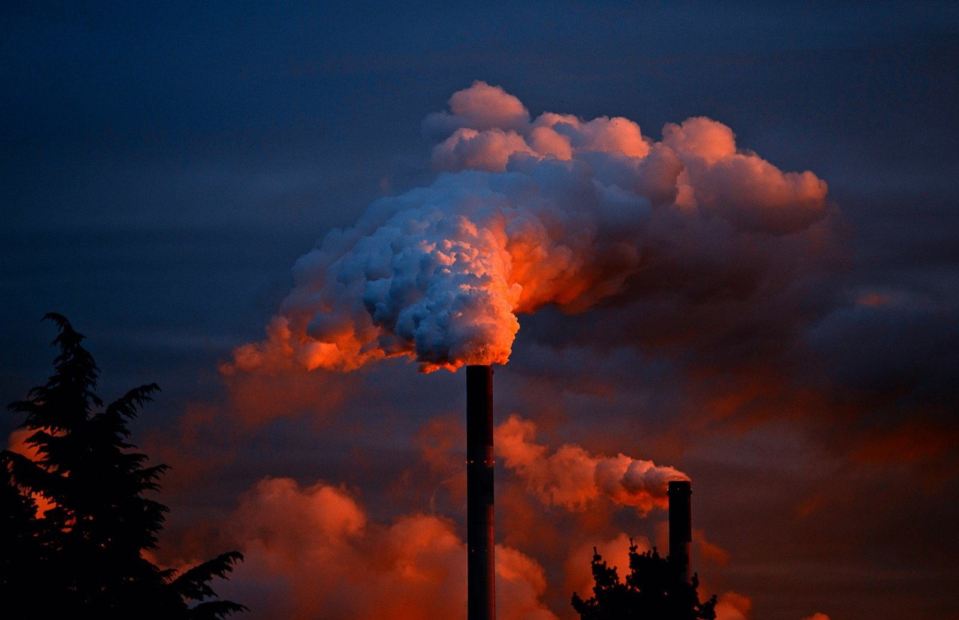
Trees absorb poisonous gases
Trees absorb CO2 from the atmosphere, so they are vital in the fight against climate change.
Tree leaves are also able to filter out airborne particulate matter and some poisonous gases. A recent study in the United Kingdom showed that warty birch, European yew and elderberry can help get rid of 79%, 71% and 70% of particulate matter, respectively.

Slide 9
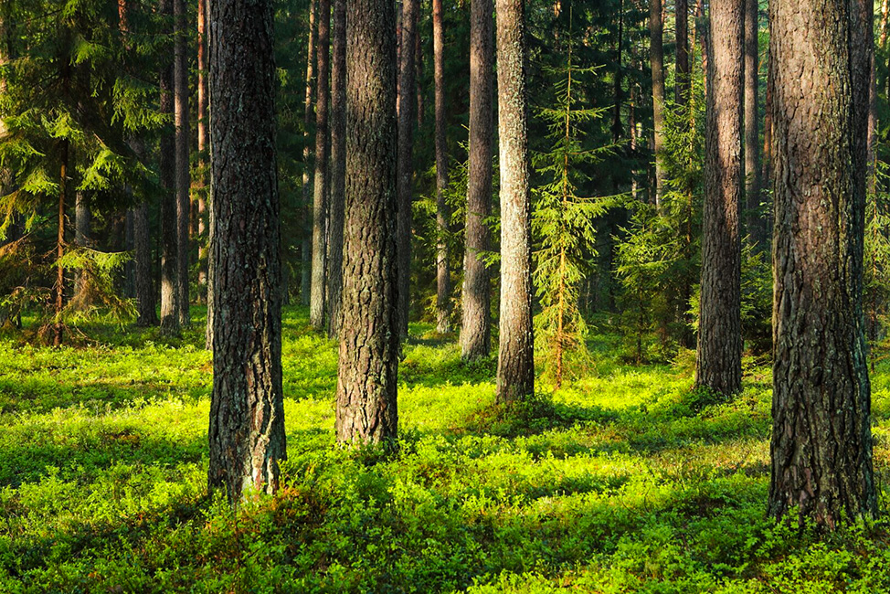
The healing properties of trees
Trees reduce stress levels, help us feel happier and healthier. Even a number of studies have found that spending time in nature or just looking at trees or flowers through the window can lead to a decrease in blood pressure, strengthening immunity, improving sleep, disappearing anxiety and even accelerating healing after operations.

Slide 10
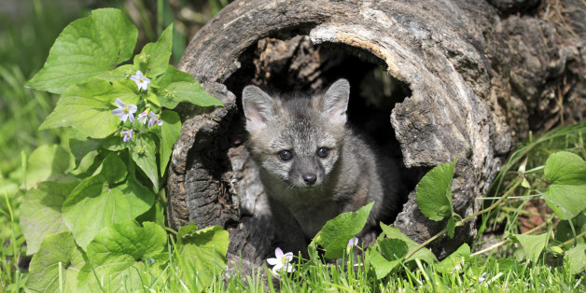
Tree language
When attacked by beetles or parasites, some species of trees, such as apple trees, release compounds into the air that warn their invaders feed on creatures. Most often these are insects. However, studies conducted in Europe have shown that trees attacked by caterpillars send chemical signals that attract the birds that feed on those caterpillars, such as the big.
Trees, when their leaves are gnawed by hungry herbivores, can release chemicals into the air, which warns representatives of the same species growing nearby about the impending danger. Studies have shown that in response to such warnings, trees increase the amount of toxins secreted by herbivores for defense against herbivores, which give bitterness to the leaves.

Slide 11
