Slide 1
BIRCH IN THE CREATION OF THE NATION
By AUSTĖJA STONKUTĖ

Slide 2
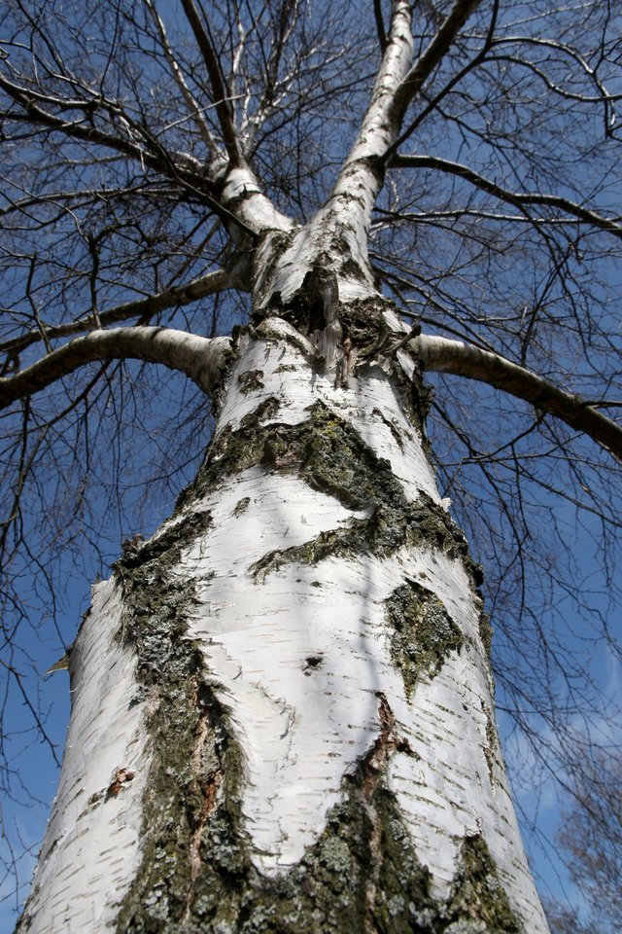
TREE - A SYMBOL OF GROWTH, STRENGTH AND RENEWAL
I CHOSE BIRCH FOR MY PRESENTATION.
4 BIRCH TREES GROW IN THE YARD OF MY GRANDMOTHER AND GRANDFATHER
BIRCH IS A VERY FAST-GROWING TREE
THE APPEARANCE OF BIRCHES IS DIFFERENT FROM OTHER TREES - THEIR BARK IS MADE UP OF WHITE AND BLACK COLORS
THERE ARE ABOUT 120 SPECIES OF BIRCH TREES IN THE WORLD
EVERY SPRING YOU CAN TASTE BIRCH SAP
BIRCH BUDS AND LEAVES – MEDICINES
BIRCH VANTOS ARE USED IN THE SAUNA
FURNITURE, DISHES MADE FROM BIRCHES

Slide 3
BIRCH IN THE CREATION OF THE NATION
SINCE ANCIENT TIMES, BIRCH SYMBOLIZES GOOD FORCES
HE IS A SYMBOL OF HARMONY. IT WAS BELIEVED THAT LEANING ON A BIRCH TREE FROM IT CAN GAIN STRENGTH AND FIND PEACE OF MIND
BIRCH IS MENTIONED VERY OFTEN IN THE CREATION OF THE NATION
IN SONGS, FAIRY TALES, FILINGS – BIRCH – A SYMBOL OF SPRING AND BIRTHPLACE.

Slide 4
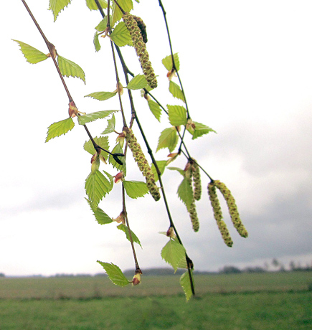
POET PAULIUS ŠIRVYS
BIRCH IN THE WORK OF THIS POET WAS OF GREAT IMPORTANCE
HE CREATED MANY POEMS WHERE BIRCH IS MENTIONED

Slide 5
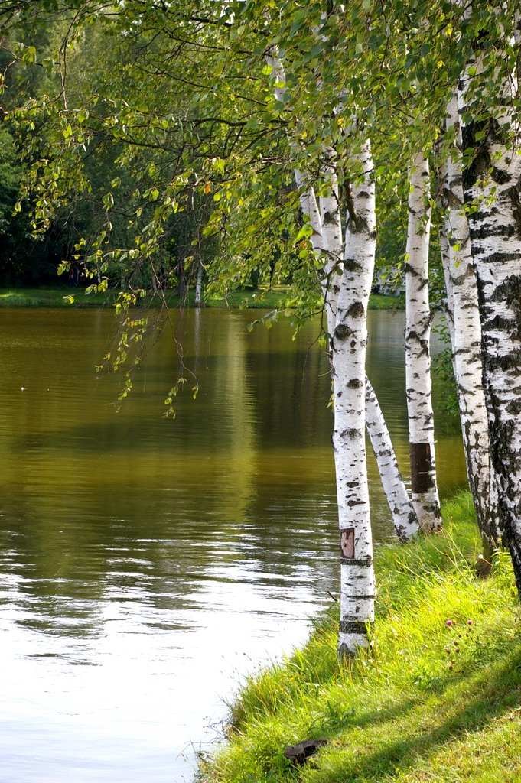
POEM BY PAUL SHIRVIS
„AŠ BERŽAS“EXTRACT
Aš – beržas.
Lietuviškas beržas
Išbridęs
Iš pievų nakties,
Sustojau
Ant mūšių
Didžiausiojo kelio
Su plieno dalgiu
Ant peties...

