Slide 1


The Tale of the Seeds

Slide 2

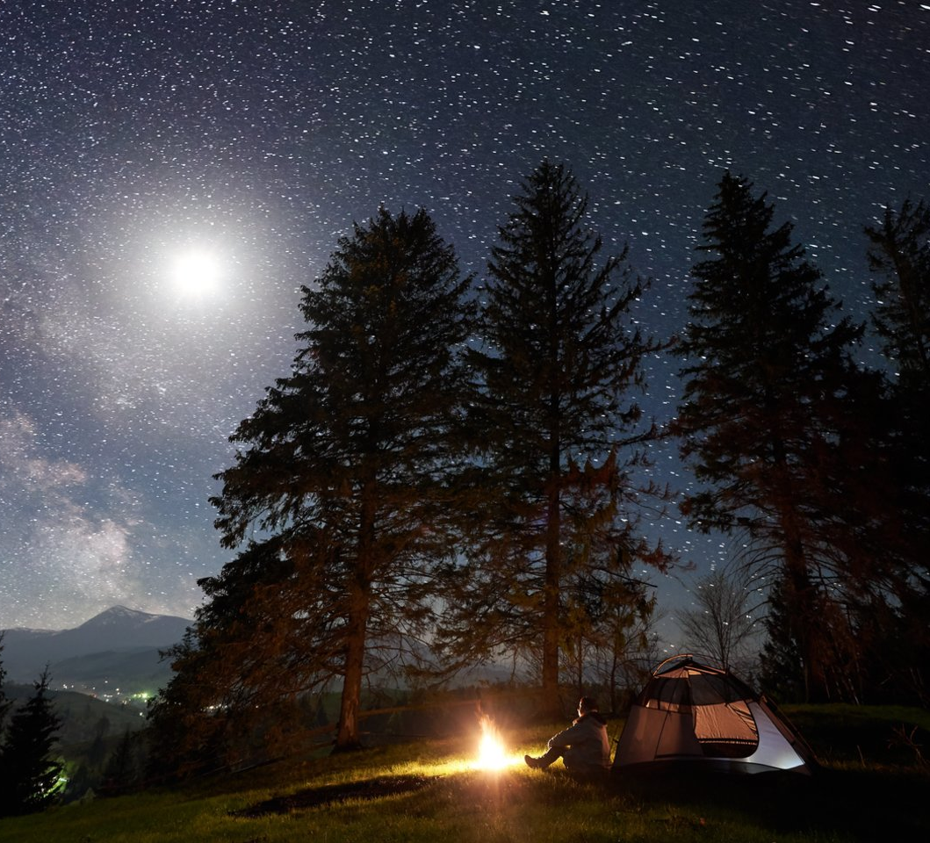



Once, on a June night, seeds gathered to discuss how to spread faster and take over the world.

Slide 3
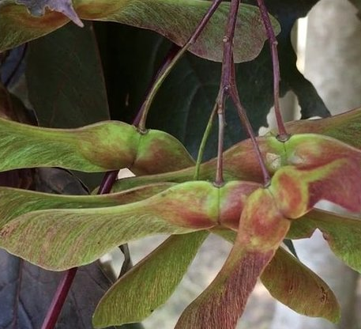
-I will grow wings and fly like a helicopter far away when the wind blows,-said the maple seed.

Slide 4
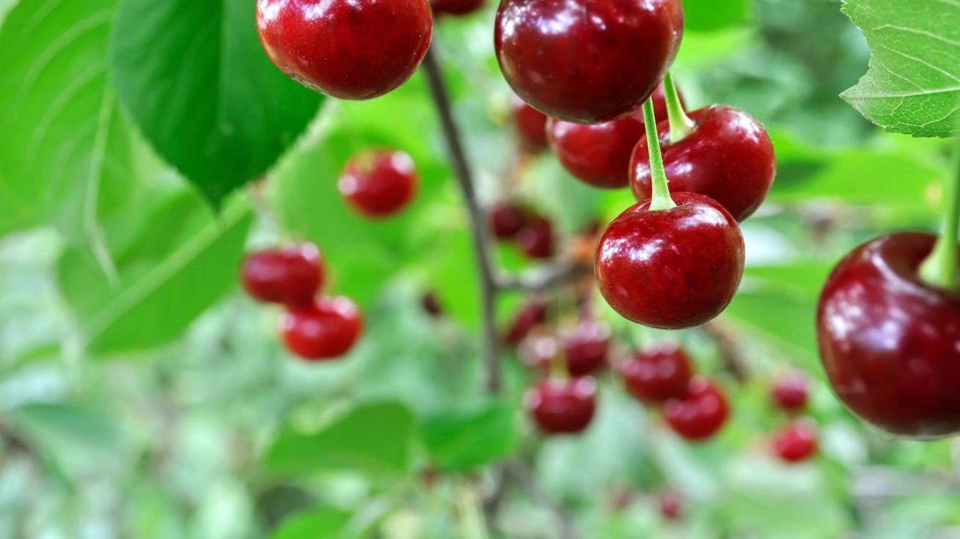
-The birds will enjoy us, they will fly far away, because they will have had their fill. Then we will fall from their tummies to the ground,-the cherry seeds have spoken.

Slide 5
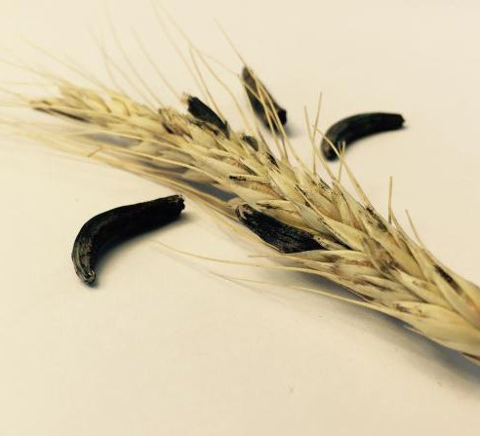
-You need to know how to simulate!-said the evil ergots.- We will sit in the furrows with the rye grain, we will be sown by man with the corn.

Slide 6
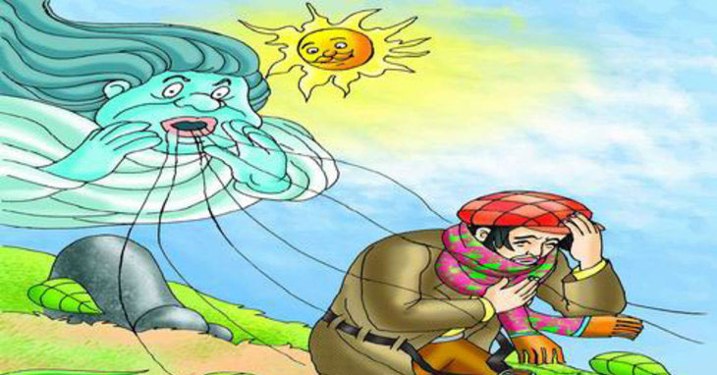
The meeting made a fuss, because ergot is poisonous to humans!!! Then came the wind, the birds and man.

Slide 7
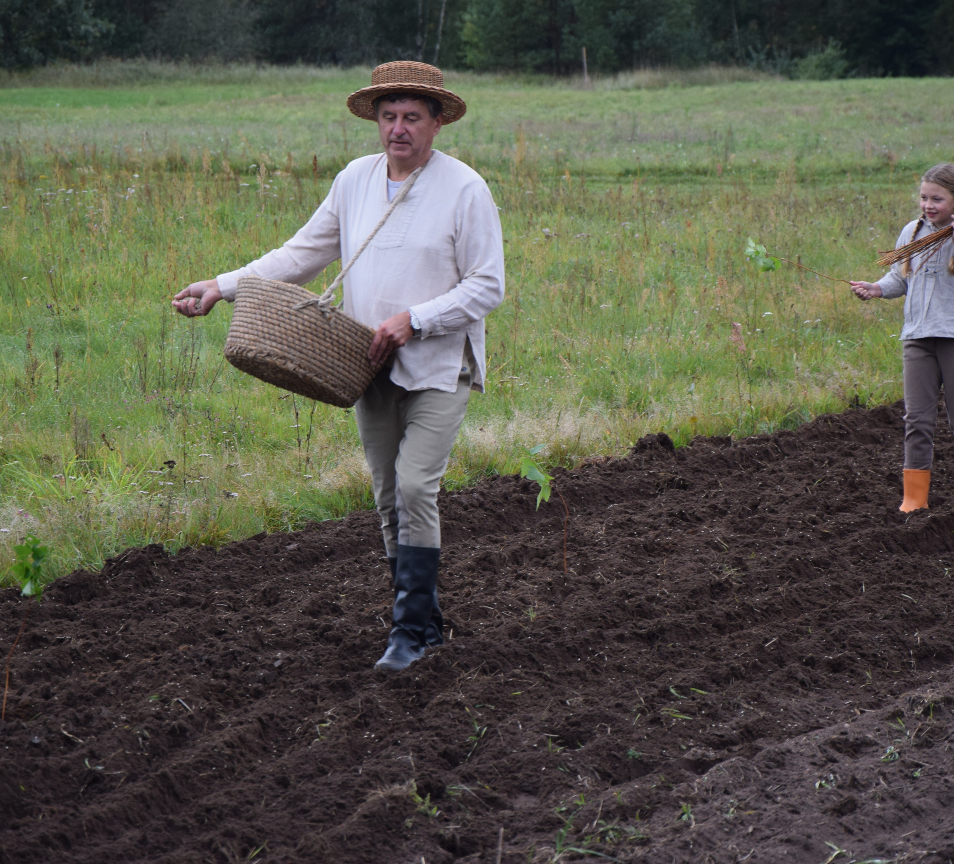
The man listened to everyone's opinions and said with a smile: -You do as you like, and we humans will change your life a little. We will plant the seeds that are good for food in good soil and take care of them, and we will not let the others grow anywhere. We can all fit in the ground!

Slide 8
THE END

