Slide 1
Experiment with birch twigs
BARBORA J.

Slide 2
WE DID THE EXPERIMENT TO PROVE THAT THE TREES NEEDED CLEAN WATER AND CLEAN LAND AND SUNLIGHT

Slide 3
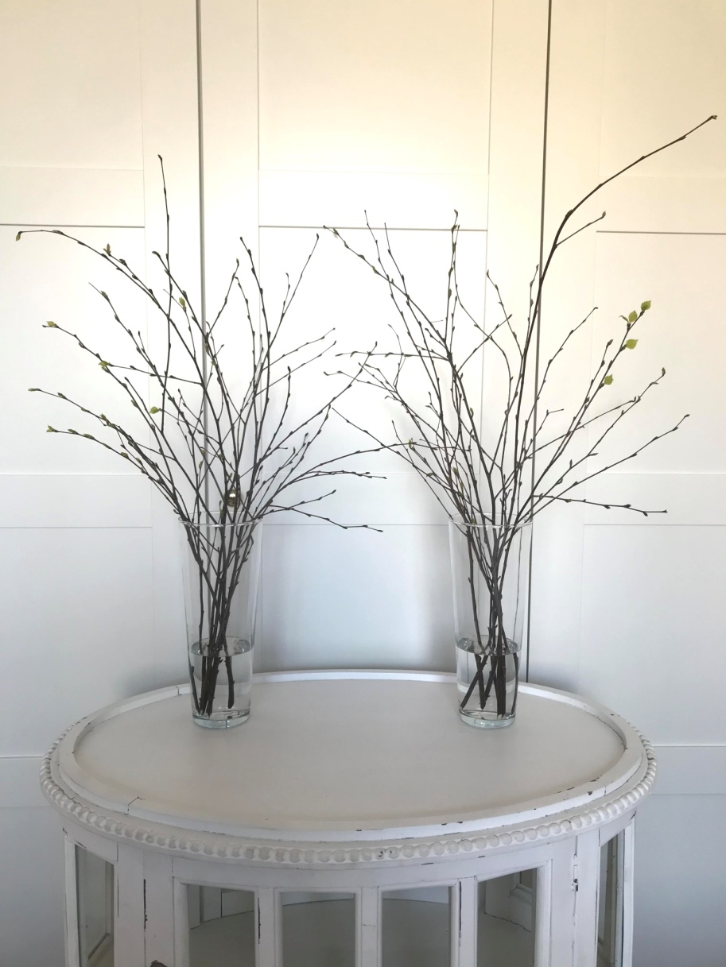
Early
WE DIVIDED THE TWIGS INTO TWO IDENTICAL VASES AND ADDED WATER

Slide 4
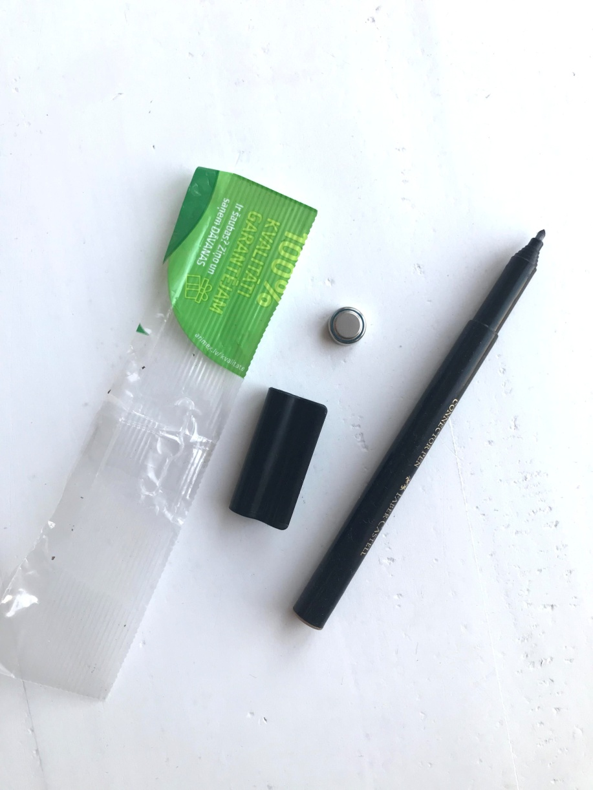
AFTERWARDS
IN ONE VASE WE PUT PLASTIC, A BROKEN FELT-TIP PEN AND AN EXPIRED BATTERY. WE TOOK THE VASE OUT TO THE DARK AND COLD GARAGE.

Slide 5
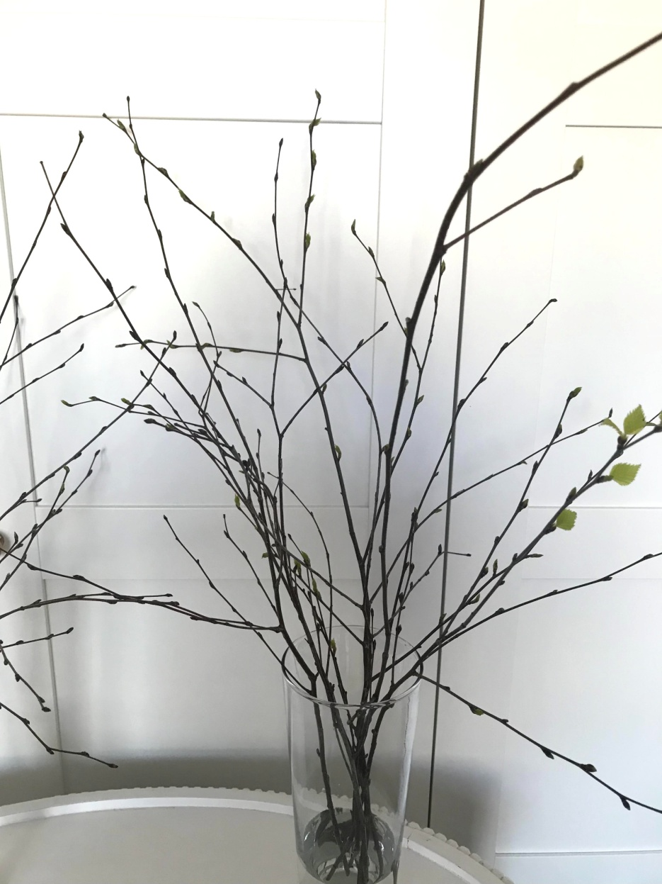
AND WE PUT ANOTHER VASE ON A SUNNY WINDOWSILL

Slide 6
WHAT HAPPENED AFTER 10 Days...

Slide 7
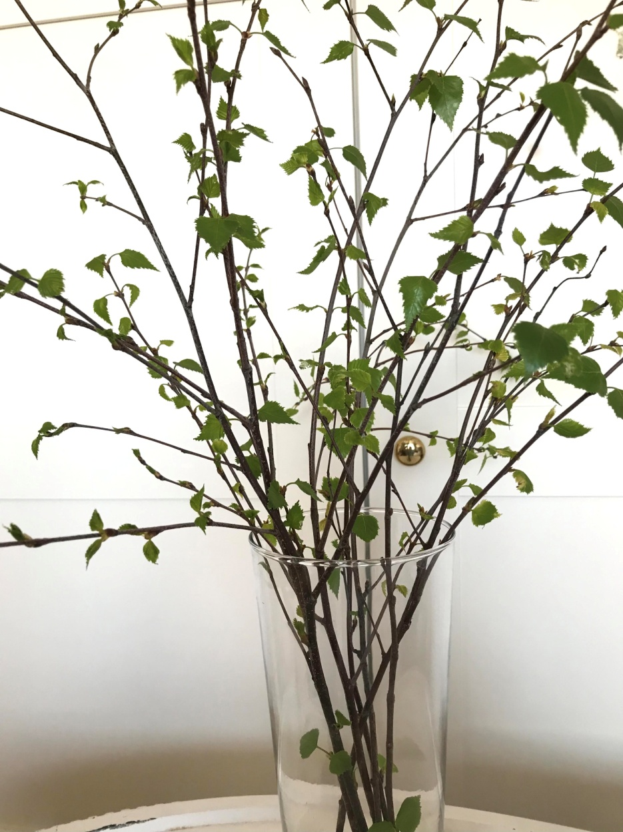
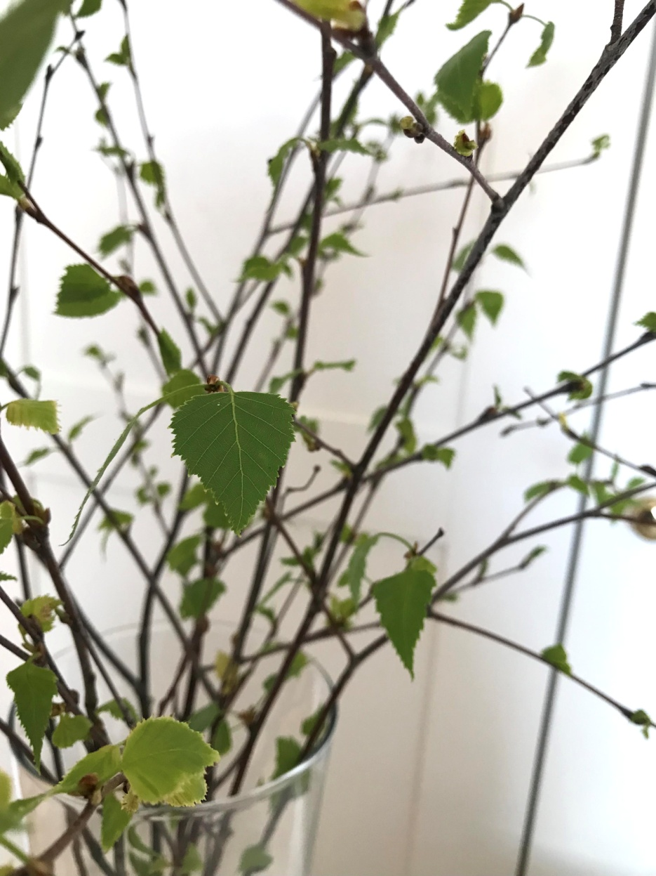
VASE FROM THE WINDOWSILL

Slide 8
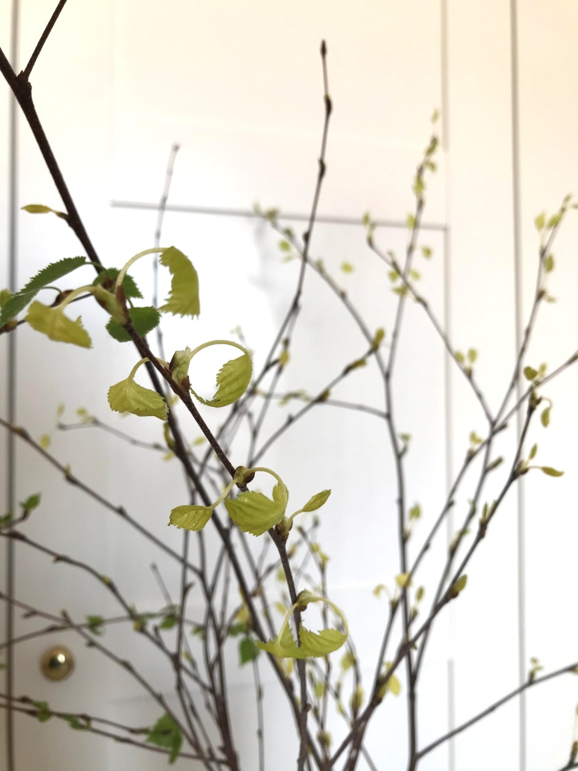
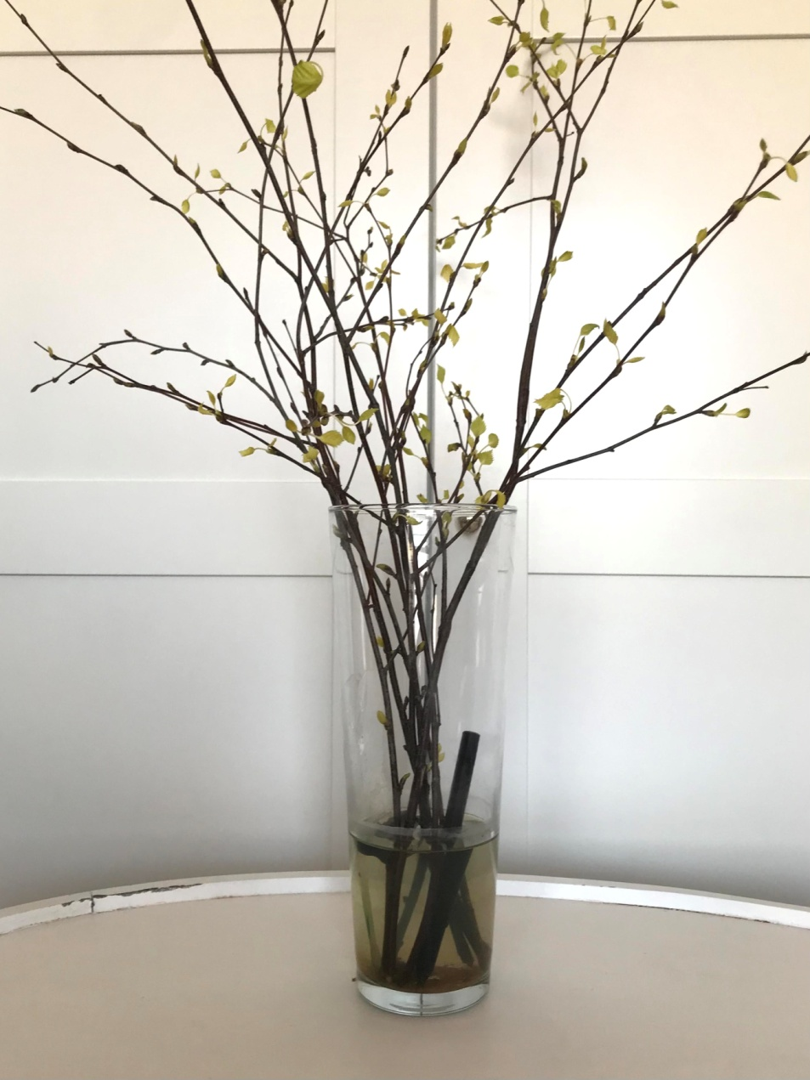
VASE FROM THE GARAGE

Slide 9
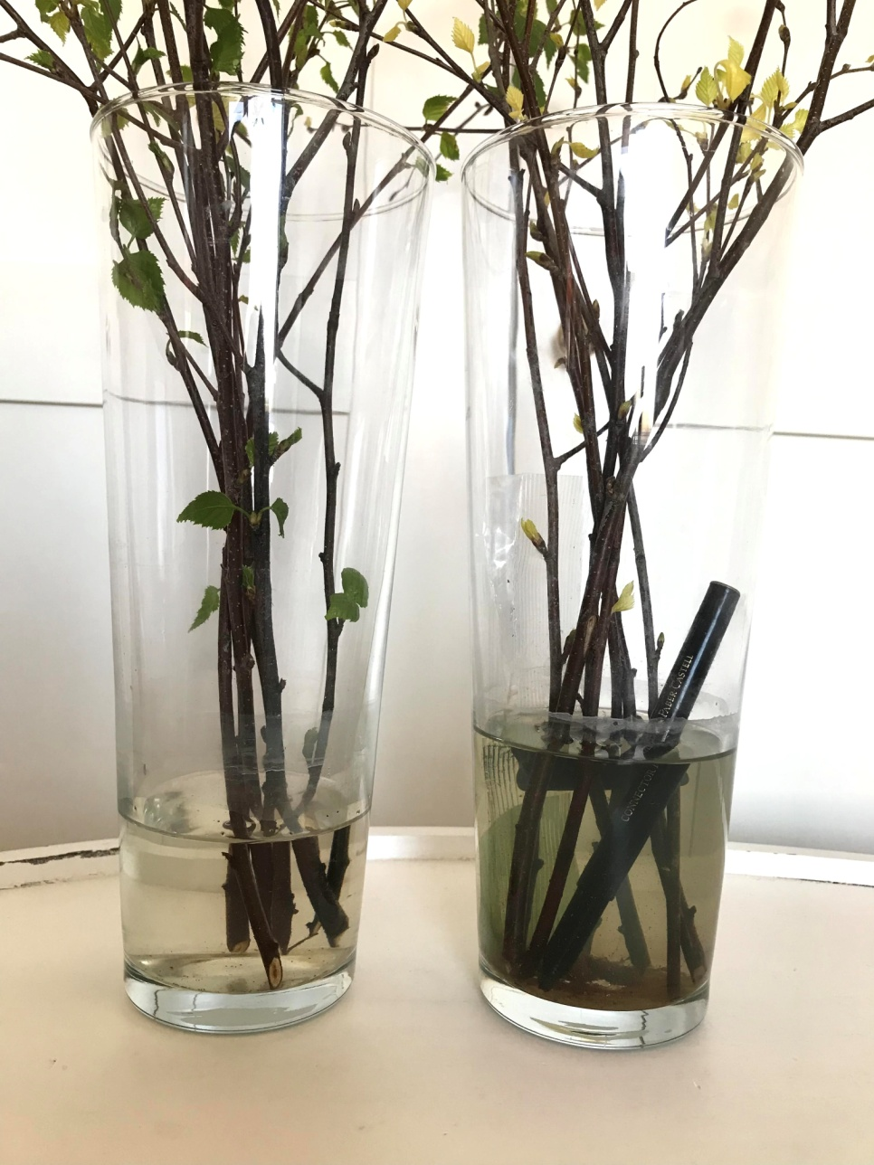
Water has decreased

Slide 10
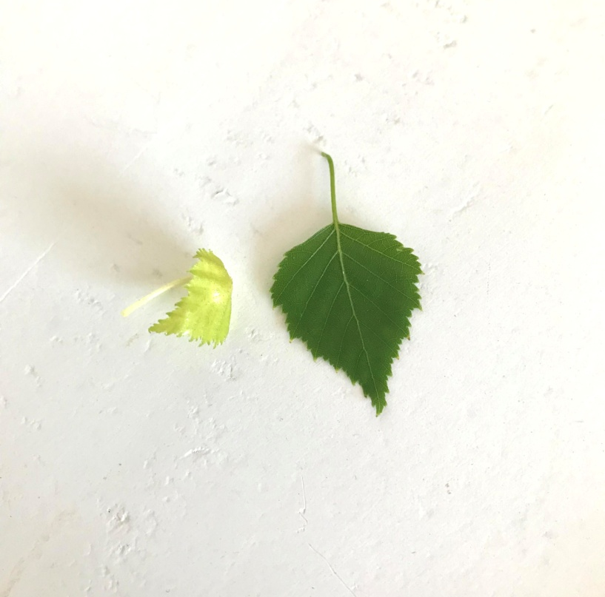
THE EXPERIMENT SUCCEEDED!!
THIS IS PROOF THAT NATURE MUST NOT BE POLLUTED.

