Slide 1
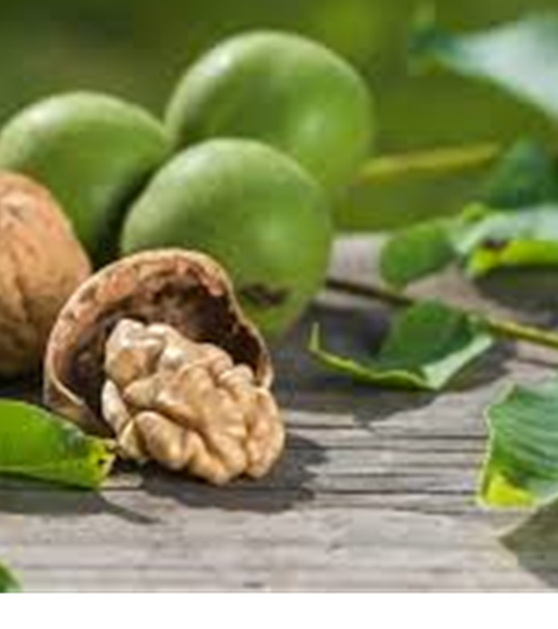
Tree seeds WALNUT
By Rojus Stankevičius

Slide 2
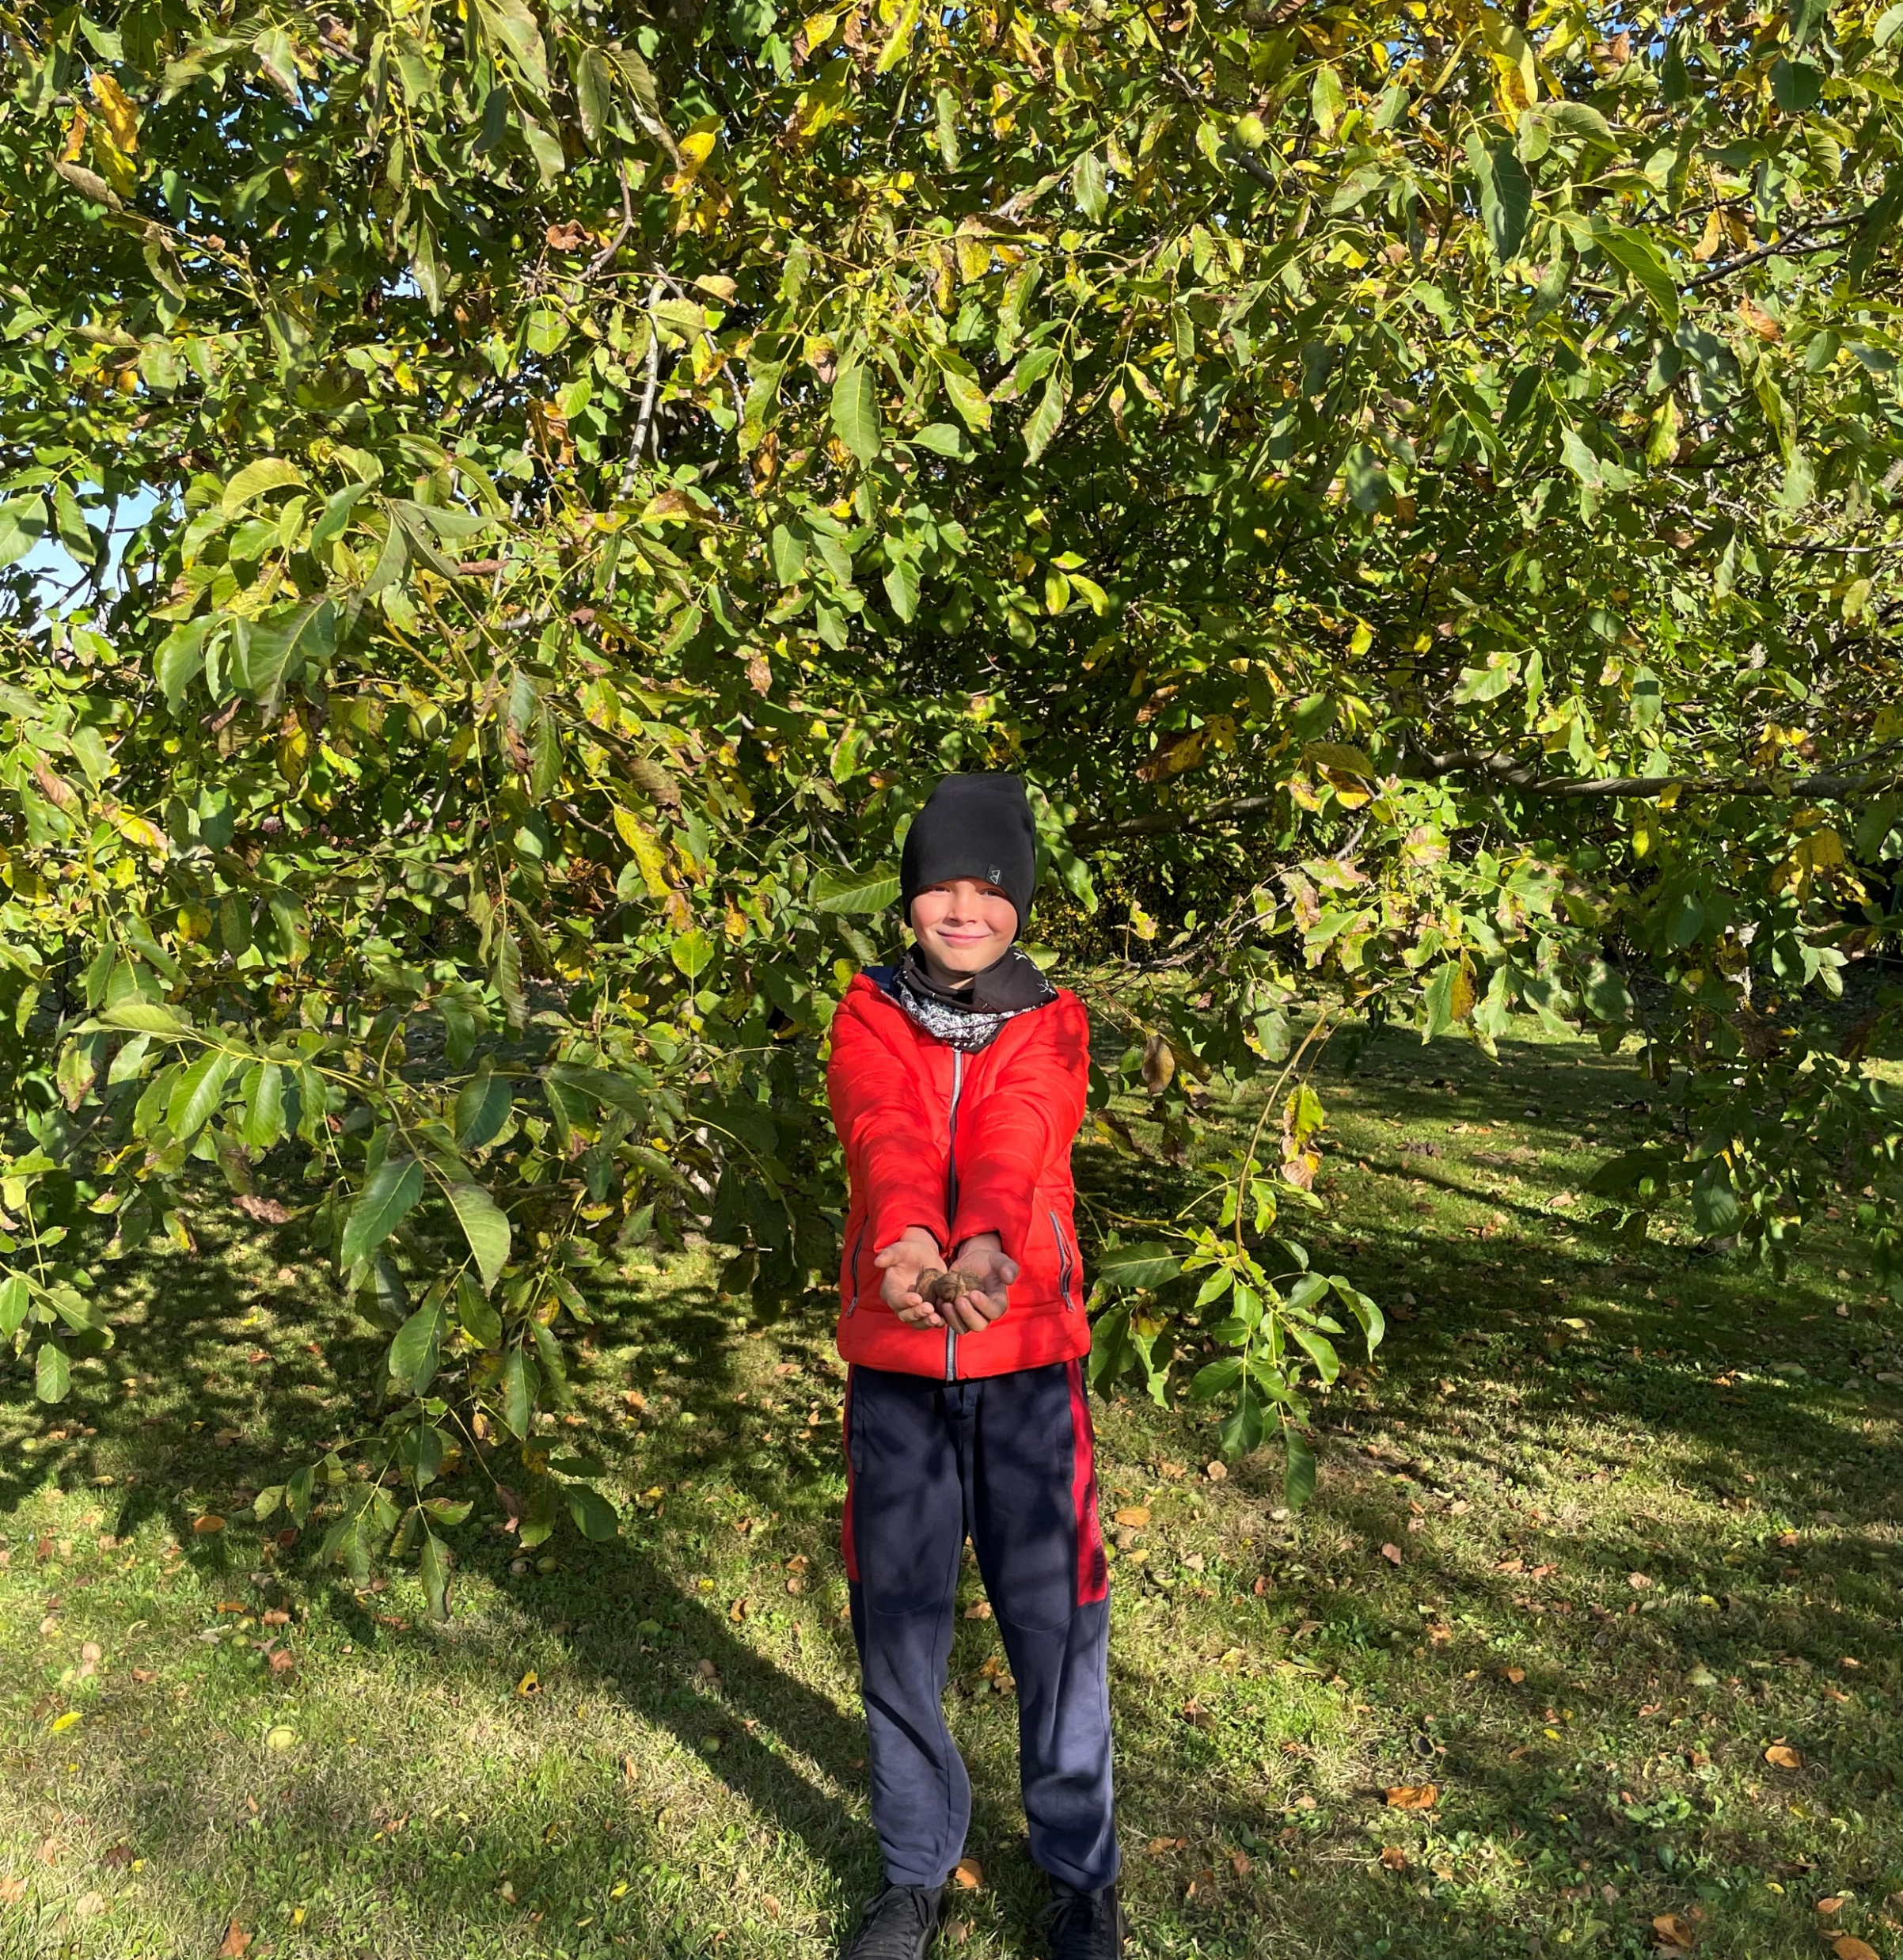
Walnut tree seeds - walnuts
A huge walnut tree has been growing on my grandparents' property in the village of Varputėnai for 15 years.
Every autumn, it produces many nuts.

Slide 3
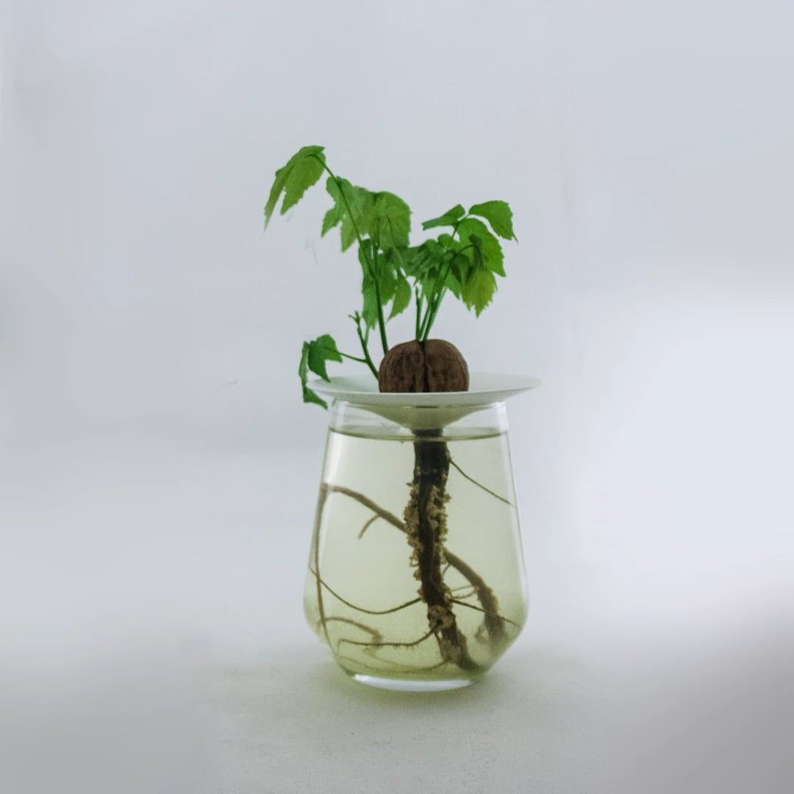
Seed = Tree
Nuts can be eaten, but they can also be sprouted to grow a full-fledged tree.
There are several ways to do this, but the simplest is the method of soaking the nut seeds.
It takes 2-3 weeks to germinate the nuts in glass jars, and after a month the seedlings reach a height of 10 centimetres and need to be replanted.

Slide 4
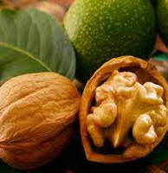
Properties of walnut
Did you know that walnuts are full of goodness?
Walnut kernels contain about 75% oil, 18% protein and are extremely calorific. Nuts contain carotene and are very rich in vitamin C.
The kernels contain vitamins C, E, P and B, iron and cobalt salts, and tanning agents.
These nuts are a source of amino acids and antioxidants.

Slide 5
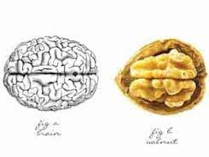
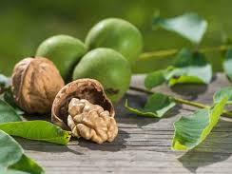
Interesting facts about walnuts
Walnuts are the oldest edible fruit of the nut tree, dating back to 10 000 BC.
The Greeks called these nuts karyon - 'head' - because the shell resembles a human skull and the nut itself looks like a brain.
The famous physician Hippocrates used the walnut and its leaves to treat various ailments.

Slide 6
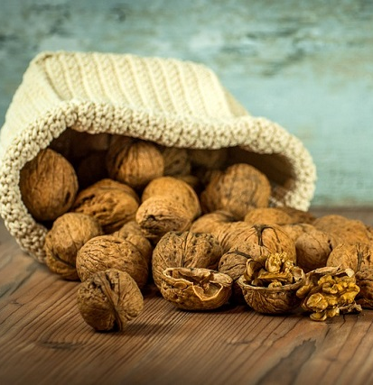
Interesting facts about walnuts
In antiquity, walnuts were known in many European nations as the food of warriors because they strengthen and relax muscles after strenuous exercise.
In China, pairs of walnuts were traditionally rolled and played in the palm of the hand, both as a circulatory aid and as a status symbol.
Record. The most walnuts crushed by hand in one minute is 212 in India in 2017.
Another record. The most walnuts crushed in the head in one minute is 181pcs, in Italy in 2016.

Slide 7
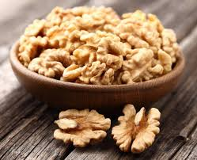
7 reasons to eat walnuts
Walnuts are brain food. It is especially recommended for those who study a lot and work hard mentally.
Walnuts are a food for longevity.
Walnuts are recommended for those who are frequently stressed.
Walnuts should be consumed by those who want to enjoy a glowing complexion.
Walnuts help to improve the condition of hair.
Walnuts are very useful for pregnant women.
Walnuts can help you get a better night's sleep.

