Slide 1
How to measure the height of a tree?
By Dorians, 4th grade student of Riga Lithuanian Secondary school

Slide 2
Summary:
I will try to measure the high of a tree with two different methods.
Subject of the study:
Two trees – weeping birch and pine tree.
Aim of the study:
Measure tree height using 2 methods. Determine whether the measurement results are the same for both methods.
Required:
tape measure;
pencil;
a friend who can help.

Slide 3
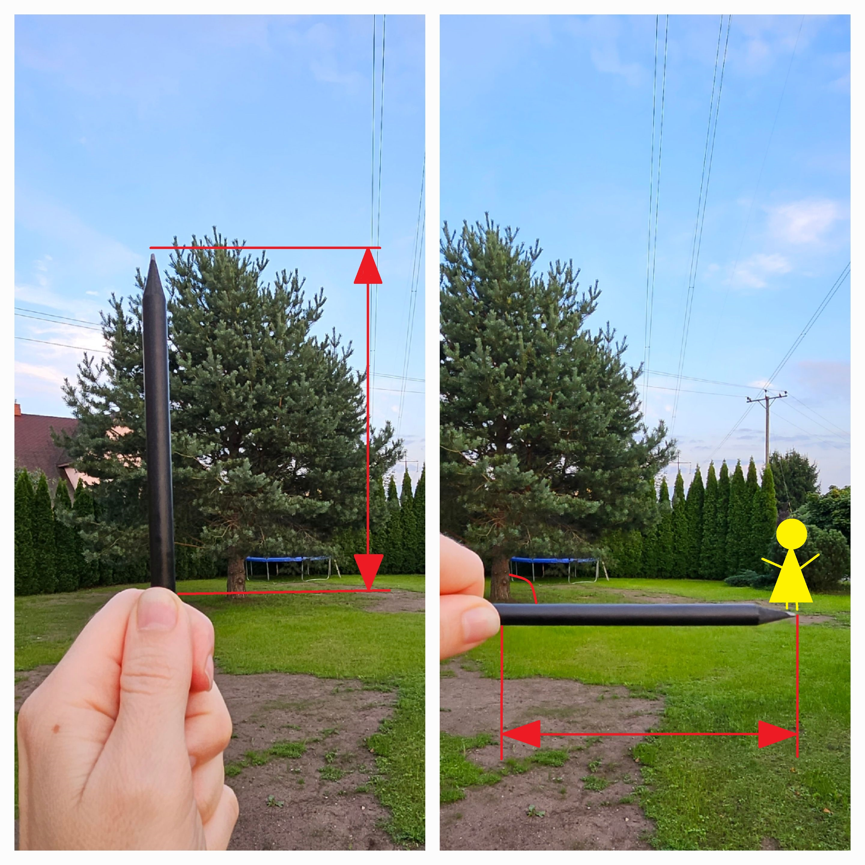
Procedure of method A
Find the tree whose height you want to measure. In my case, they will be weeping birch and pine tree. Preferably, the tree should not be on a hill or in a valley, as this will make the estimate more inaccurate.
For this method you need a pencil and a friend. Stand at such a distance from the tree that you can see the whole tree - from the base to the top. Position a mate next to the trunk. Extend your hand in front of you with a pencil clenched in your fist. Squint one eye and bring the tip of the lead to the top of the tree. Now move the fingernail of your thumb so that it is under the base of the trunk. Turn your fist 90 degrees so that the pencil is parallel to the ground. Your fingernail should remain at the point of the base of the trunk.
Tell your mate to run away from the tree. When your mate reaches the point where the point of the pencil is pointing, signal him to stop. Measure the distance from the trunk to where your mate has stopped. This will be the height of the tree. A tape measure will help you to find the height of the tree. Write down the result.

Slide 4
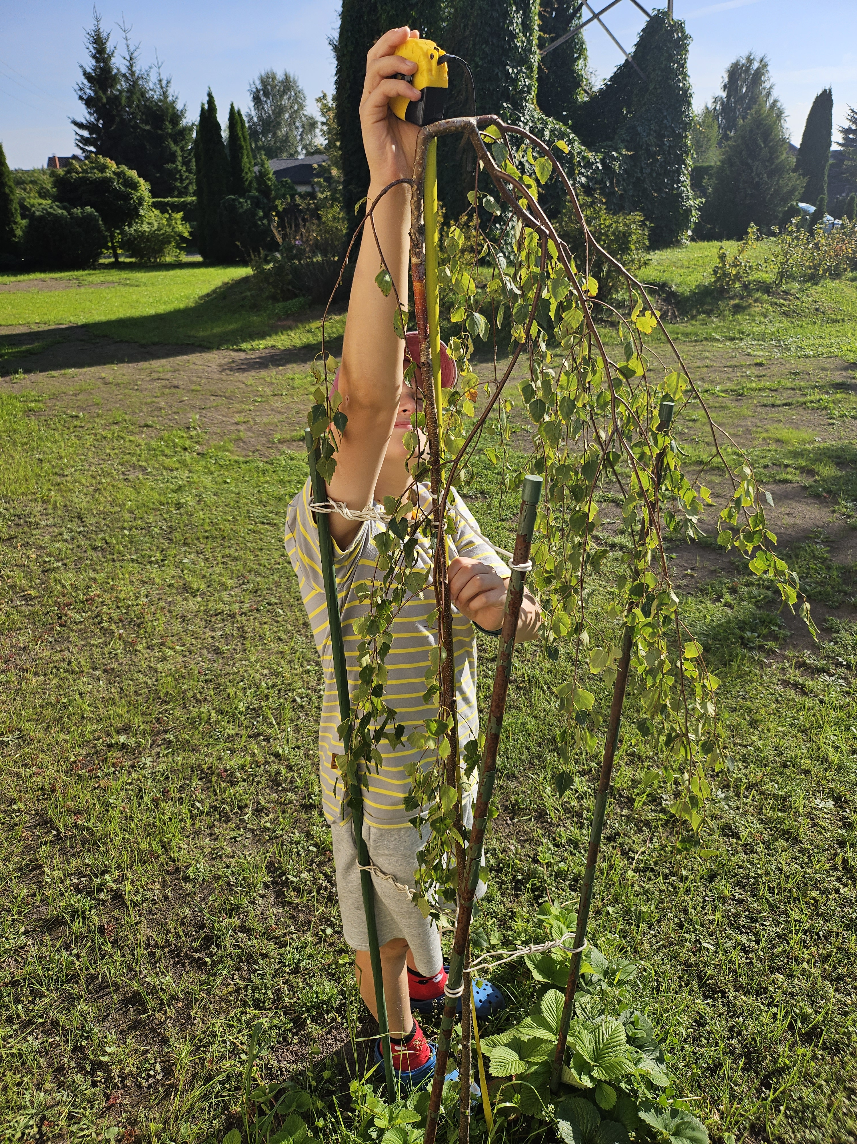
Procedure of method B
Choose a small tree or shrub that you can measure from the top to the ground. Take a tape measure and measure. Write down the result.

Slide 5
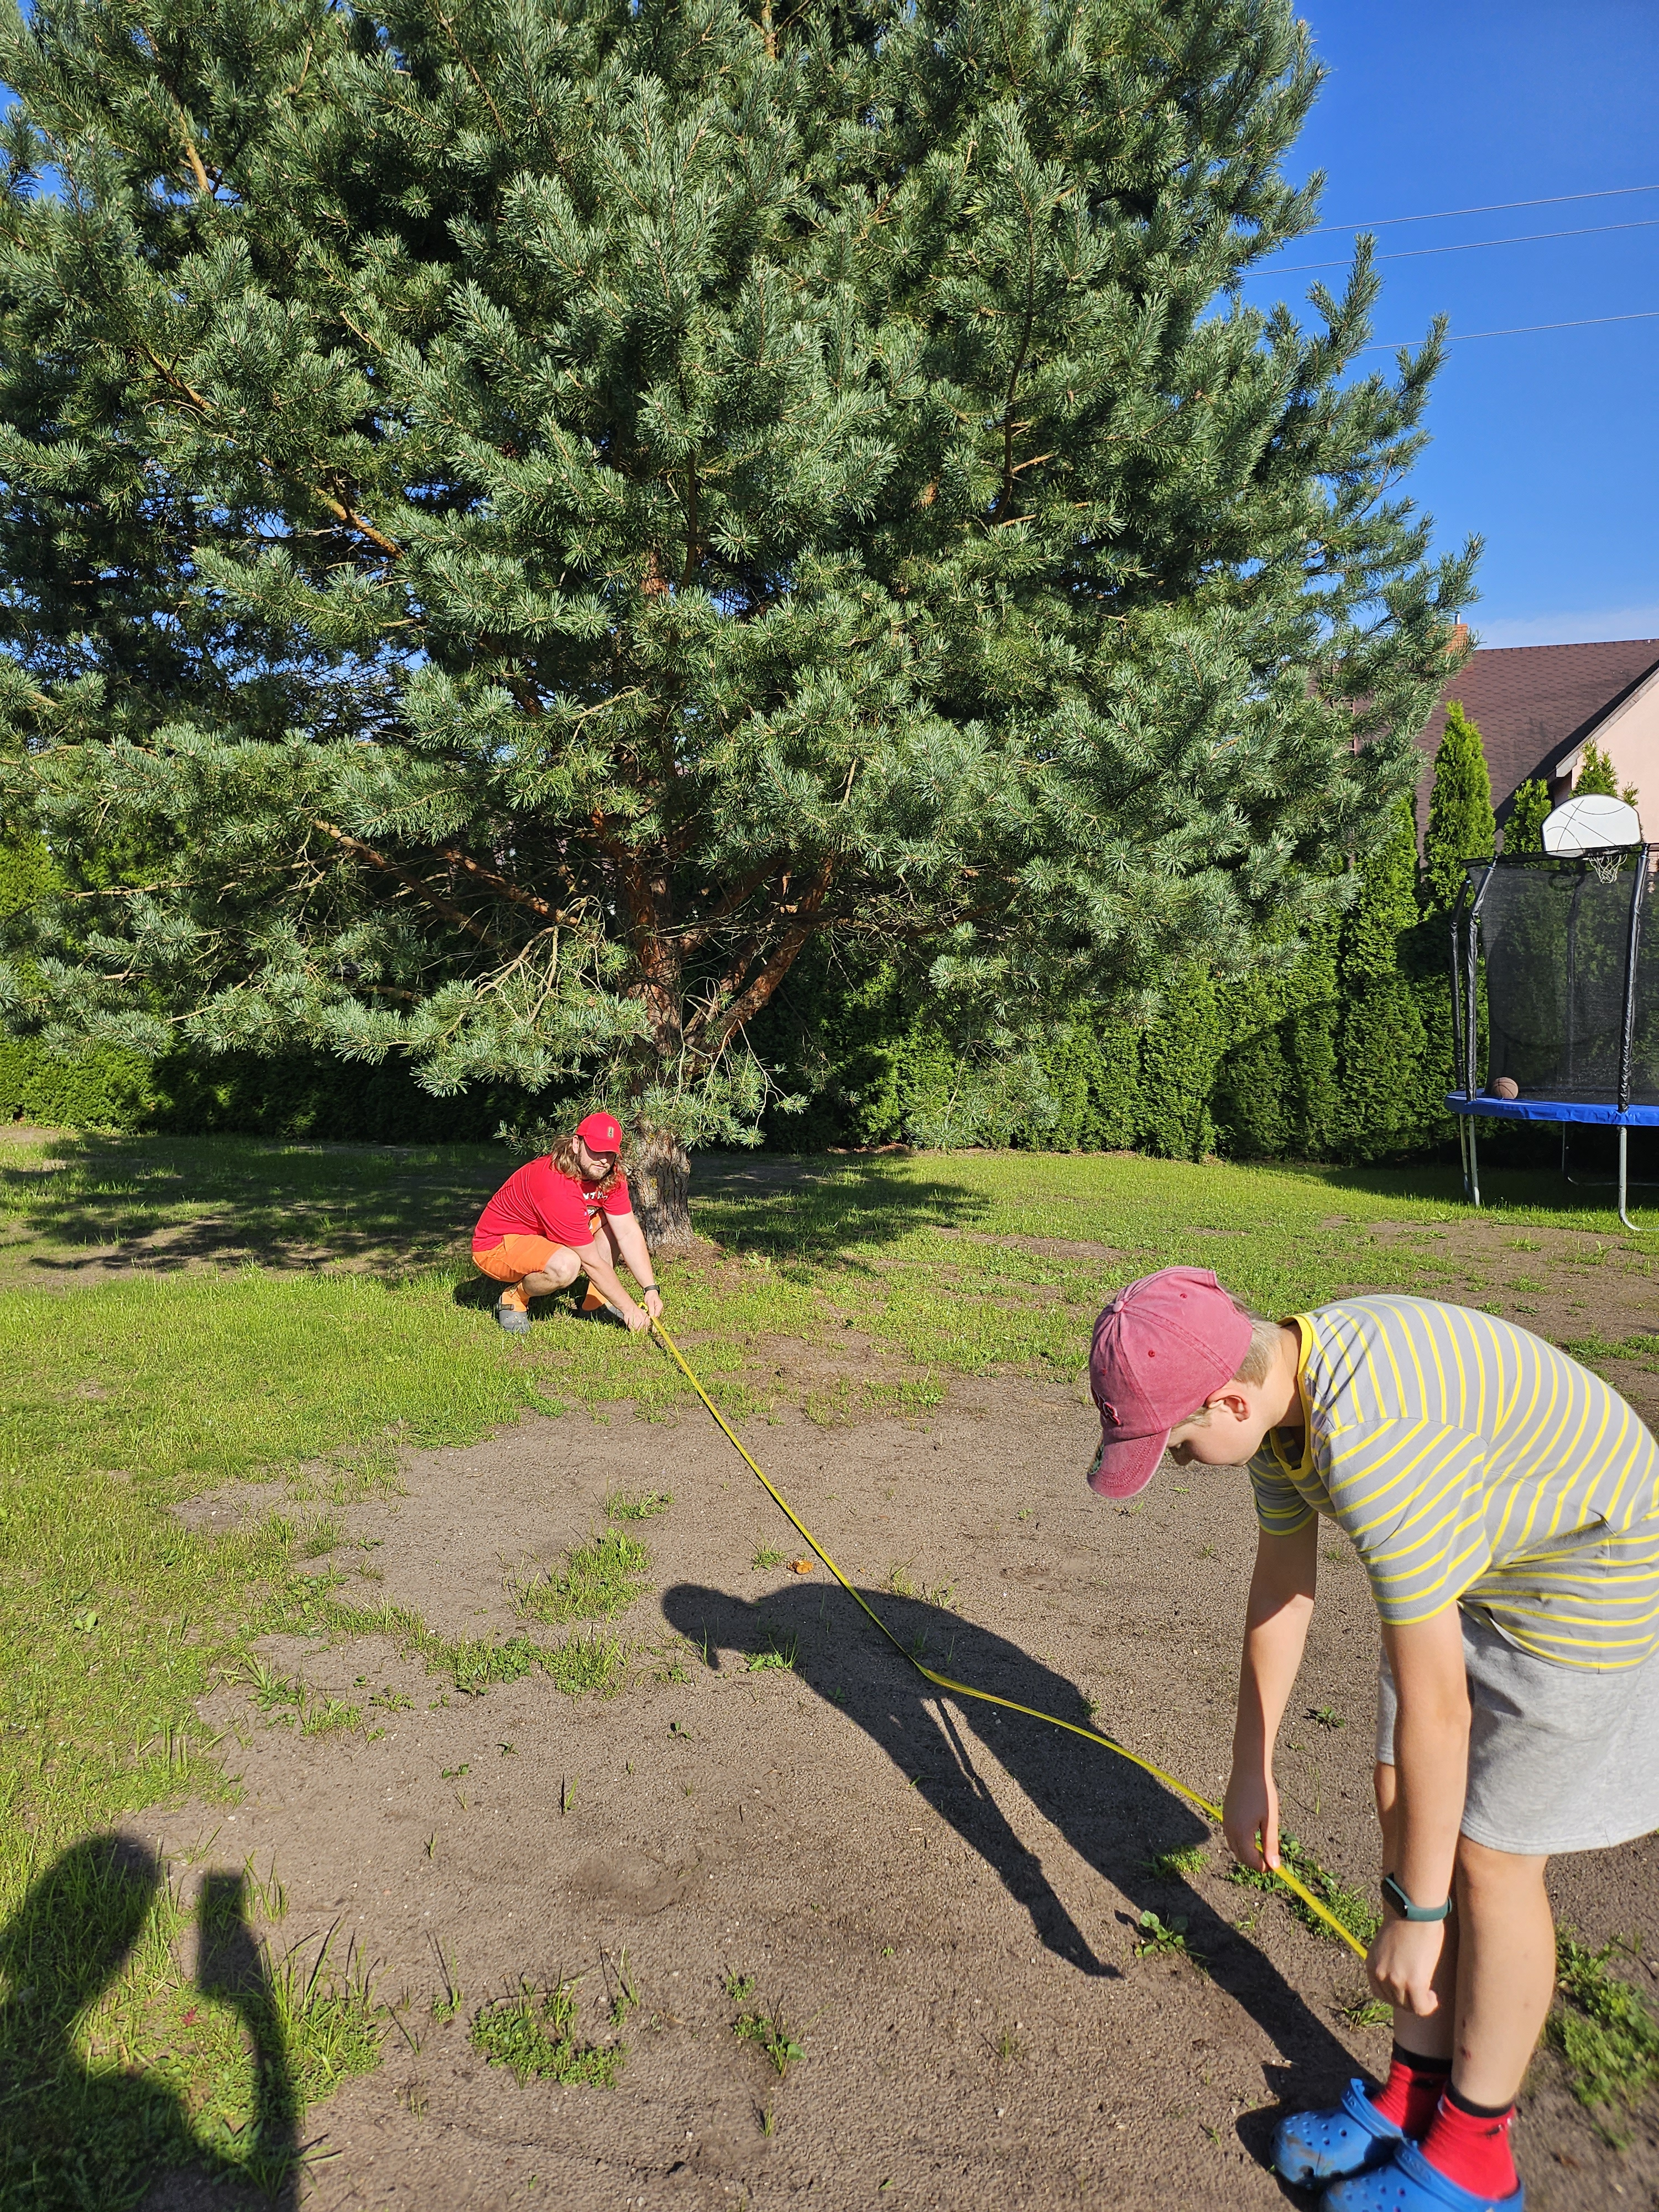
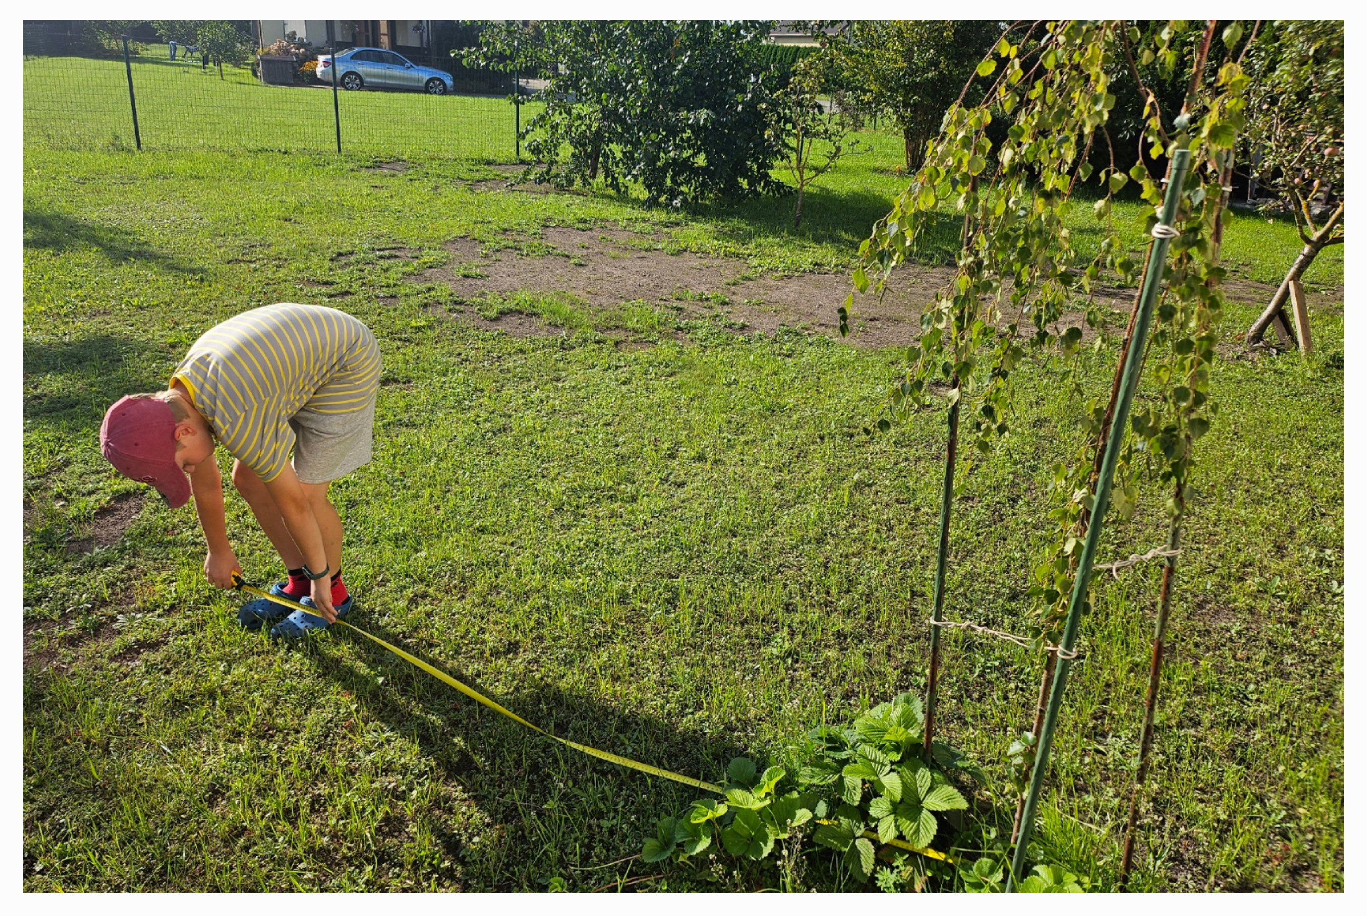
Results
Method A
Tree | Height, cm
weeping birch | 178
pine | 690

Slide 6
Results
Method B
Tree | Height, cm
weeping birch | 174
pine | - *
* I couldn’t measure the pine tree, because it was too high. So I ignored method B for pine tree measuring.

Slide 7
Conclusions
When measuring weeping birch with each method, the difference in results was insignificant. So it can be concluded that both methods are accurate for measuring tree height.
Method B can only be used to measure small trees or shrubs.
Method A is quite accurate, suitable for measuring the height of both small and large trees.

