Slide 1
RESEARCH - Tree bark
By NOJUS PAULAUSKAS

Slide 2
SUMMARY: I studied the bark of trees of different ages and species. I made a bark album, observed and compared the bark stamps obtained.
OBJECT: Tree bark.
OBJECTIVE: To investigate the characteristics of the bark of different tree species.
OBJECTIVES:
To collect information about tree bark.
To make an album on tree bark.
To analyse the tree bark album and record observations.
RESEARCH METHODS: Information retrieval, data collection and processing.
MATERIALS: Crayons, paper, photographic camera, information on tree bark from Peter Wohlleben's book 'Do you hear trees talking?'.

Slide 3
Tree bark
The bark of a tree is like a human ODA;
The bark of the tree PROTECTS the tree;
THE BARK OF EVERY KIND OF TREE IS DIFFERENT;
The bark of the tree is growing thicker and thicker year after year, and the bark of the trunk of some species of tree is becoming more abundant.

Slide 4
PROGRESS OF THE STUDY - TREE BARK ALBUM
Preparation of tools (sheets of paper, crayons, photo camera);
3 types of trees - birch, pine and aspen (1 old and 1 young);
Hold a piece of paper against the bark of the tree and swipe it with a crayon to bring out the patterns of the bark on the paper.
The bark of the tree that was stamped on the piece of paper is photographed.

Slide 5
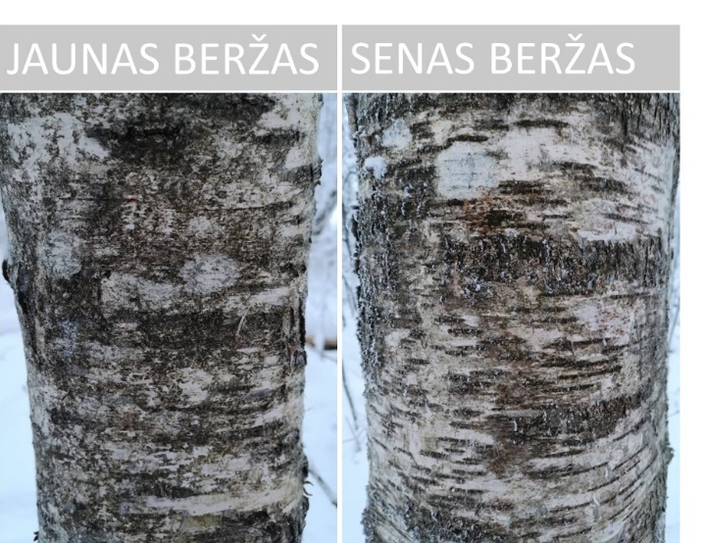
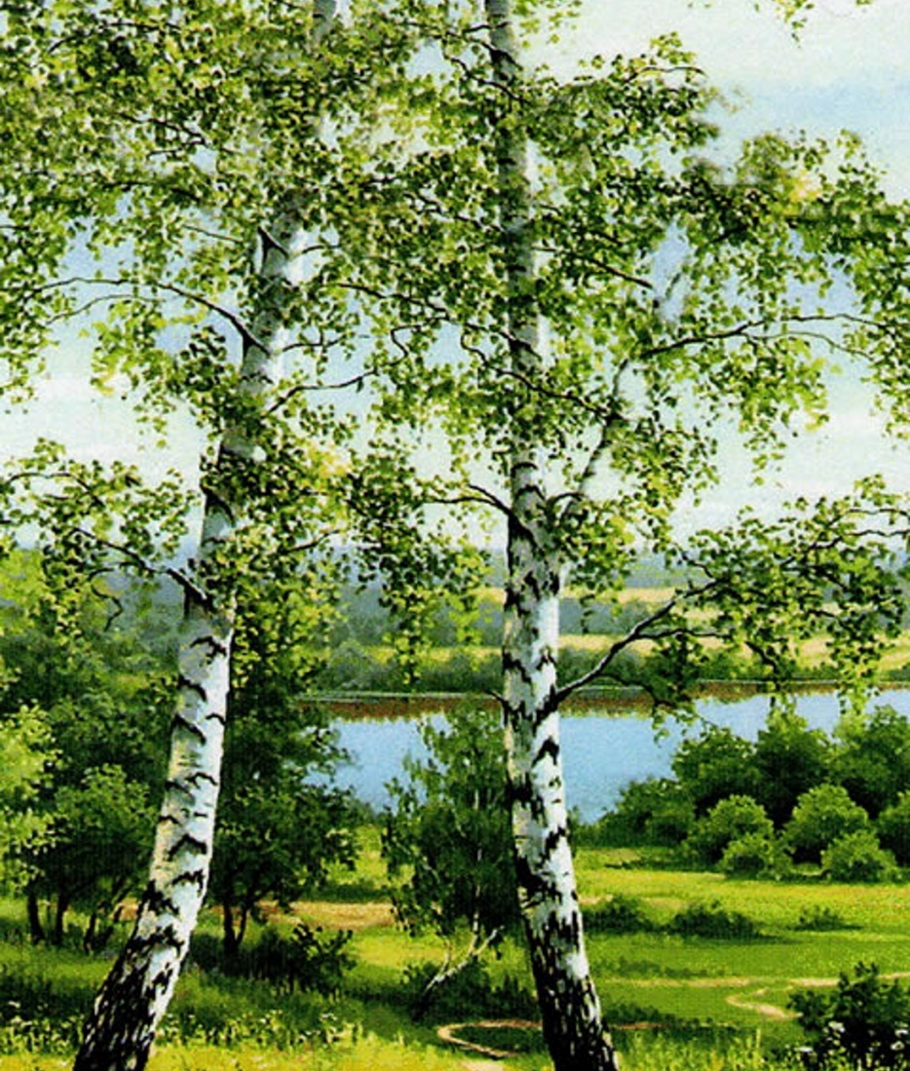
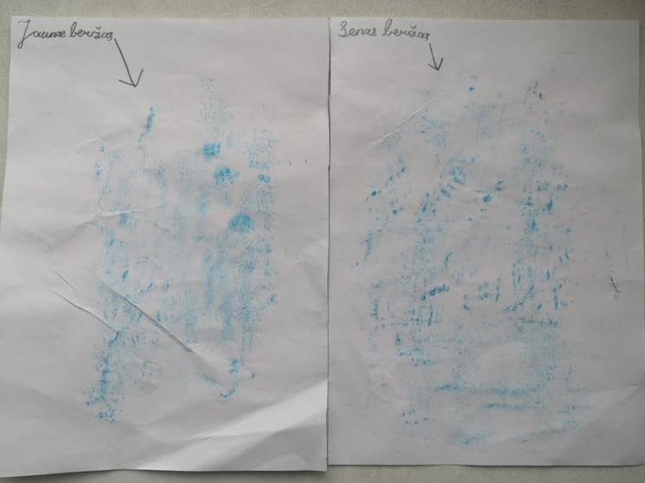
Birch tree
The bark of young birch is smoother and smoother than that of old birch.
Birch bark patterns are different from those of other trees, with horizontal streaks and a mottled colour (black and white).

Slide 6
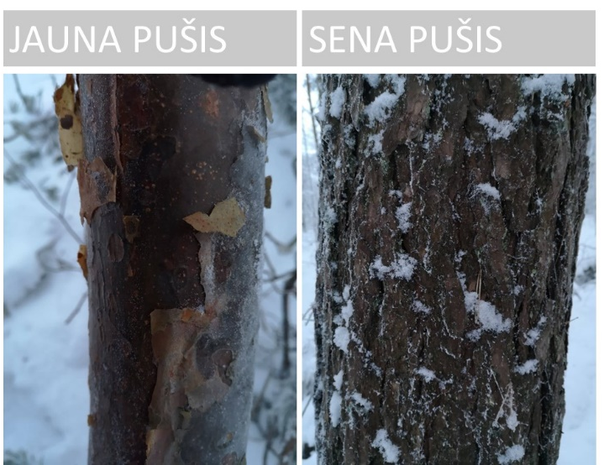
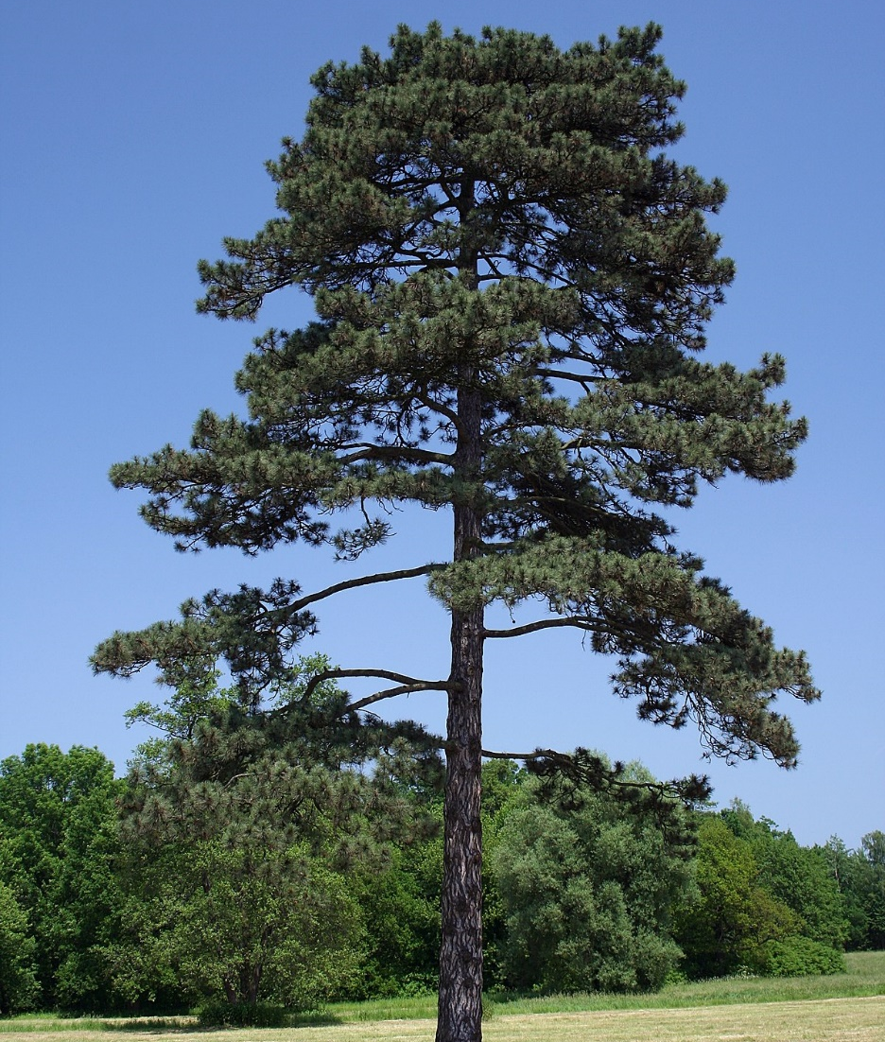
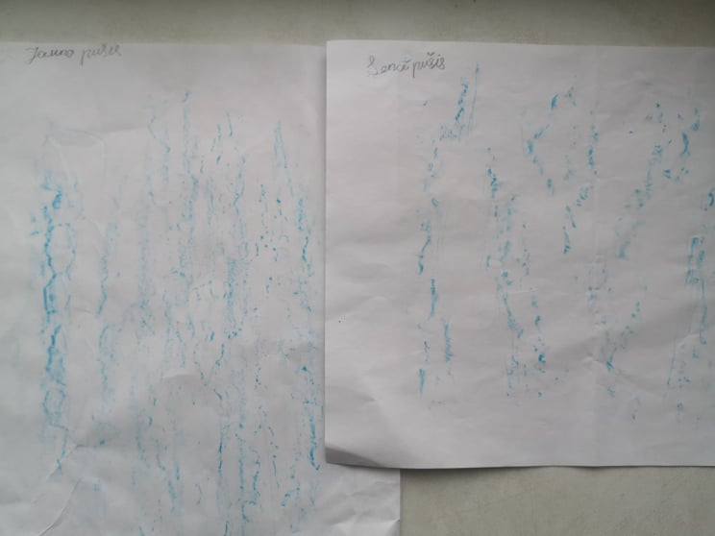
Pine tree
The bark of young pine is smooth, that of old pine rough.
Colour variegated (light and dark brown)
Bark splits visible on old pine are vertical.

Slide 7
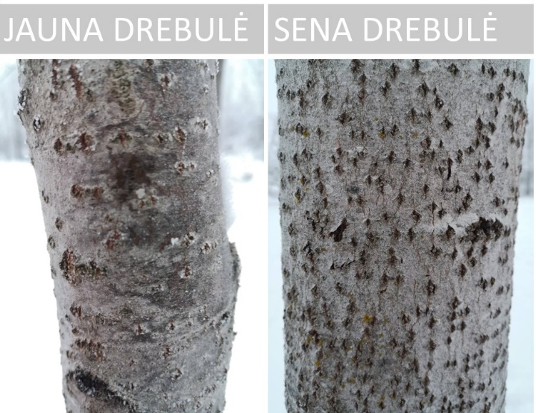
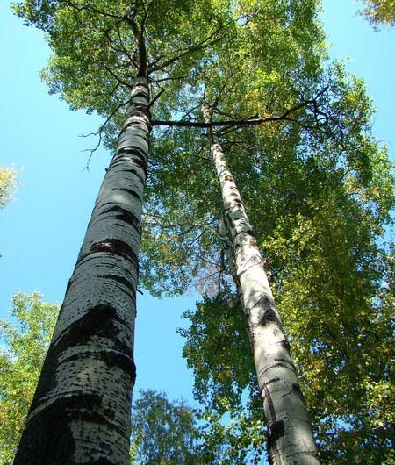
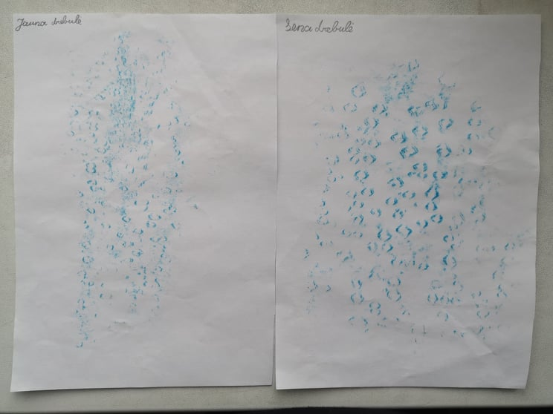
Aspen
The bark of young aspen is smoother than that of old aspen.
As the tree grows, more splits appear in the bark.
The splits in the bark resemble the shape of a circle.
The bark colour is grey.

Slide 8
CONCLUSIONS
The species and age of the tree can affect the formation of wrinkles in the bark of the tree:
With age, the bark of a tree becomes thicker, cracks and becomes rougher.
Different species have different bark patterns.

Slide 9



