Slide 1
THE NORTHERN RED OAK TREE
By Mila, 3rd grade student of Riga Lithuanian Secondary school

Slide 2
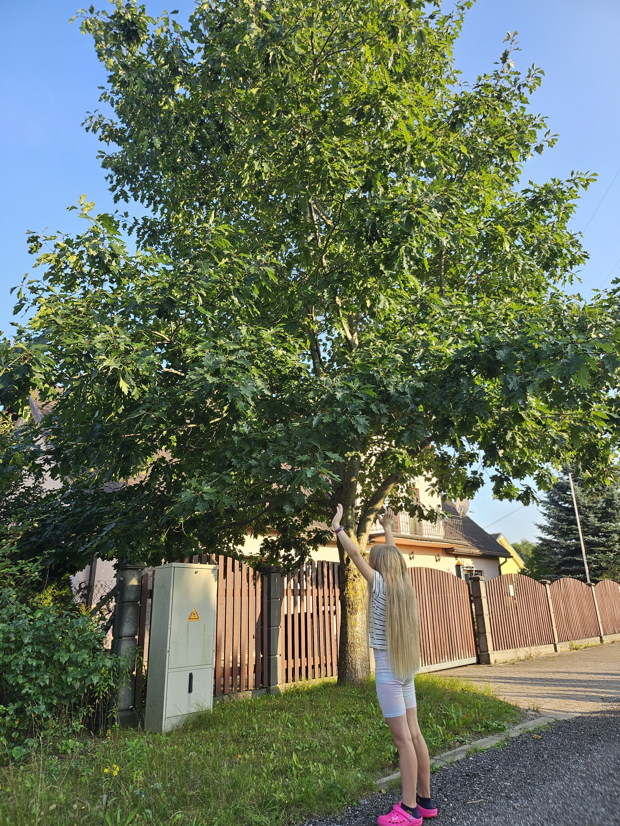
When I think of an oak tree, the first thing that comes to mind is the oak leaves, which resemble an illustrated cloud. However, there are other varieties of oak. There is a Northern red oak near my neighbor’s house in Riga, which is not so common in Europe. I found out some facts about it.

Slide 3
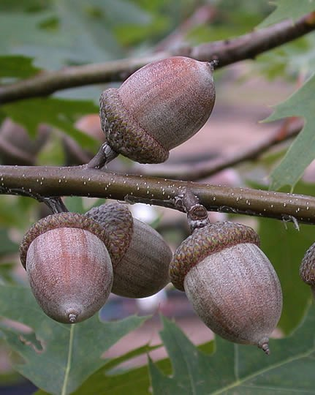
Quercus rubra, the Northern red oak, is an oak tree in the red oak group. It is a native of North America, in the eastern and central United States and southeast and south-central Canada. It has been introduced to small areas in Western Europe, where it can frequently be seen cultivated in gardens and parks.

Slide 4
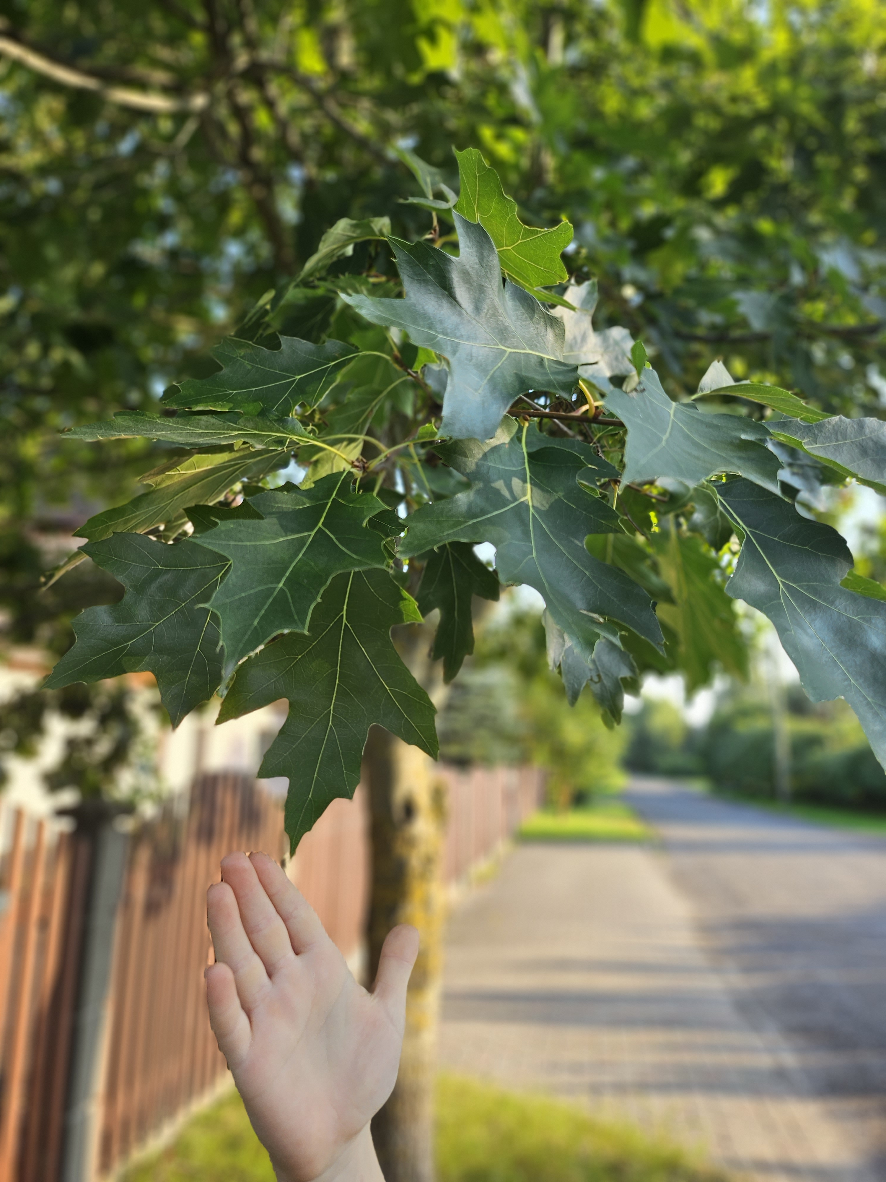
Facts
Red oak is a deciduous broadleaf tree.
It can grow to 25m and develops a rounded crown.
The red oak is one of the faster growing oaks.
It is often planted as an ornamental tree for its flaming autumn color.
The leaves are handsome throughout the year, emerging pinkish-red, turning lustrous dark green in summer, and changing to russet-red to bright red in autumn.
Acorns are an important winter food source for squirrels, deer, wild turkeys, and several songbirds.

