Slide 1
FACTS ABOUT TREE SEEDS

Slide 2

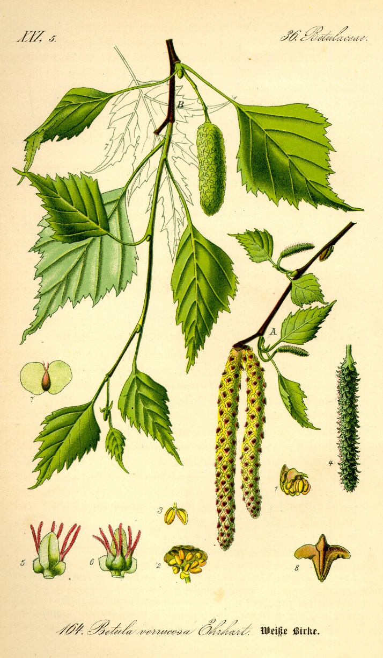
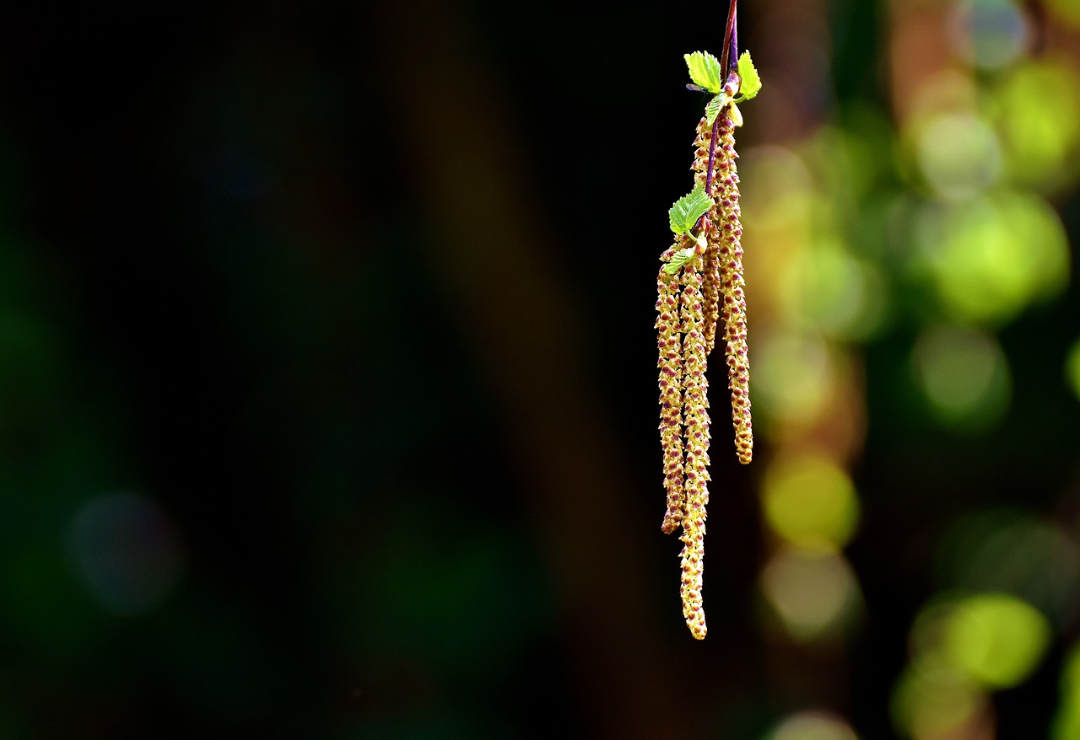
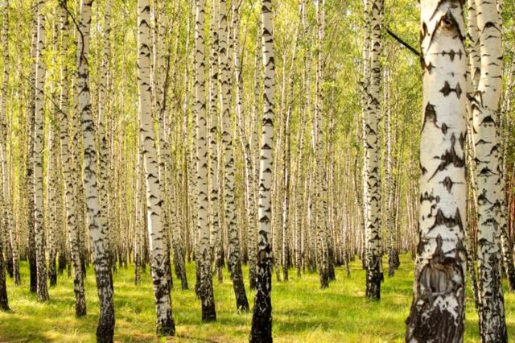
A mature birch tree can spread about one million seeds a year.

Slide 3
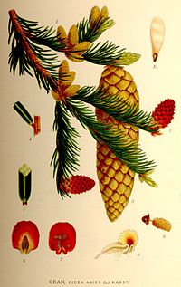
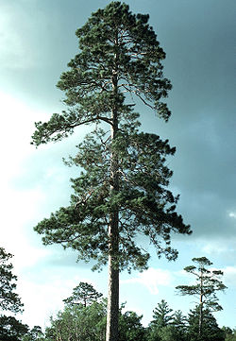
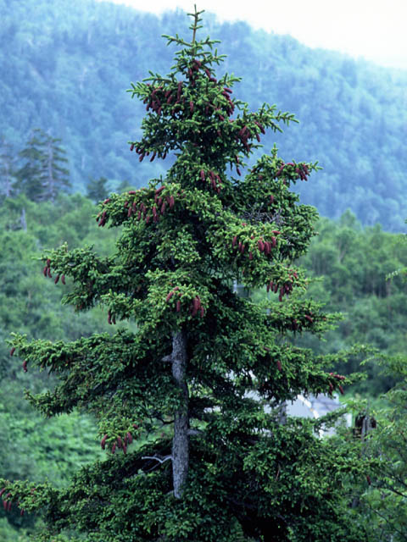
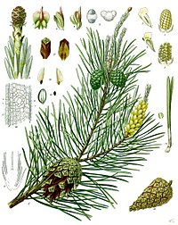
The seeds of spruce and pine trees ripen in cones. They are small and have transparent wings. As the seeds fall, they fall all around and are carried by the wind to different places.

Slide 4


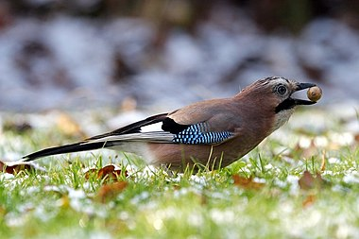
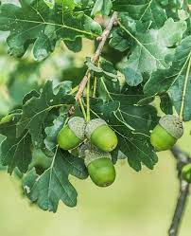
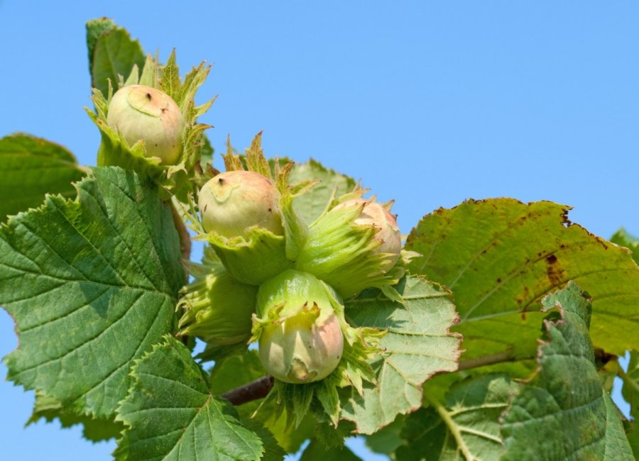
The crested woodpecker hides oak acorns and hazelnuts in the autumn in moss and under clods of earth. This is how the birds prepare their winter supplies. Some of their hidden treats are no longer found, so trees grow out of them.

Slide 5

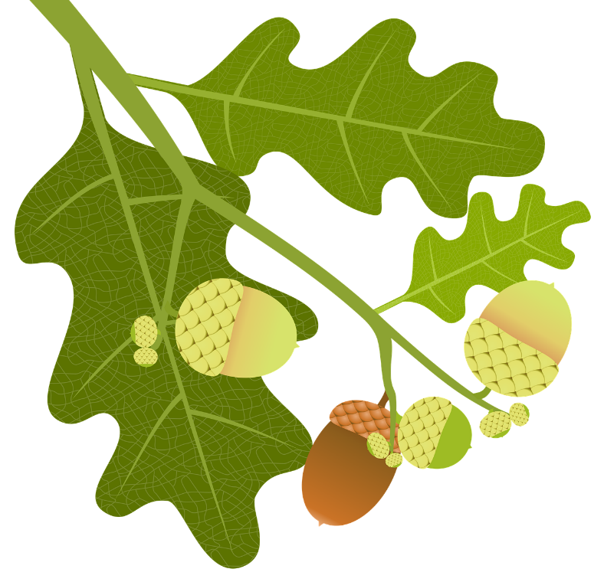

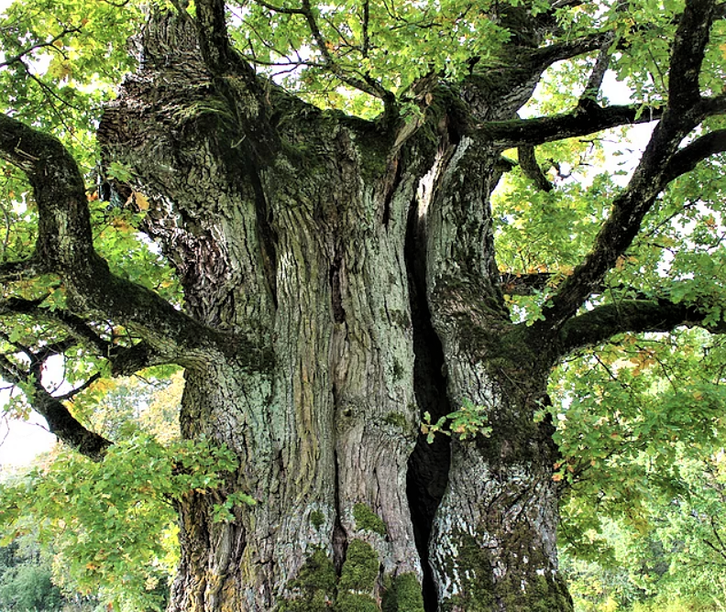



A seedling can grow into a mighty oak tree. Like the Stelmužės Oak.

Slide 6
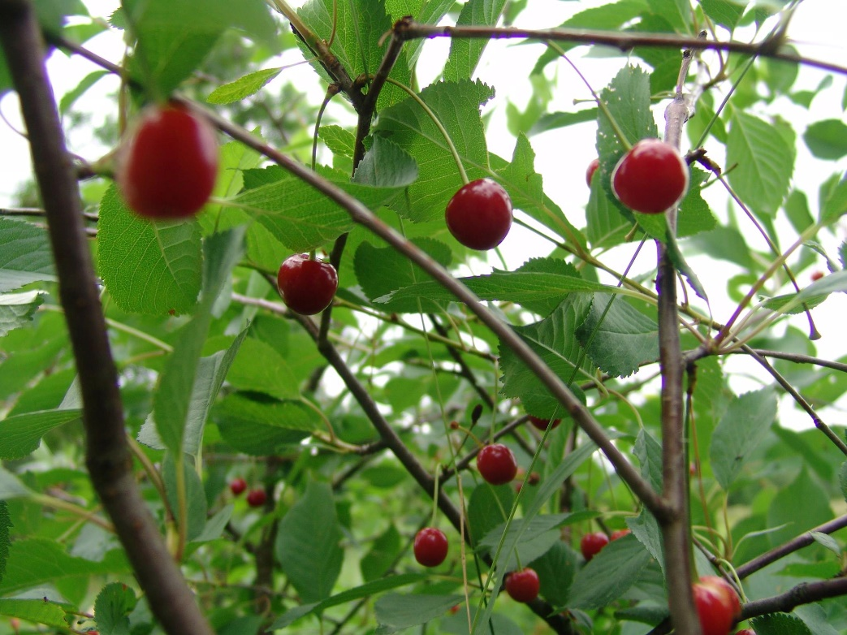
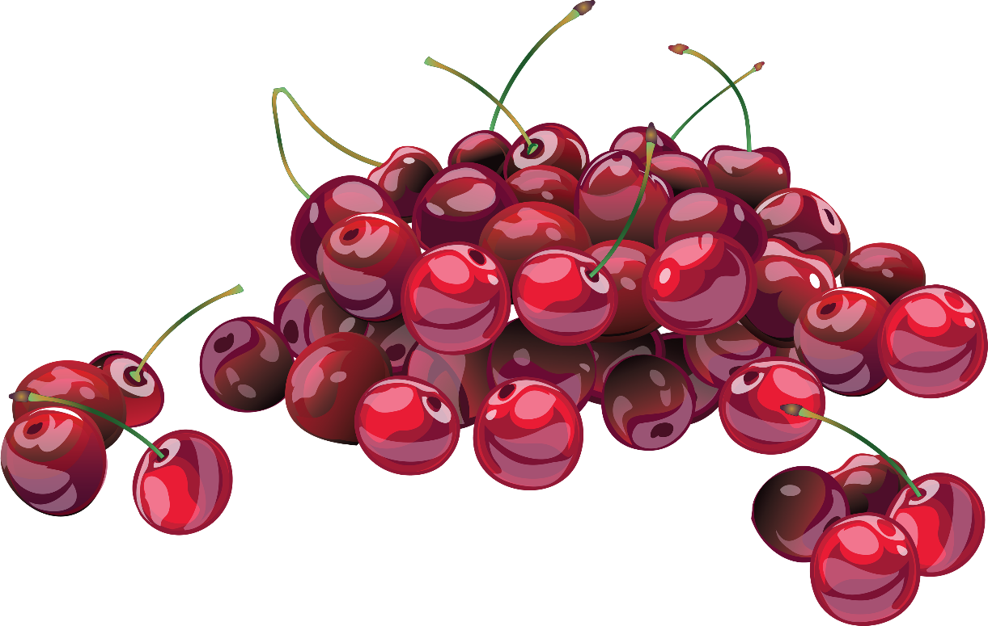
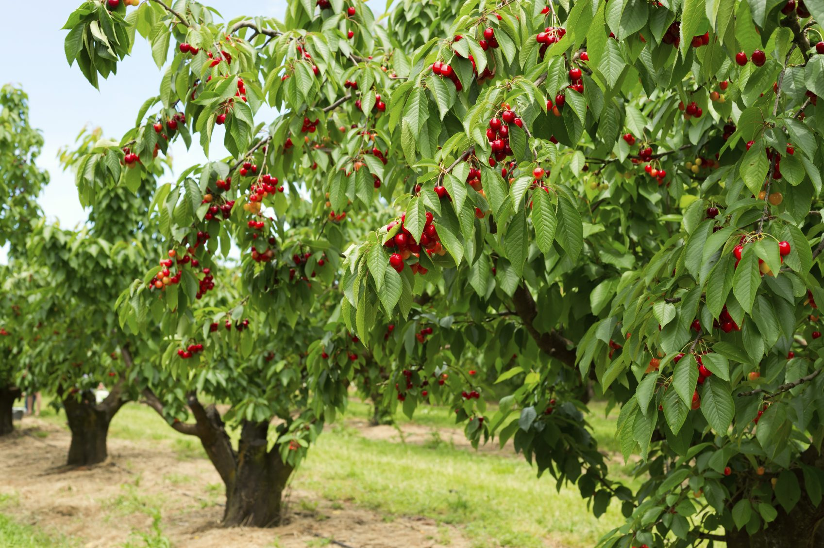

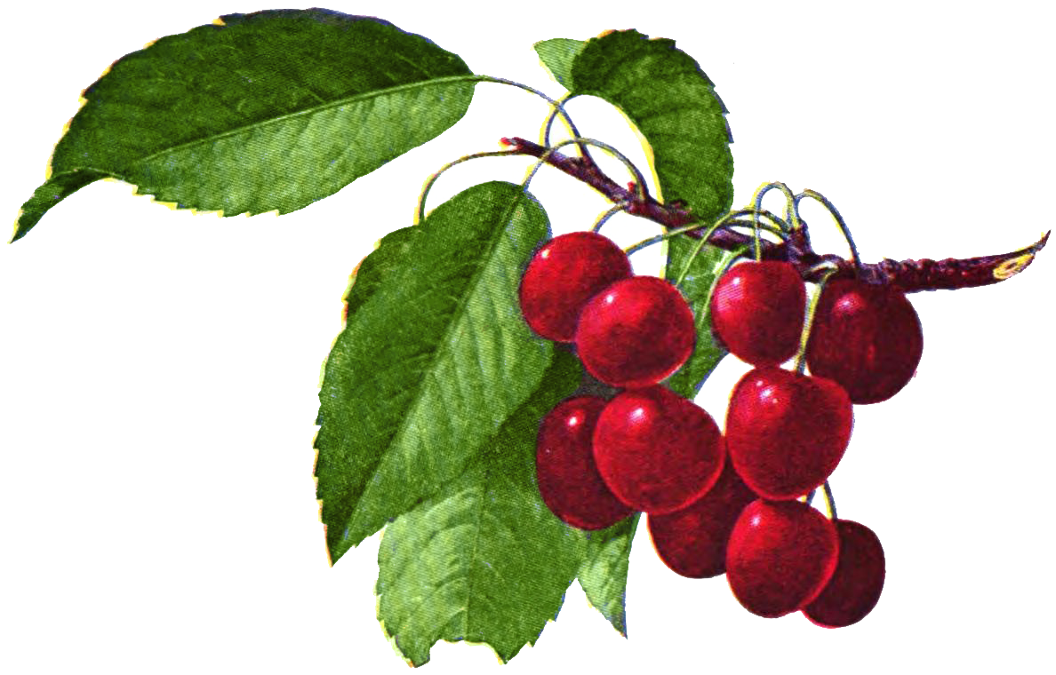
Each cherry has one stone. The seed in the pit can grow into a new cherry tree.

Slide 7
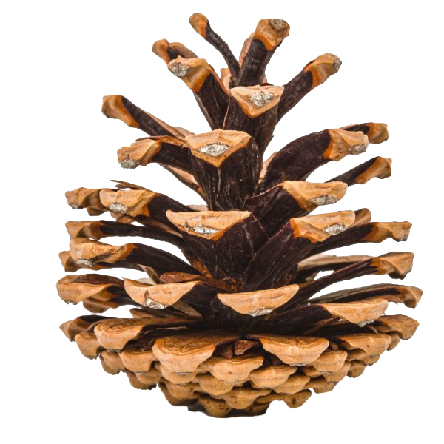
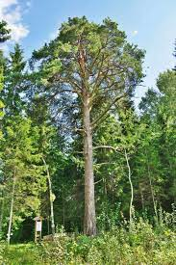
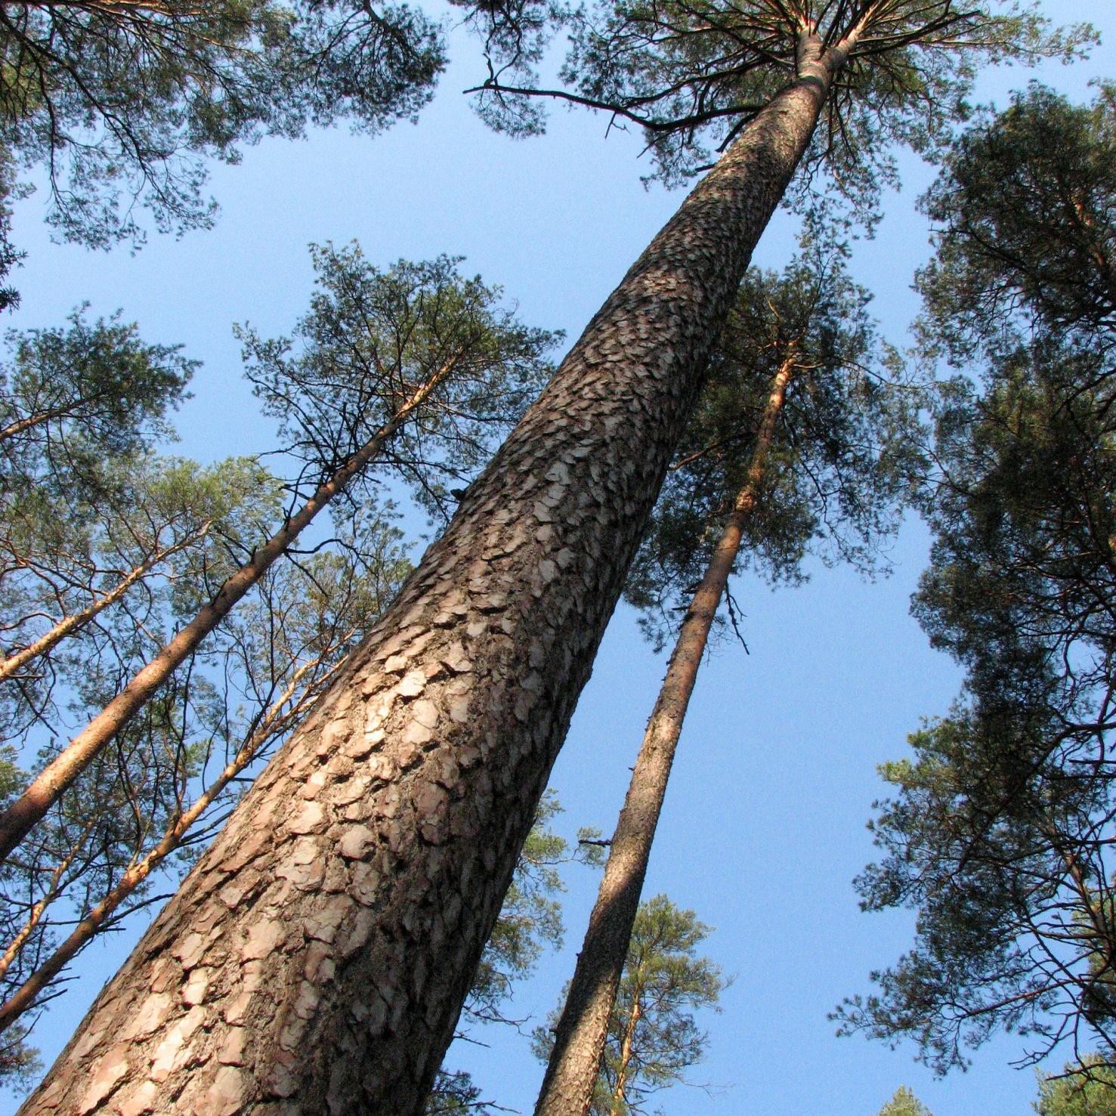
It takes only a few years for pine cones to produce all their seeds.

Slide 8

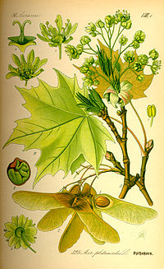
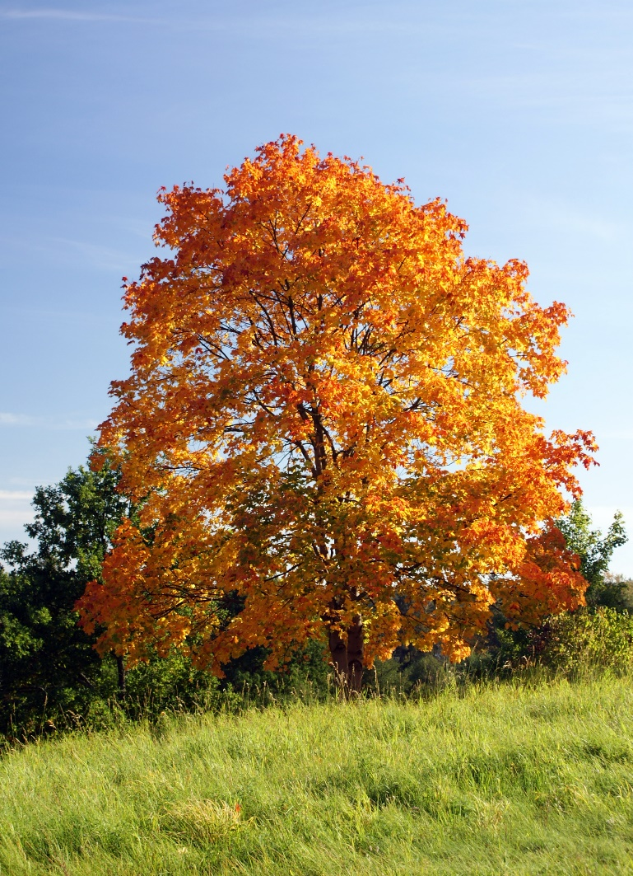
Klevo sėklytė turi du plėviškus sparnelius. Pučiant vėjui ji gali nuskristi labai tolKlevo sėklytė turi du plėviškus sparnelius. Pučiant vėjui ji gali nuskristi labai toli, o atrodo kaip mažas malūnspaarnis.i, o atrodo kaip mažas malūnspaarnis.

Slide 9

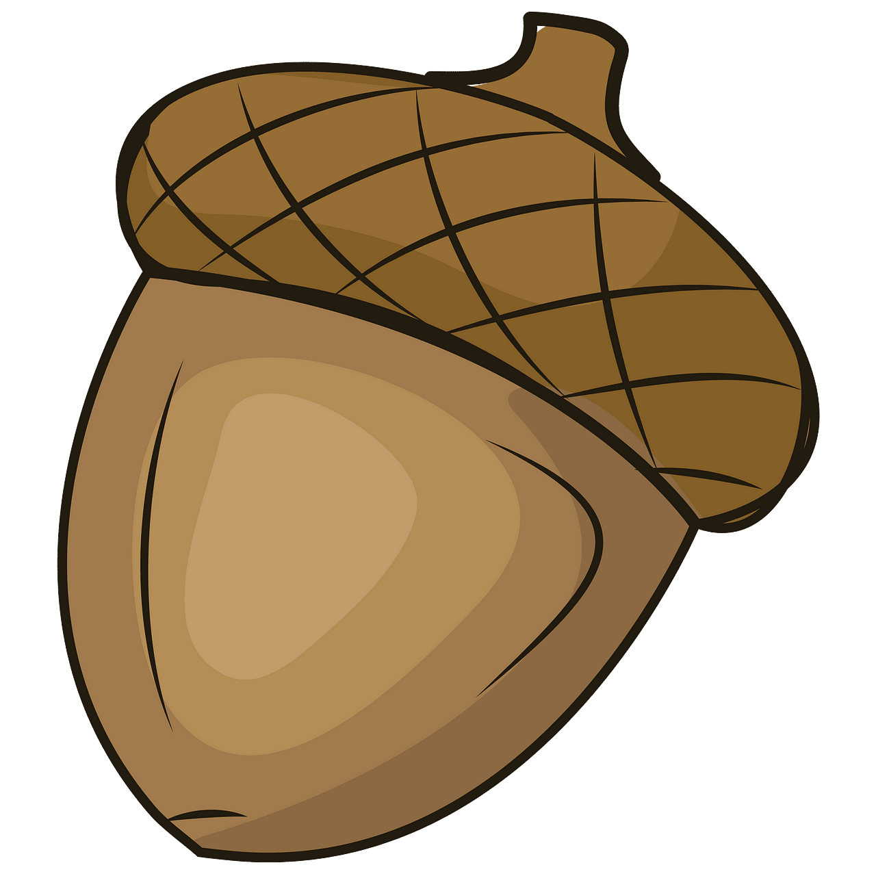


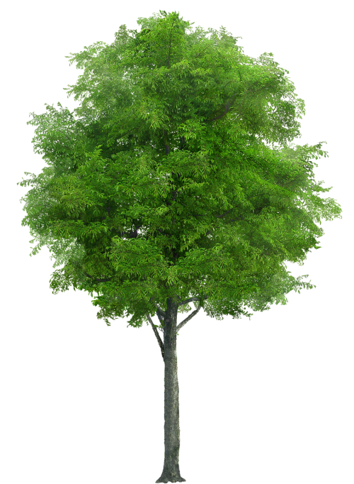


THANK YOU FOR YOUR ATTENTION
Elžbieta Augutė

