Slide 1
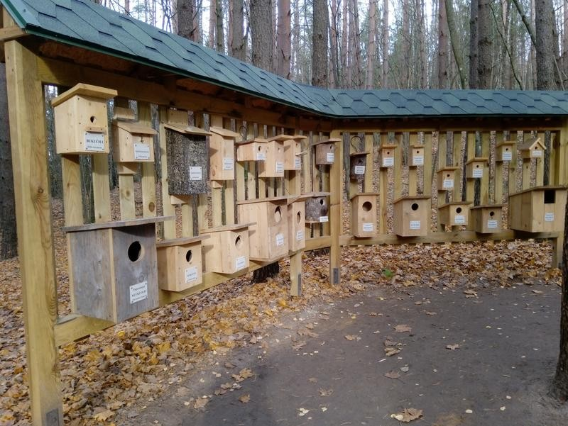
Modern "hollow"
by
Lėja Kavaliauskaitė ir Gabrielė Meškaitė

Slide 2
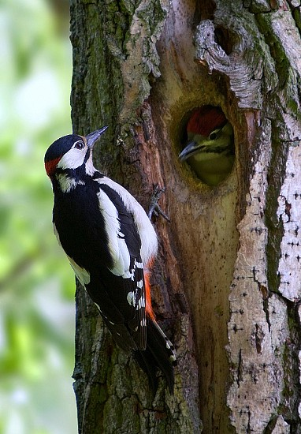
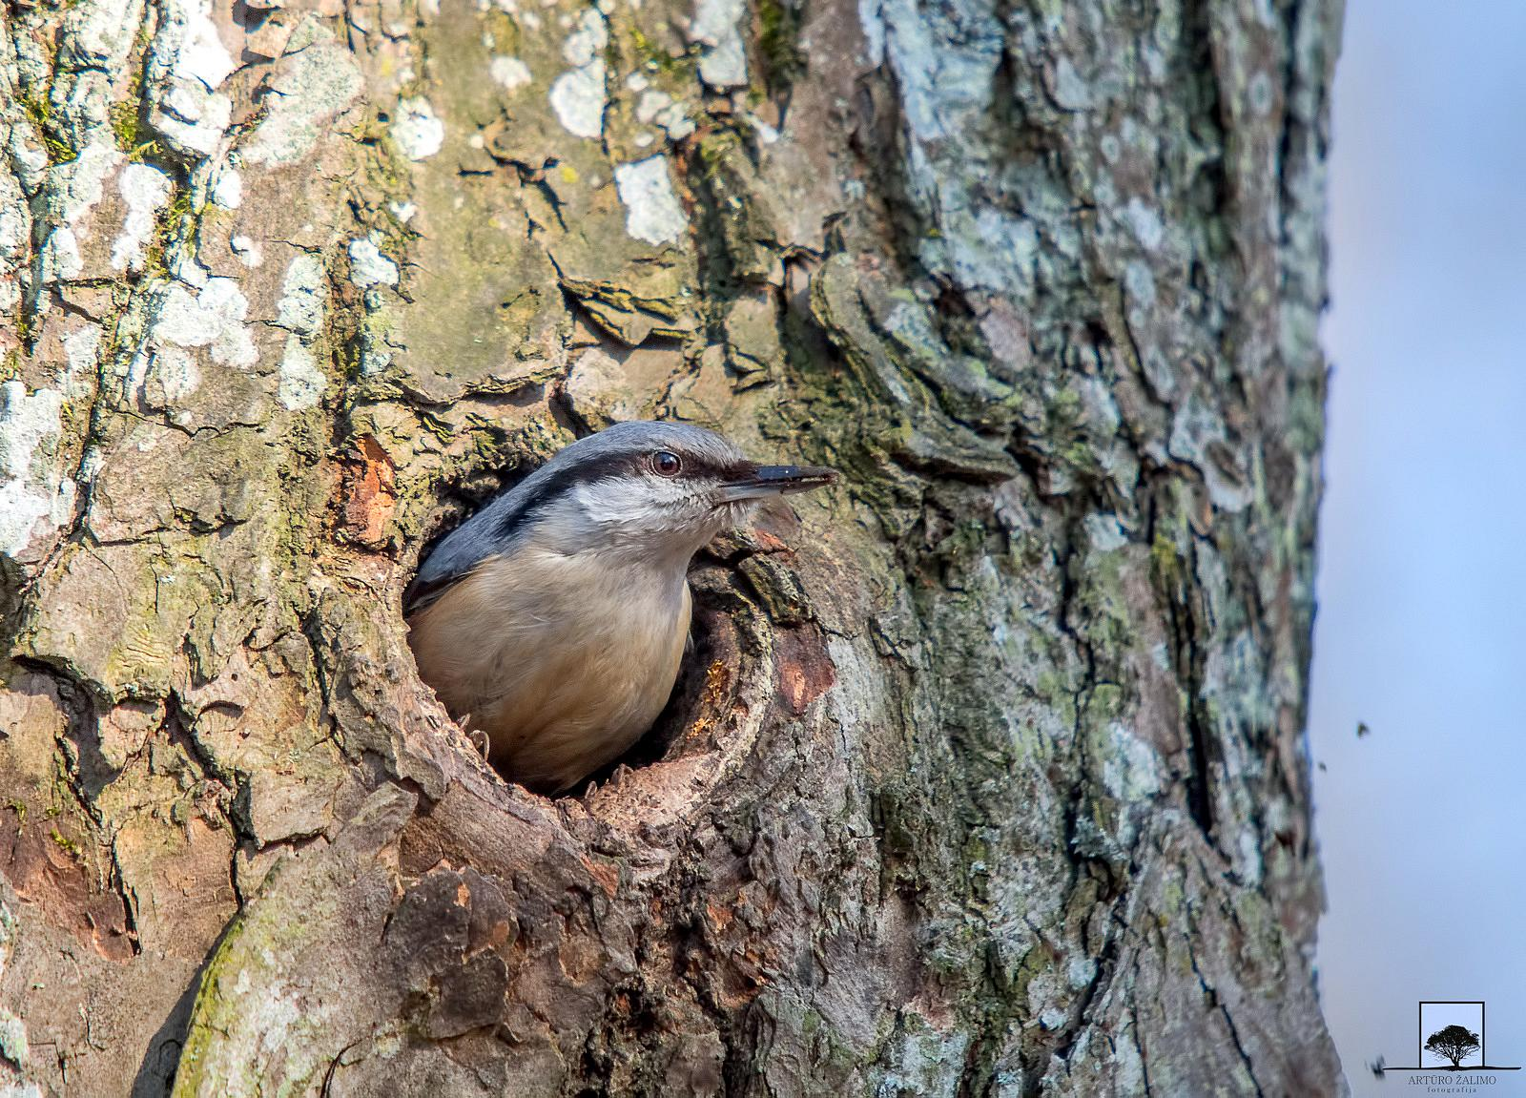
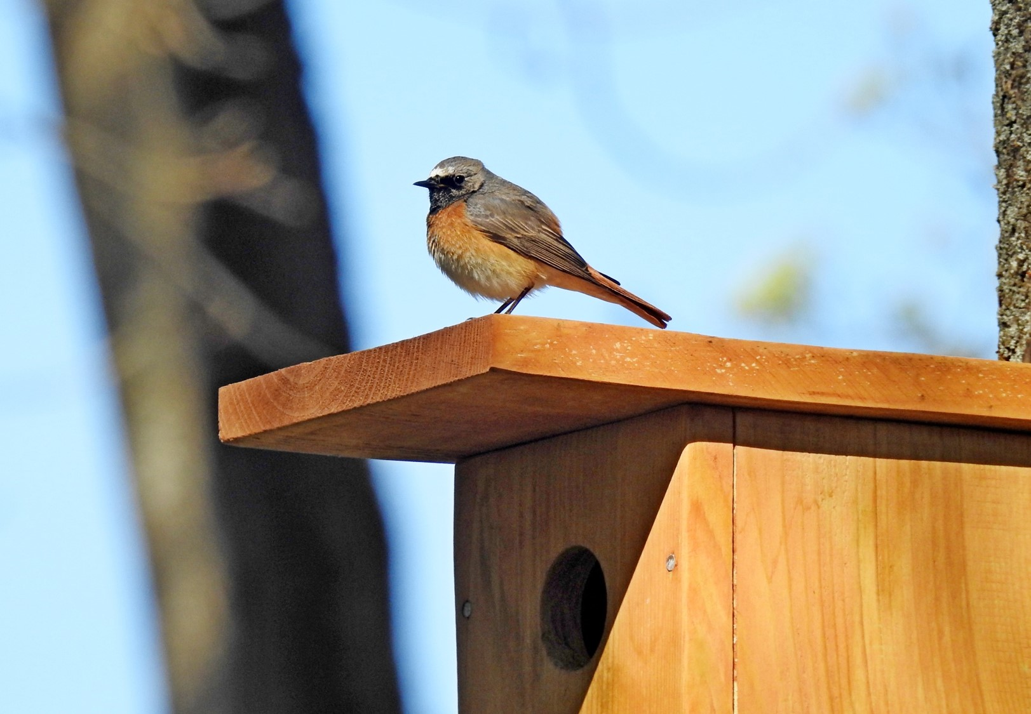
Trees are the home and refuge of birds. Those that don't build nests, raise their children and hide from predators in hollow trees. An anvil is an imitation of a hollow. People have started to make nest boxes because intensive deforestation leaves no old trees left to form hollows, so birds have nowhere to live and breed.Nesting boxes are made of wood. The inside of the nest box must be made of planks that have not been planed. This is to make it easier for the birds to get out of the nest box when they have grown up.

Slide 3
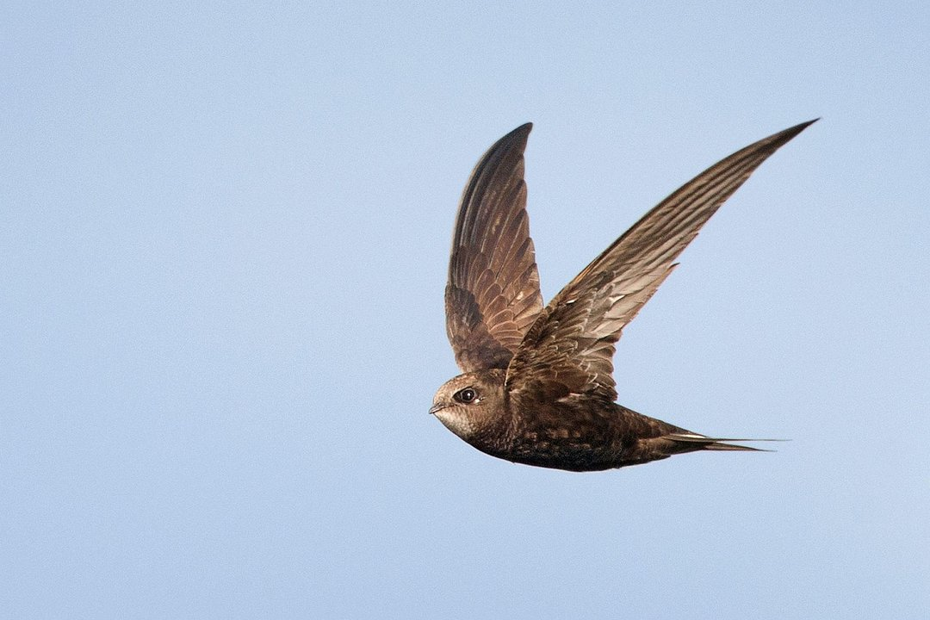
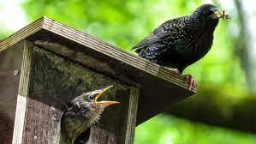
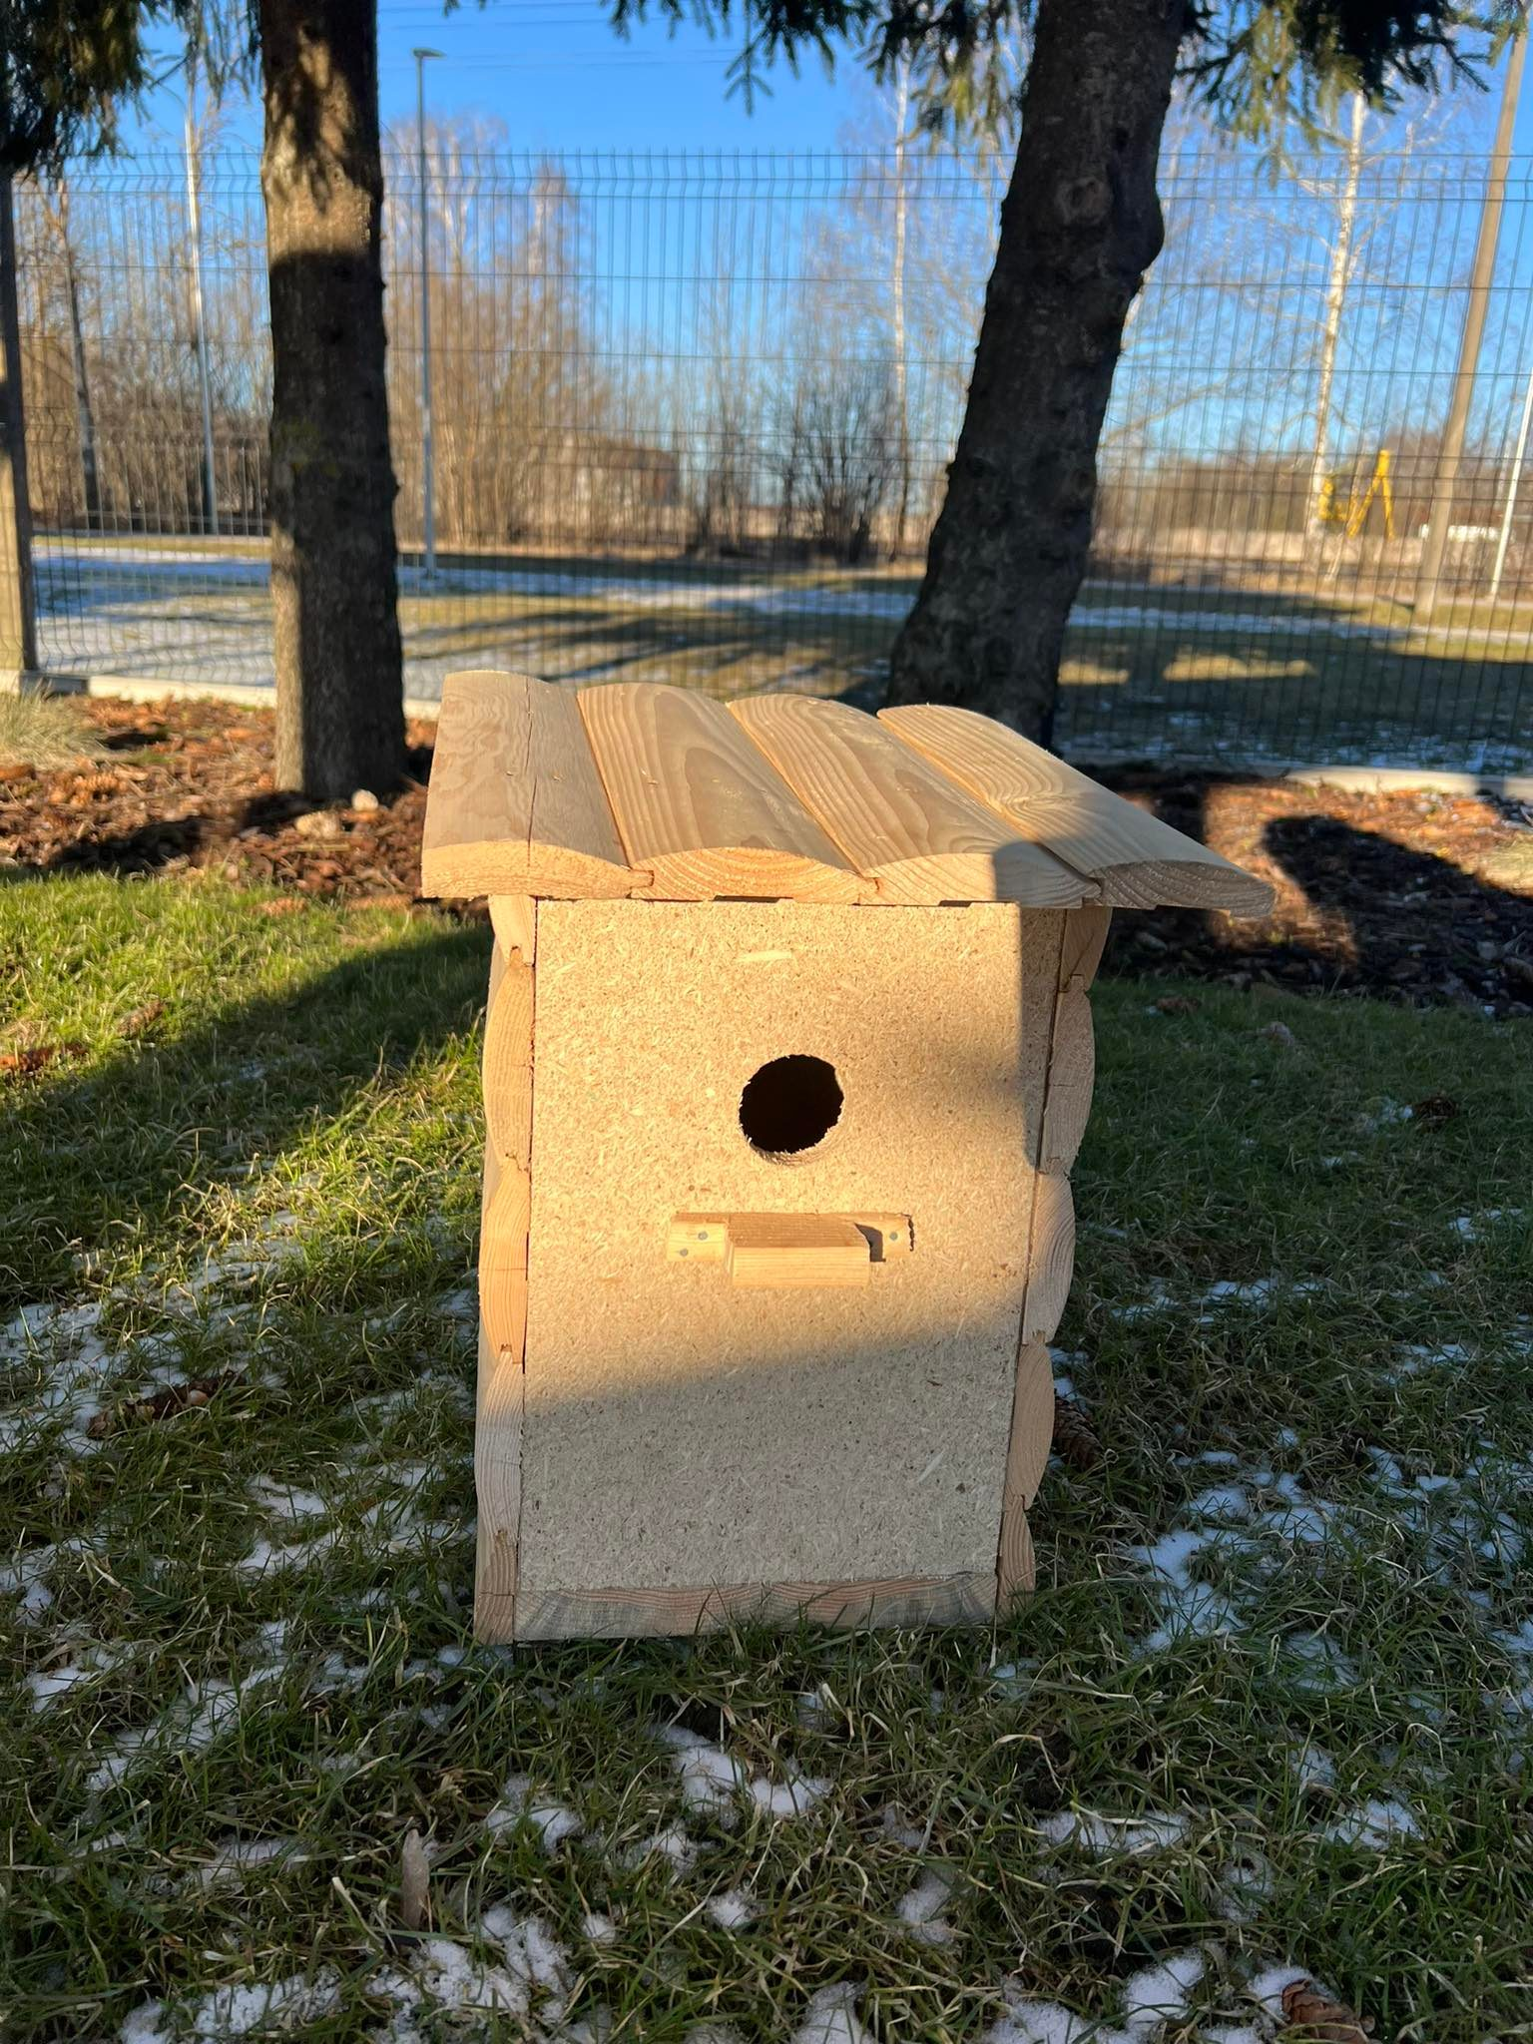
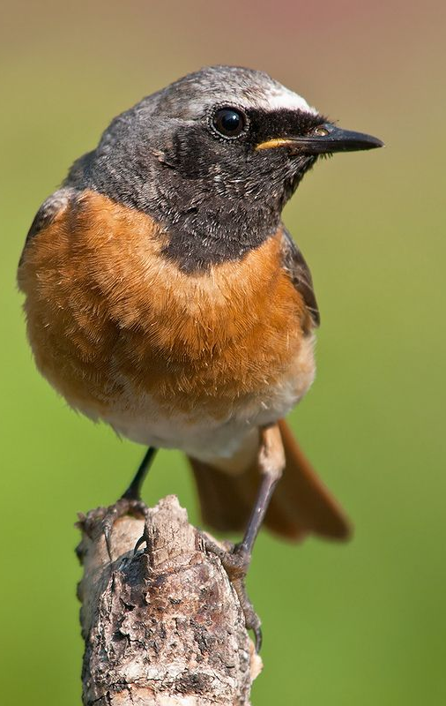
Different sizes of nest boxes are made for different birds. For example, our nest box is designed for birds that are quite small: the starling, the common redstart, the blackcap. The size of the nesting box (diameter) is 5 cm. In contrast, for example, the nesting box for Barn Owls must be square, with one side of the box measuring 17 cm.

Slide 4
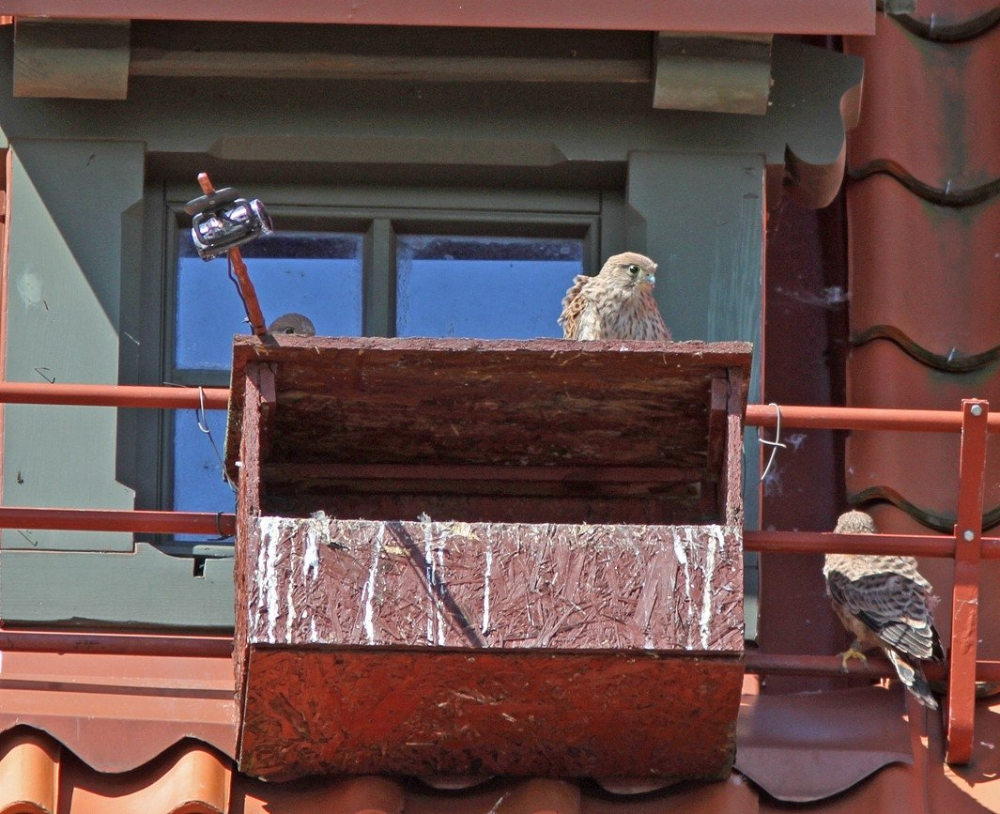
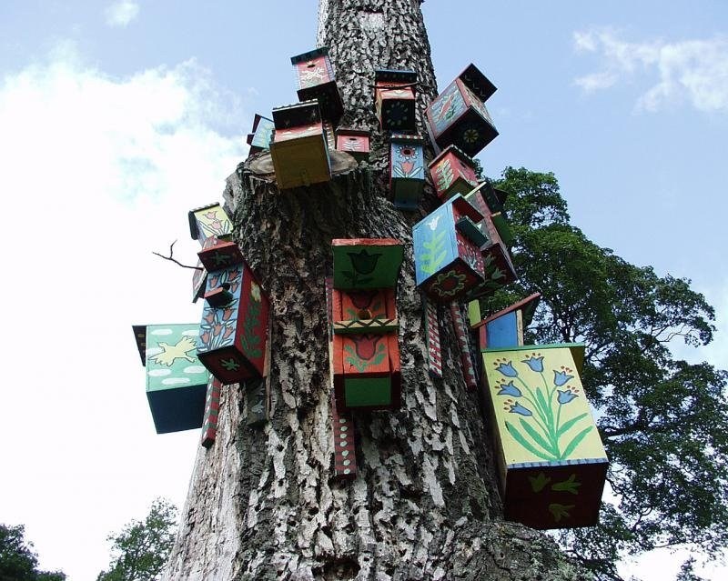
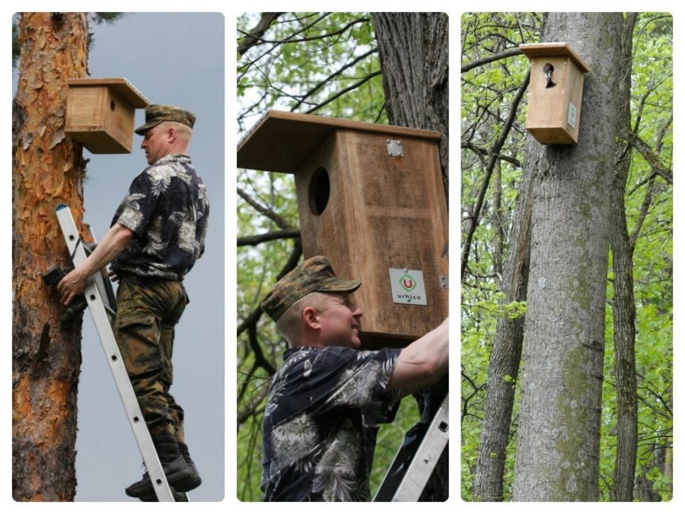
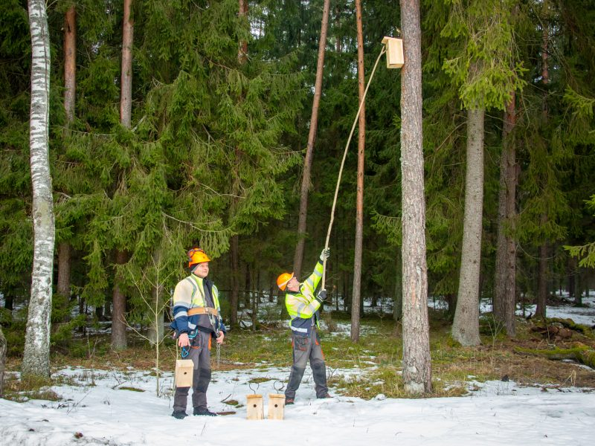
It is very important to raise the nesting box correctly. Some birds also need wood chips to be added to the inside.Nest boxes can be placed in forests, parks and gardens, but the location of the nest box depends on what it is for. Barn Owls and Barn Owls need old forests, while starlings need woodlands, gardens and parks. Roosts also need to be maintained. If we do not clean the nest boxes, the birds are cramped to breed, and parasites develop over time as the conditions are favourable for them to breed.

Slide 5
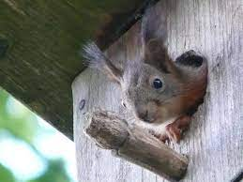
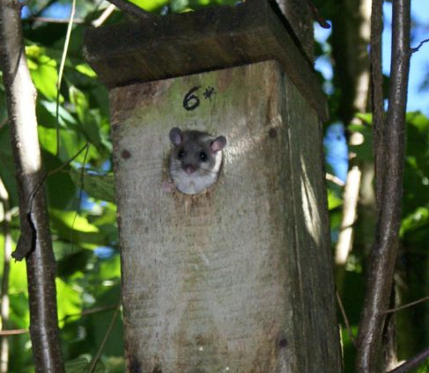
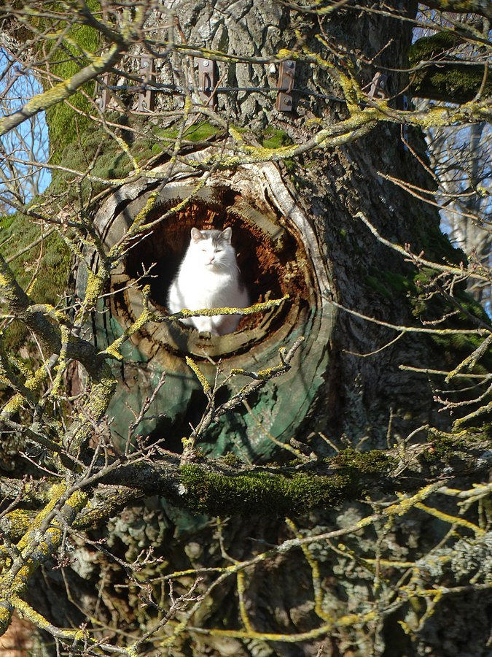
Nesting boxes are not only useful in spring, when birds return from warmer climes and prepare to breed. Like hollows, it is not only birds that spend the winter in nest boxes. The anchors can also be used by dormice, bats, ants, bumblebees and wasps.

Slide 6
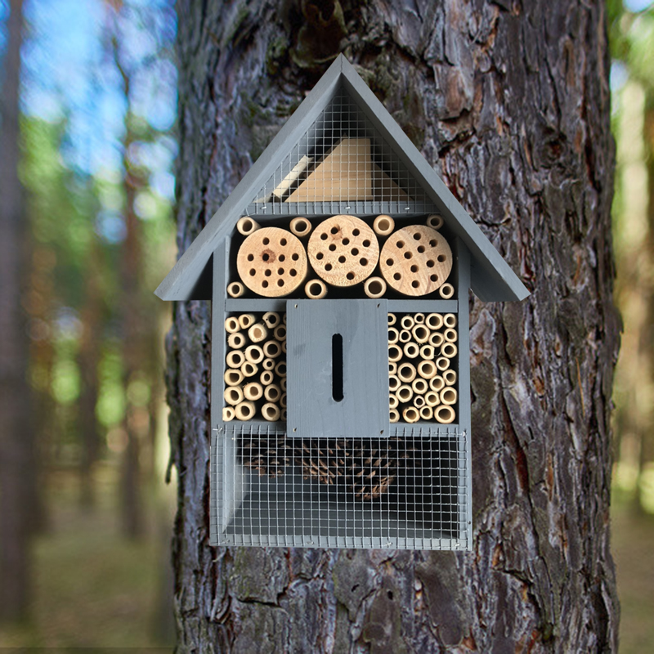
Nest boxes are not just for birds. More and more houses are also being built for bugs. They also miss old forests and old, decaying trees.

