Slide 1
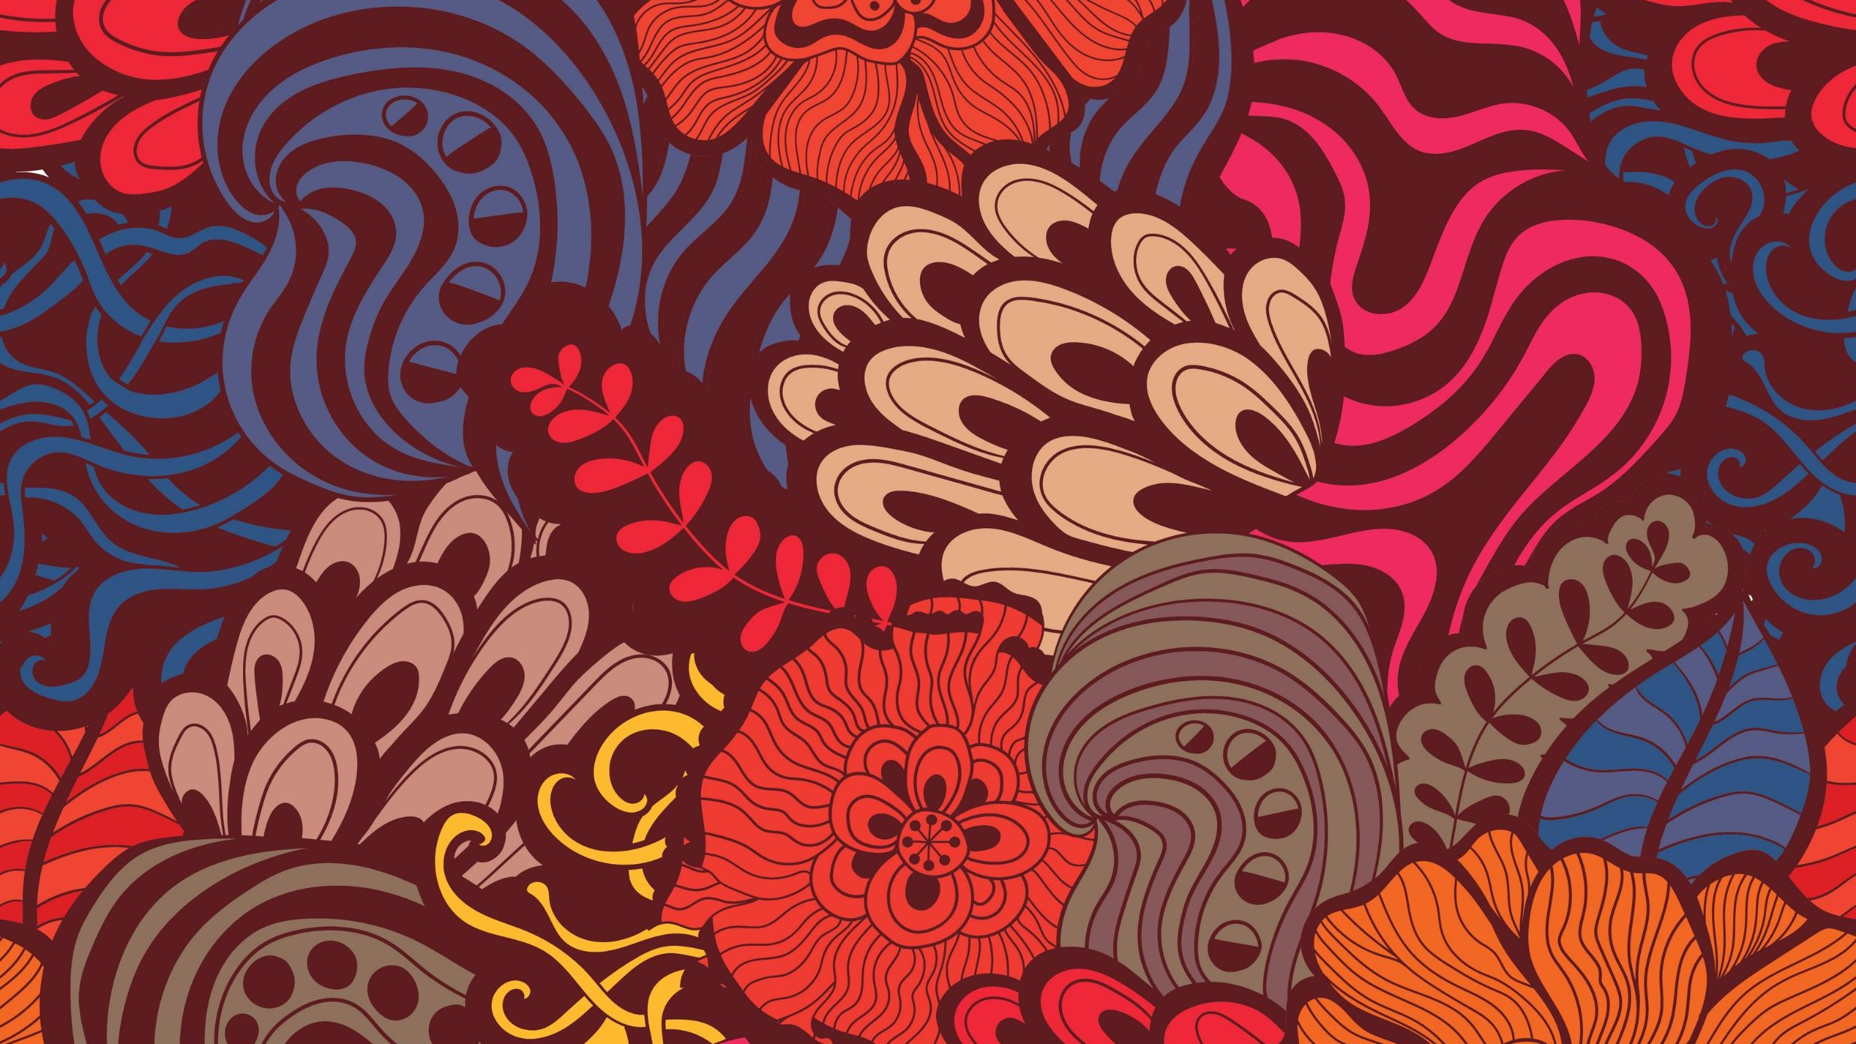
THE "BRANCH TREASURE" GAME
By Esmilė Garbaliauskaitė

Slide 2
PREPARATION FOR THE GAME
Summary. Branch Treasure is a lively game that teaches mindfulness.
Materials. Depending on the number of players, you will need about 20 sticks of the same length per player. Some of the sticks (for example 7 out of 20) are specially marked. Preparation. Prepare in advance sticks of equal length. Approximately 20 sticks per player are needed. Colour one end of seven sticks (out of 20). A referee and a timer are also needed.

Slide 3
RULES
Players line up at the starting line.
The referee scatters the sticks in an area.
The referee takes a timer and announces the start of the game.
Within 15 seconds, the players collect the sticks.
Players must collect only unmarked sticks.
Once a stick has been picked up, it cannot be put back down.
The game is stopped when the time runs out.
Points are counted. 1 point is awarded for an unmarked stick and -1 point if a marked stick is taken.
The player with the most points wins.

Slide 4
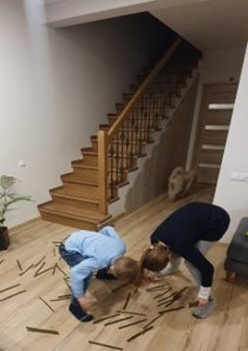
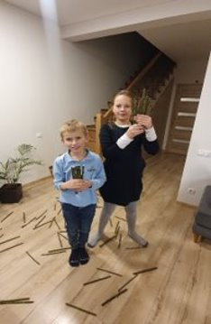
SHALL WE PLAY?

