Slide 1
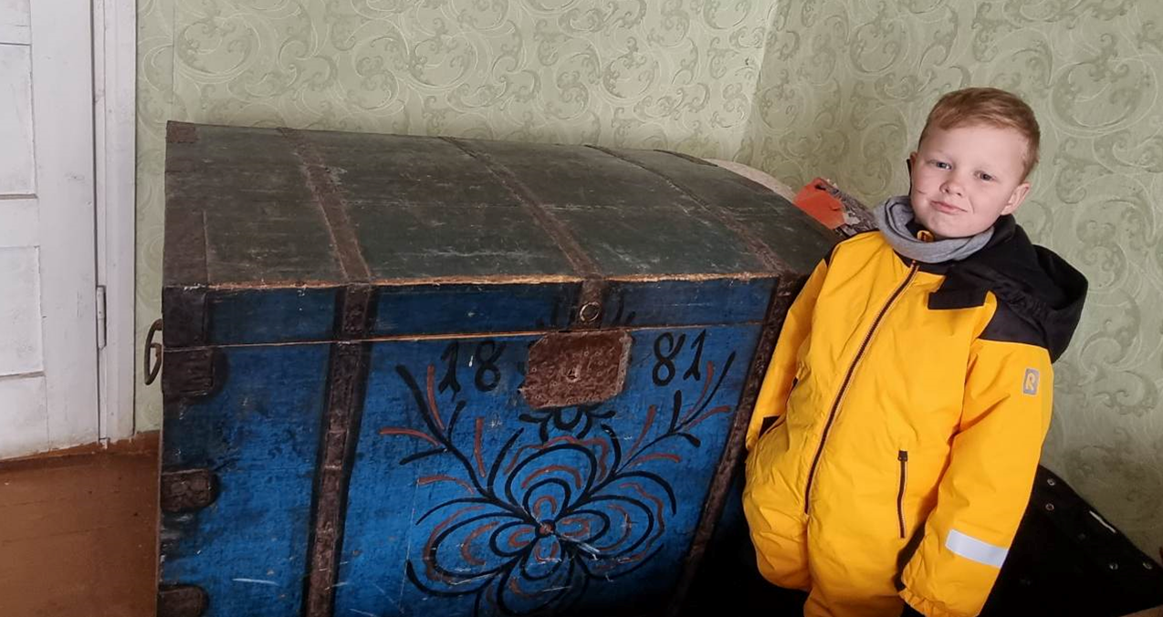
THE TREE OF LIFE ON THE CHESTS OF THE GREAT-GRANDMOTHER
By Kristijonas Bavaras

Slide 2
Lithuanians, like all the peoples of Europe and other parts of the world, have created a rich mythological folklore, complex rites, many working customs, interesting works of art related to the cult of trees.
This is how the Trees of the World and Life appeared.
The tree of life depicts the eternity of life of the Universe, constant birth, death and rebirth.
The mythological Tree of Life is associated with a woman with supernatural qualities or a female deity.
More detailed images of the tree of life as a symbol of eternally endless life were formed with the advent of agriculture.

Slide 3
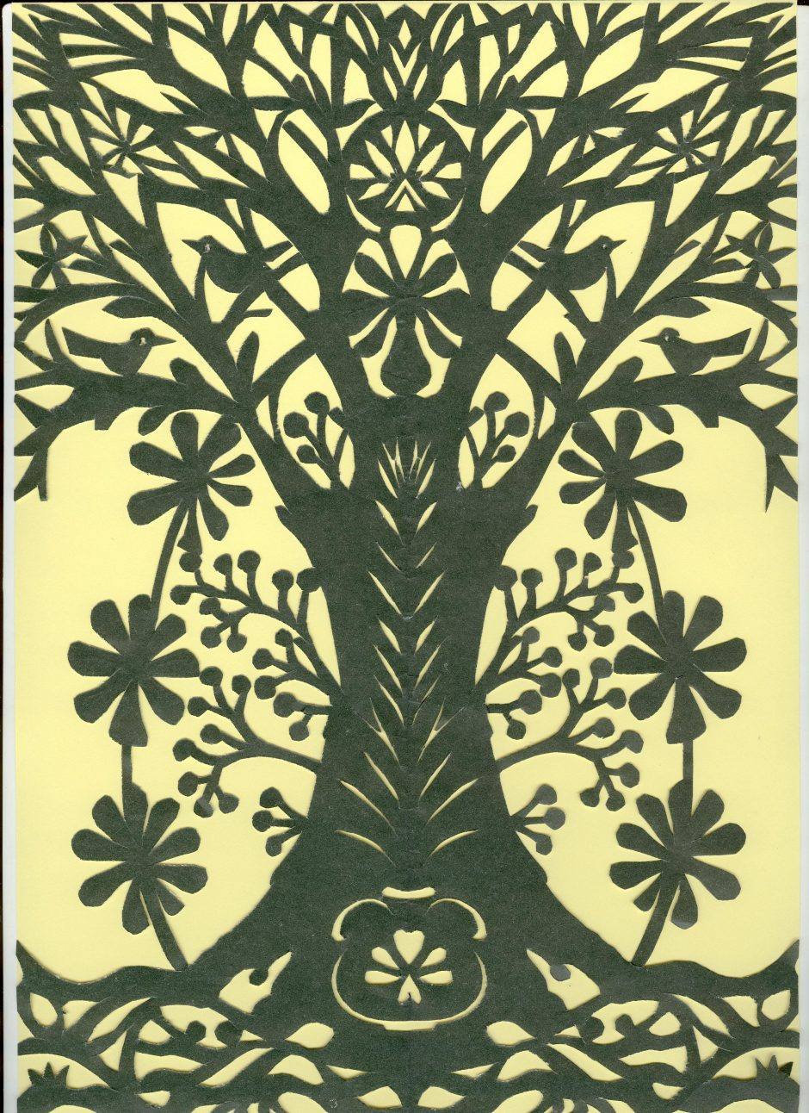
Trees of life are found in Lithuanian art even on the huts, hives, means of communication of the XVIII-XIX centuries, especially on objects intended for women: dowry chests, cabinets, rolling pins, etc.
I visited the house of my great-grandparents, located in pakruojis district, and with my grandfather I looked for dowry chests.
We managed to find one chest with decorative elements still in use even now. The ark was made and drawn in 1881 (in the XIX century).

Slide 4
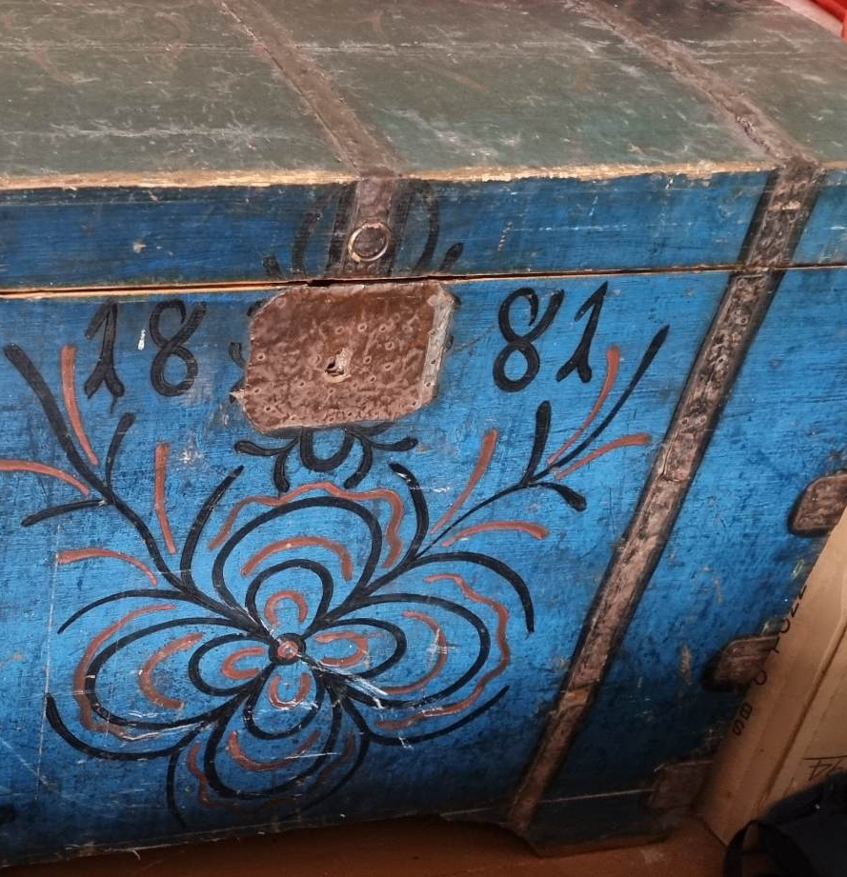
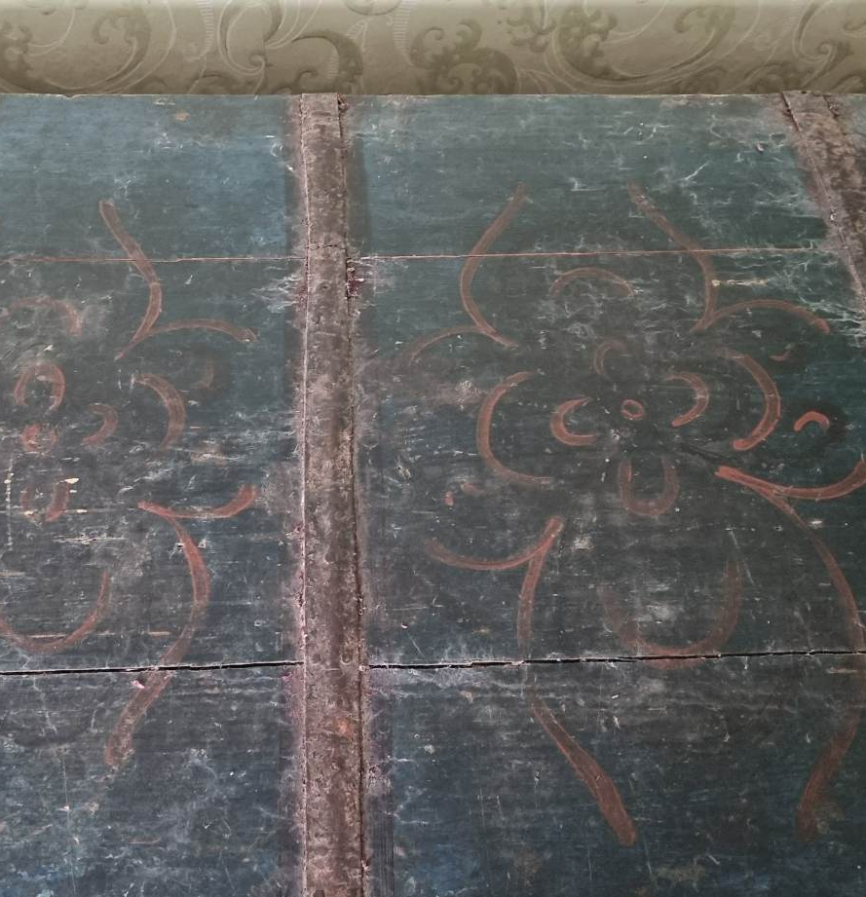

Slide 5
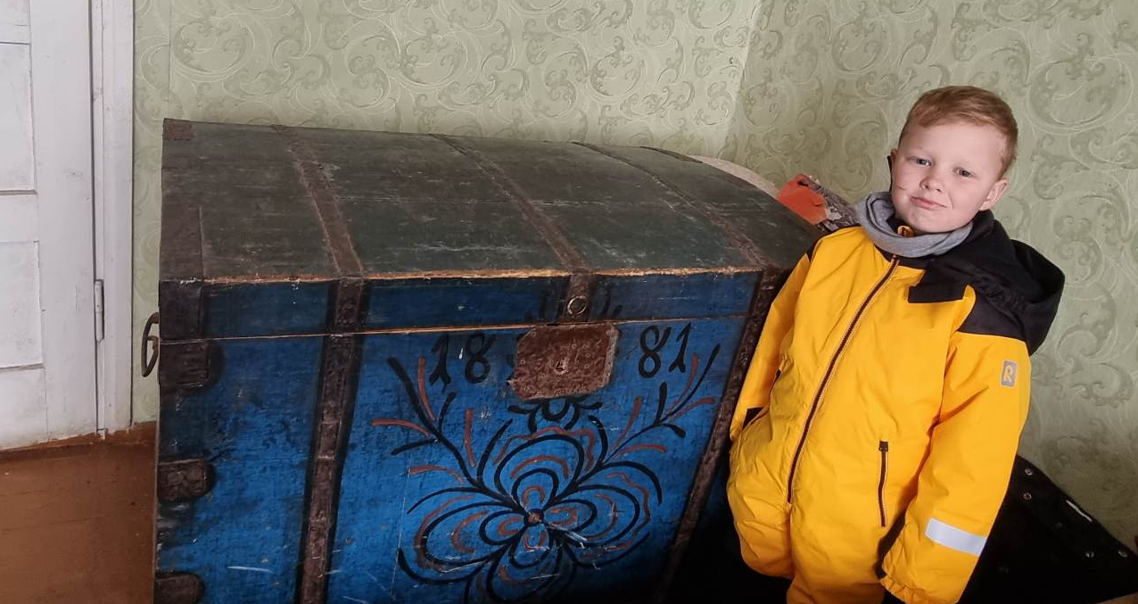

Slide 6
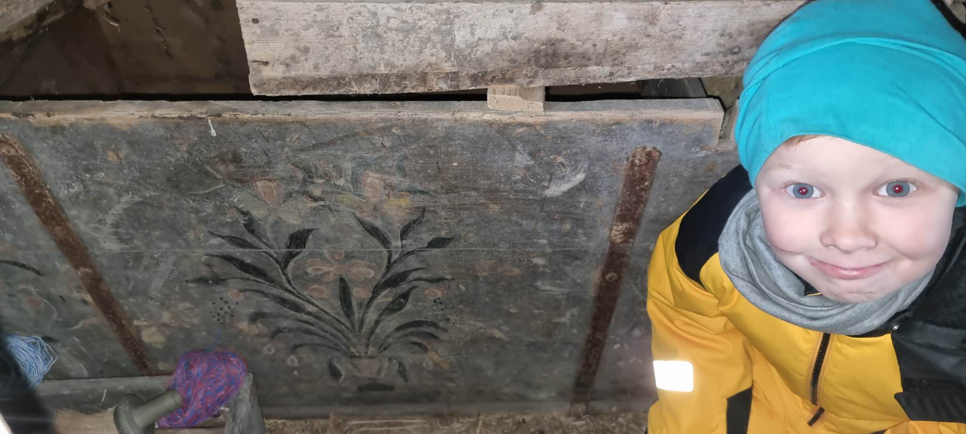
In the attic we also found fragments of one very old dowry chest with elements of the tree of life.

