Slide 1
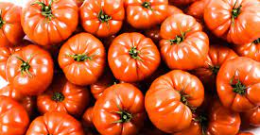
Tomatoes. From sowing to harvest

Slide 2
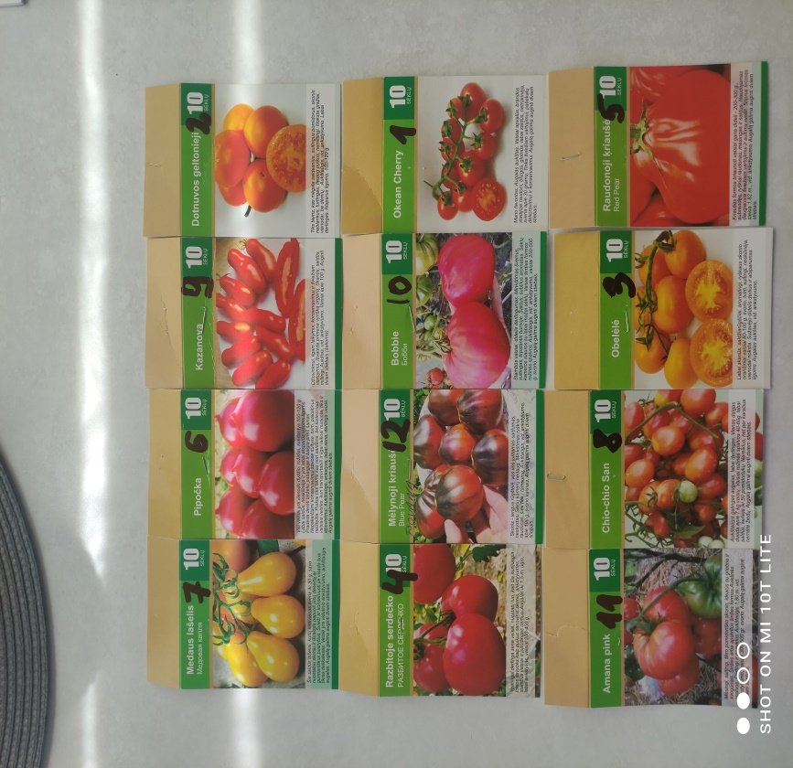
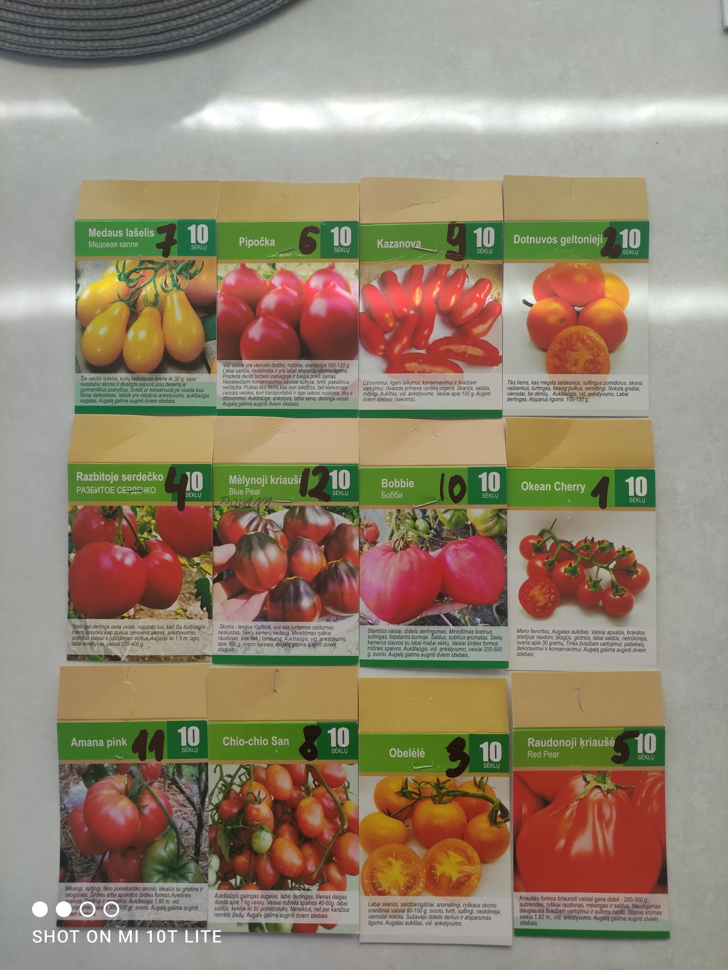
Seeding
Starting the sowing of tomatoes, first of all, our family chooses varieties of tomatoes. The ones we like the most delicious and like the most.

Slide 3
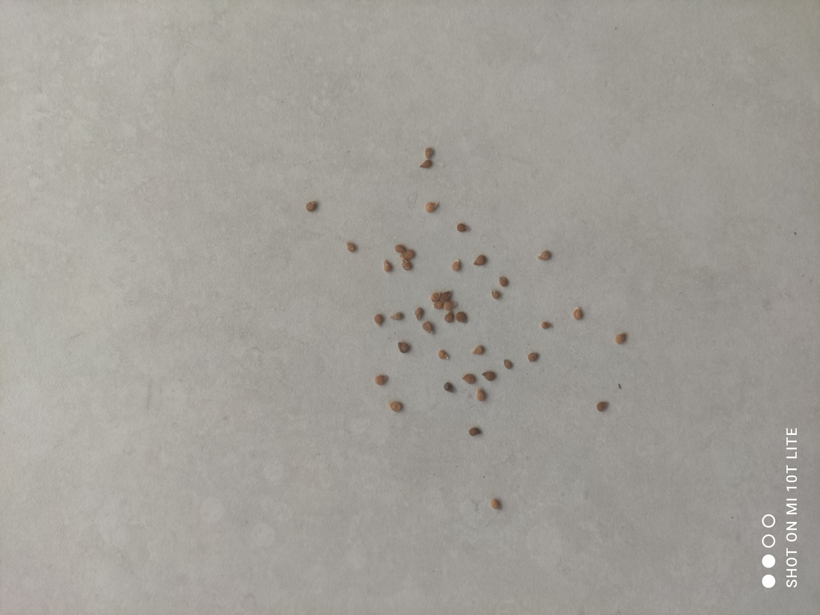
Tomato Seeds

Slide 4
Seeding
We sow the seeds in the middle of March in nurseries, boxes filled with quality universal peat.
Seeds need to be pressed into peat, watered.
The boxes should be covered with a canopy until the sprouts germinate and do not forget to ventilate.

Slide 5
Seeding
LET'S MARK THE SEEDS OF TOMATOES WITH NUMBERS THAT INDICATE THE TYPE OF TOMATO.
WHEN PLANTING IN THE GREENHOUSE WE WILL KNOW WHAT KIND OF TOMATOES WILL GROW.

Slide 6
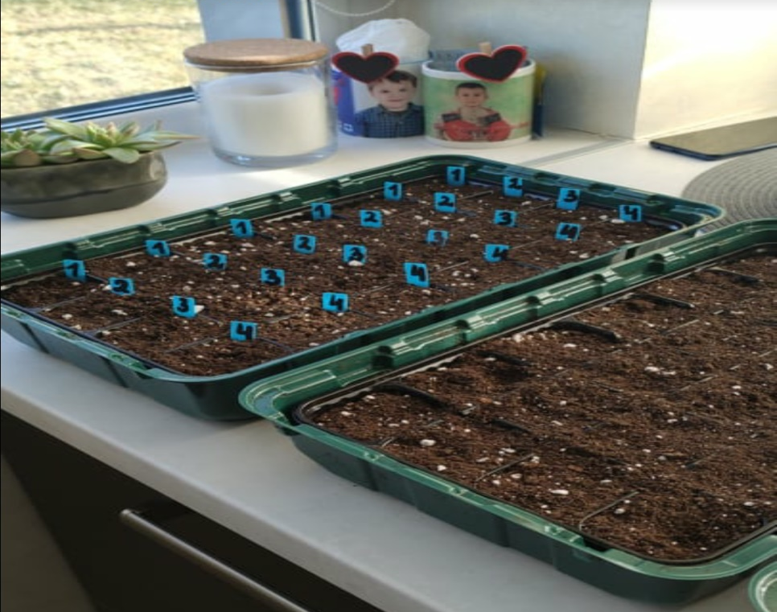
Seeds in nurseries

Slide 7
Seedlings germinate after 4-6 days.
5-7 days after germination, it is necessary to transfer the nurseries to a colder place, then the roots of the plants will develop better.
When the sprouts already have the first true leaflet, they can already be picked into cups.
We transplant each sprout into a separate jar.

Slide 8
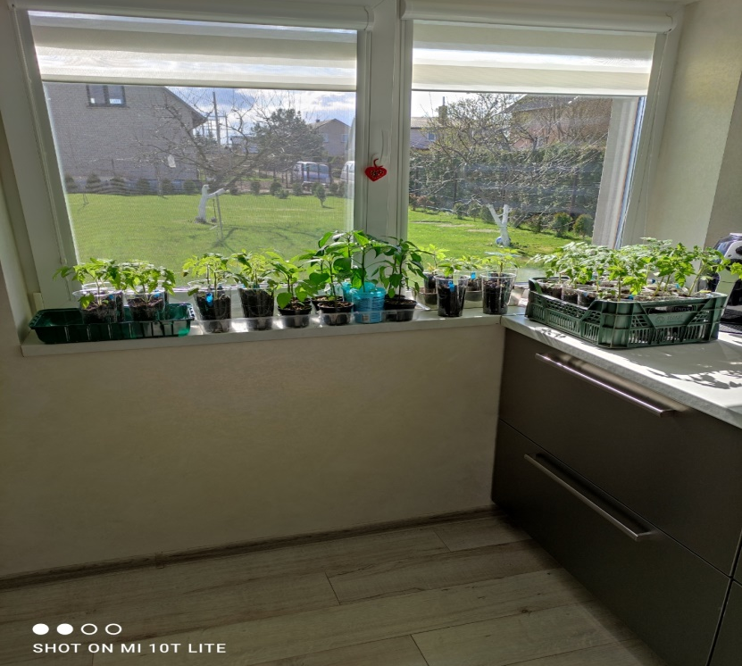
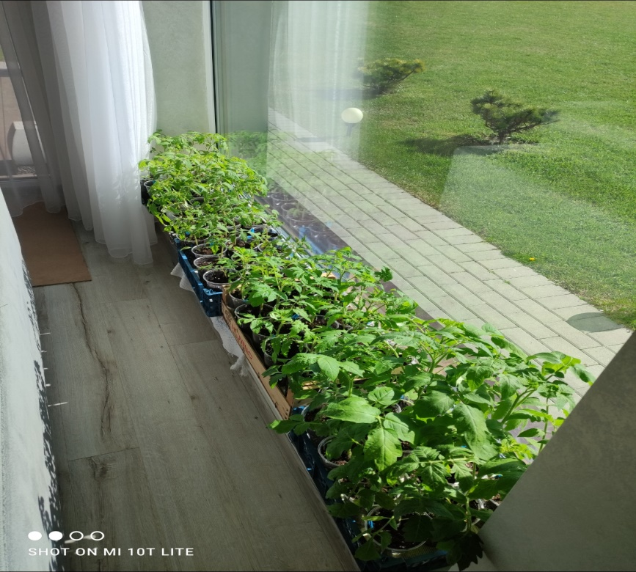
Seedlings in separate jars

Slide 9
Tomato seedlings should be watered infrequently, but abundantly with warm water. The earth in the pot should be moist, but not wet.
In mid-May, we transplant the seedlings already into the greenhouse.

Slide 10
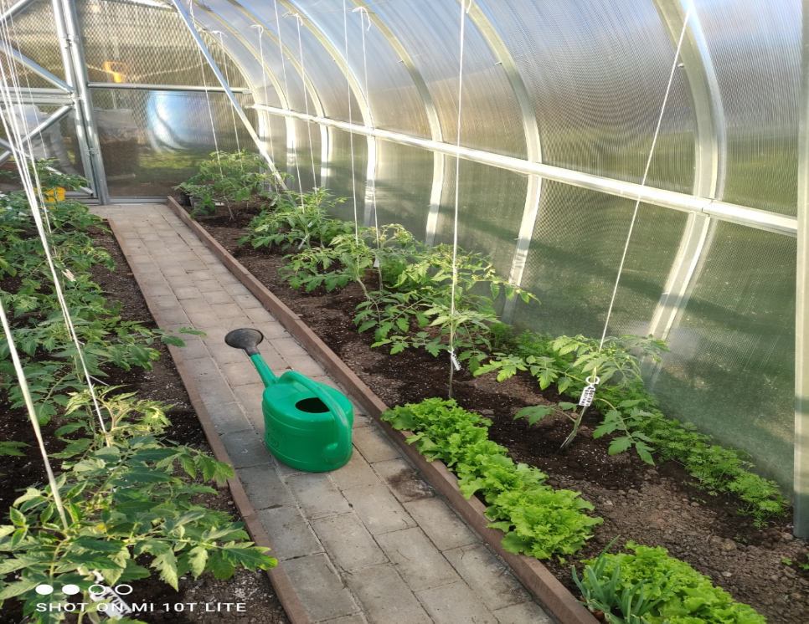
Tomato seedlings in the greenhouse

Slide 11
Tomato care
Tomato care consists of:
Loosening the earth
Tethering of seedlings, as they grow up to 2 meters in height and can overturn.
Abundant watering
Fertilizing with the necessary fertilizers so that the tomatoes get minerals and are healthy.

Slide 12
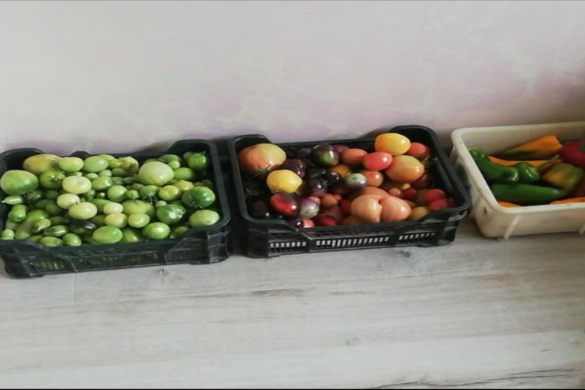
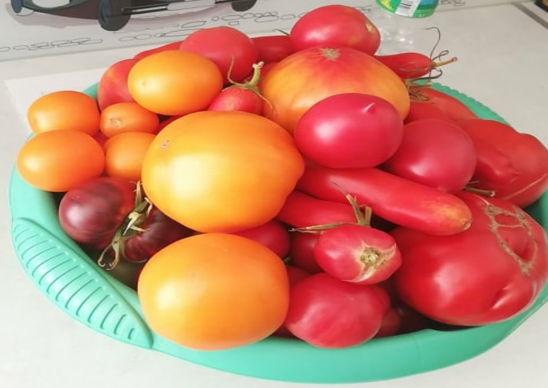
Tomato harvest

Slide 13
Tomatoes in our family:
From mid-June to October, we are pleased with the abundant harvest of tomatoes.
We eat picked, fresh.
We prepare stocks for the winter.
We squeeze the tomato juice.

