Slide 1
WOODEN MUSICAL INSTRUMENTS
Research by Mila, 3rd grade student
of Riga Lithuanian secondary school

Slide 2
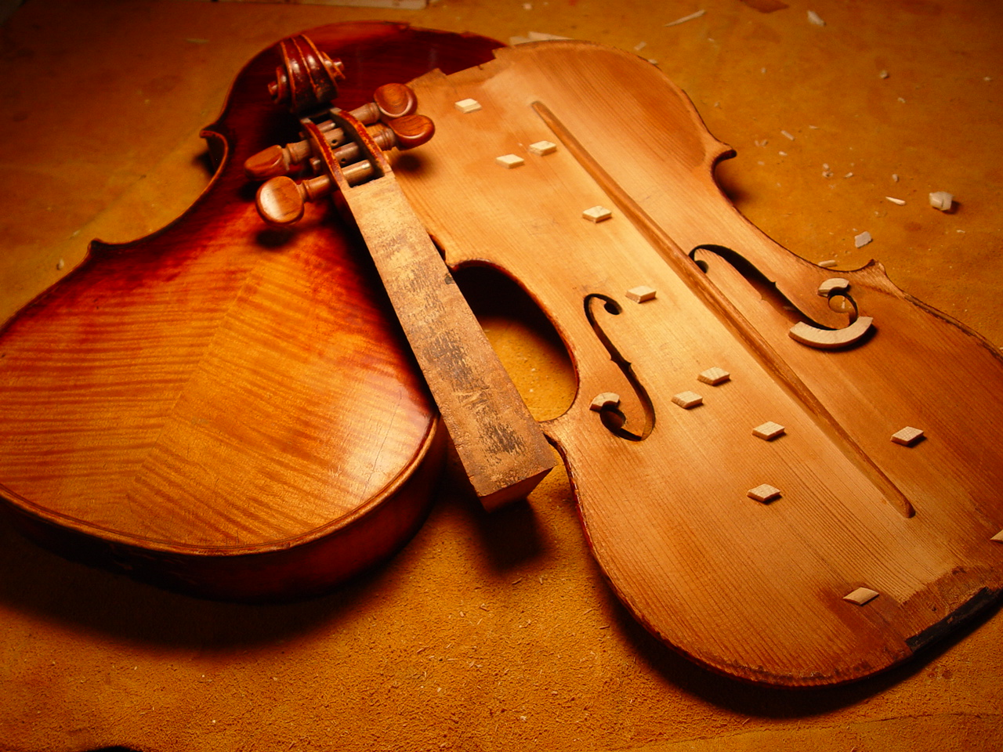
Summary:
I will learn the role of wood as an important material in the field of culture - music.
Subject of the study:
I will study 5 musical instruments made of wood, which I can find near my school in Riga.
Aim of the study:
I want to find out the names of musical instruments, their group membership and the names of the trees they are made from.

Slide 3
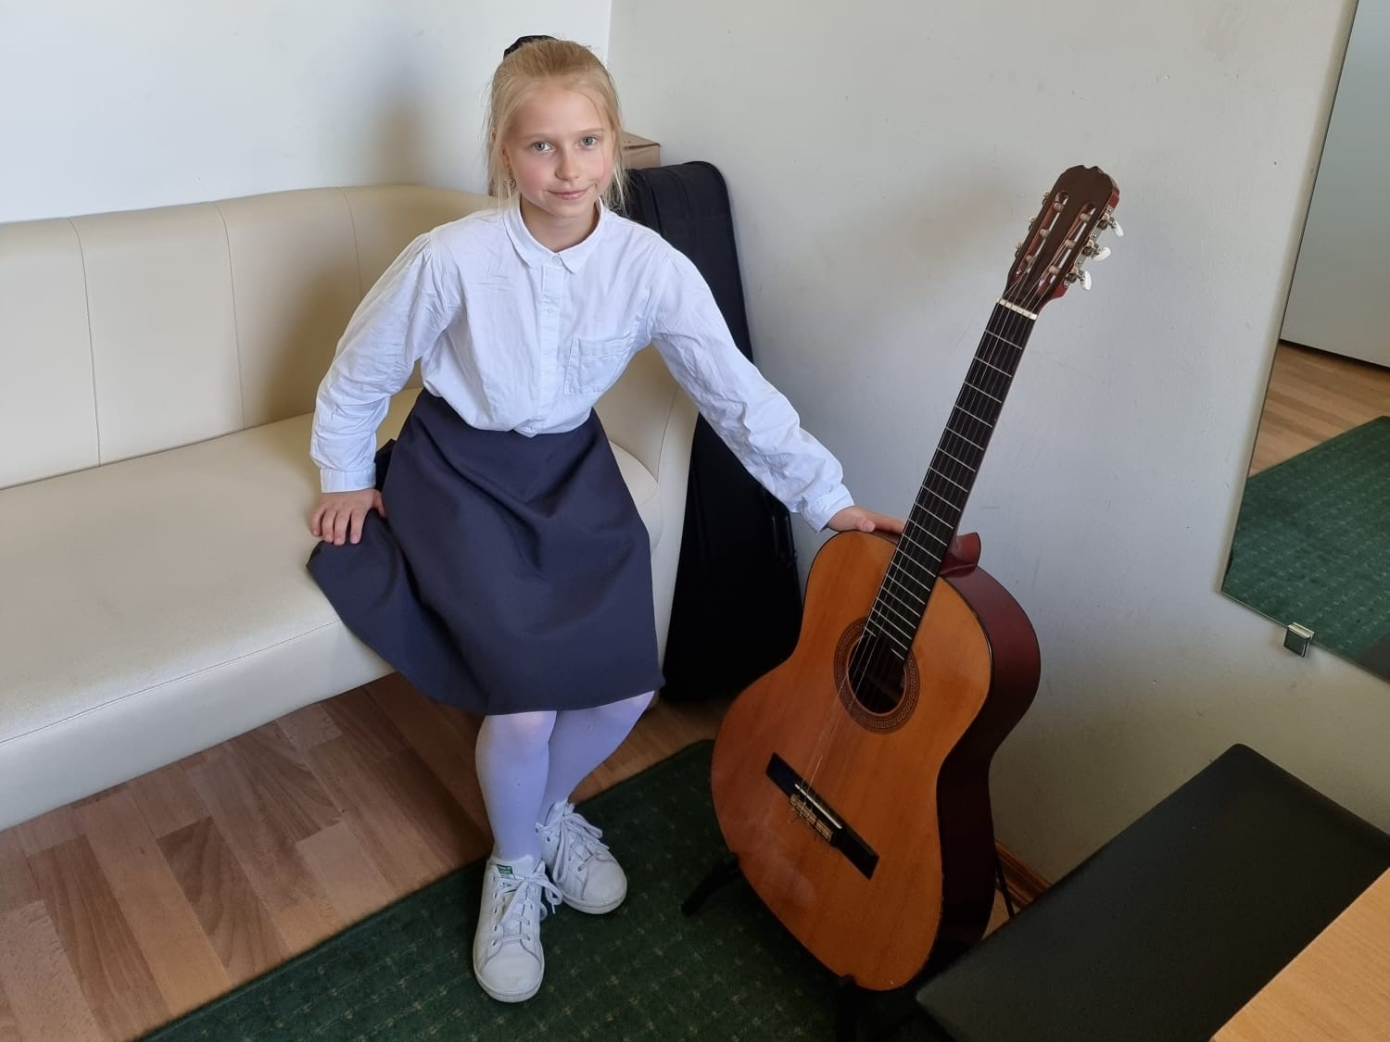
Research progress
1. The classic guitar
Many different musical instruments in the world are made of wood. I went to a music school near my school to find them. My goal was to find and study 5 musical instruments made of wood.
The first one I found was a classical guitar. Its body and neck are made of wood.

Slide 4
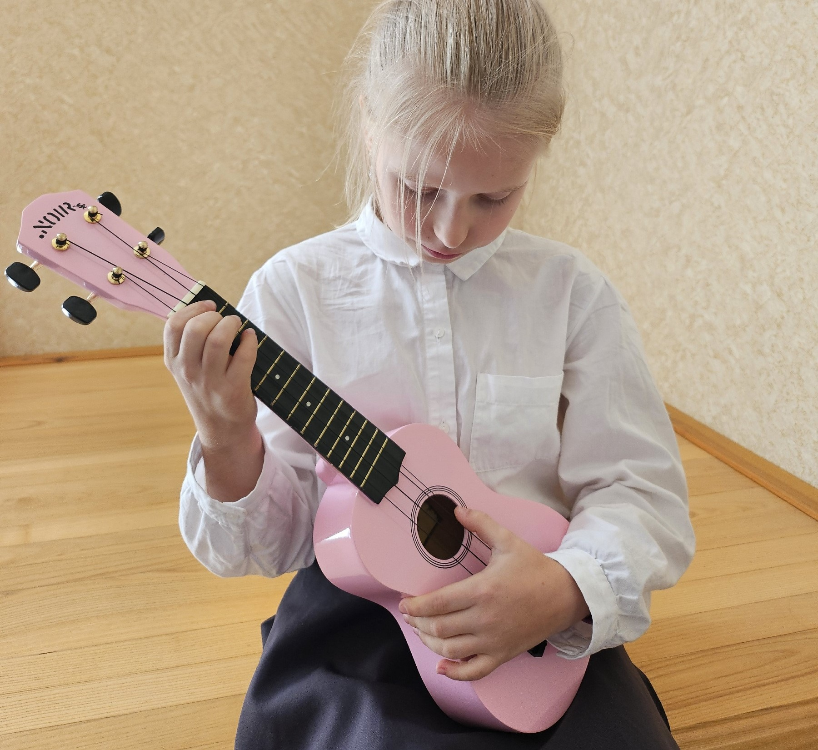
2. Ukulele
Second one was ukulele. The ukulele is a four-stringed musical instrument made from wood that resembles a small classical acoustic guitar.

Slide 5
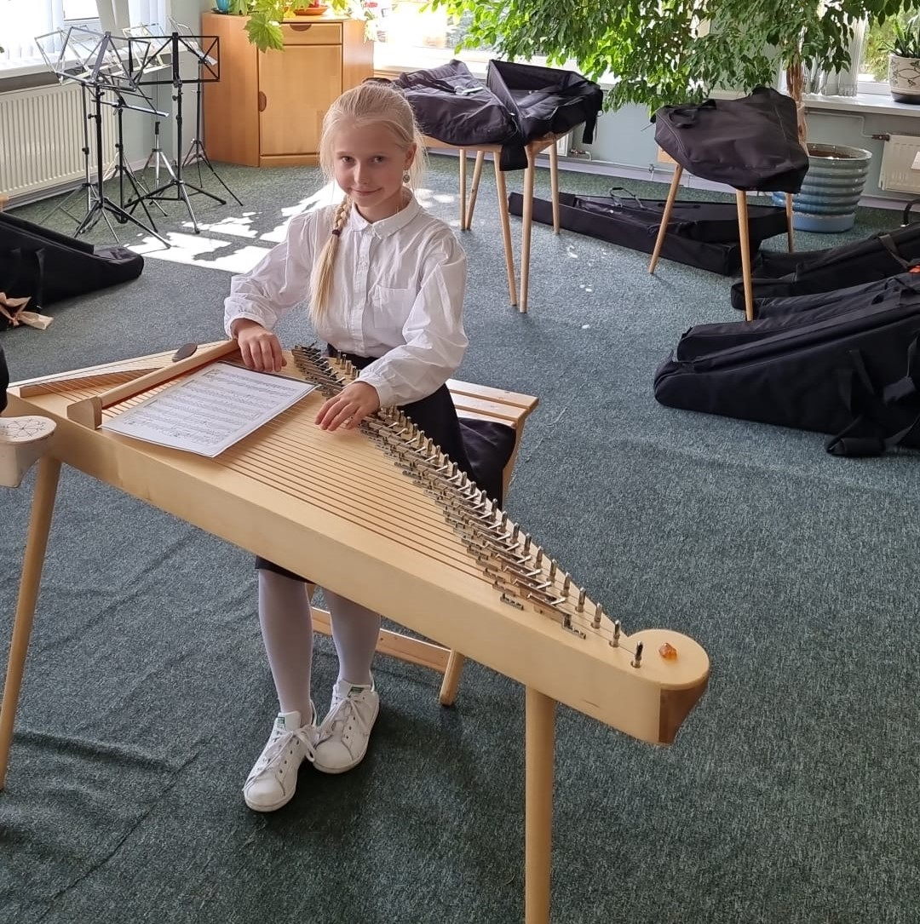
3. Kokle (latvian)
The third musiacal instrument made of wood – kokle (latvian). It is a Latvian stringed instrument and a Latvian folk music instrument. Made almost entirely of wood (typically spruce).

Slide 6
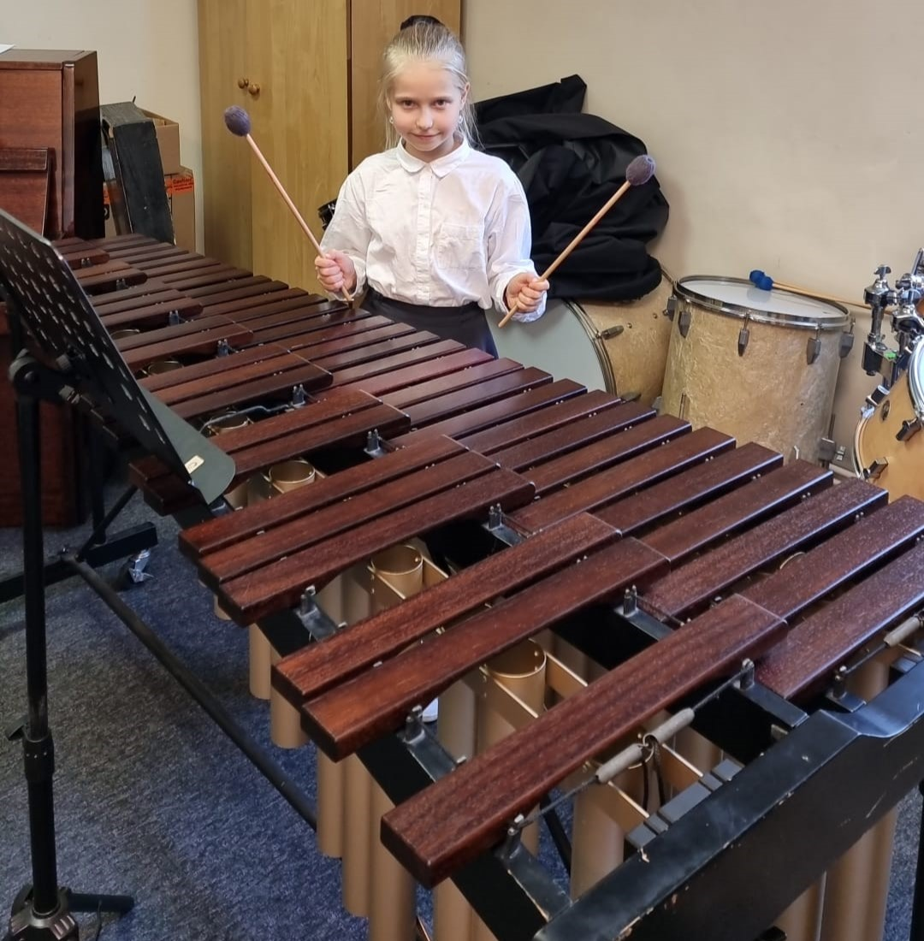
4. Marimba
The next one instrument - marimba. The marimba is a musical instrument in the percussion family that consists of wooden bars that are struck by wooden mallets.

Slide 7

5. Piano
5th instrument is piano. The piano is a keyboard instrument that produces sound when pressed on the keys. In the early years of piano construction, keys were commonly made from sugar pine. In the 2010s, they are usually made of spruce or basswood. Spruce is typically used in high-quality pianos. Black keys were traditionally made of ebony.

Slide 8
Results
MUSICAL INSTRUMENT | GROUP | WOOD THIS IS MADE FROM
Guitar | Strummed string instrument | Typical woods used for the body and neck of a guitar today are Mahogany, Ash, Maple, Basswood, Agathis, Alder, Poplar, Walnut, Spruce, and Holly.
Ukulele | Strummed string instrument | Body of traditional Hawaiian ukuleles are often made of koa wood, but spruce and mahogany are also common tonewoods. Most soundboards are made from koa, acacia, or sitka spruce.
Kokle (latvian) | Plucked string instrument | Made almost entirely of wood (typically spruce).
Marimba | Keyboard percussion | Bars (rosewood or paduka), mallet (birch or rattan).
Piano | Keyboard instrument | The outer casing of a piano is made out of wood, such as maple. The soundboard is made of specially crafted spruce wood. The keys are made of wood.

Slide 9
Conclusion
There are many musical instruments made from wood. I was able to look at some of them and find out, that the use of wood as a material is very important in the field of culture, specifically music.

