Slide 1
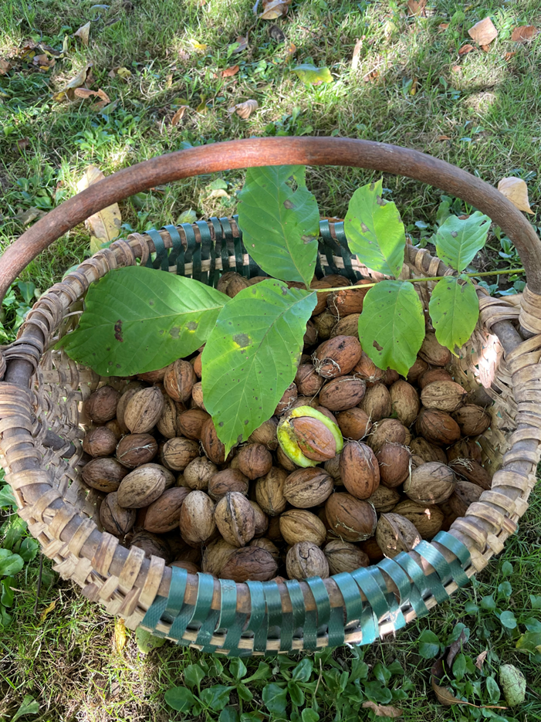
Seeds of a walnut tree
Aronas Stankevičius

Slide 2
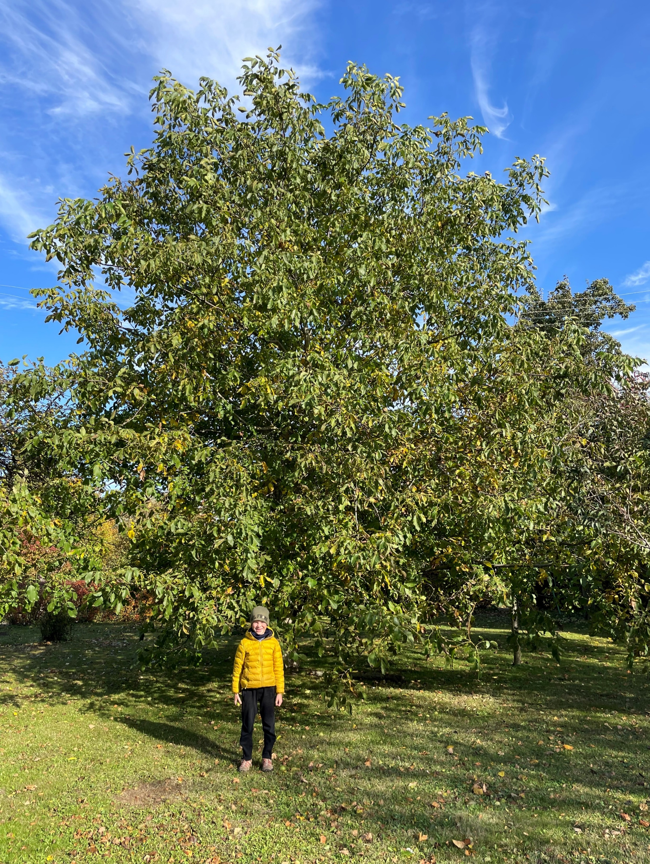
WALNUT
A huge tree has been growing in my grandparents' homestead in the village of Varputėnai for 15 years.

Slide 3
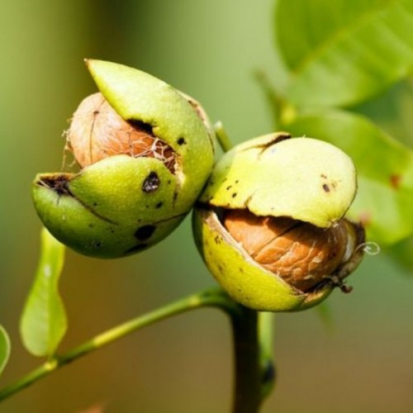
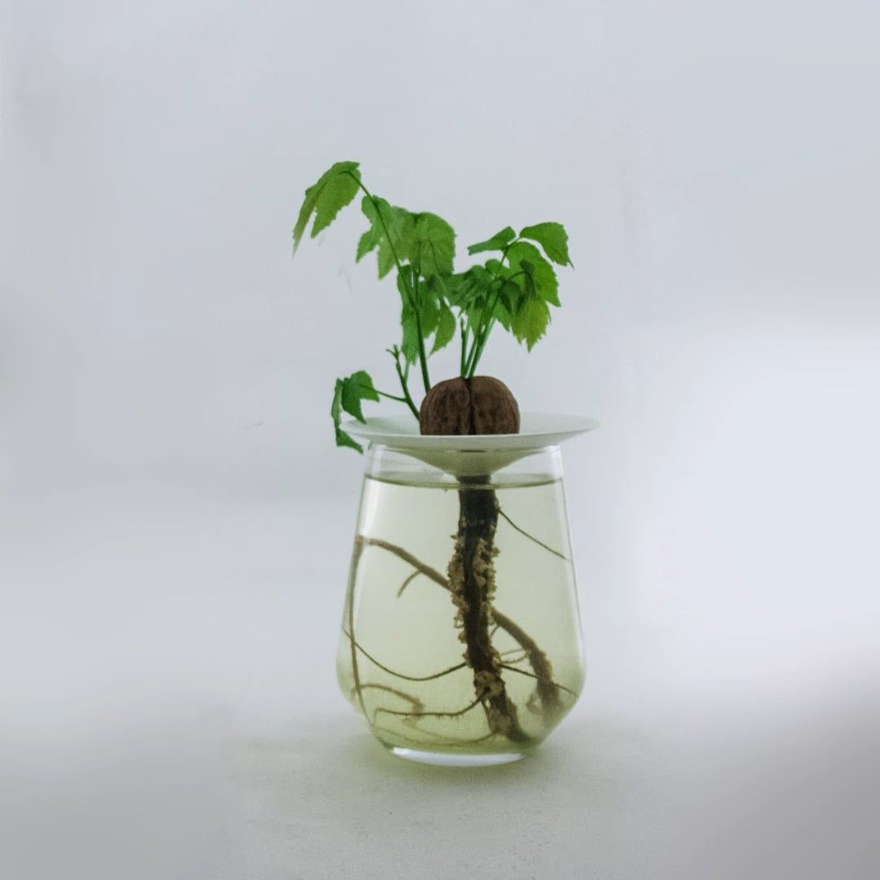
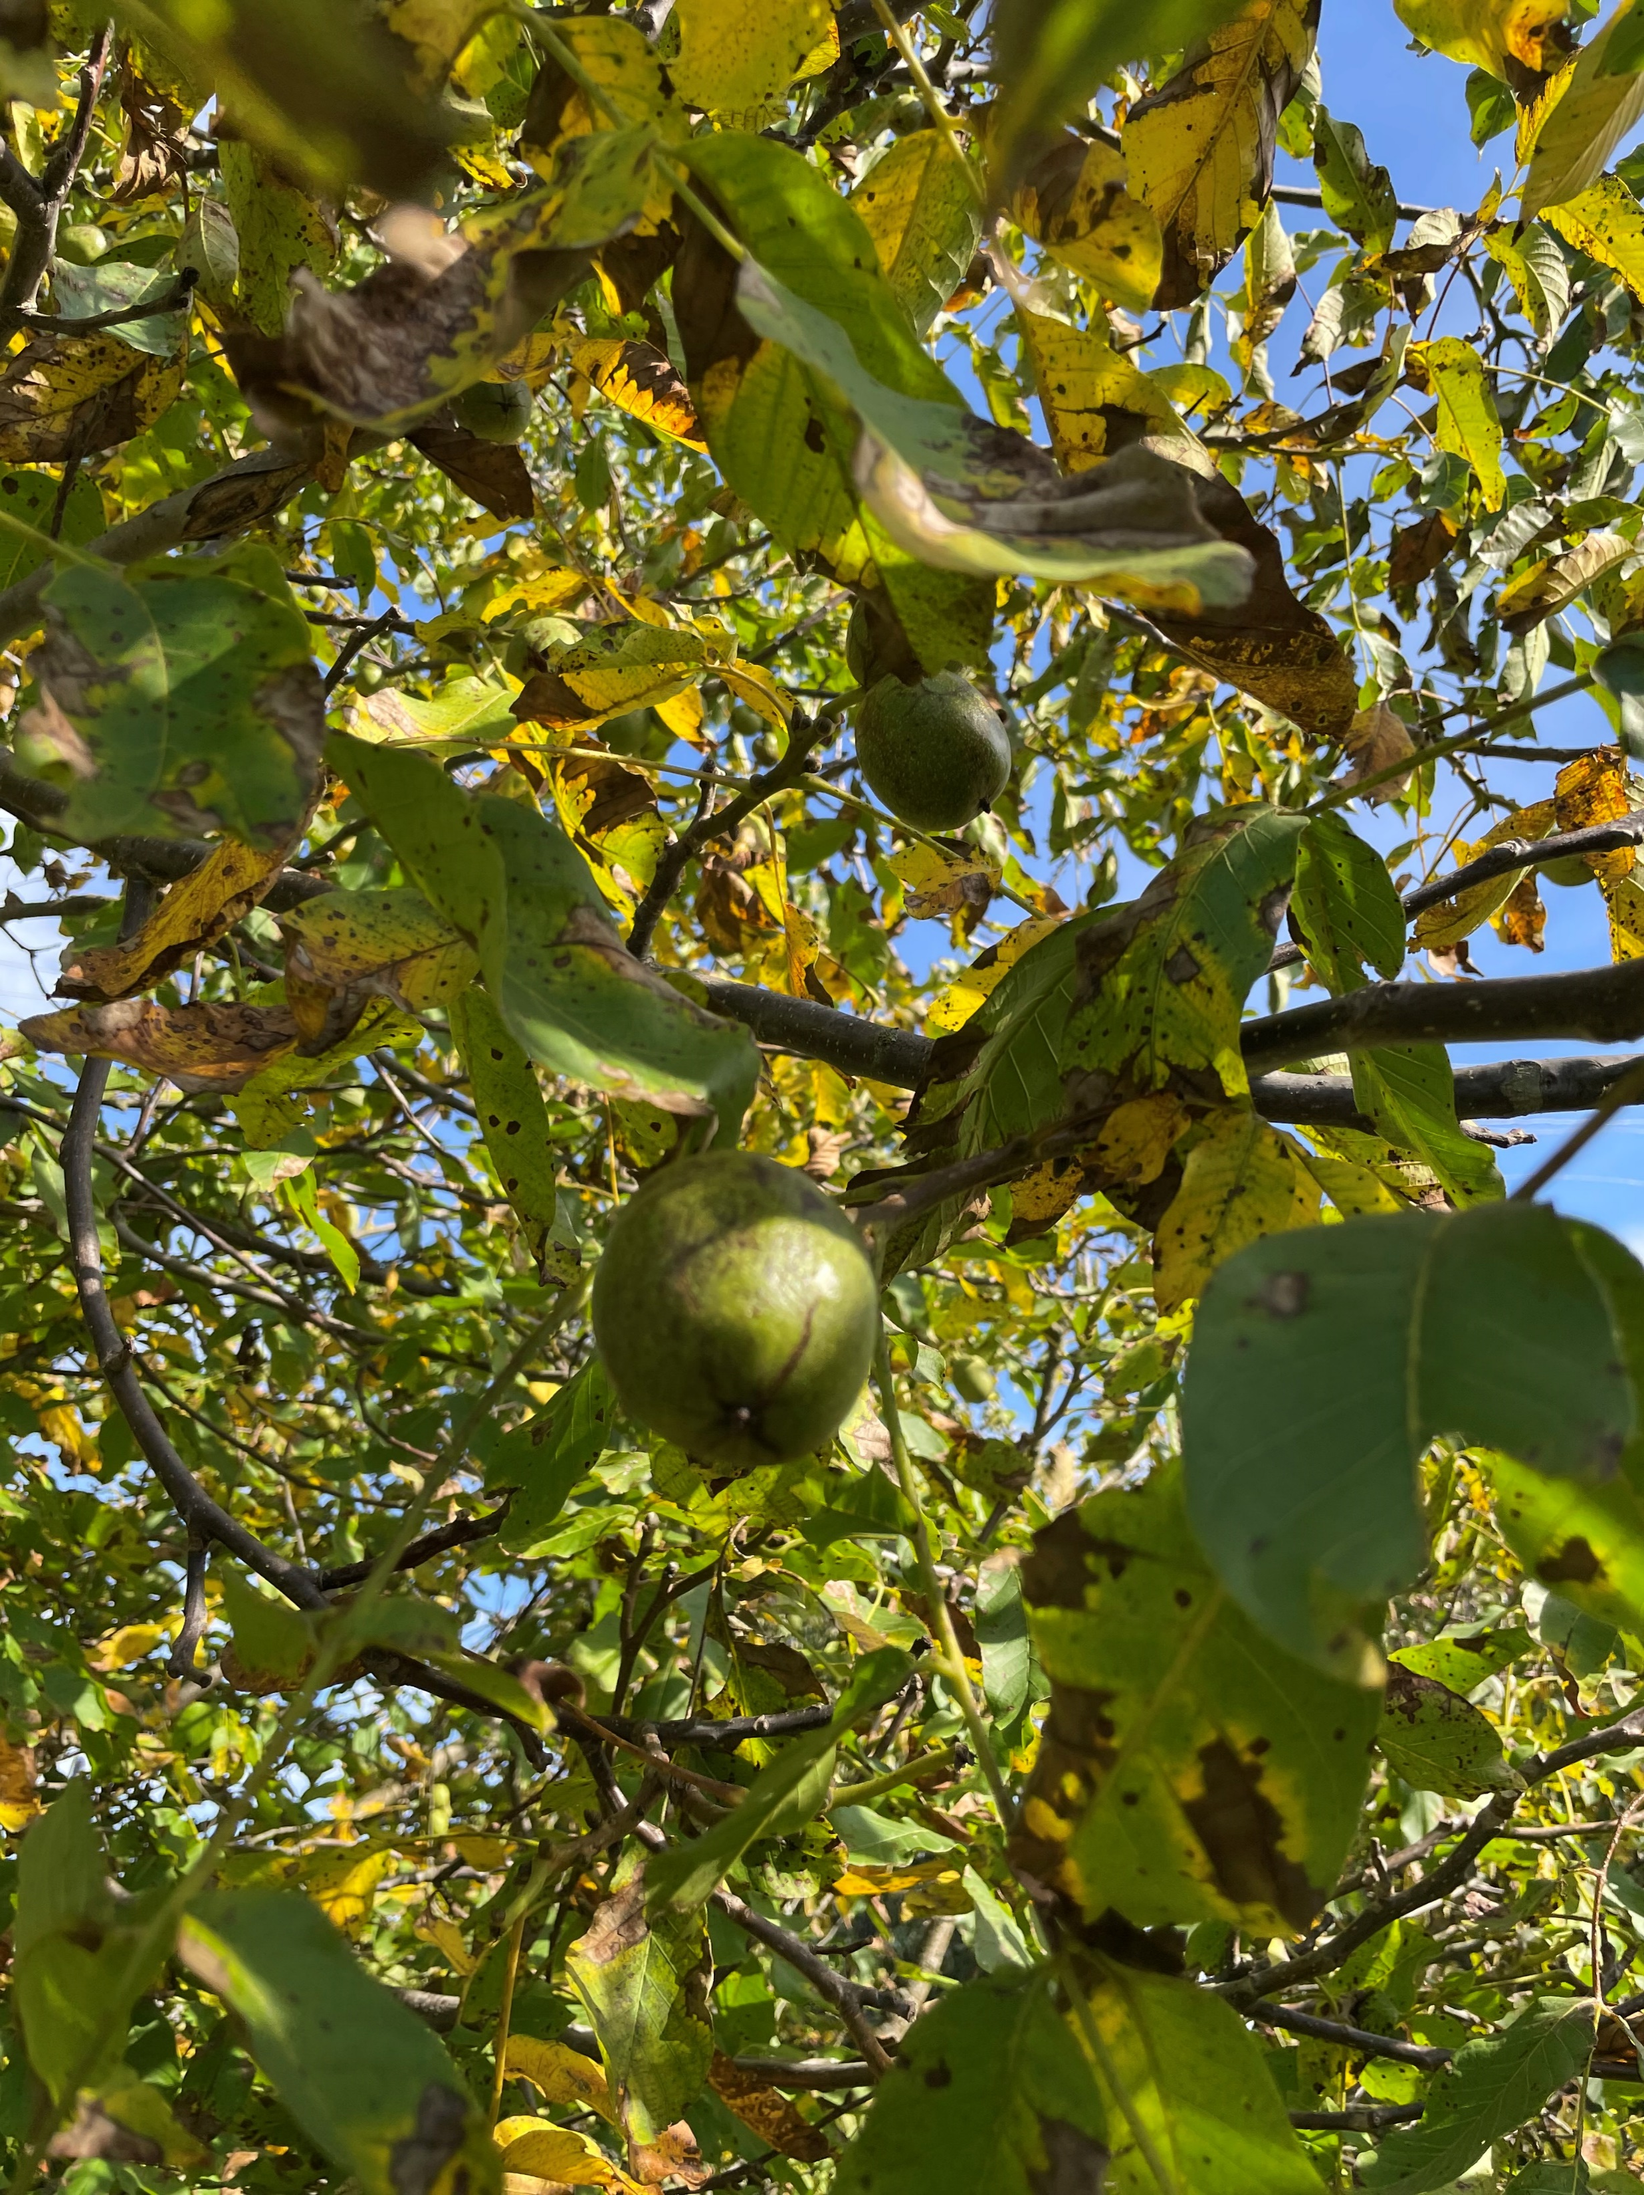
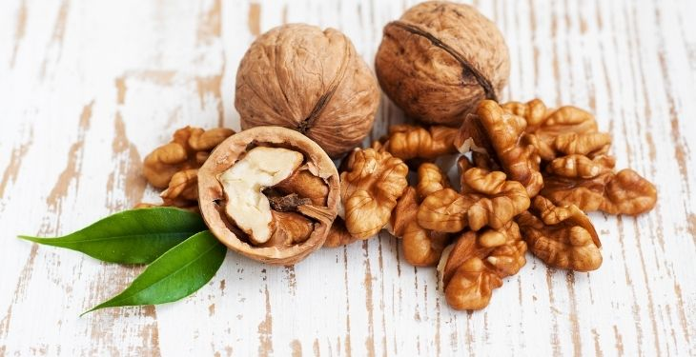
Every autumn, it produces nuts that peel themselves out of their green husks and fall off the tree.
The nuts are then collected, dried, shelled and eaten.
If we want to grow a tree, we soak the nuts in warm water for a few days and wait for them to sprout.

Slide 4
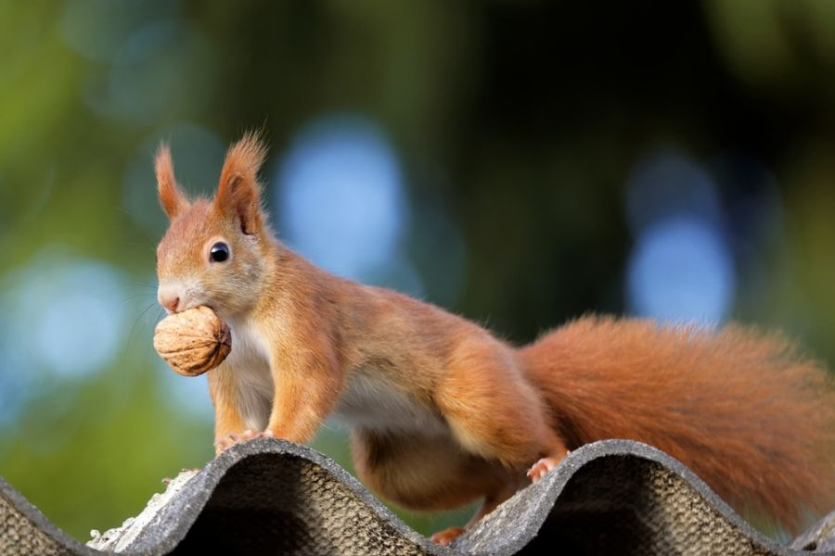
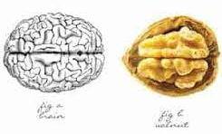
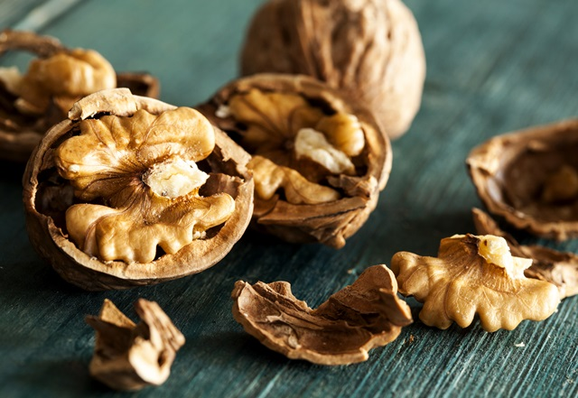
Walnuts are one of the most valuable nuts, are very healthy to eat and are said to be brain food (they are also shaped like brains).
They are very rich in vitamins, proteins and oils.

Slide 5
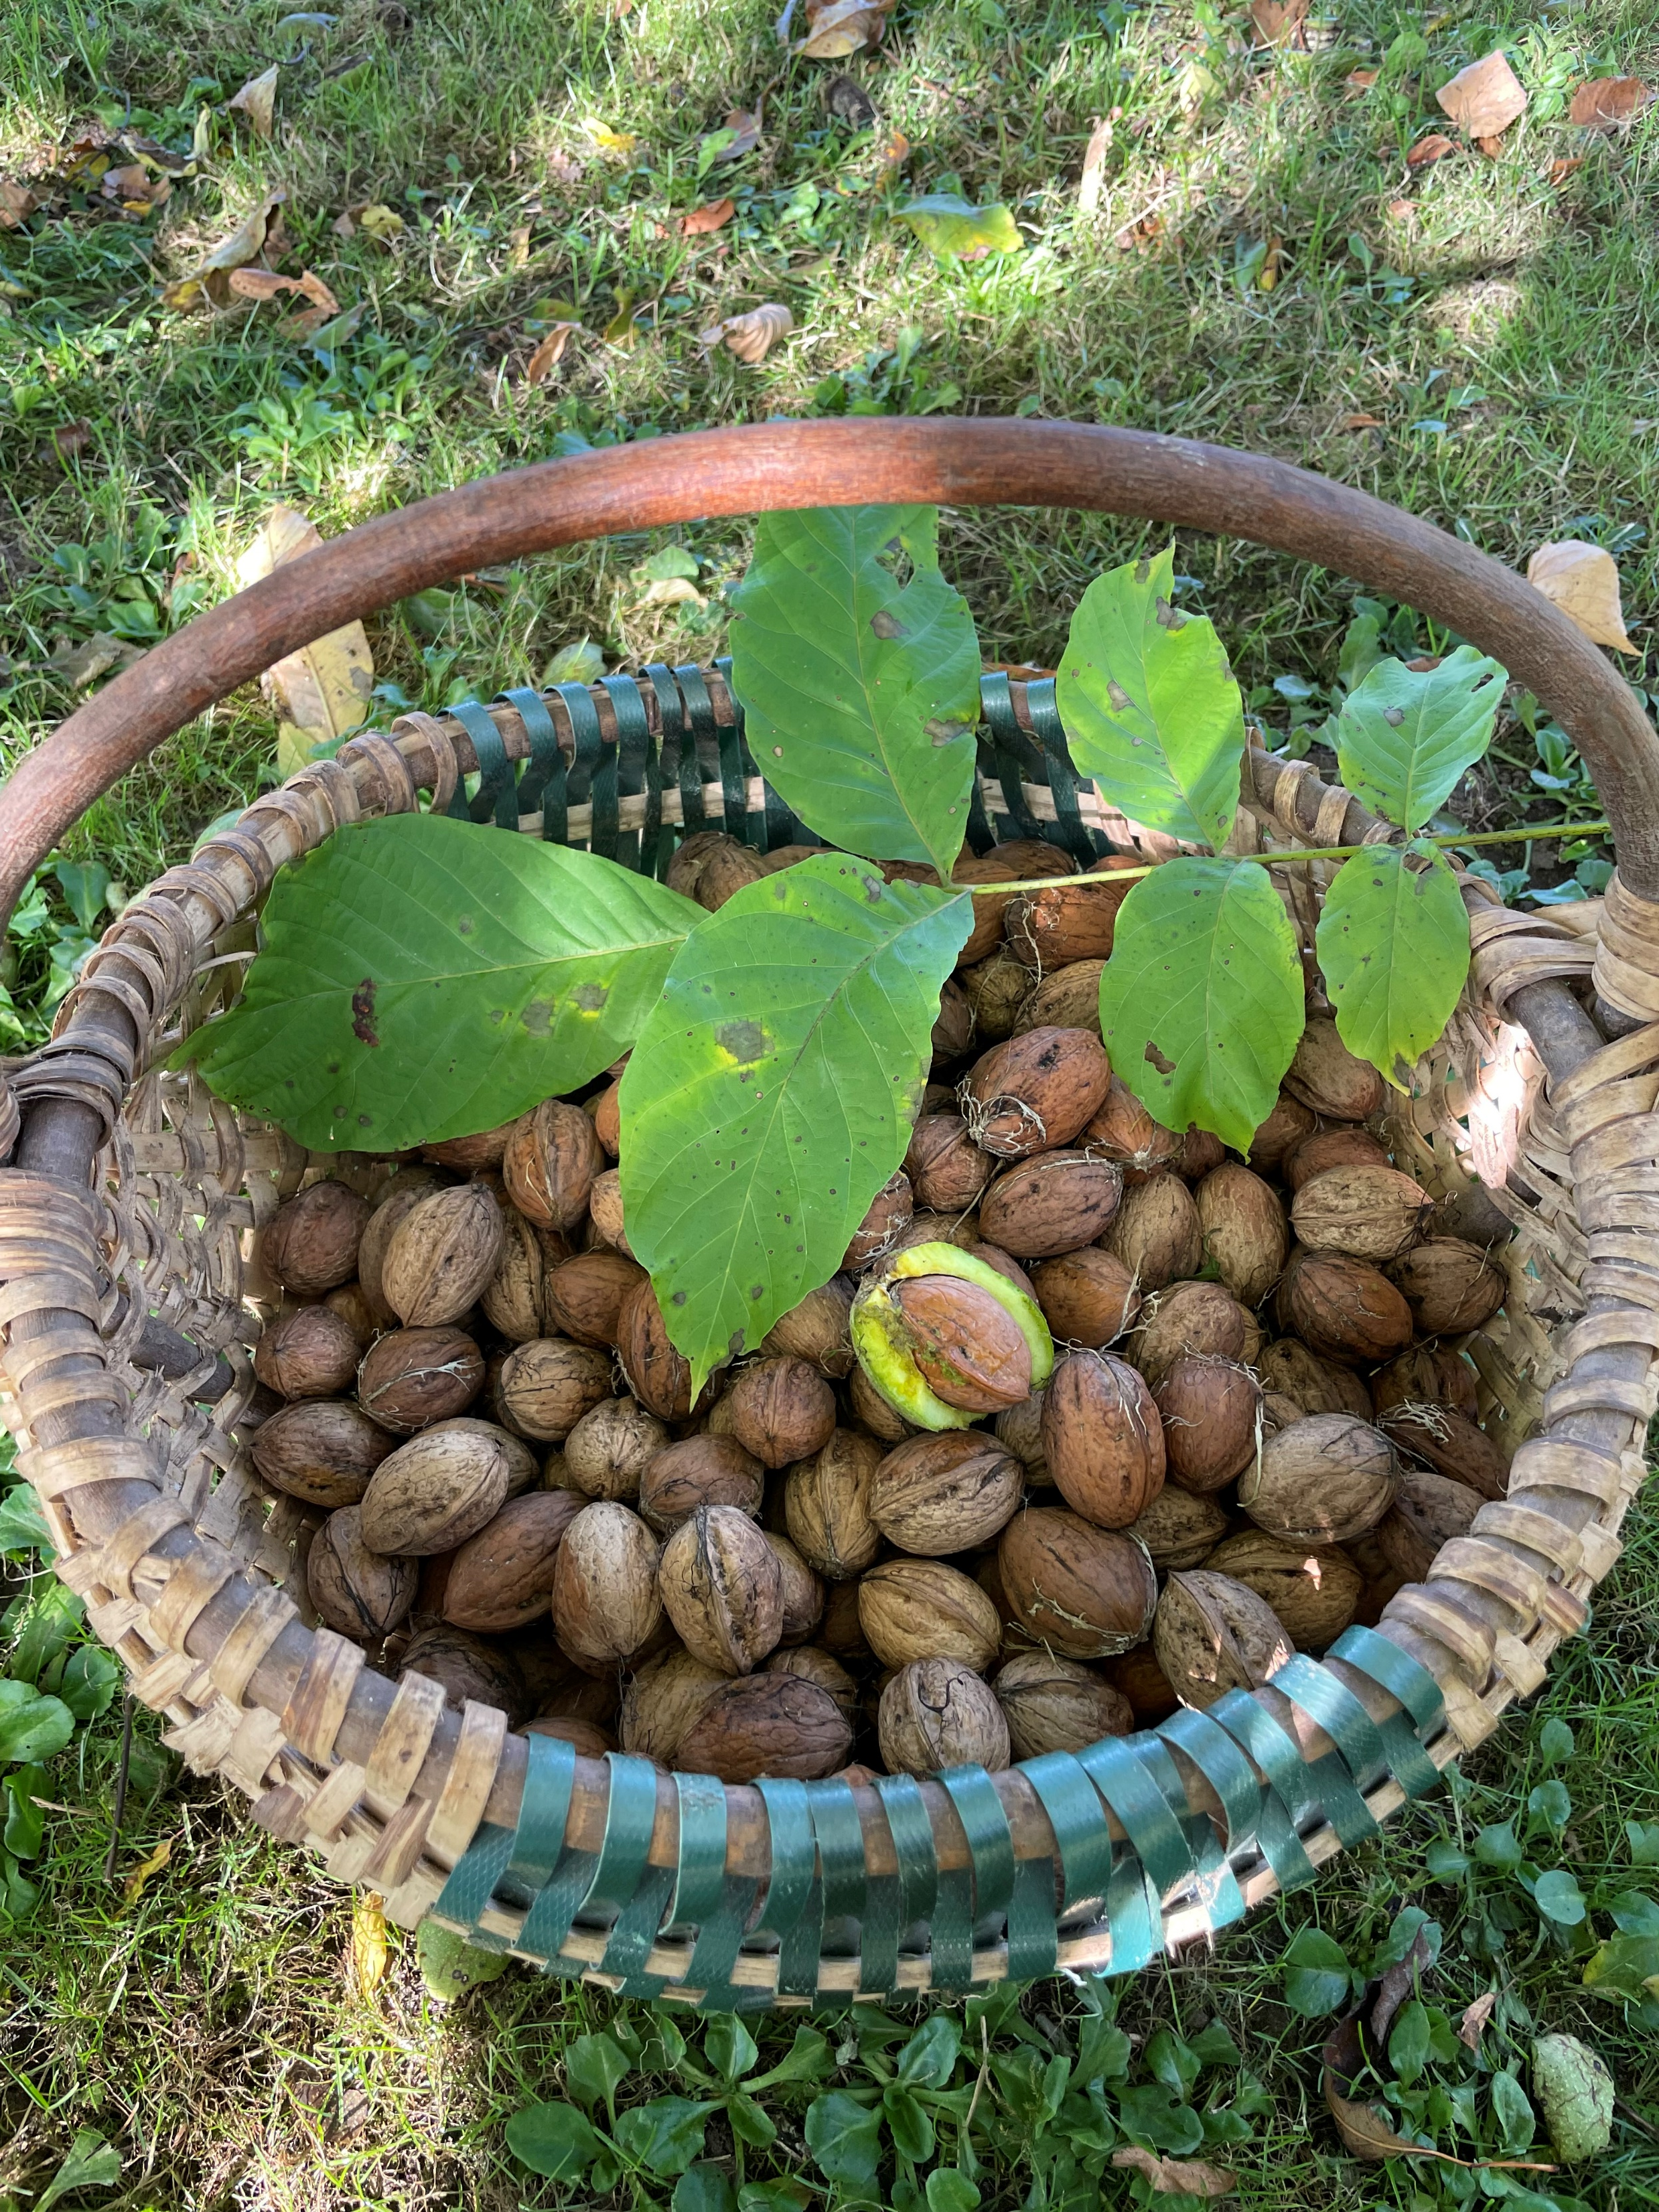
IŠDYKUS VOVERYTĖ
Voverytė
Rudakytė
Šokinėjo po egles,
Voverytė
Rudakytė
Svaidė riešutus, giles.
O pro šalį
Per šilelį
Senis šaltis ėjo,
Į krepšelį
Į krepšelį
Riešutus sudėjo.
Jeigu tu neišdykausi
Riešutų krepšelį gausi. (K.Kubilinskas)
"A tiny little room - high up, only locked". What?

Slide 6
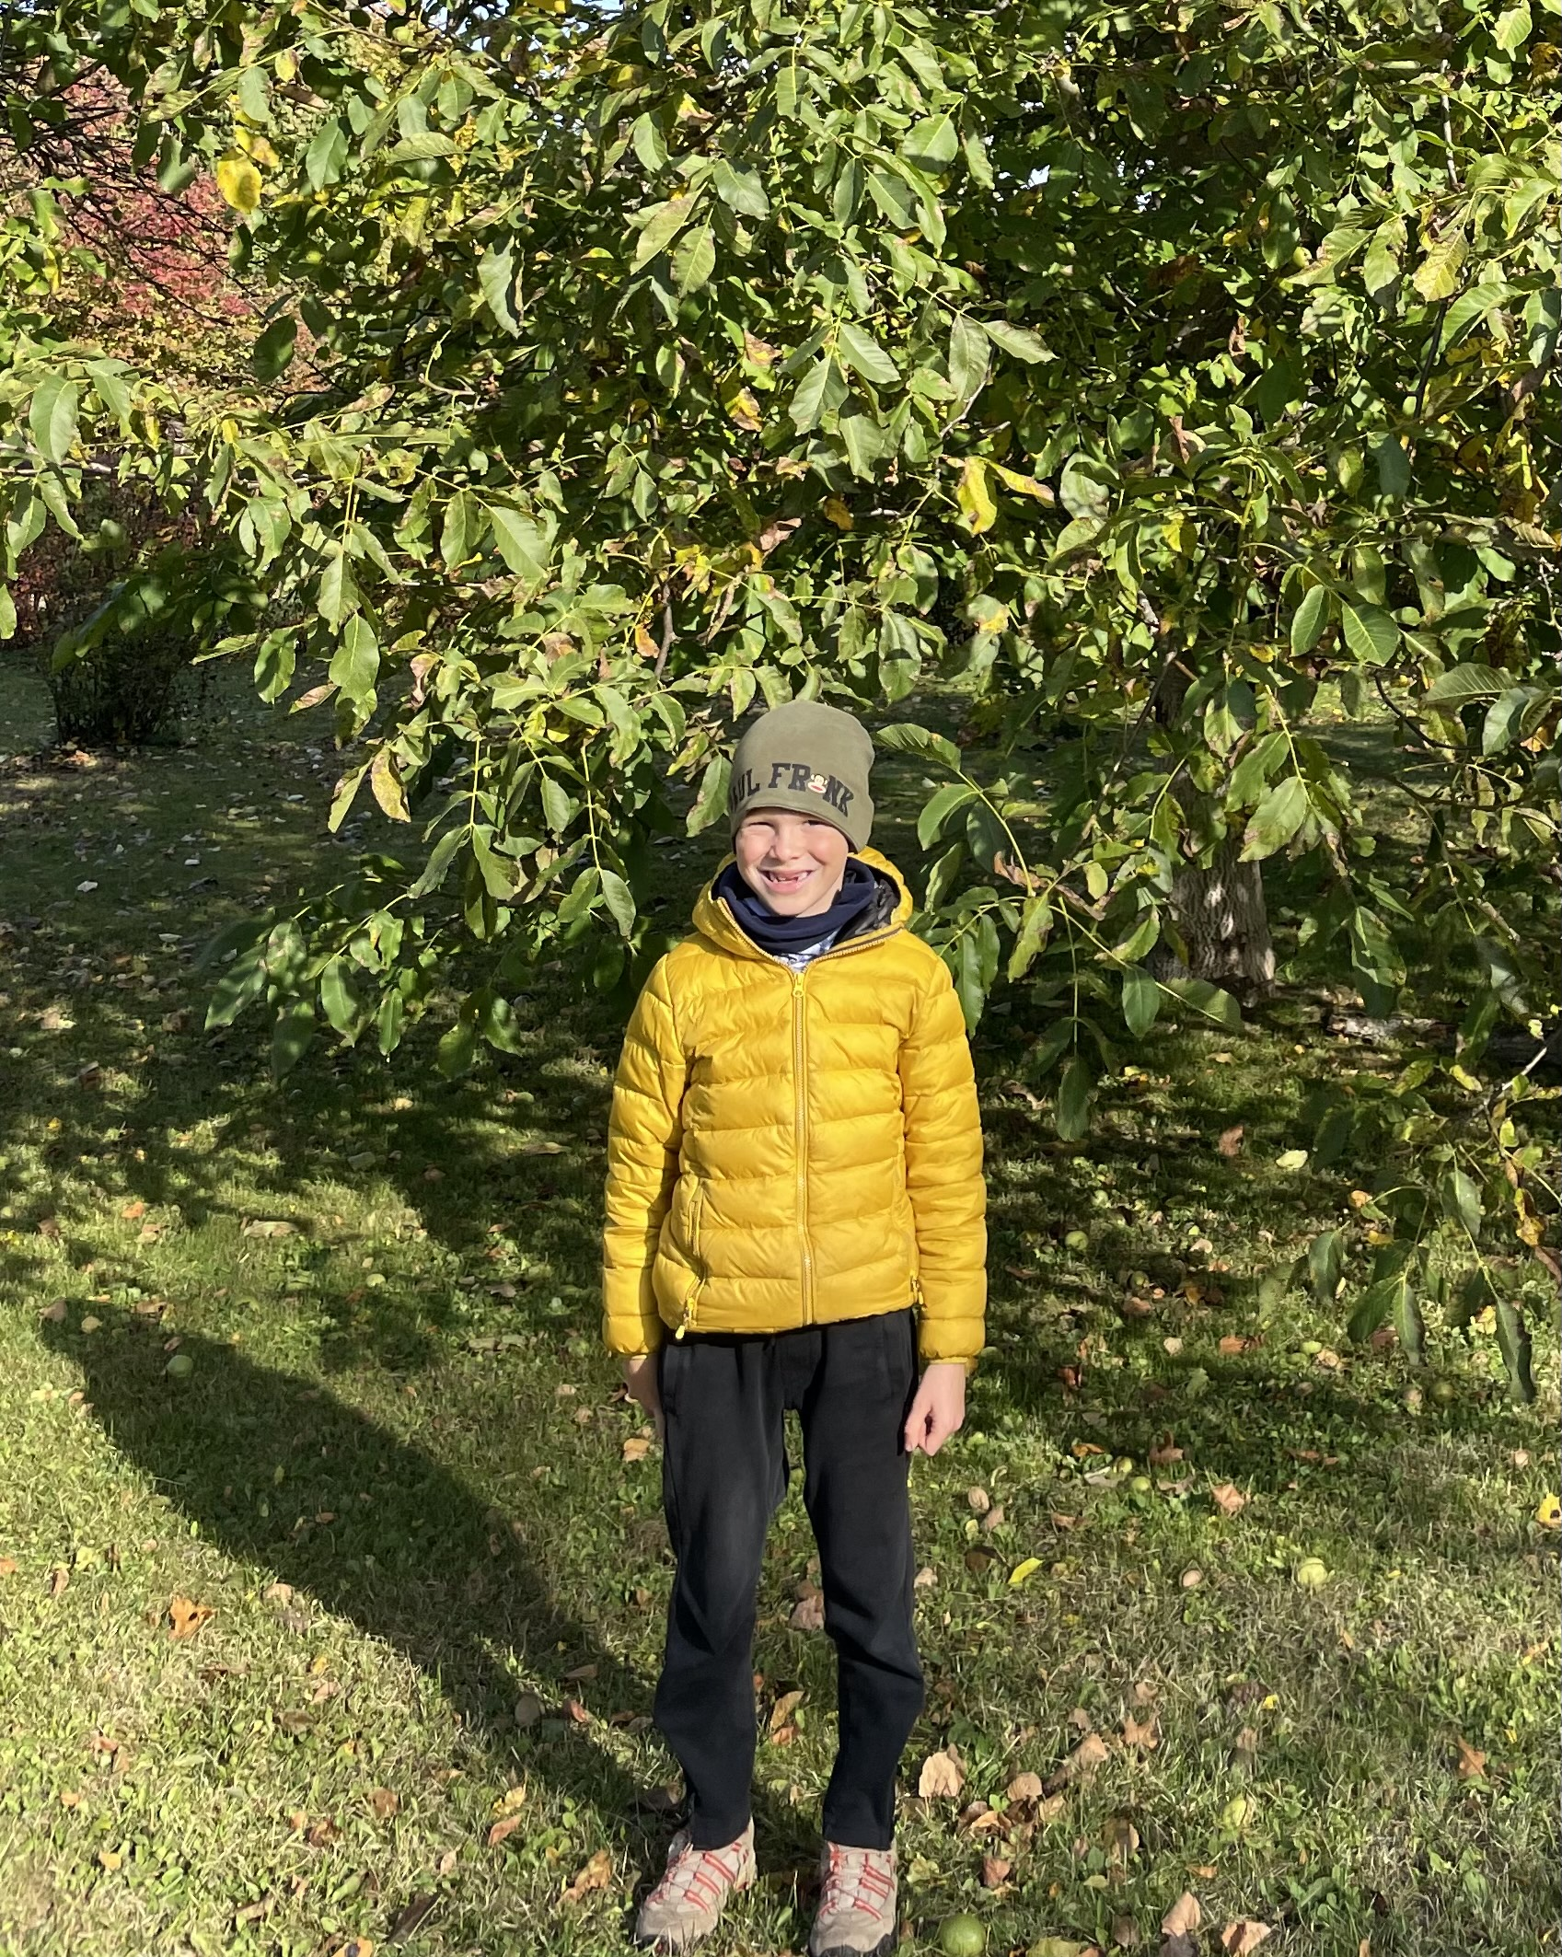
I am a HARD NUT myself!
Ačiū už dėmesį

