Slide 1
BIRCH TREE
(by Mila, 3rd grade student of Riga Lithuanian Secondary school)

Slide 2
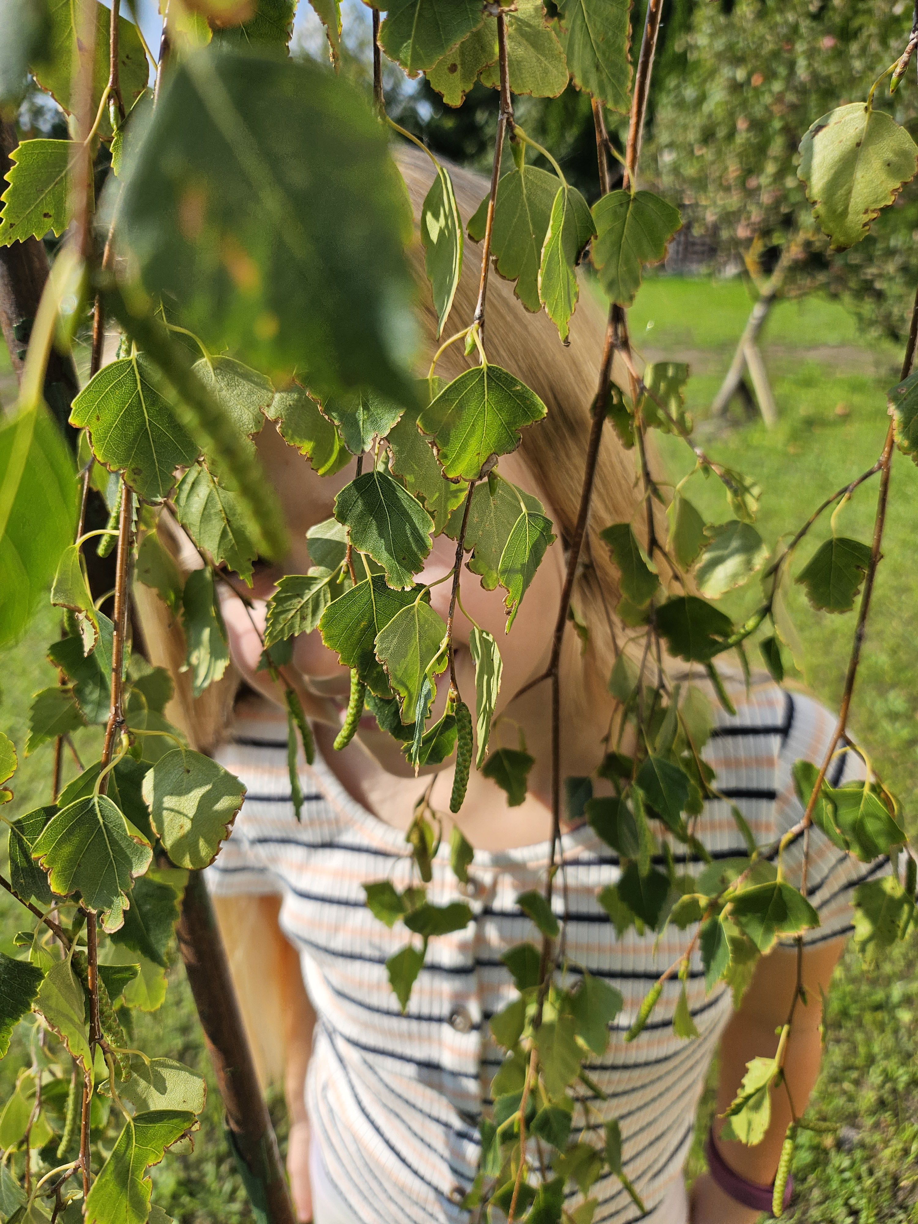
Birch is deciduous tree. It is found in almost all countries having a temperate climate.
Birch trees are recognizable by their bark, which peels off in strips in all birches except the gray birch. Young trees have smooth bark. Deep ridges on the bark are characteristic for the older plants.
Every spring my grandfather gets birch sap, it is very refreshing, and so I will share some facts about birch trees.

Slide 3
Facts about birch tree
There are about 60 different species of birch.
The average height of a birch tree is around 12 meters, but the paper and yellow birch can grow up to 24 meters tall.
Birch trees have simple leaves with toothed edges called margins.
Both male and female flowers bloom on the same tree in the birch family.
Birch is used as firewood. It burns well, without popping, even when frozen and freshly hewn.
Extracts of birch are used for flavoring or leather oil, and in cosmetic industry for the production of soaps and shampoos.

Slide 4
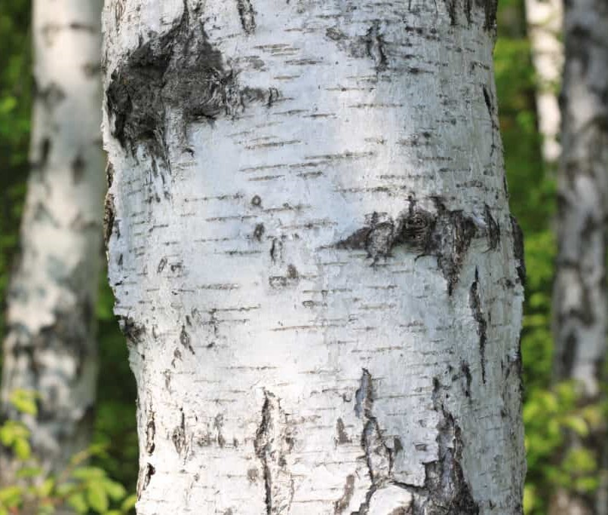
Bark of the birch
Bark of the birch can be white, grey, yellow, silver or black in color.
Birch bark has been used as paper for centuries.
Bark contains substances such as betulin and betulinic acid that are used in the pharmaceutical industry.
Bark is used as old folk remedy for the stomach ache.
Birch bark can be soaked until moist in water, and then formed into a cast for a broken arm.

Slide 5
Birch sap
Birch sap is also known as birch water.
Birch water is the sap of birch trees and harvested in early spring.
It has a clear color and slightly sweet flavor.
Birch sap is a traditional drink in Northern Europe, Russia, and Northern China.
The sap is also bottled and sold commercially.
Birch sap can be used to make birch syrup, which is used like maple syrup for panckakes and waffles.
It’s also used in cosmetics and other skin care products.
Information collected from https://justfunfacts.com/interesting-facts-about-birch-trees/

