Slide 1

Tree species through the seasons
Made by: Augustė Laimikė

Slide 2
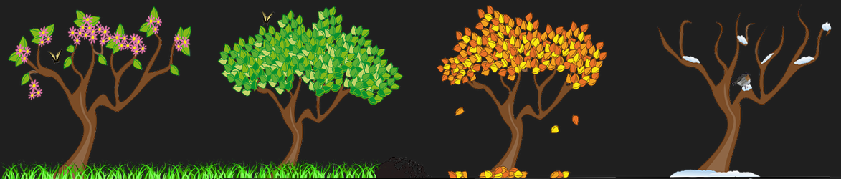
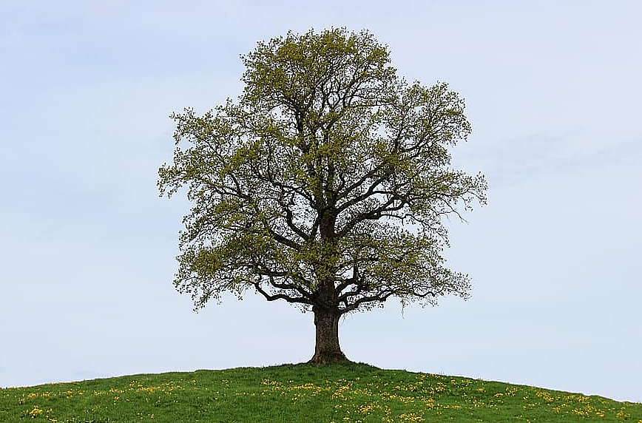
Spring - when the weather warms up a bit, the tree wakes up, blooms and puts out its first leaves.

Slide 3
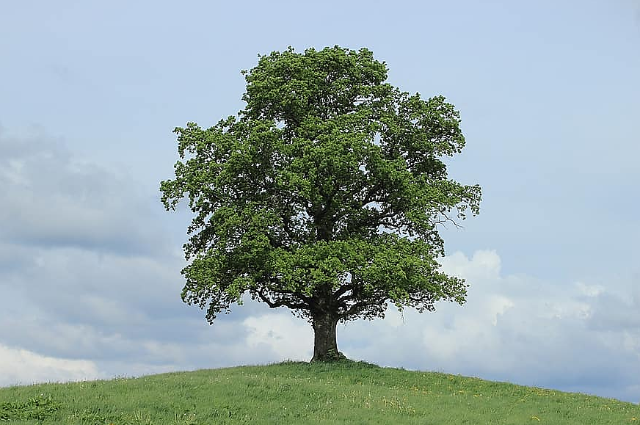
In summer, the very warm weather leads to ripening of the fruit, growth of the branches and an increase in the number of leaves.

Slide 4
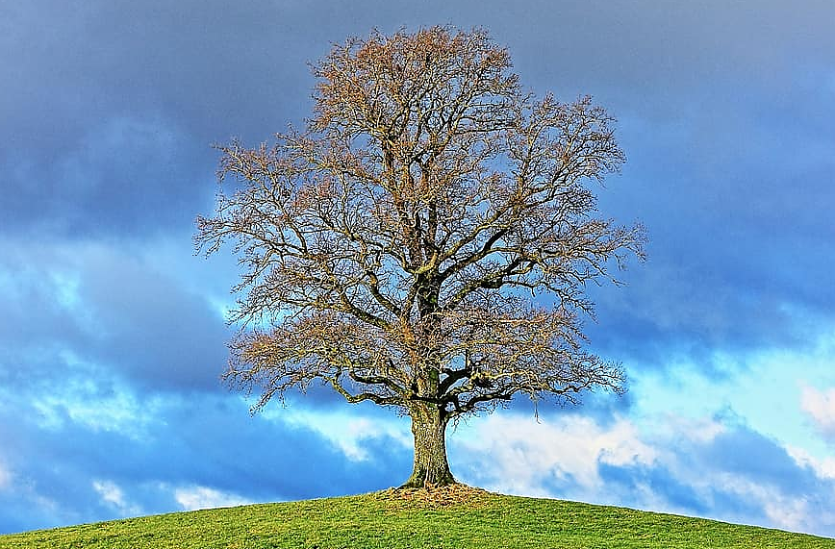
Autumn - leaves turn yellow and start to fall to the ground due to the cold weather. The tree prepares its food reserves for the winter.

Slide 5
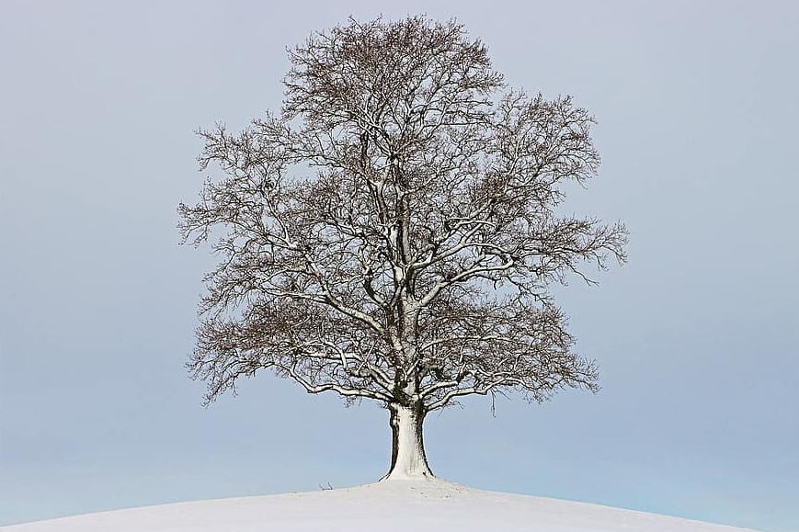
In winter, the very cold weather causes the tree to lose its leaves completely, fall asleep and wake up in spring.

Slide 6

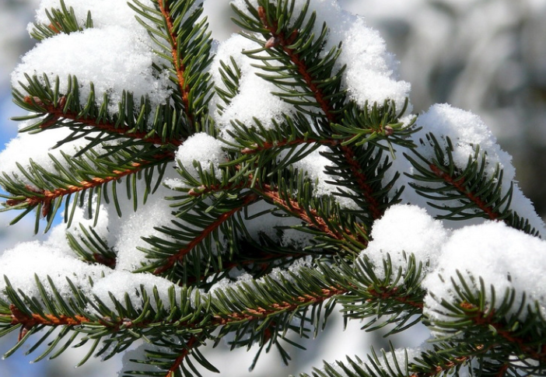
But...
There are other types of trees - conifers are adapted to live in harsh conditions. Their thorns are resistant to frost, so the tree doesn't shed them in winter and delights us with its greenery in the white season.

