Slide 1
Lithuanian folk tale
ASH TREE

Slide 2
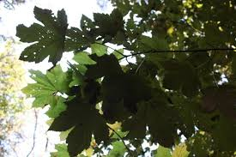
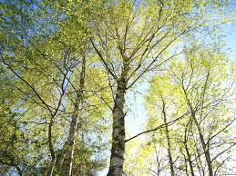
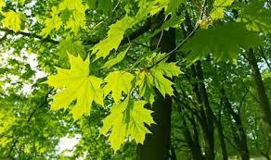
Spring came, trees and shrubs dressed up with beautiful leaves, light flowers.

Slide 3
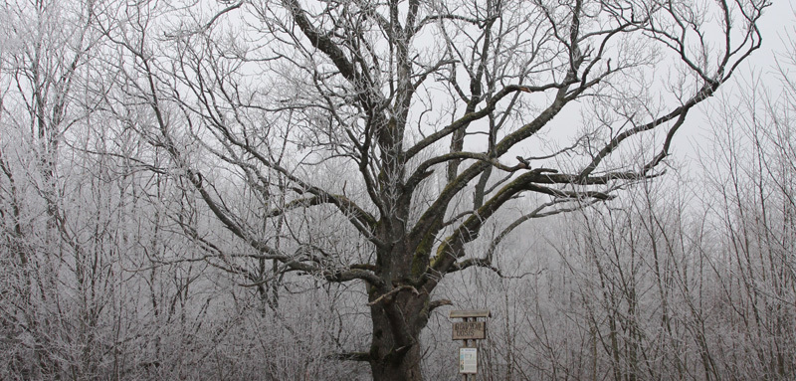
Only the lice still stood bare as in the cold winter. God had taken away the light of his eyes, and the poor man had no idea that spring was already pleasing to everyone.

Slide 4
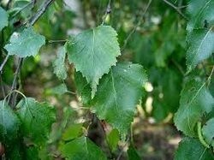
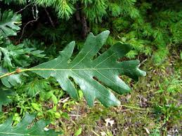
When the birch had long since settled on its cut hearts, and the oak tree had shrivelled its leaves, the two of them asked why the ash didn't care about the festive attire.

Slide 5
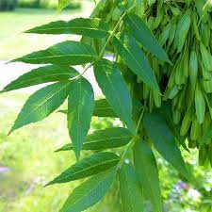
Ash was surprised: "Has spring already come?" "A long time ago," replied the other trees to him. Ash hastily danced the festive robe to sew, but during such a rush the leaves came out ugly, angular, deeply carved.

Slide 6
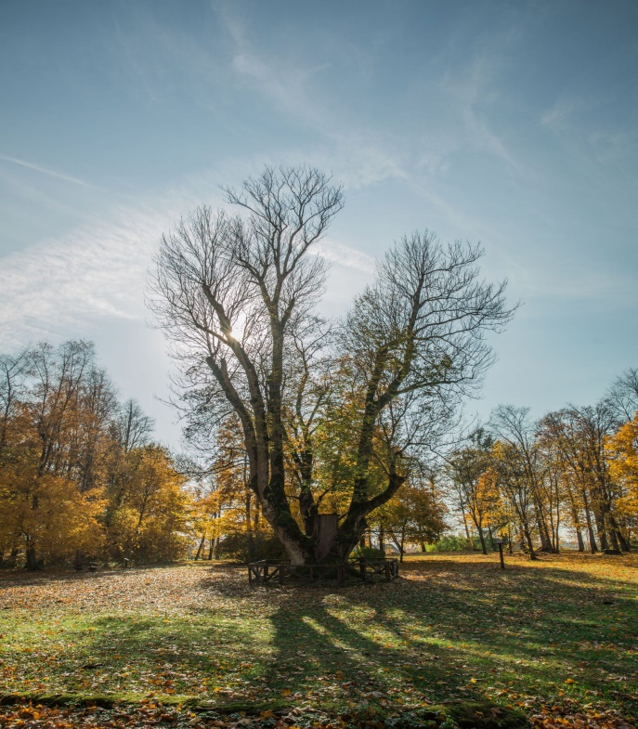
In the fall, when already the north began to rot, the ashes ask the other trees: "How soon will autumn be?" "So it's autumn," the trees replied. Hearing this, and not wanting to be the last to be the last to be the apologists of others again, the ashes shook off all the leaves at once.

Slide 7
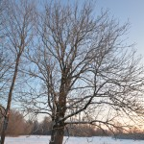
The other trees were still beautifully raw, and the ash blind man was already standing bare, and underneath his branches the north could sway and shove as much as he could fit.

