Slide 1
Interesting facts about tree seeds

Slide 2
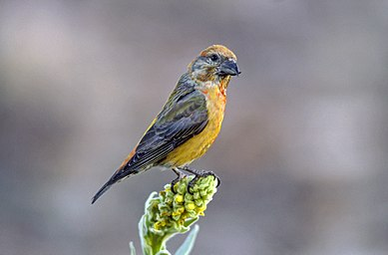
Maple seeds
Maple fruits are known as 'winged'.
Maple fruits ripen and fall between September and October.
Their fragile husk allows the seeds to be shelled.
The wings they have help the fruit to spread on the ground with the help of the wind.
Maple seeds are borne by crossbills.

Slide 3
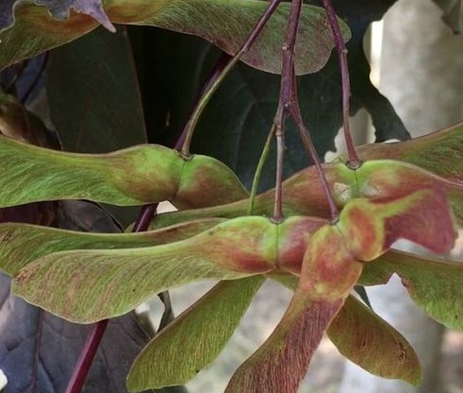
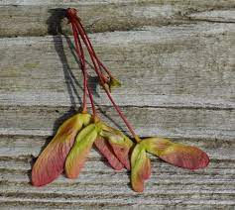
Maple seeds

Slide 4
Spruce seeds
Spruce seeds are 3-4 mm long and ripen in November-December when the sun is shining.
In autumn, one other seed starts to crumble, but most of the seeds fall out in the second half of winter and spring.
The colour is brown or dark brown with a wing three times as long as the seed.
Naturally occurring spruce trees are genetically unaltered by man and their seeds are highly prized.

Slide 5
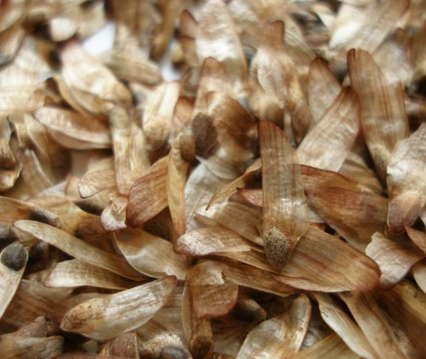
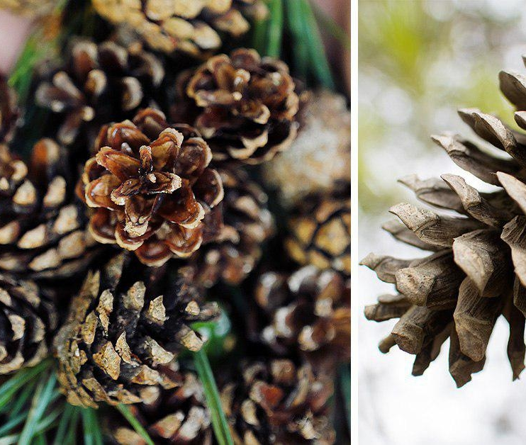
Spruce seeds

Slide 6
Chestnut seeds
The chestnut tree bears 1 to 5 fruits on the stalk in autumn.
The fruit usually has one, and less often two or three, large brown seeds inside.
Unprocessed chestnut seeds are poisonous, while processed seeds are used in soap and cosmetics and are eaten by deer.

Slide 7
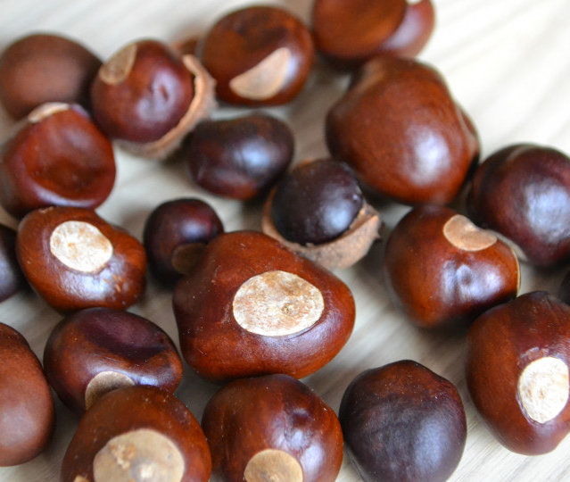
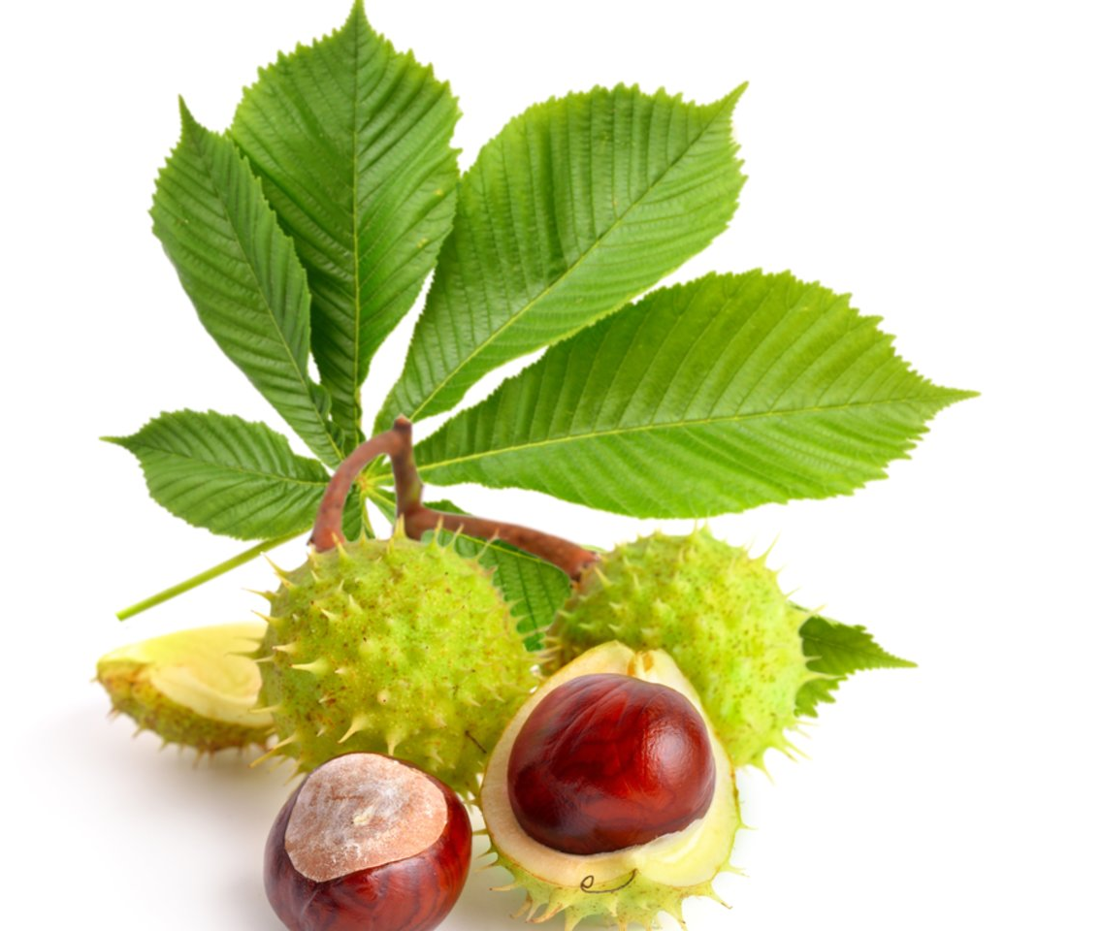
Chestnut seeds

Slide 8
Seeds of oak
The fruit of the oak is a beech-shaped, egg-shaped, one-seeded acorn.
They ripen and fall between September and October.
Oak trees growing in the open produce seeds between 20 and 25 years old.
The acorns are used to make flour, which can be used to bake bread, and also to make acorn coffee.
They are as nutritious as vegetables.

Slide 9
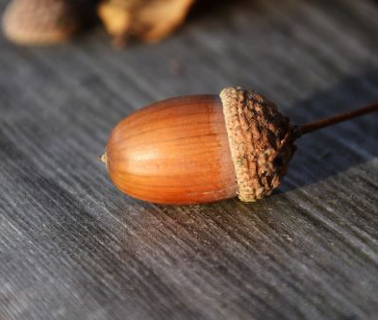
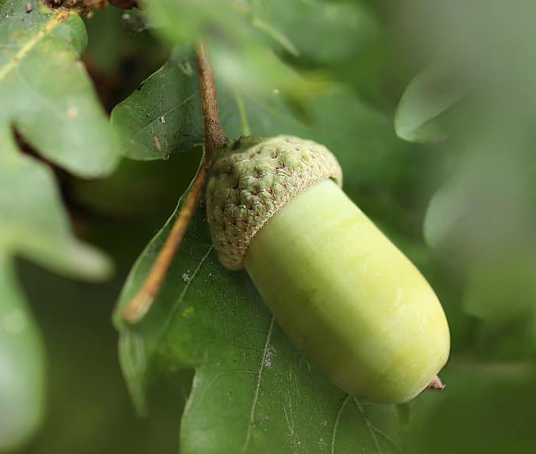
Oak seeds

Slide 10
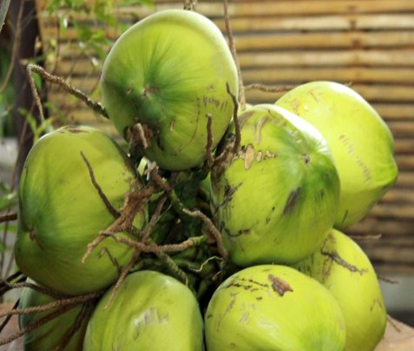
COCONUT
Coconut palms like to grow on the coast, and each year they often end up as seeds in the sea. Coconuts can withstand even a long journey through seawater; the shell provides good protection. And then, sooner or later, they are washed ashore. Then they germinate in a new place and start bearing fruit, forming palm groves.

Slide 11
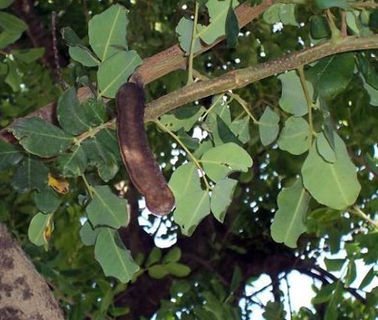
SWEET CAROB
Each carob seed weighs the same - 0.2 g., which is why dried seeds have been used in the past to weigh gold and precious stones.
The word 'carat' is derived from the name carob.
The Bible mentions that John the Baptist fed on the seeds of this plant in the desert.

Slide 12
By Kaja Cvikaitė and Barbora Sluckutė

