Slide 1

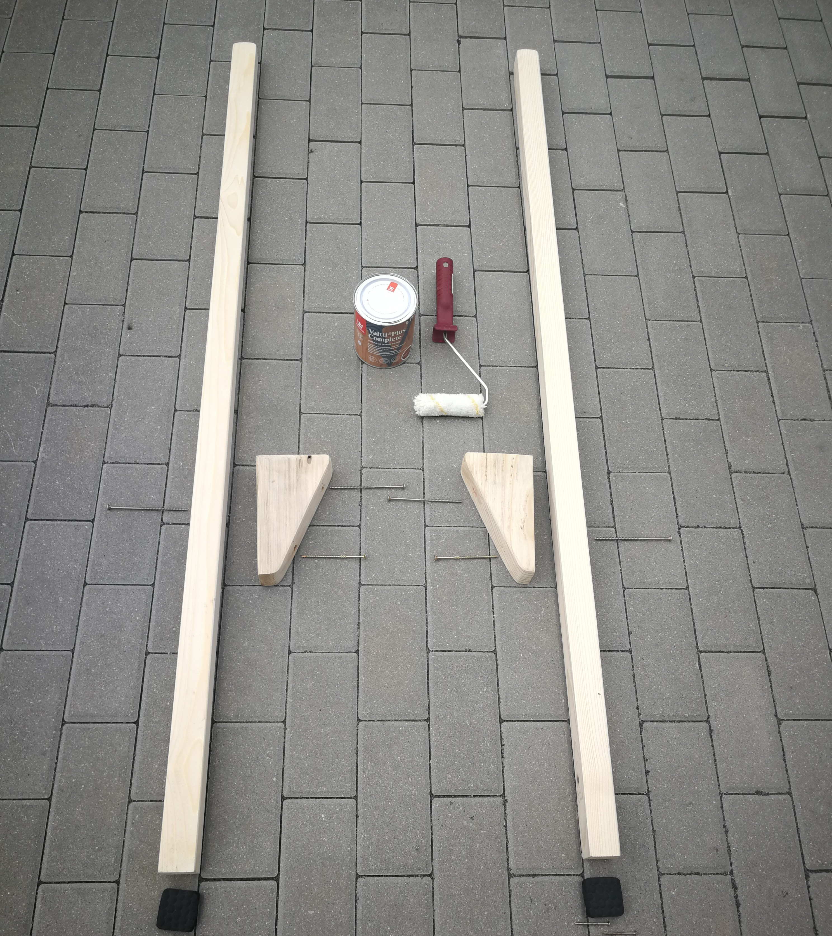
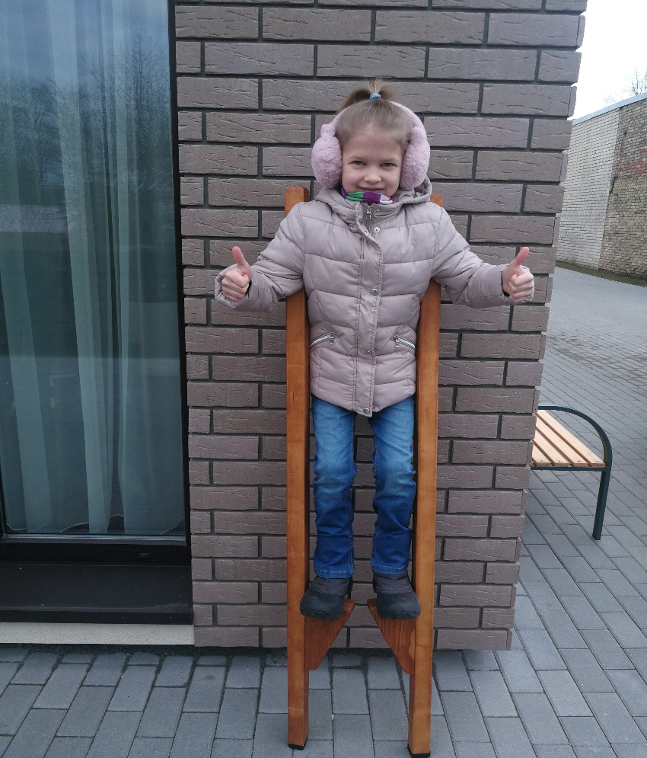
Walking sticks
These are 2 high carts to which bricks are nailed to attach legs

Slide 2
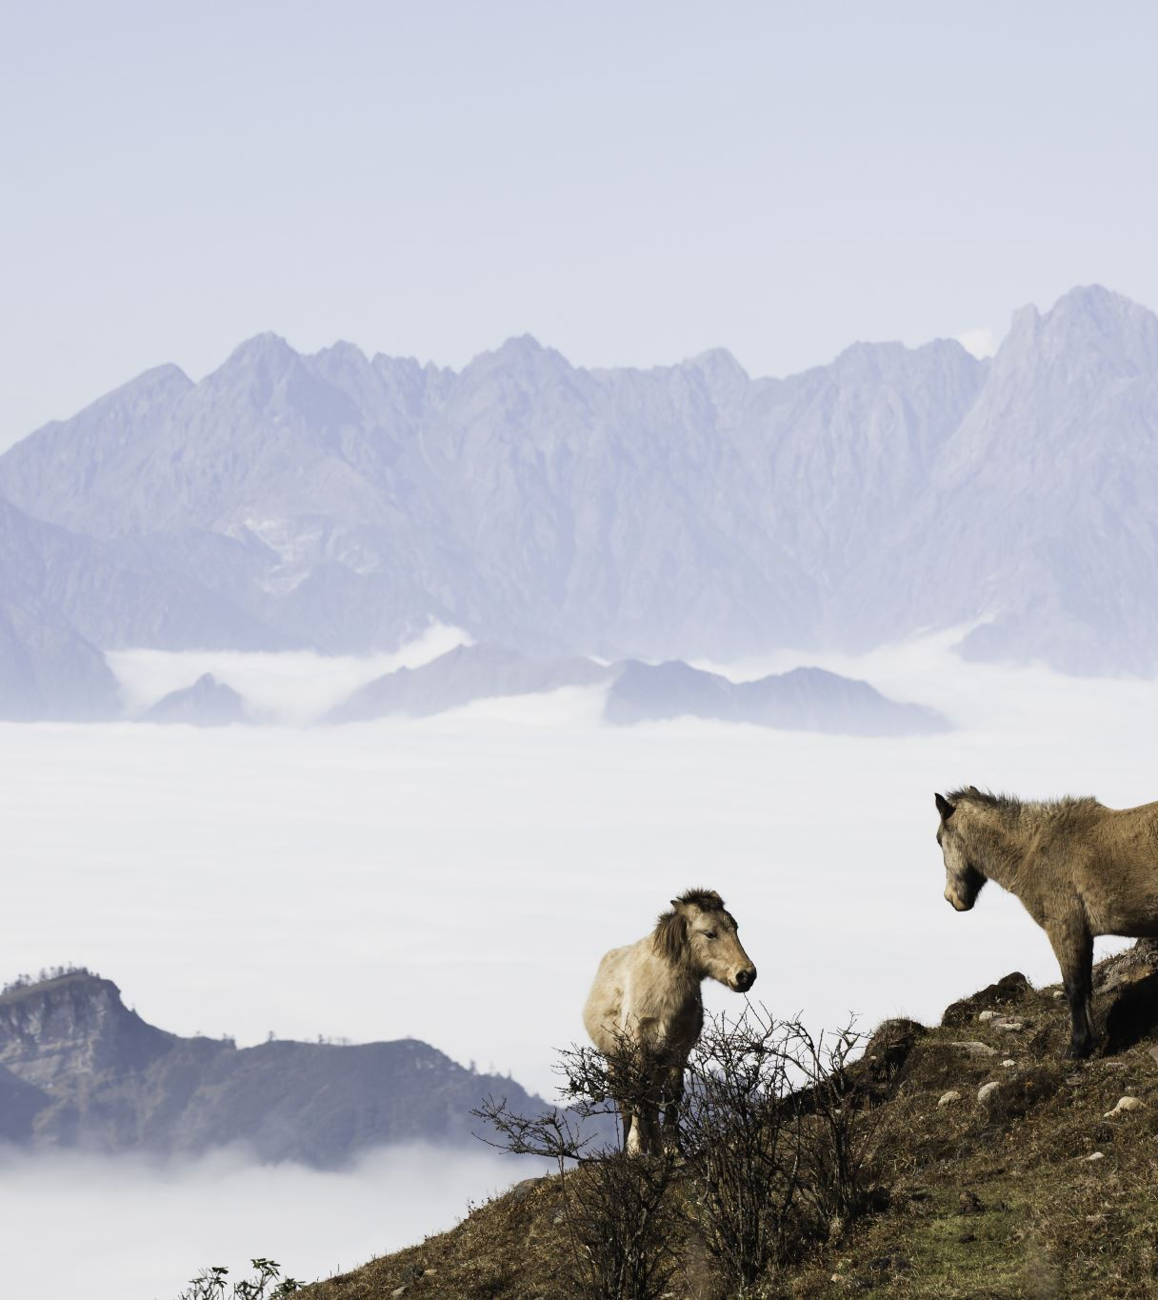
Walking sticks were used in ancient times
The ancient Mayans used them to be closer to the gods during religious ceremonies
Archaeological finds and historical sources testify to the fact that the foothills walked back in ancient Greece.
In Europe, socks were rescued by going to the swamps, shepherds used them to graze sheep
Postmen also wore socks – to avoid dogs
They were also used by people who had to light and extinguish gas lights.

Slide 3
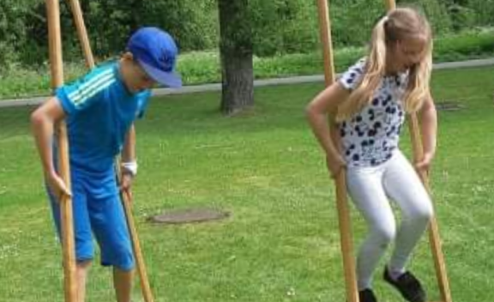
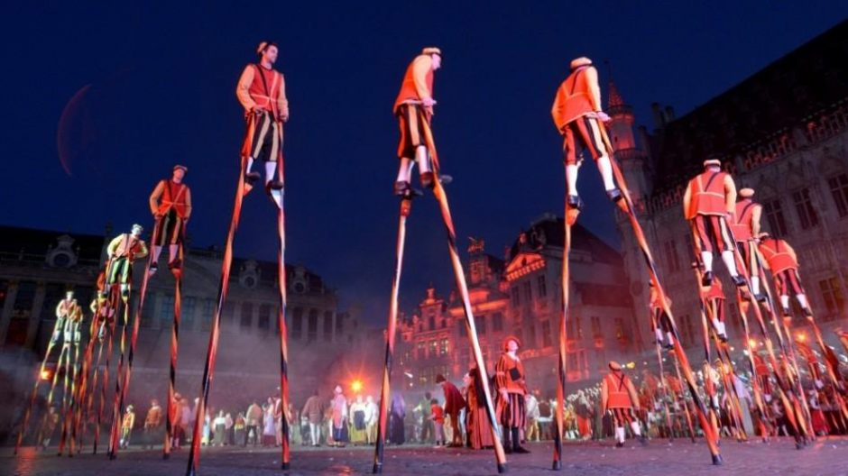
use of walking sticks
In the theater, in the circus, at street events
For active games, competitions
Buildings
Walking with socks helps to develop balance, coordination of movements and balance

Slide 4
Active game with Walking sticks
Two teams (3-5 players each) compete with each other on the field (meadow, field and etc.).
Each team must memorize a riddle about a tree
After memorizing the riddle, one participant with his feet must walk to a certain point (wood, fence, and etc..) and return to his team as soon as possible.
The goal is to memorize the riddle as quickly as possible and overtake the opposing team with his feet.

