Slide 1
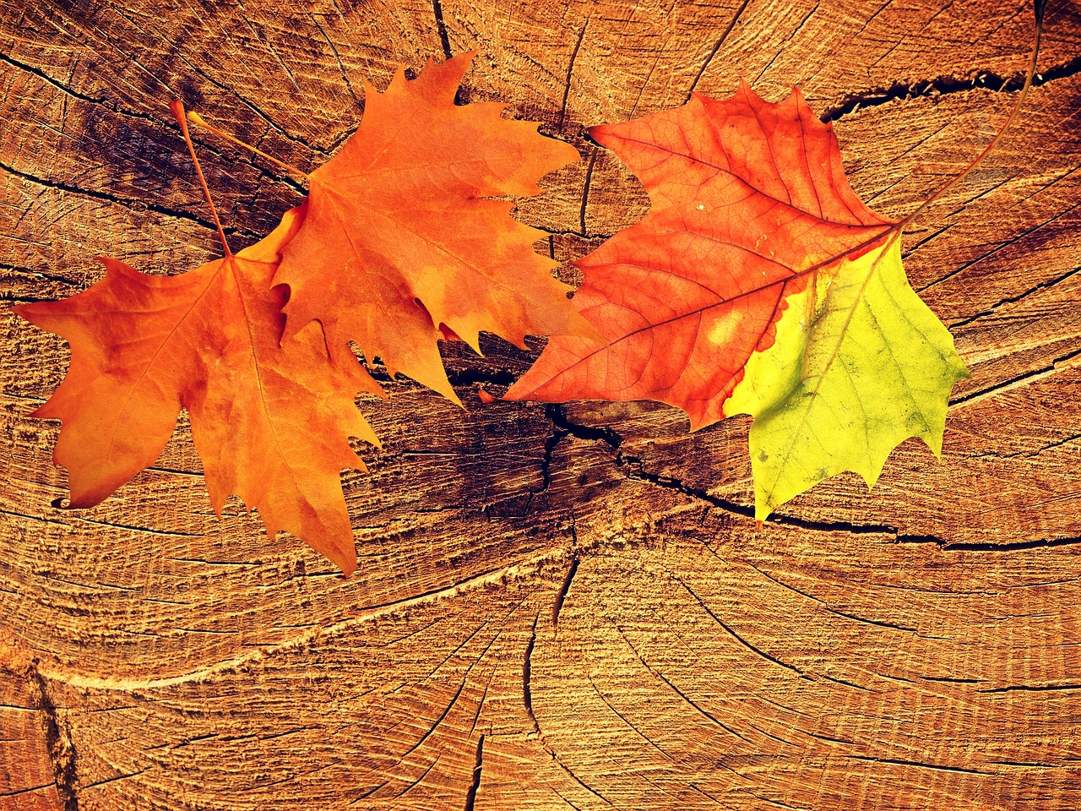
The Maple
By Martynas Juodagalvis

Slide 2
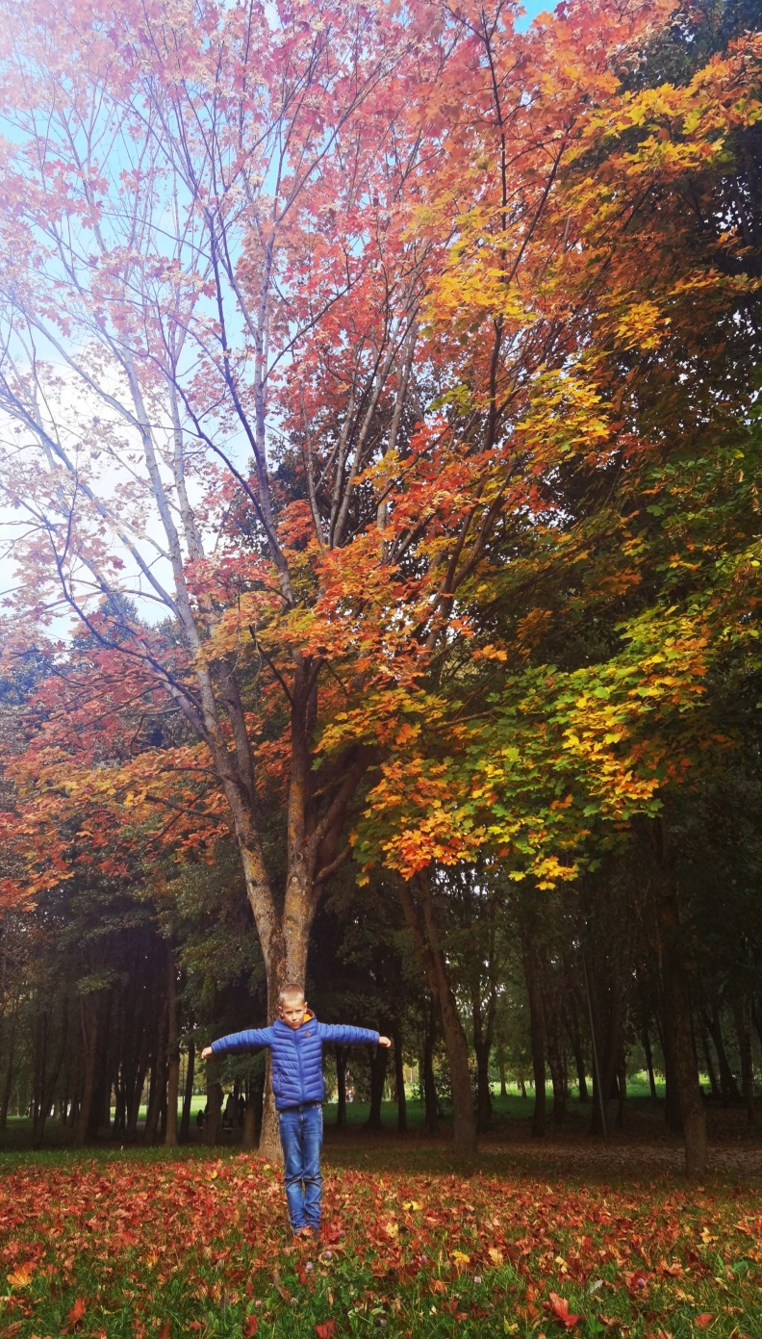
The maple
Large leaves, bright in autumn
Grows to 20-30 metres
Lives 100-200 years

Slide 3
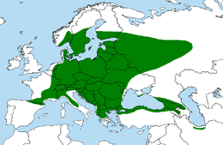
Distribution of maple trees

Slide 4
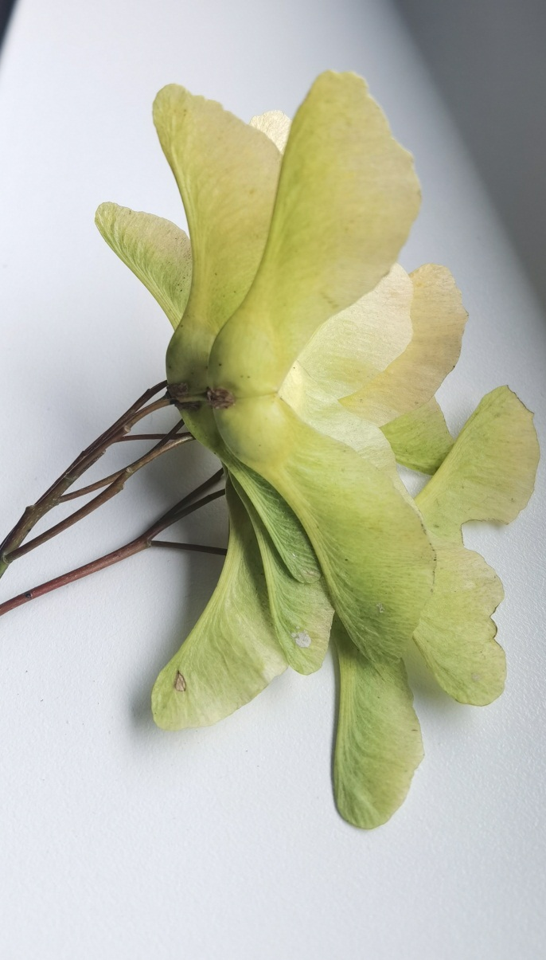
MAPLE SEEDS
Mature winglets are distributed by the wind.
After detaching from the plant, they fall in a circular motion and float up to several hundred metres.

Slide 5
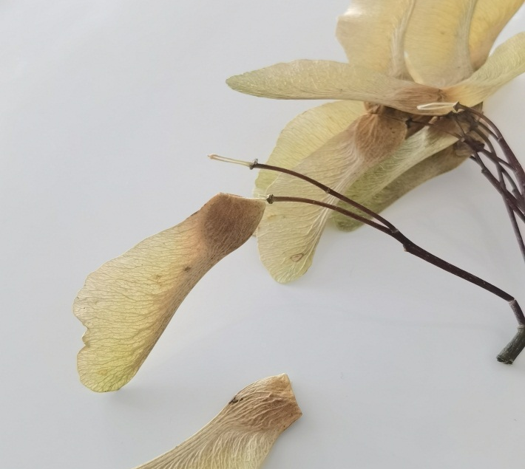
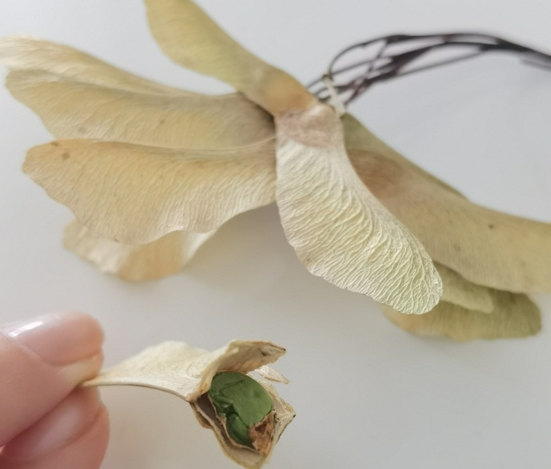
Mature winglets split.
Inside are maple seeds, about 5mm in size.

Slide 6
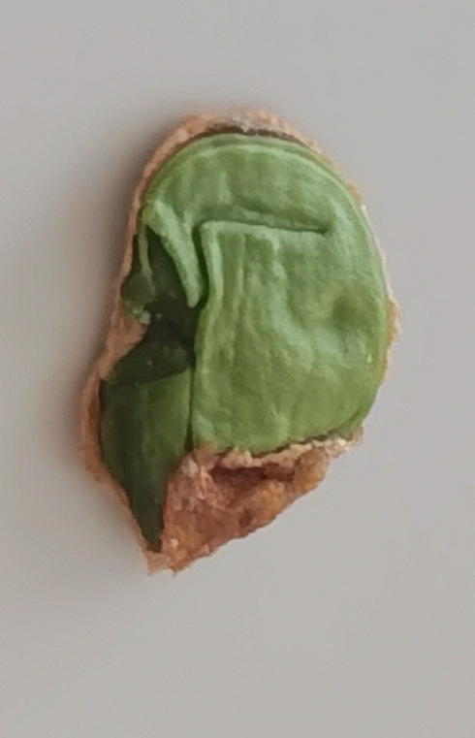
The seed forms a sprout.
In this way, a new maple tree can grow in the ground.

Slide 7
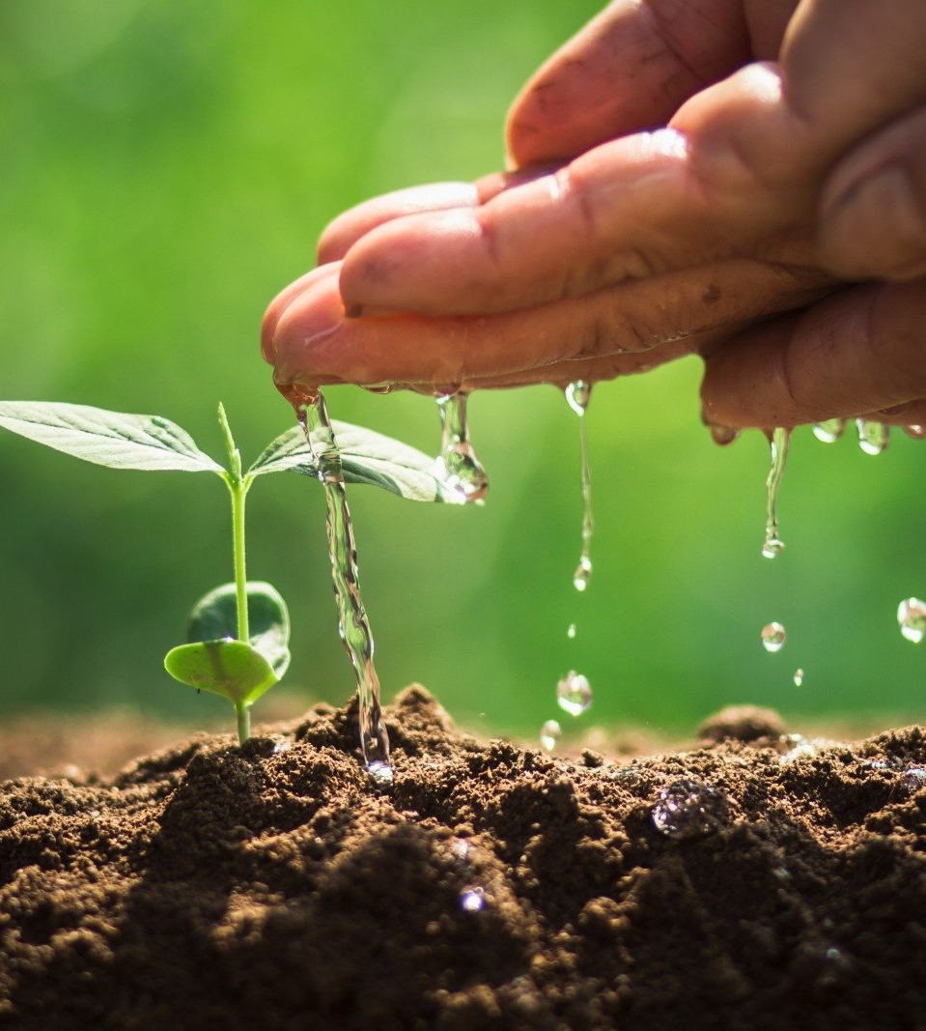
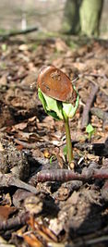

Slide 8
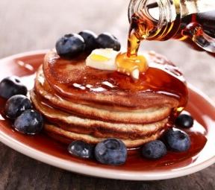
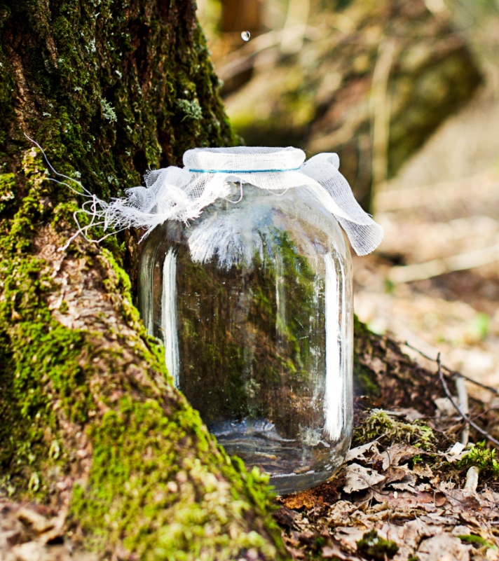
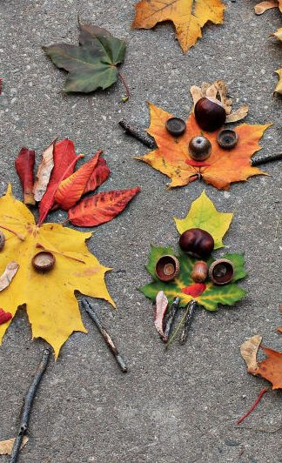
Benefits of maple tree
Colourful leaves.
Sula, a folk heritage drink that improves metabolism and can help with a wide range of diseases.
Maple syrup - to make a litre of maple syrup you will need at least 20-50 litres of maple sap.

