Slide 1
SPRUCE TREE AND CHESTNUT
by JOMANTAS LUNSKIS

Slide 2
THIS AUTUMN TIME, WHILE ENJOYING AND WALKING THROUGH THE YARD OR THE PARK, WE CAN CHOOSE VARIOUS NATURAL WEALTH - NOT ONLY BEAUTIFUL LEAVES, BUT ALSO SEEDS.

Slide 3
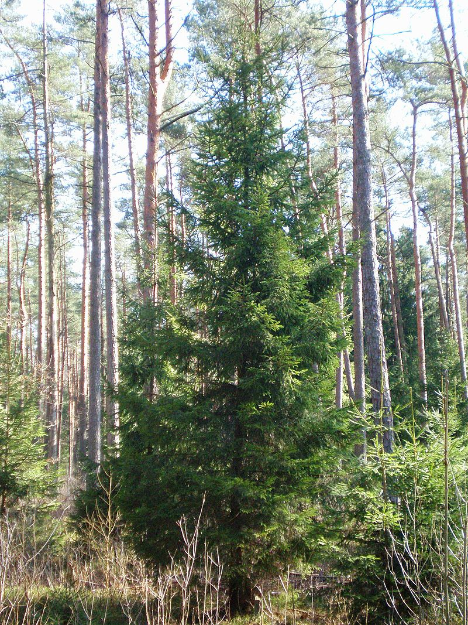
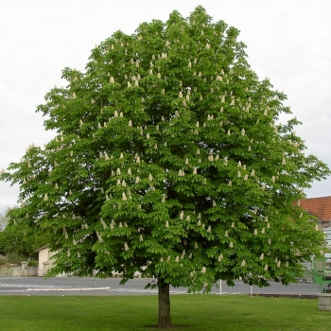
SPRUCE TRE AND CHESNUT
CONIFEROUS TREE
DECIDOUS TREE

Slide 4
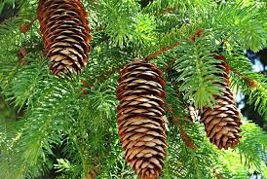
Fir- cone

Slide 5
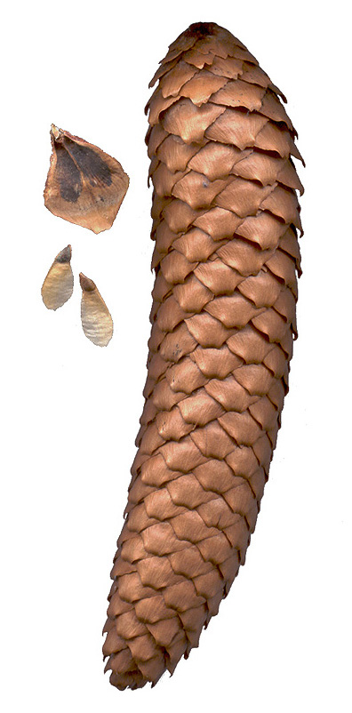
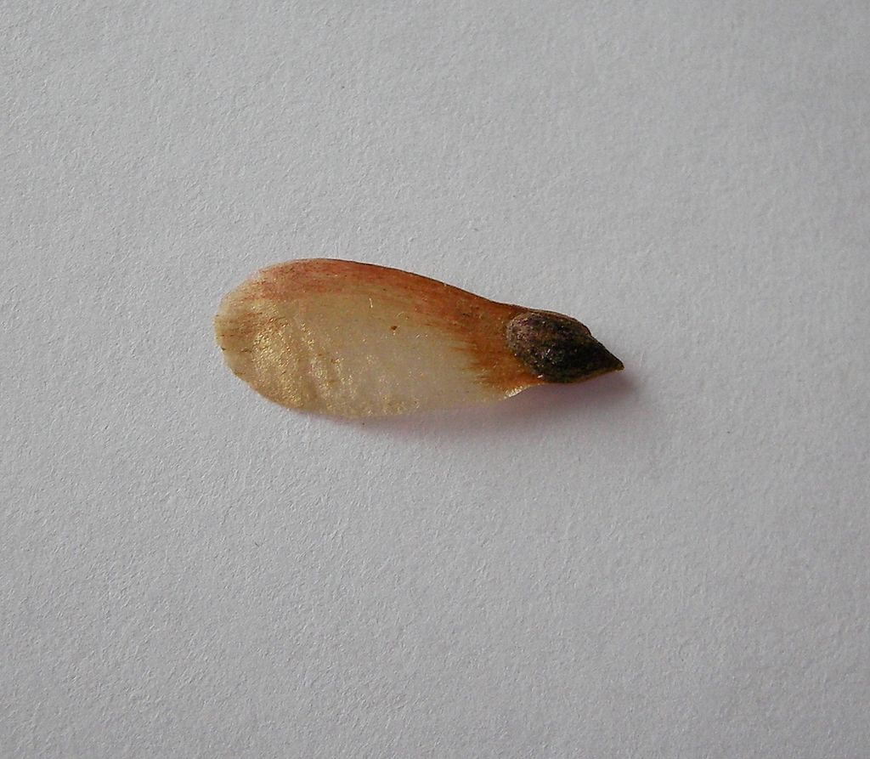
THE LENGTH OF FIR-CONE IS ABOUT 10 CM

Slide 6
SEEDS ARE SMALL,0.2-1 CM IN SIZE, WITH A WING WHICHHELPS THE SEED TO FLY AWAYFOLLOW UP.

Slide 7
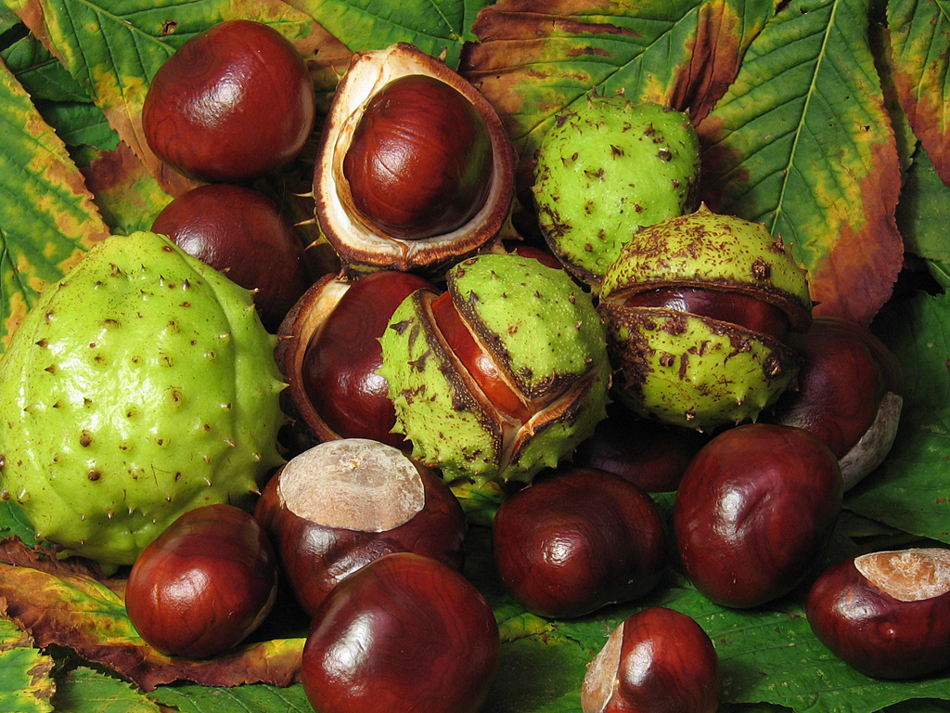
CHESTNUT SEEDS - ARE ONE OF THE BIGGEST IN OUR COUNTRY. THEY ARE ROUND AND THEIR DIAMETER IS ABOUT 2-4 CM.

Slide 8
FIR-CONE AND CHESTNUT DIFFERS NOT ONLY IN SHAPE AND SIZE, BUT ALSO IN THE QUANTITY OF SEED.FROM ONE CHESTNUT CANGROW ONE CHESTNUT TREE, AND ONE PINE CONE CAN GROW A LOT OF CHRISTMAS TREES.

