Slide 1
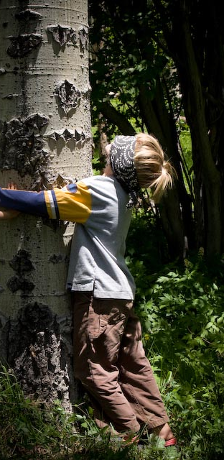
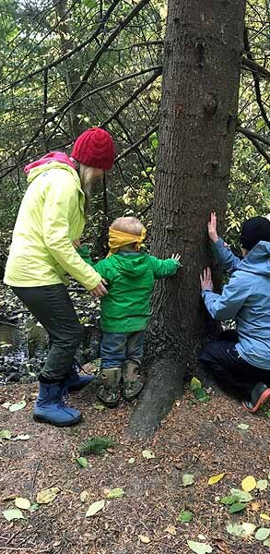
GAME
"Hug and recognize the tree"

Slide 2
Game Description:
From 2-10 people can participate in the game.
The game takes place in pairs.
The game must take place in a park or in the forest, where there are various trees.
One player blindfolds his companion and takes him to the tree of his choice. A player with blindfolded eyes can palpate a tree, smell it in order to memorize its qualities and be able to recognize it. After that, he is returned to his previous place and his eyes are untied. The player must recognize what kind of tree it is and what it is called.

Slide 3
