Slide 1
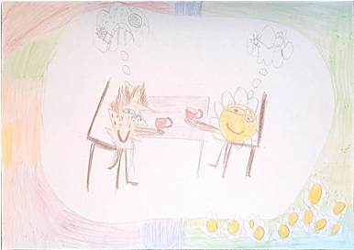
The fairy tale "Acorn Coffee"
Artūras Mockūnas
Šiauliai Jesuit School

Slide 2
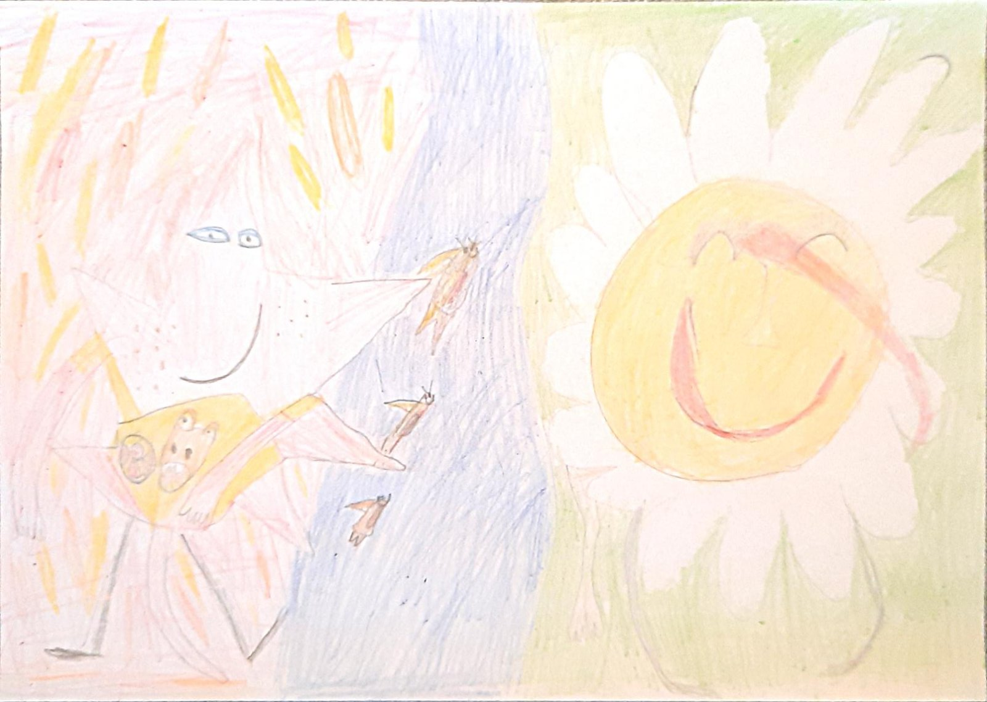
There is a land in the world where Autumn lives. Such a lonely Autumn. Brown-haired and a little freckled. Far away from him, on the other side of a wide river, lives Summer. Autumn waits anxiously for her to appear. Summer is a very rare visitor in the land of Autumn. But sometimes she comes in a rudderless boat. Whimsical lady, Summer! You never know what Autumn will ask for - rain or sleet, a slight breeze or a gale. Even more so, you never know how many stars she will need. That's the brilliance of Summer! The whole sky seems to have turned into one star, and Summer keeps sending and sending her messengers to Autumn - the birds of the night. One more star, one more star, or preferably two more stars...

Slide 3
There is only one happy moment in the year for Autumn. One solitary moment. A moment so short and so happy that Autumn doesn't know if he invented it to comfort himself. And so it goes: Summer is fed up with the blossoming world, tired of pampering people with dew in the mornings, sunshine in the days, coolness in the evenings, stars at night. Then she jumps into her boat, determined and strong, and sets sail without looking back to Autumn. They drink deep coffee. Two of them. On the veranda of Autumn, on the steep bank of a wide river. Autumn tries to drink very slowly. Another word, another.... Everything. The stay ends.

Slide 4

Autumn's letters fly to the Summer land, and those that don't - fall to the ground, fall into the river. Autumn's letters, written on the leaves of the trees, are flying, but Autumn doesn't know if Summer can read what is written in cosy colours: yellow, brown, red, green. But she knows: if Summer has been cold, she will burn those letters - leaves - and her summer house will smell extremely delicious. It will smell of autumn.
When there are no leaves left in towns and cities, when there are no more letters to write on, Autumn will wink sometimes at my door, sometimes at yours. What's there to wink at. Autumn howls because it has run out not only of leaves - letters - but also of rain - tears.

Slide 5
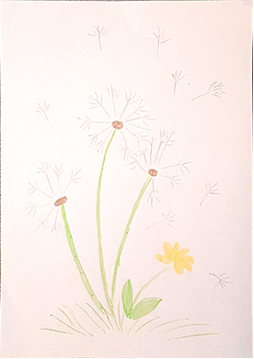
- I'll comfort you, says Winter to Autumn, who always comes unexpectedly.
- I will," she says, and laughs horribly, and Autumn retreats from her, relieved.
Winter has to wait for Spring. The light-hearted Spring that Autumn has never seen, has never seen before. That is why he does not know that it is not his letters that Summer needs, not those of Autumn. And if there are letters, they are not Autumn letters. Because her own letters to Spring are dandelion fluff. Wherever the wind wants to go, it takes them.

