Slide 1
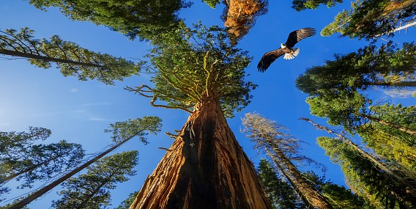
SEQUOIA
By Simonas Gaižauskas

Slide 2
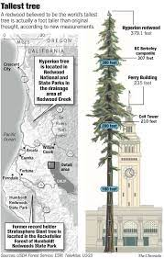
The largest tree in the world, 115.6m.

Slide 3
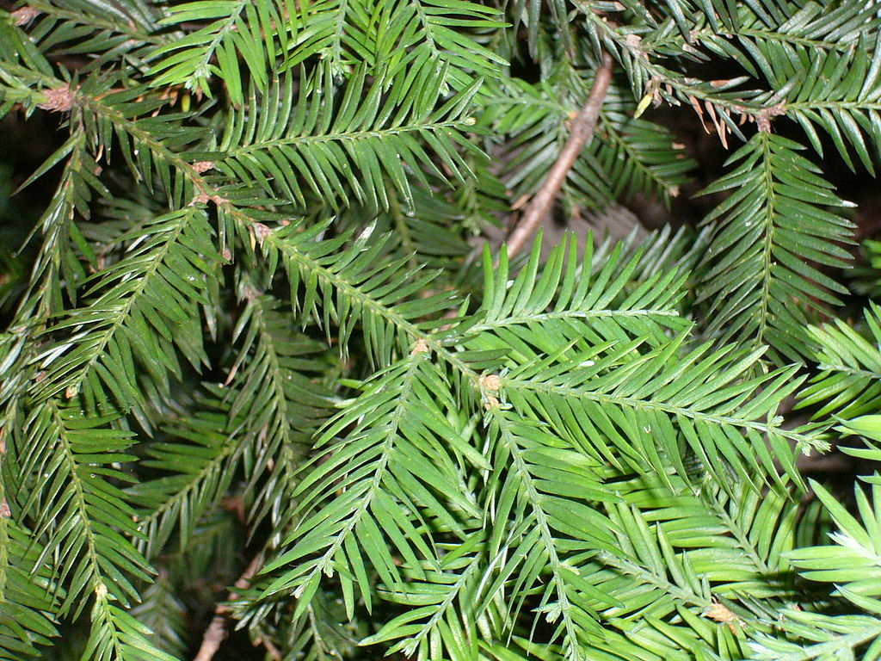
Spines 15-25 mm long

Slide 4
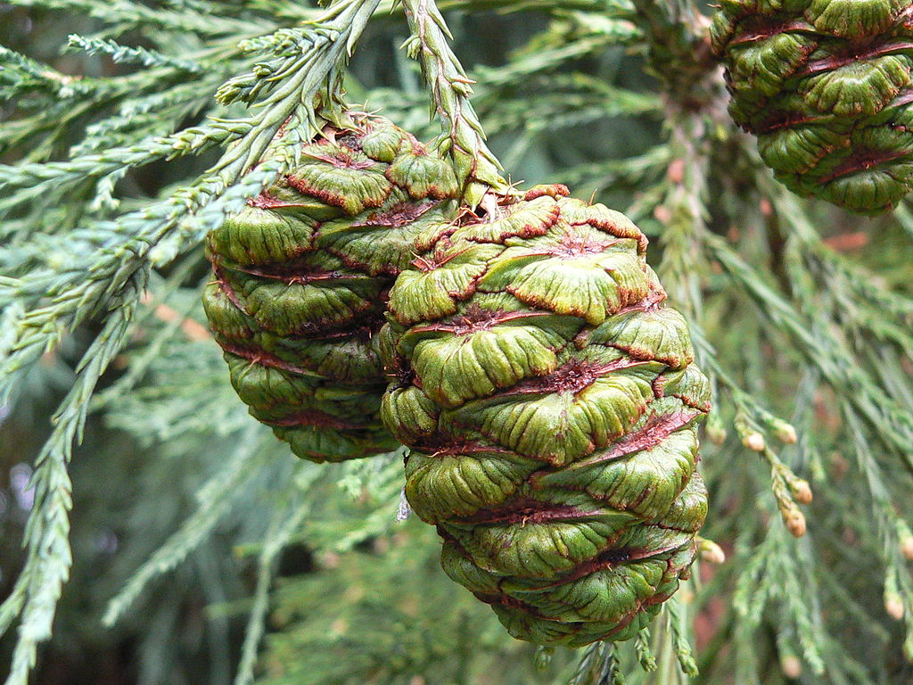
Pine cones 15-32 mm long

Slide 5
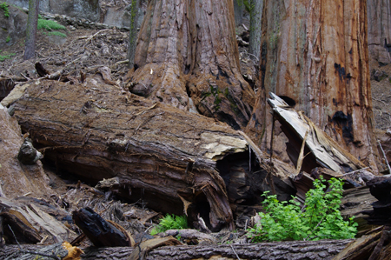
Interesting Facts
The thickest tree bark in the world.

Slide 6
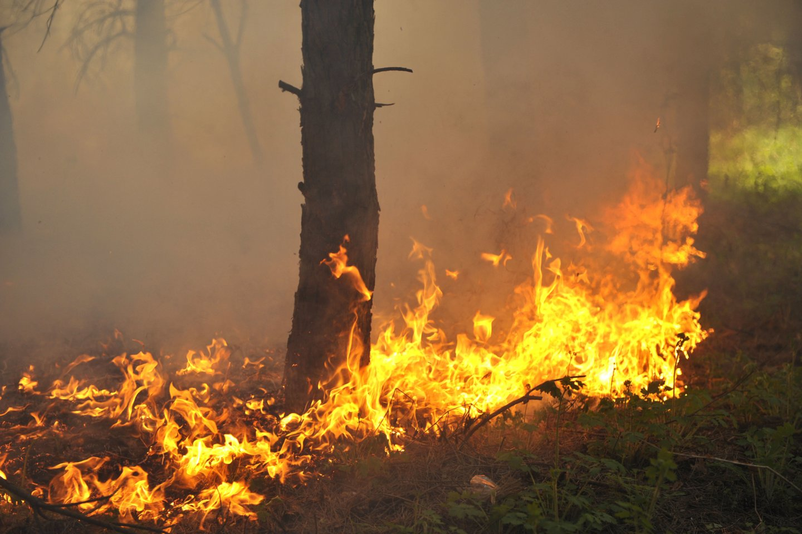
Due to the thick bark is not afraid of fire

Slide 7
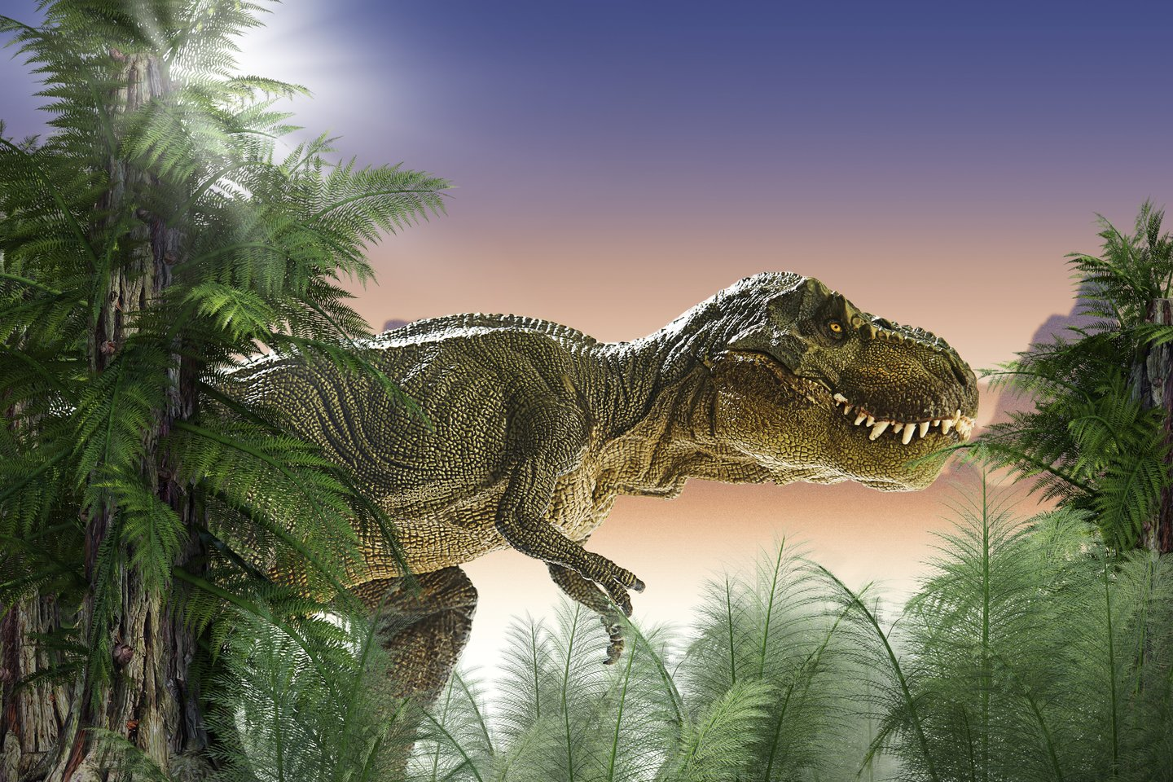
Sequoia is of the same age as dinosaurs

Slide 8
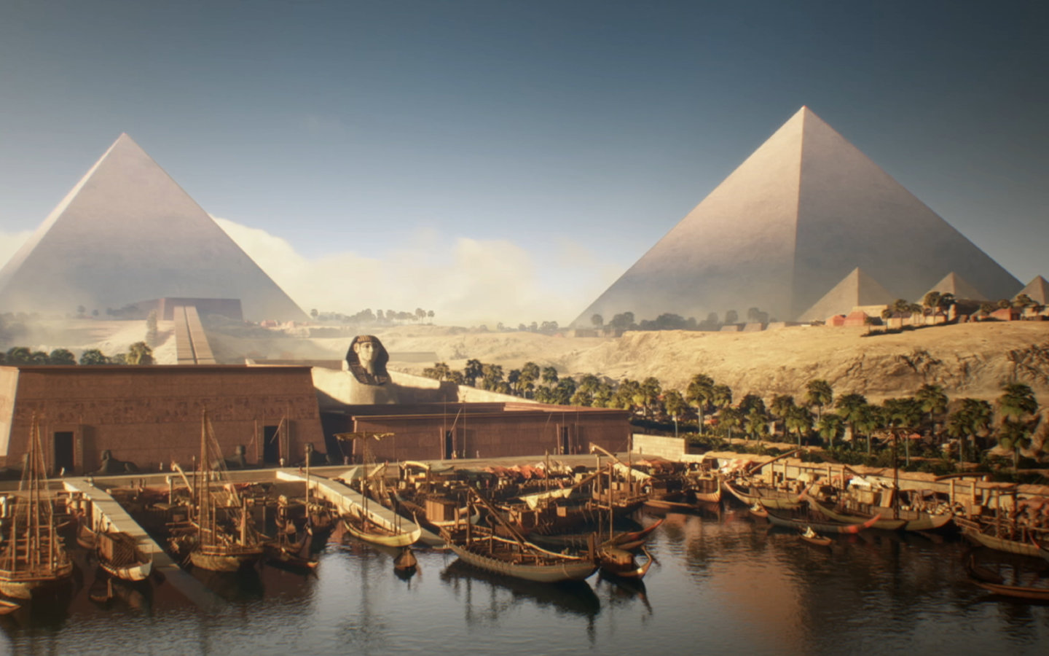
After the construction of the first pyramids in Egypt was completed, the oldest living sequoia began to grow in Mexico.

Slide 9
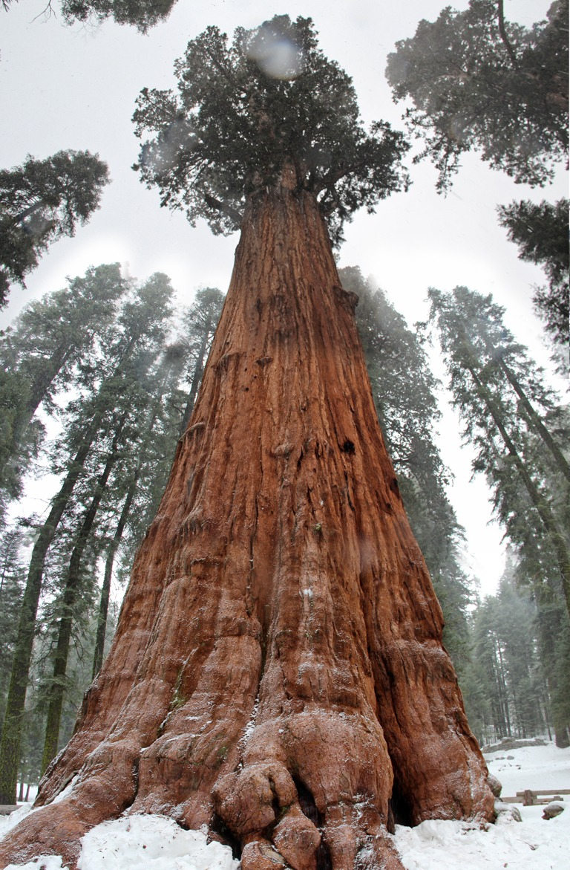
END

