Slide 1
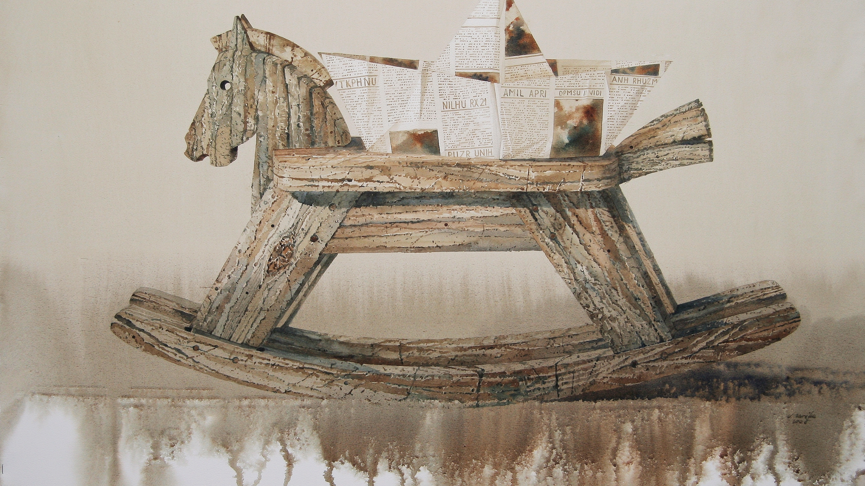
Wood and ecology: a wooden horse toy
JORINGIS ZARĖKA AND GABRIELIUS ZARĖKA
ST. CLAUDIUS COLOMBIER 1ST GRADE

Slide 2








The horse was one of the first domesticated animals, an important companion of man in all historical periods.
In different cultural environments, horses accompanied people in different forms: they carried, carried, plowed or accompanied them to the afterlife. Their images adorn household utensils, jewelry, weapons, tools of labor.
In the form of a toy, the horse has been known in Europe since antiquity, and in the Middle Ages, with the flourishing of knights, and in new times it becomes a symbol of toys.

Slide 3

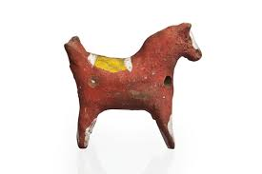
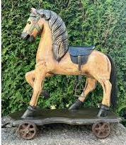
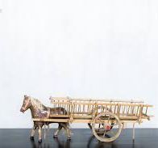
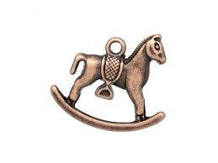
Archaeological sources and works of art show an extremely wide variety of forms and materials of this toy – clay, metal and wooden rolled soldiers, chariots and carriages, earthen horse-shaped whistles, horses with wheels, horses on the shank.

Slide 4
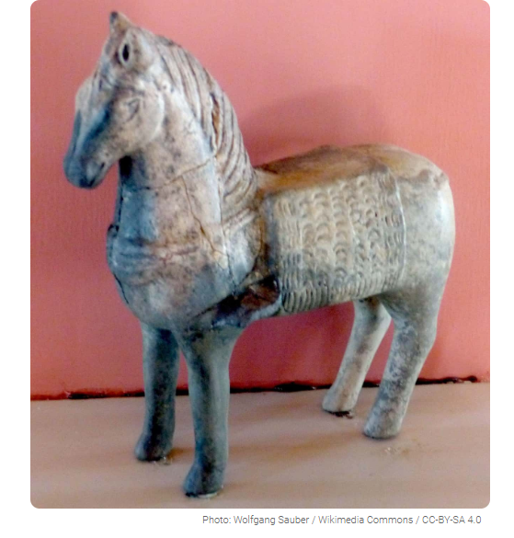
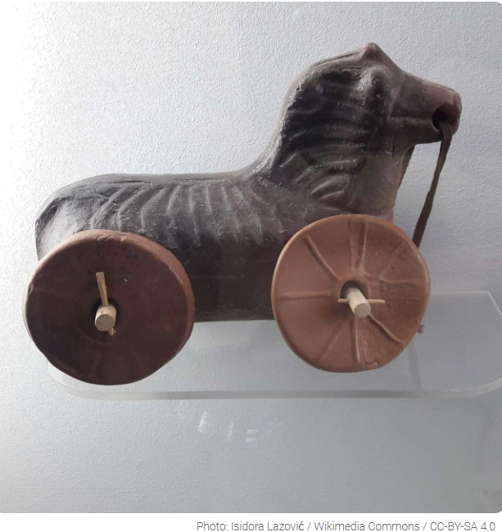
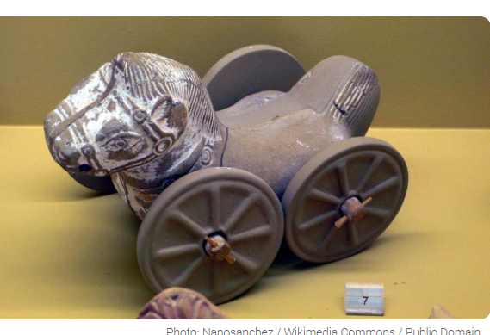
The first ancient toys are horses of burnt clay, found in Egypt, which are believed to be about 2500 years old.

Slide 5
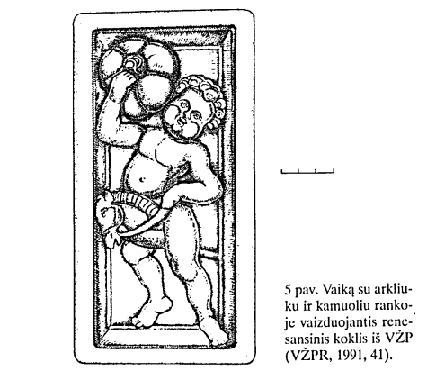
Of the archaeological finds, it is necessary to single out a playing child depicted on a (early 16th century). The work depicts a boy holding a raised ball with one hand and a sleek wooden horse with the other.

Slide 6
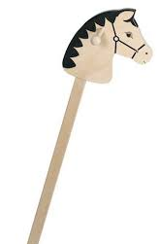
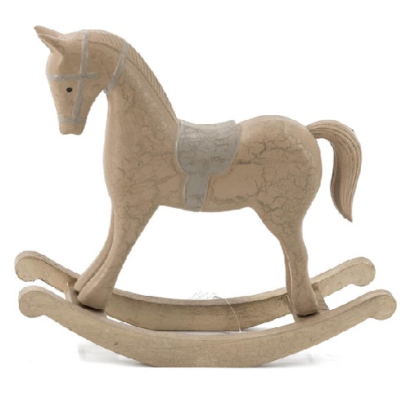
The horse is a classic children's toy, the sizes and shapes of which can vary from a simple overwintered stick to a life-sized horse on the springs.

Slide 7
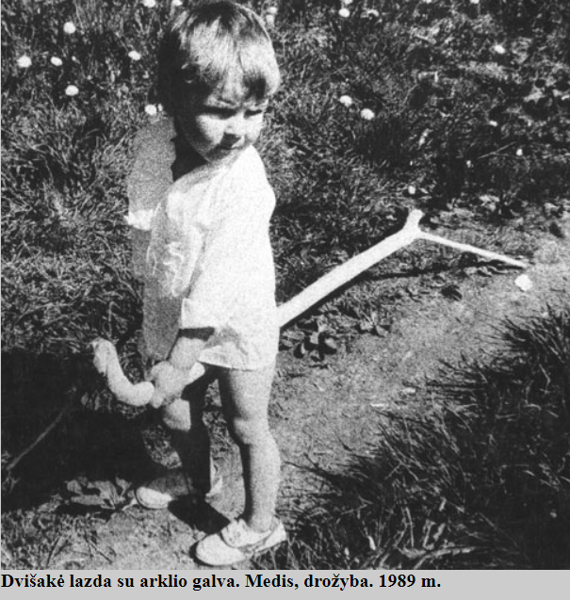
The purpose of many toys is to prepare children for adult life. For example, a stick with a horse's head helps a child understand how a horse is riding, much earlier than he is able to hold out in the saddle.

Slide 8
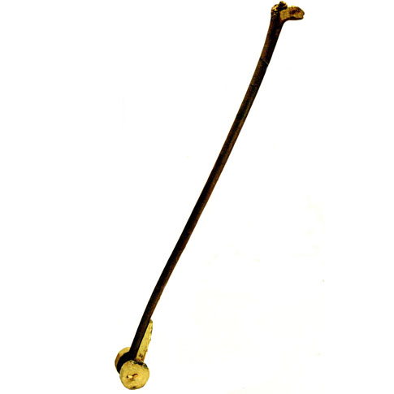
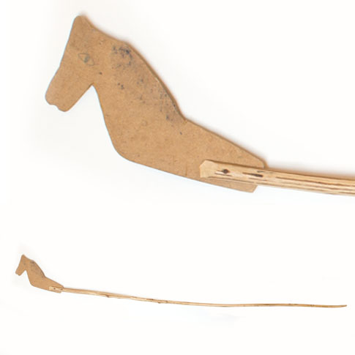
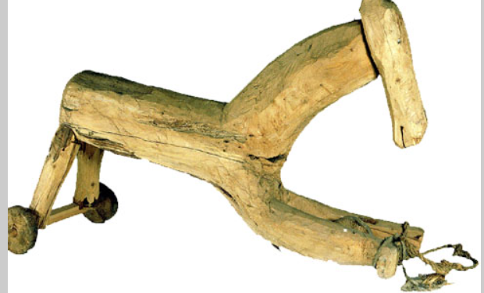
RECONSTRUCTION OF ANTANAS BIELINIS TOYS AT THE LITHUANIAN FOLK LIFE MUSEUM

Slide 9
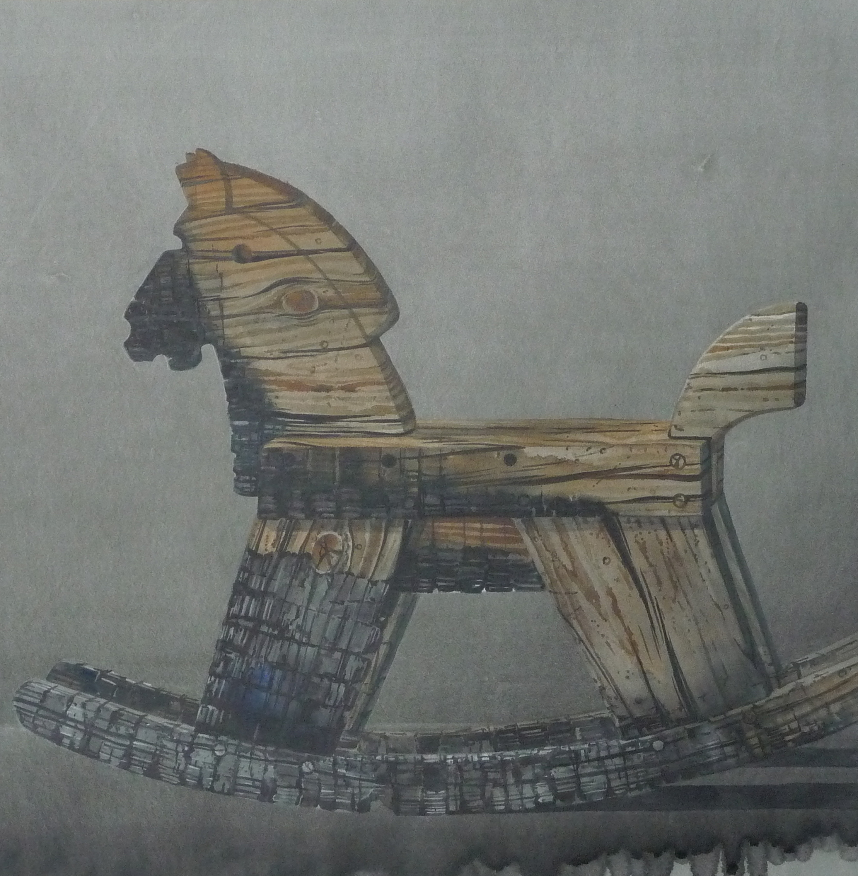
It is believed that the first horses on swings began to be produced by German artisans in the 16th century. Later, in the 18th and 19th centuries, they became widespread in the rest of Europe.
And from the beginning of the 20th century, they also became part of Lithuanian children's entertainment.

Slide 10
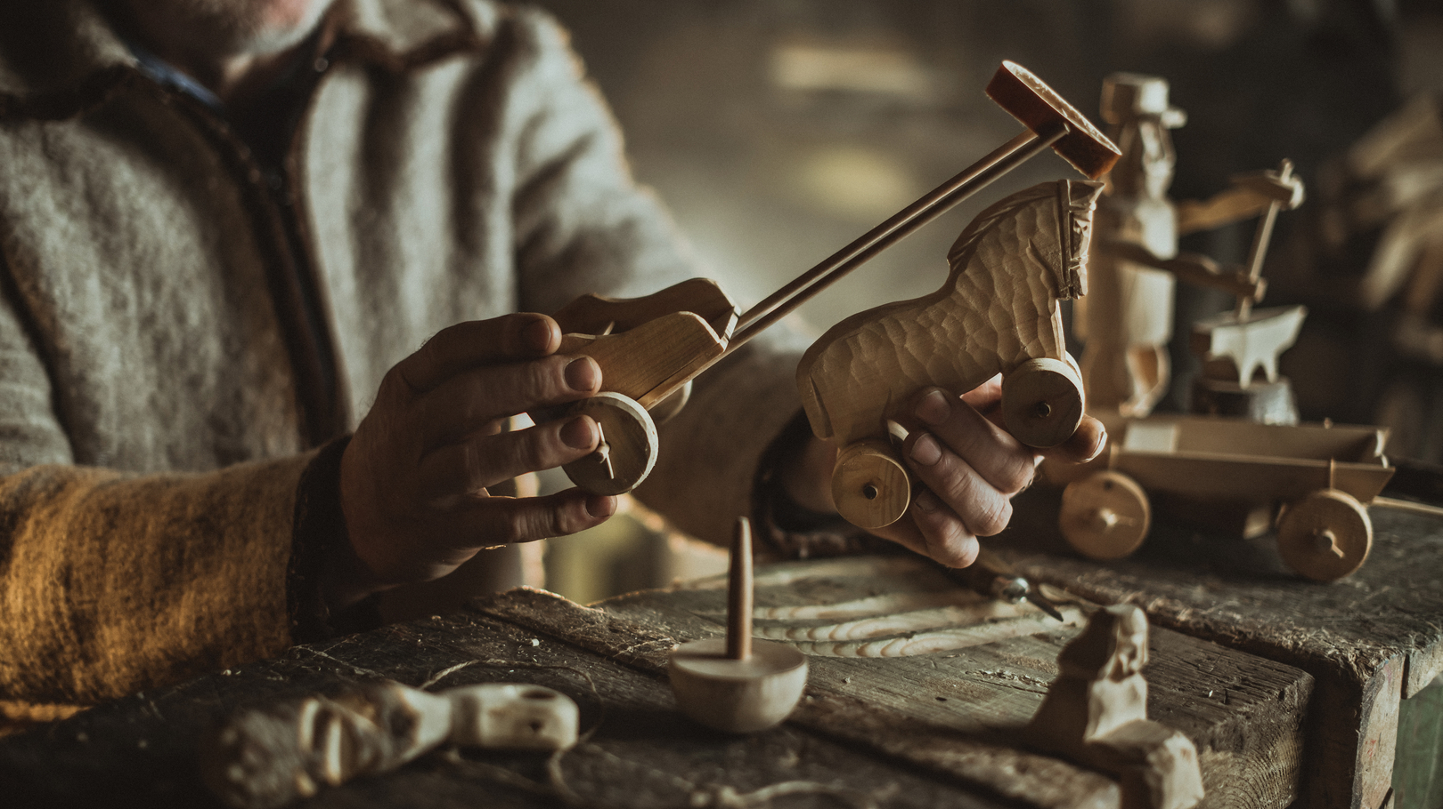
PLAYMAKER

Slide 11
At the beginning of the 20th century, the center of horse producers was the villages of Chekoniškės and Prapuoliai located on the outskirts of Vilnius. The craftsmen who worked in these villages usually sold horses only during the Kaziuk fair, but there were also those who made a living from it.
For example, F. Sinkevičius sold 4-5 rocking horses to Vilnius traders every week.

Slide 12
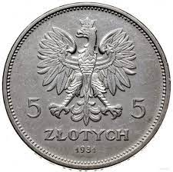
The production of horses began with the purchase of raw materials. For a fox tree chosen in the forest, you had to pay about 25 zlotys . Most of the wood was used to make wooden tubs and utensils, and horses were made from the rest.
As a rule, linden, aspen or alder wood was used for production. In the summer, the prepared raw material was dried, and in late autumn and winter, the time came for the manufacture of toys.

Slide 13
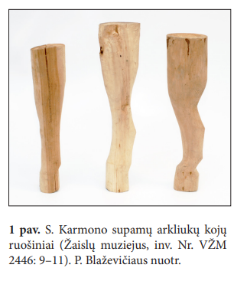
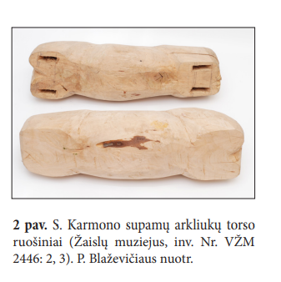
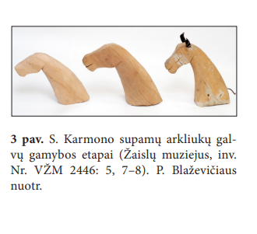
First of all, separate parts were produced. The classic rocking horse needed 10 elements: a head, 4 legs, a torso and 4 pavais.

Slide 14
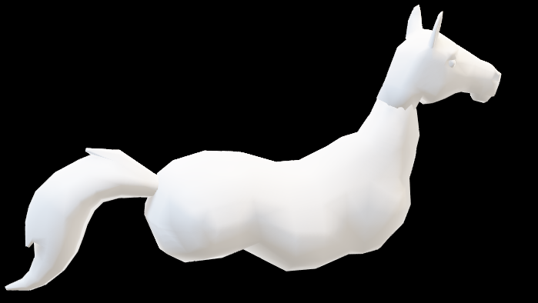
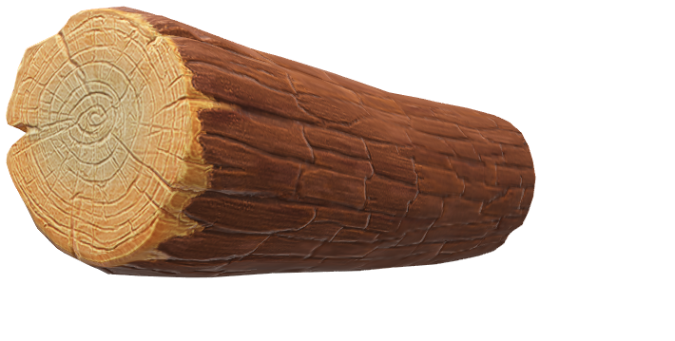




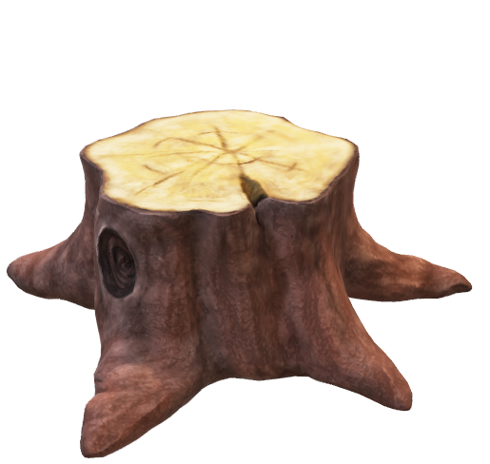
At the beginning, individual details were cut out and splashed, later, when carving, the features of the horse and the elements of the connection were formed.
The final stage of processing the parts is grinding with sandpaper and sealing small cracks. When connecting the details, ears made of triangular skin scraps were attached to the head. The assembled product is decorated.
The manes and tails of the horses were made already after dyeing, sometimes from white rope, but most often only from the natural hair of horses.

Slide 15
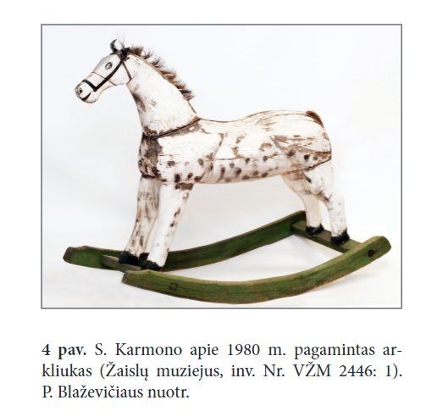
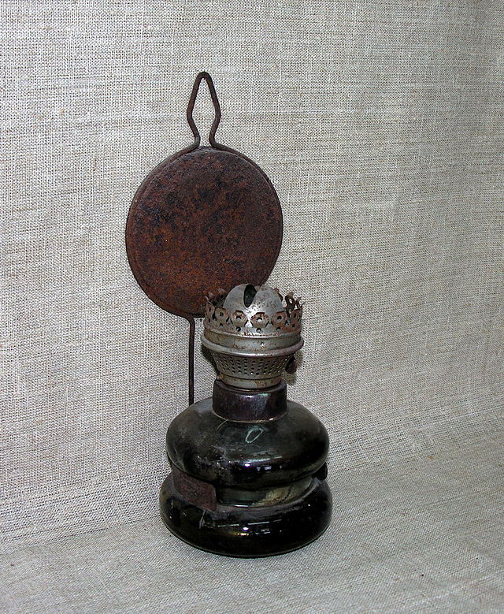

Most often, the horses were painted in the usual way in the Vilnius region – a toy painted white was smoked with a kerosene lamp and turned into an apple.

Slide 16
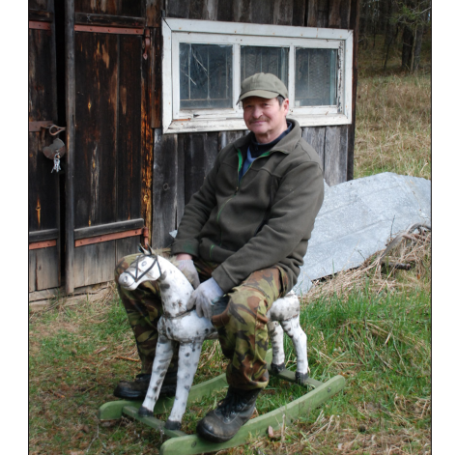
The apple horses made by Stanislovas were large – their height at the back was about 45 cm, and the body length ranged from 42 to 60 cm, so several children or even an adult could safely swing on them.

Slide 17
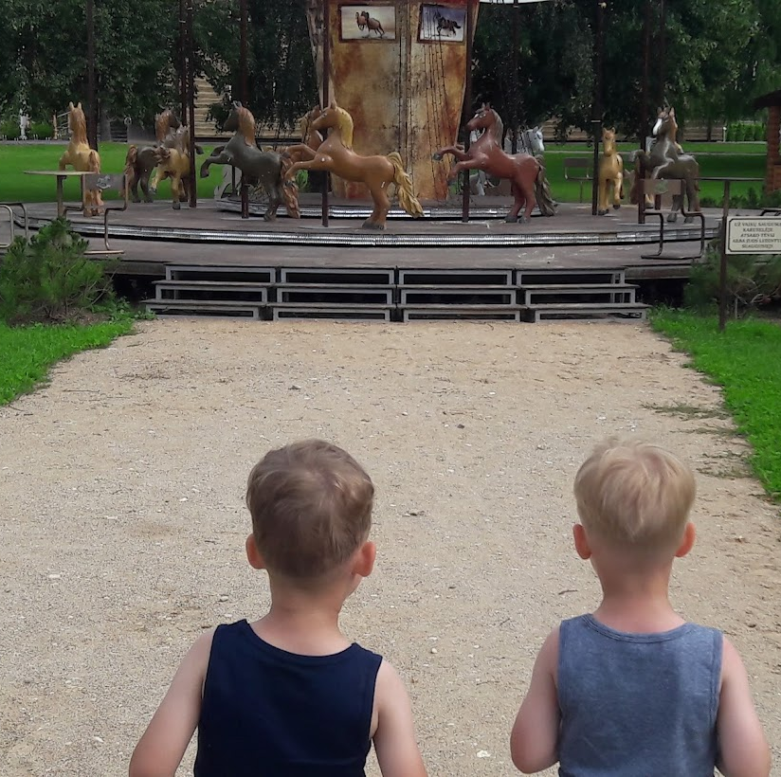
The horse toy was enjoyed by grandparents and parents, and even nowadays it is not losing popularity.

