Slide 1
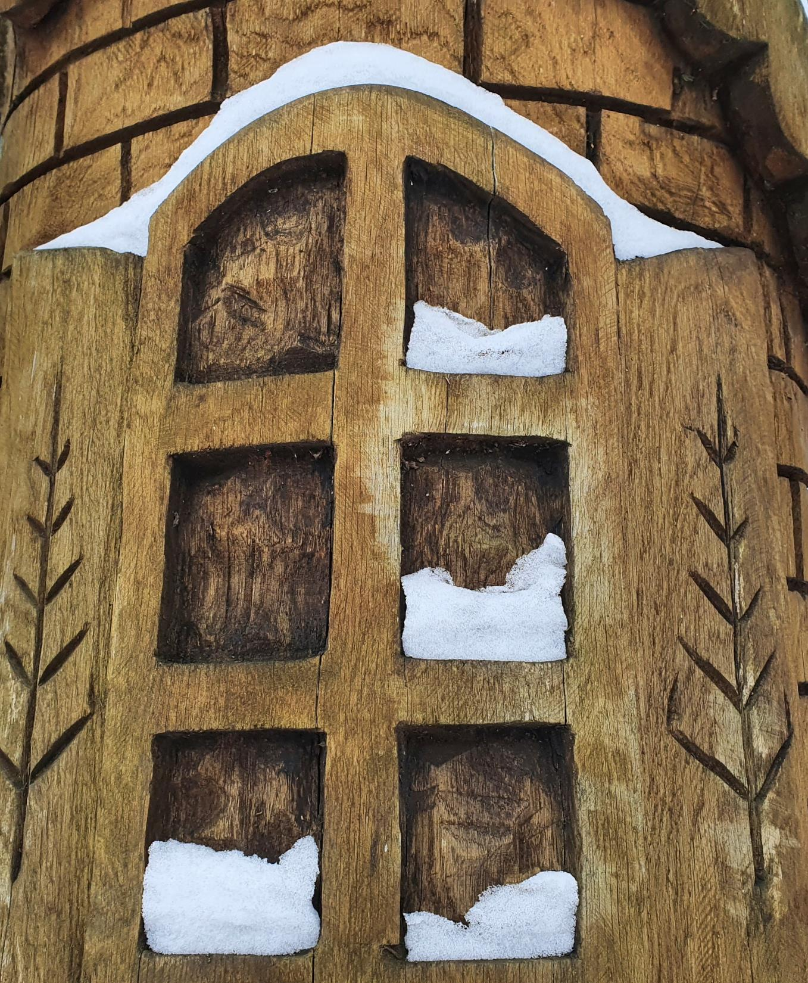
PARTS OF TREES IN THE CREATION OF THE NATION: FOLK ART SCULPTURES IN ŠIAULIAI CITY PARK
By GABRIELIUS ZARĖKA

Slide 2




THE AIM OF THE PROJECT IS TO PHOTOGRAPH AND DESCRIBE FOLK ART SCULPTURES
PROJECT OBJECTIVES:
1. TO FIND AND PHOTOGRAPH FOLK ART SCULPTURES IN THE CENTRAL PARK OF ŠIAULIAI CITY
2. 2. TO EDIT THE PHOTOGRAPHS
3. IDENTIFY AND NAME FAIRY TALE CHARACTERS IN THE SCULPTURES
4. LEARN HOW TO CREATE SLIDES AND MAKE A PRESENTATION OF THEIR WORK

Slide 3
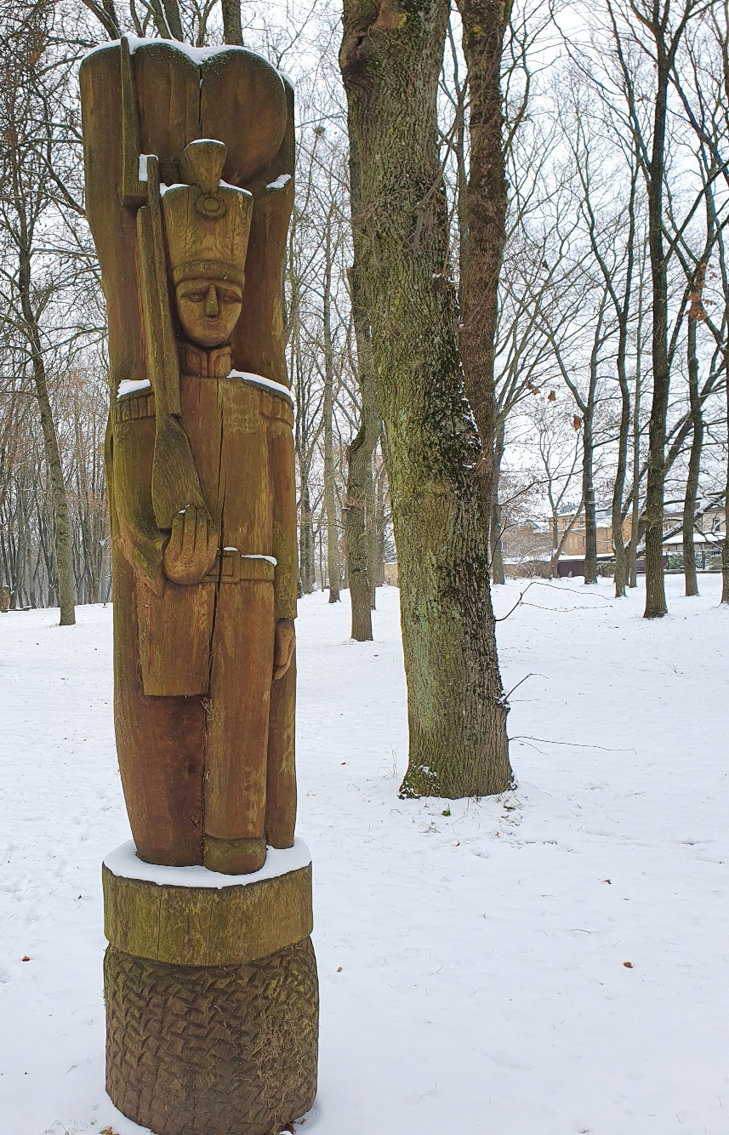
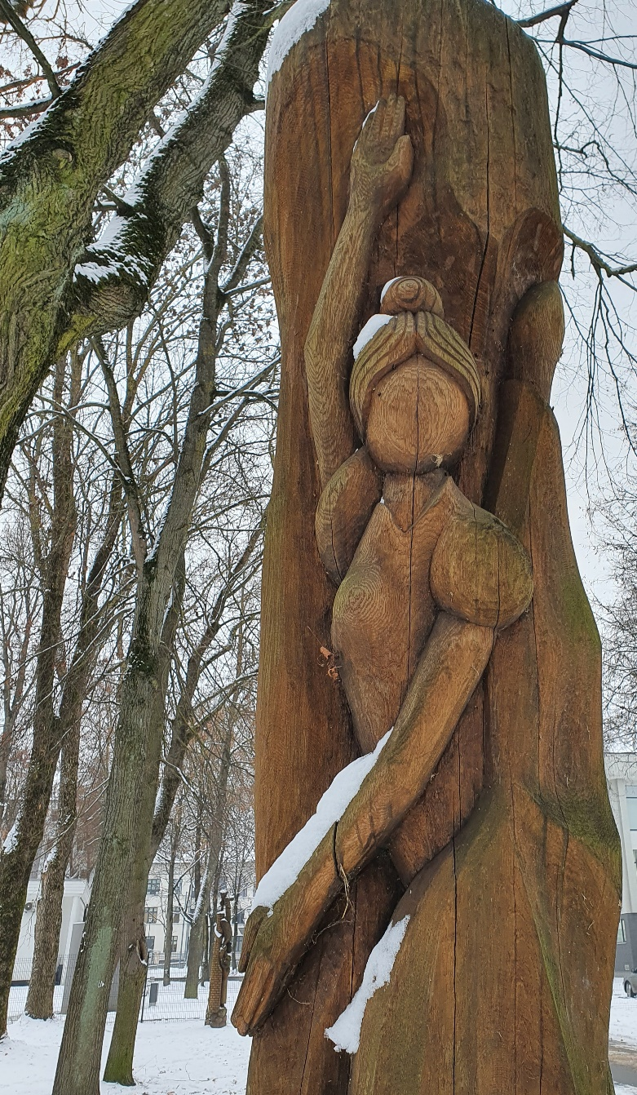
A fairy tale

Slide 4
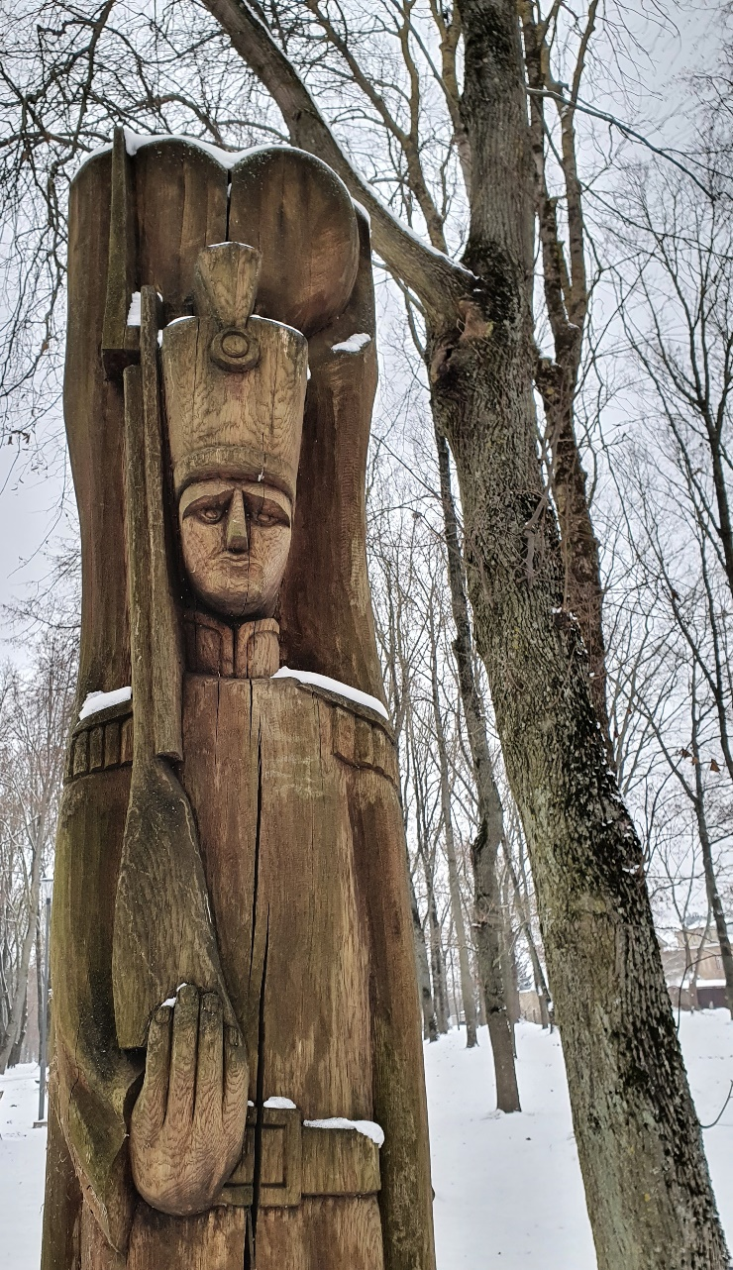
THE TIN SOLDIER

Slide 5
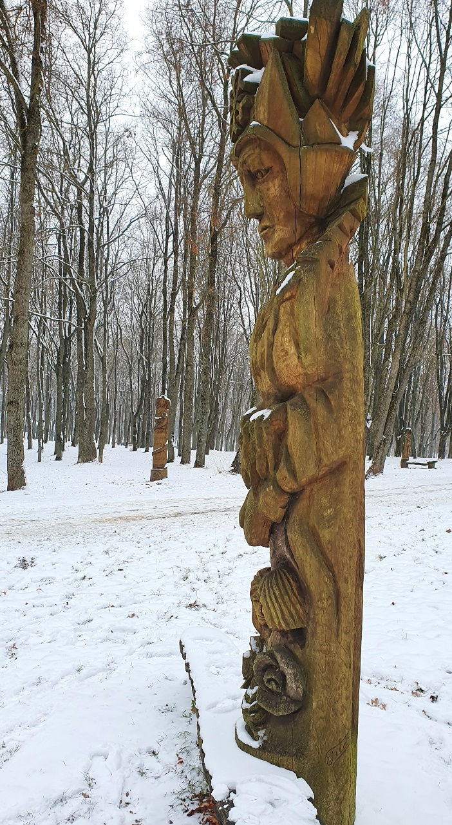
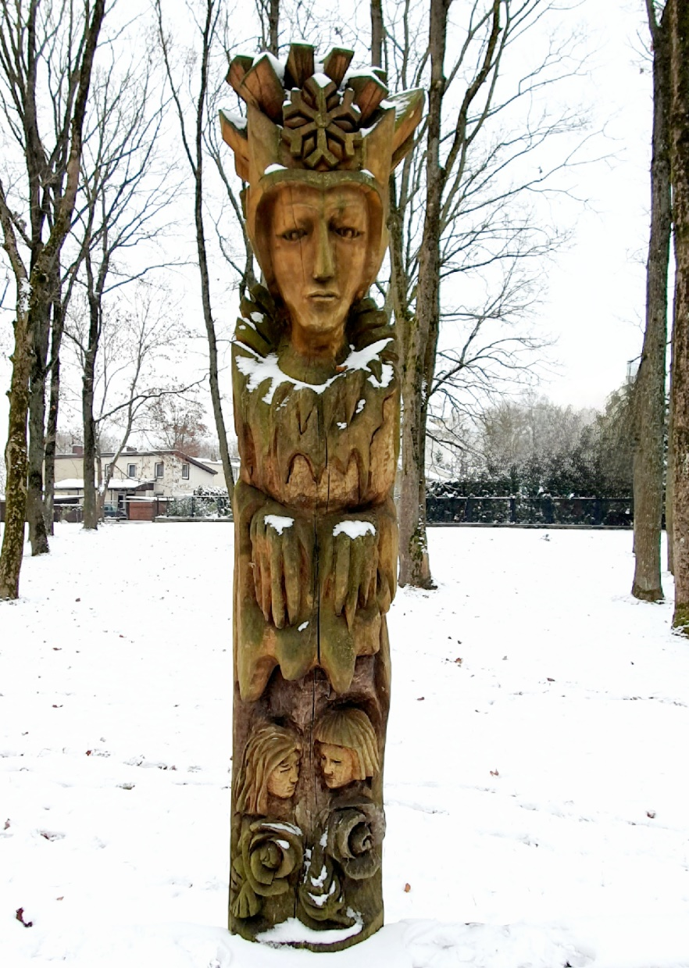
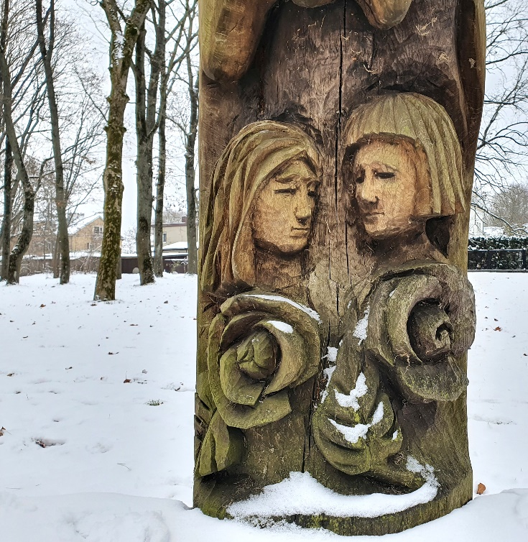
A fairy tale

Slide 6
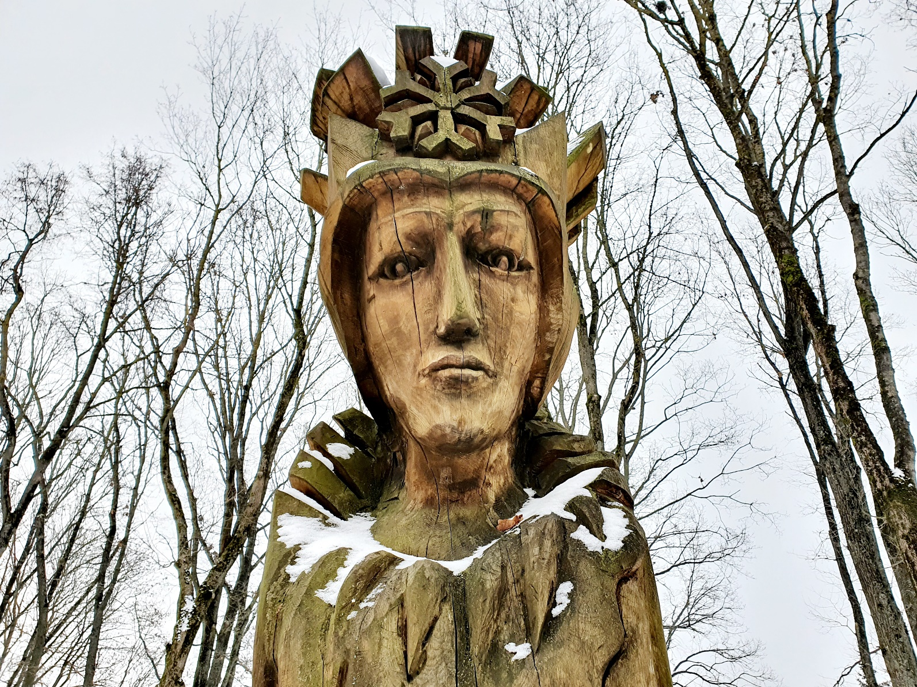
THE SNOW QUEEN

Slide 7
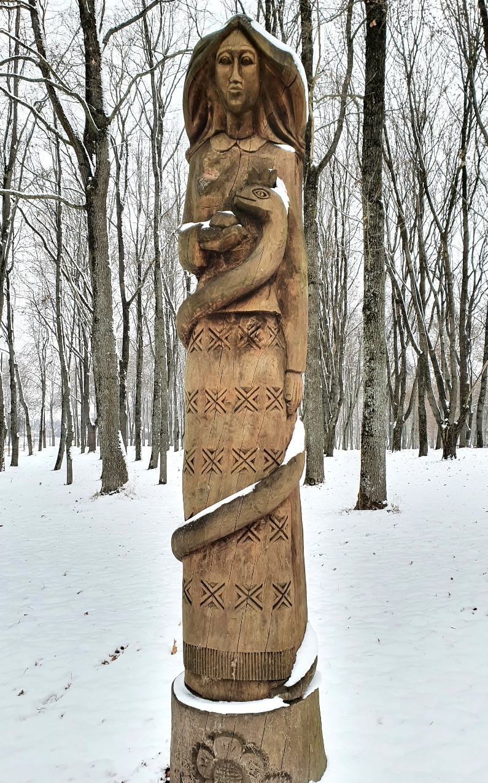
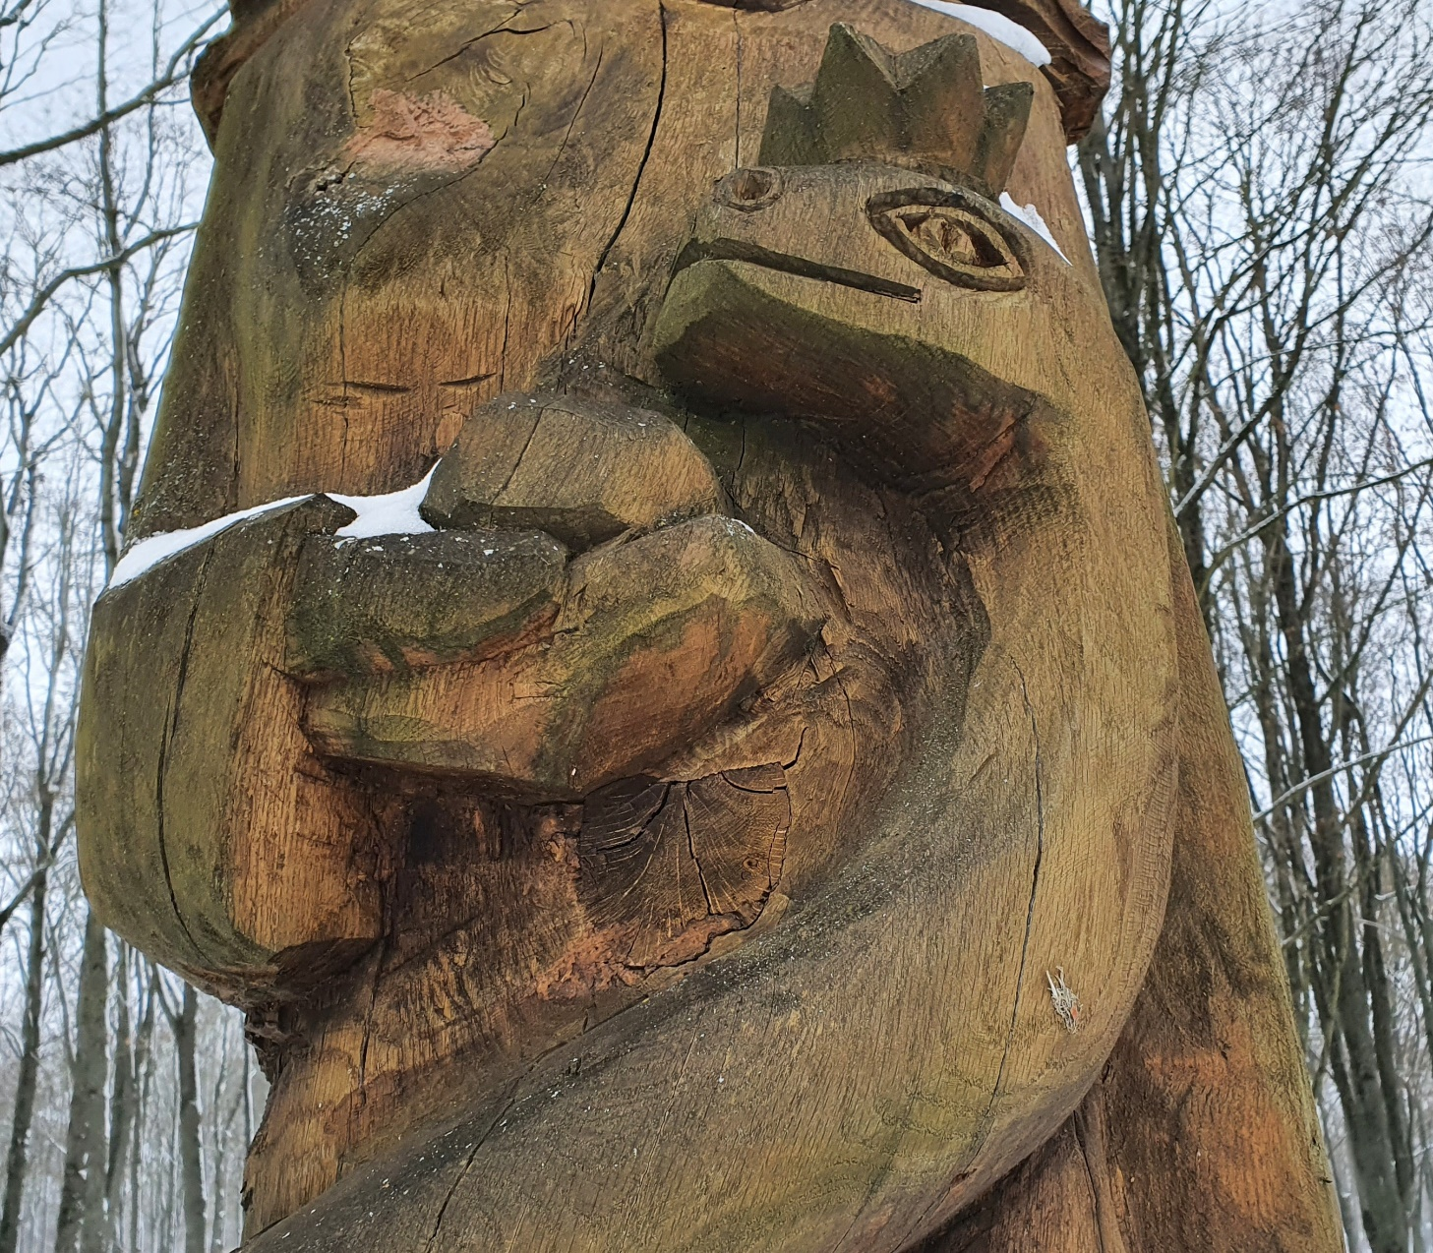
A fairy tale

Slide 8
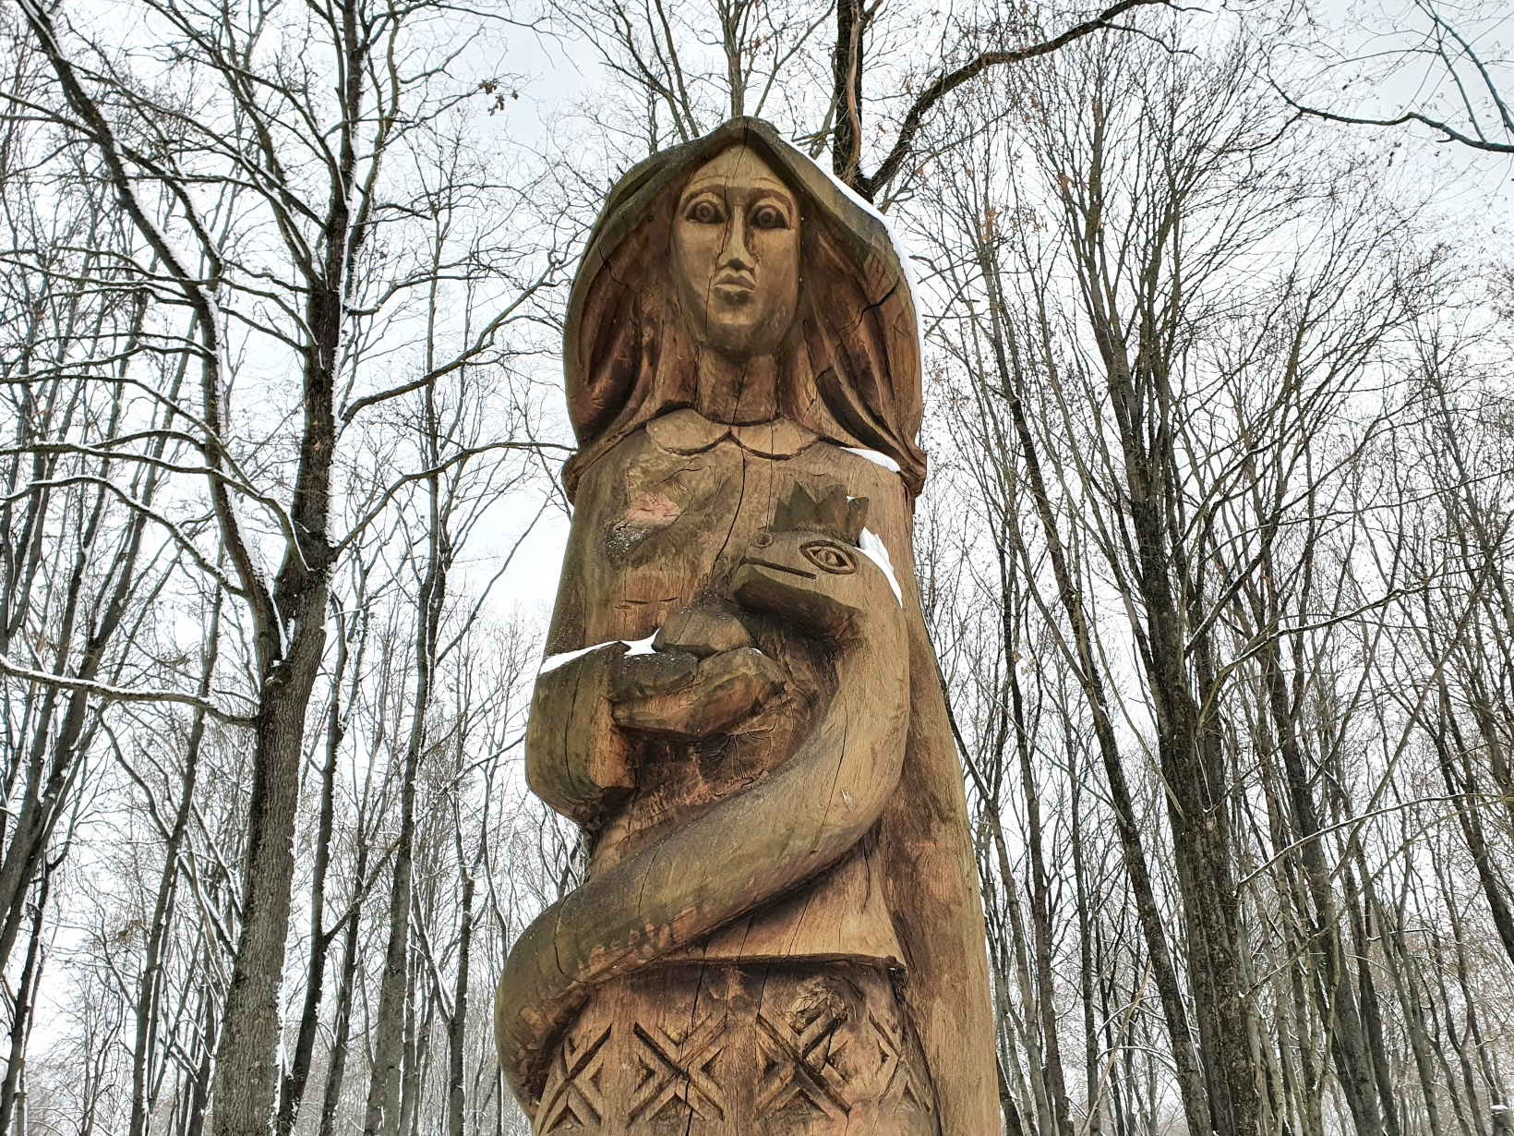
Eglė, Queen of the Sea Serpents

Slide 9
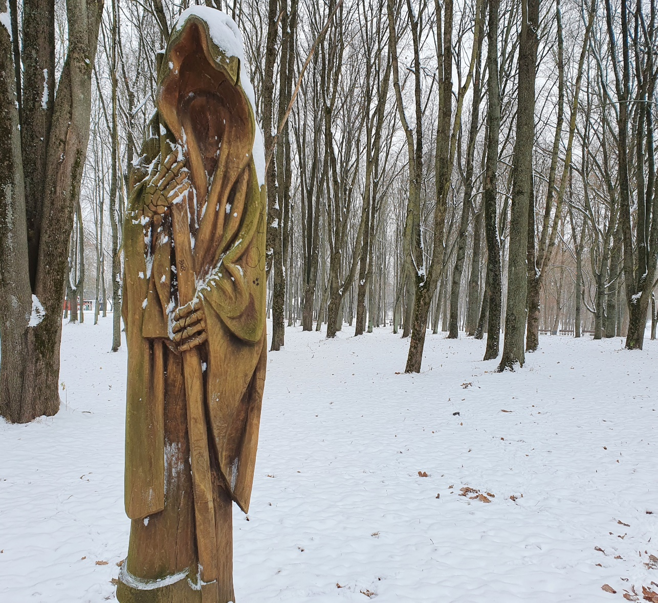
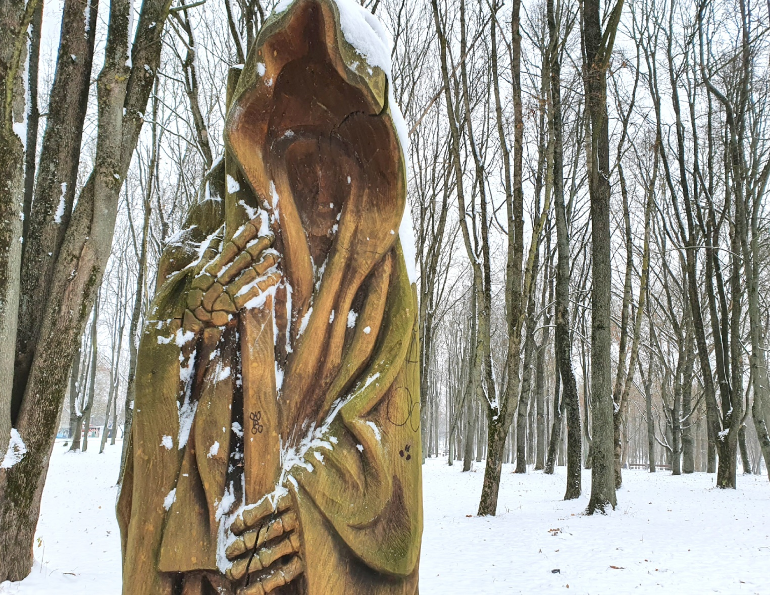
A fairy tale

Slide 10
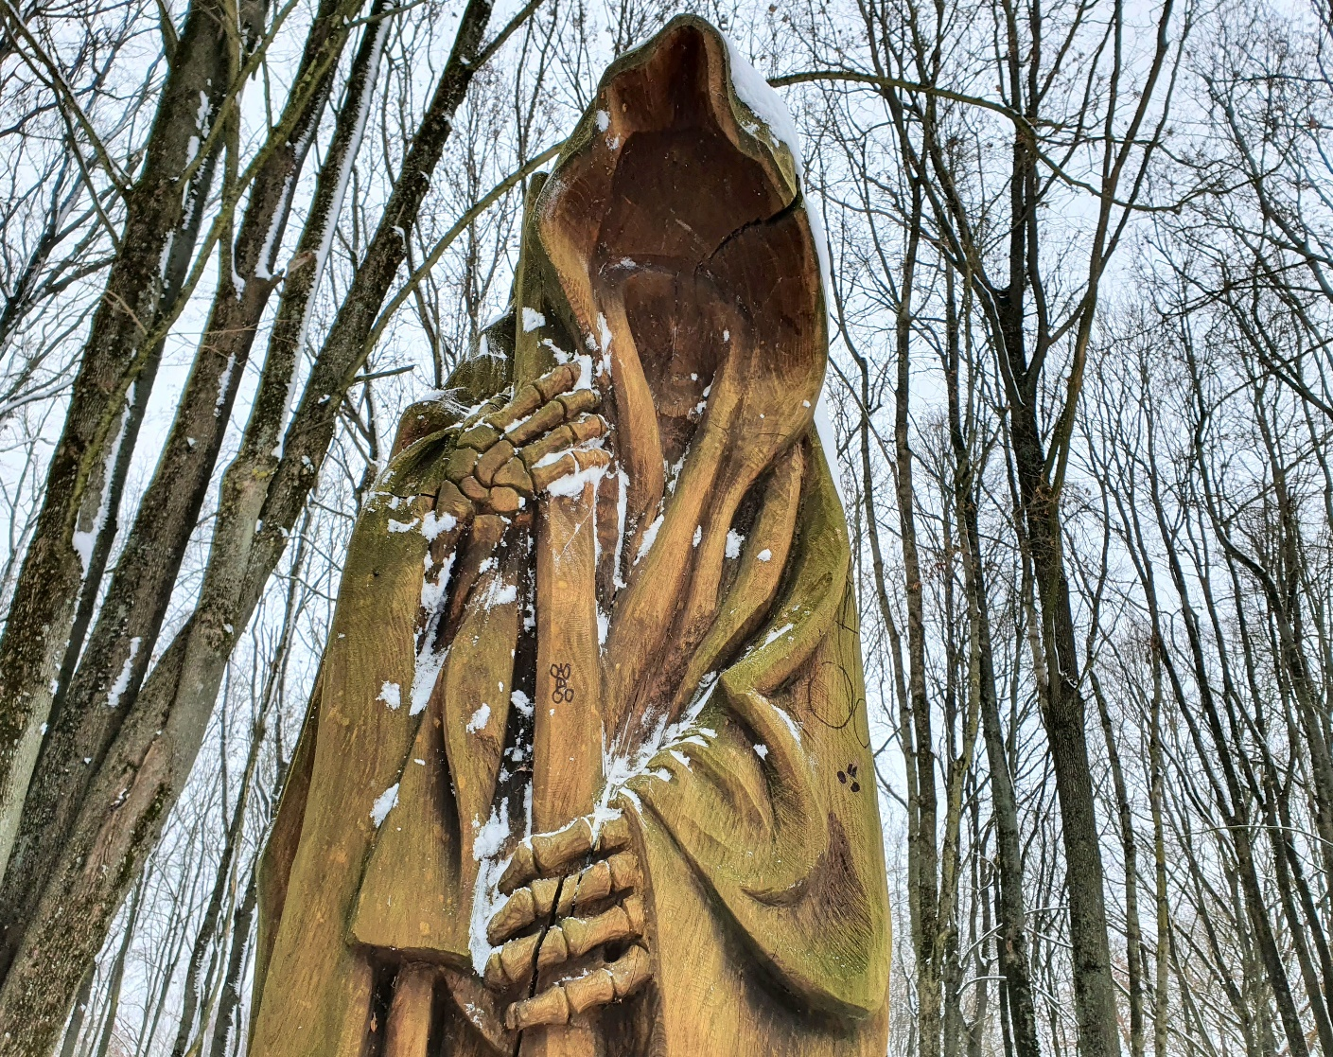
GILTINĖ IR KŪMA

Slide 11
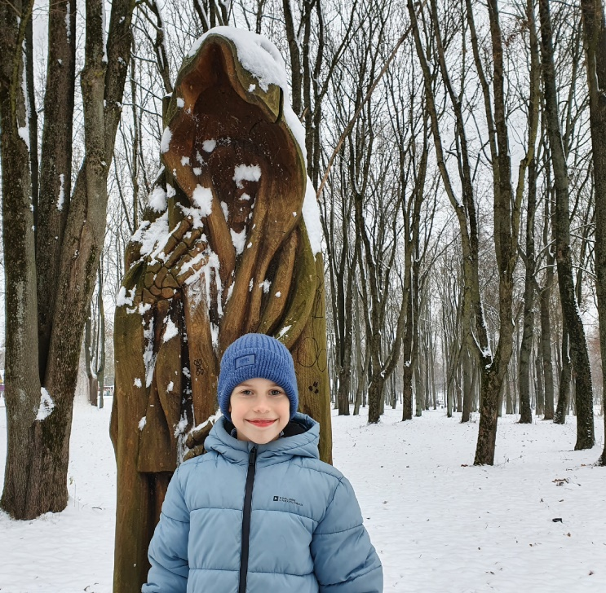

Slide 12
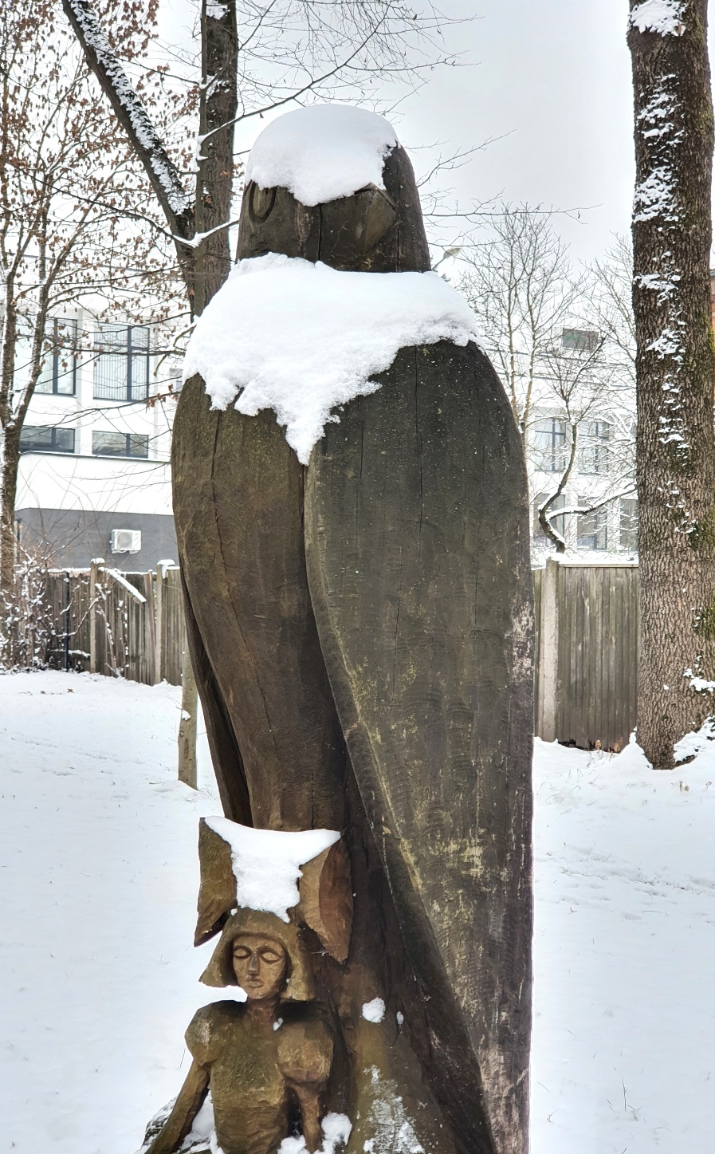
A fairy tale

Slide 13
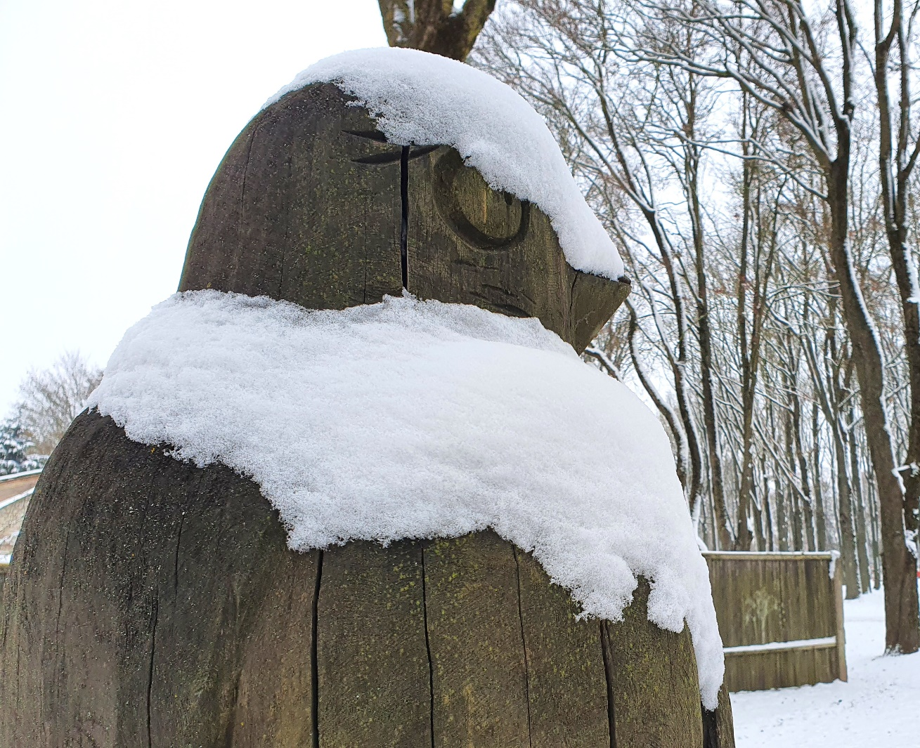
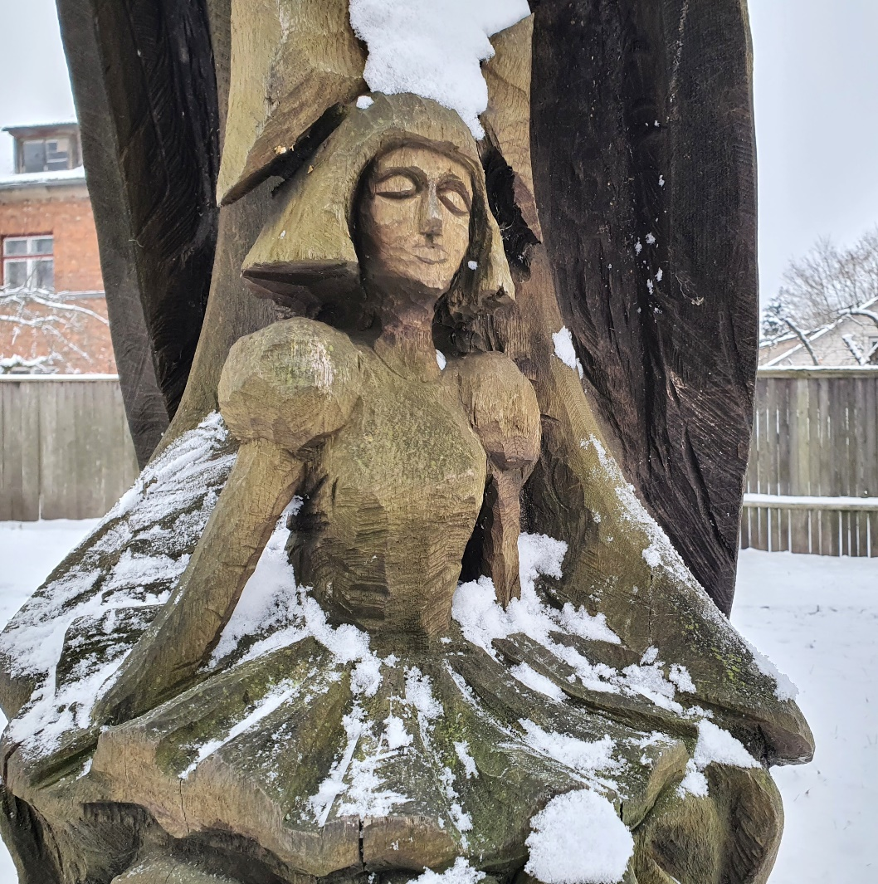
Thumbelina

Slide 14
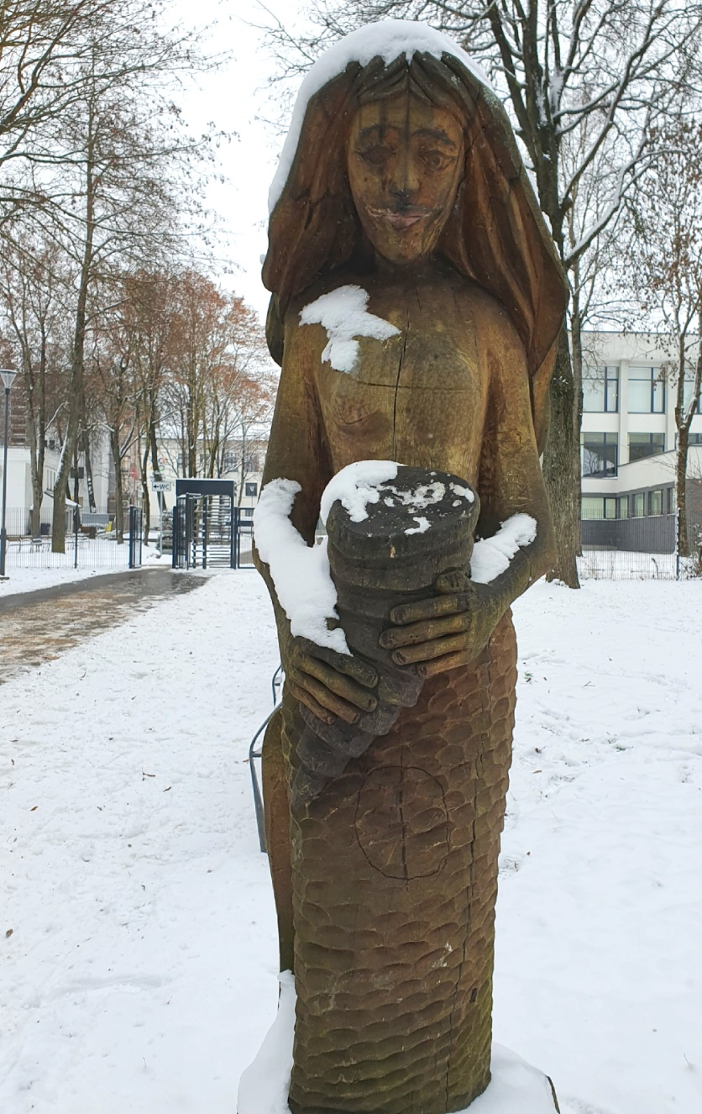
A fairy tale

Slide 15
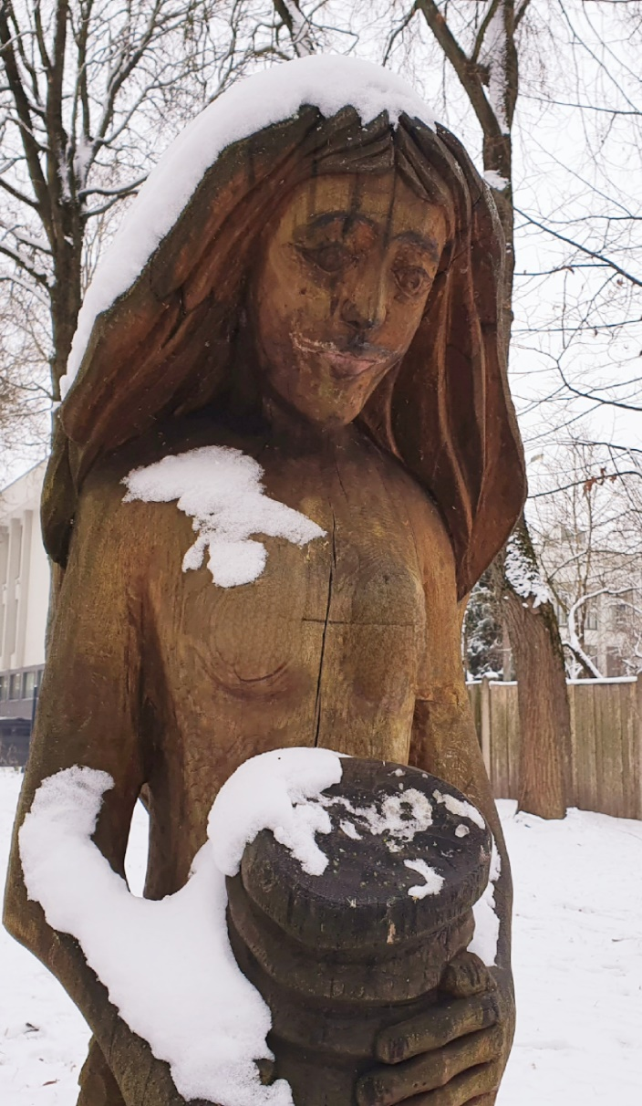
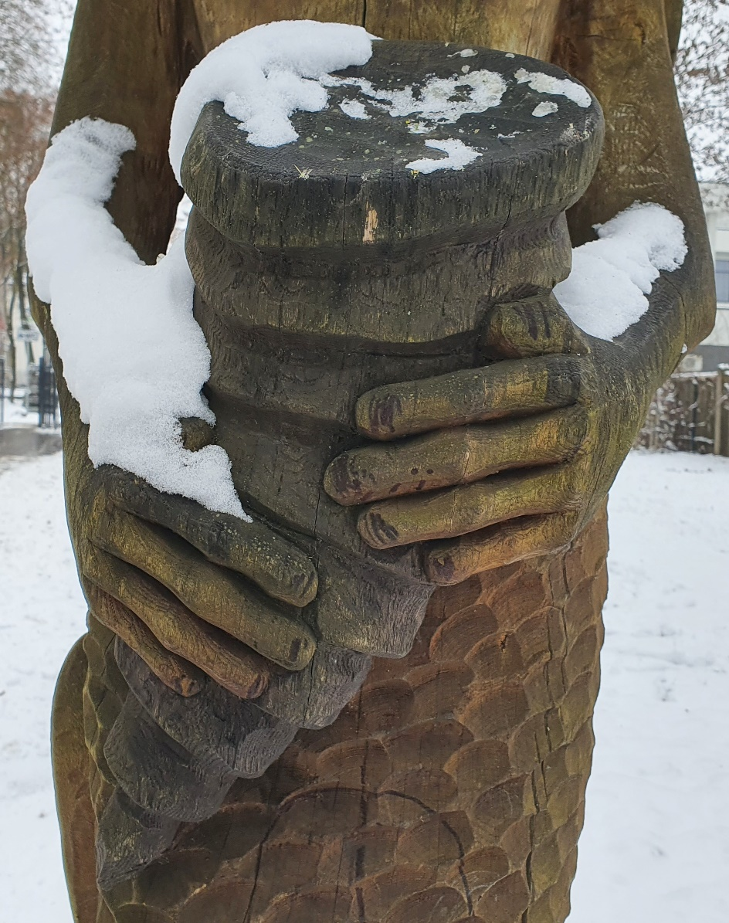
Mermaid

Slide 16
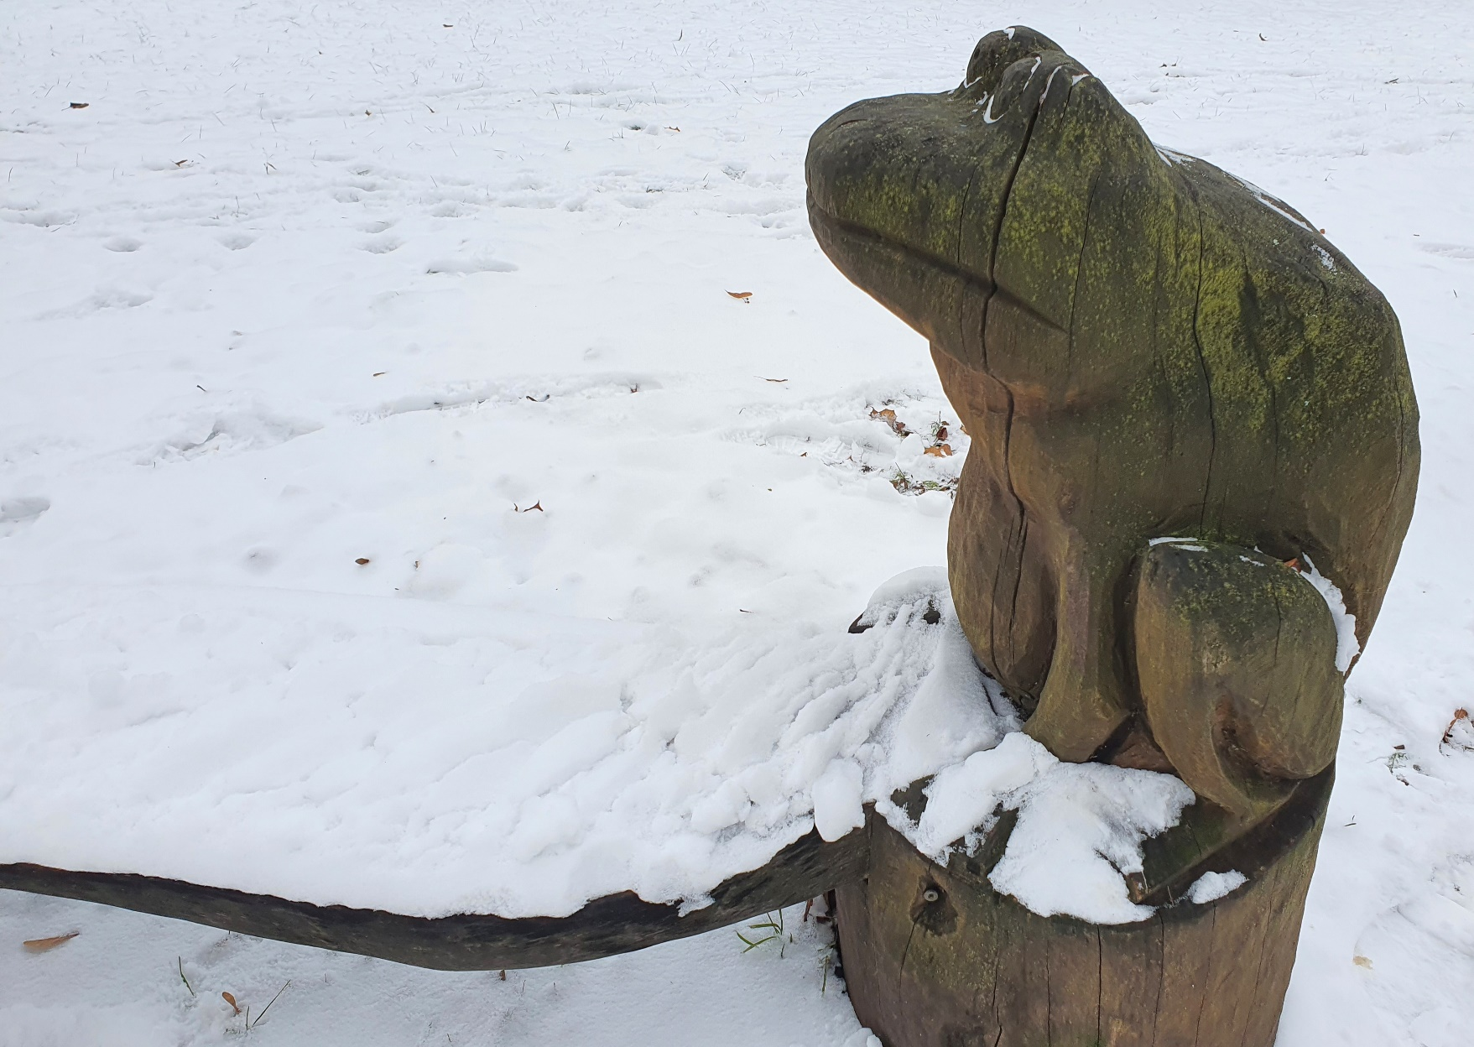
A fairy tale

Slide 17
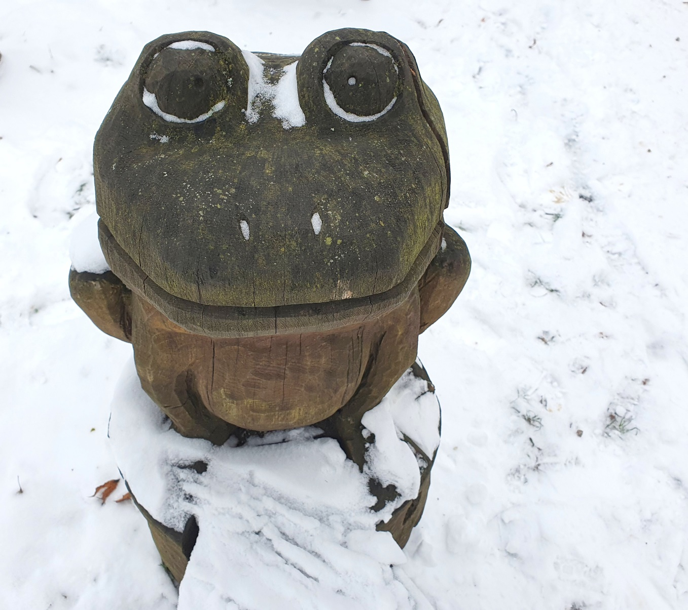
The Frog Prince

Slide 18
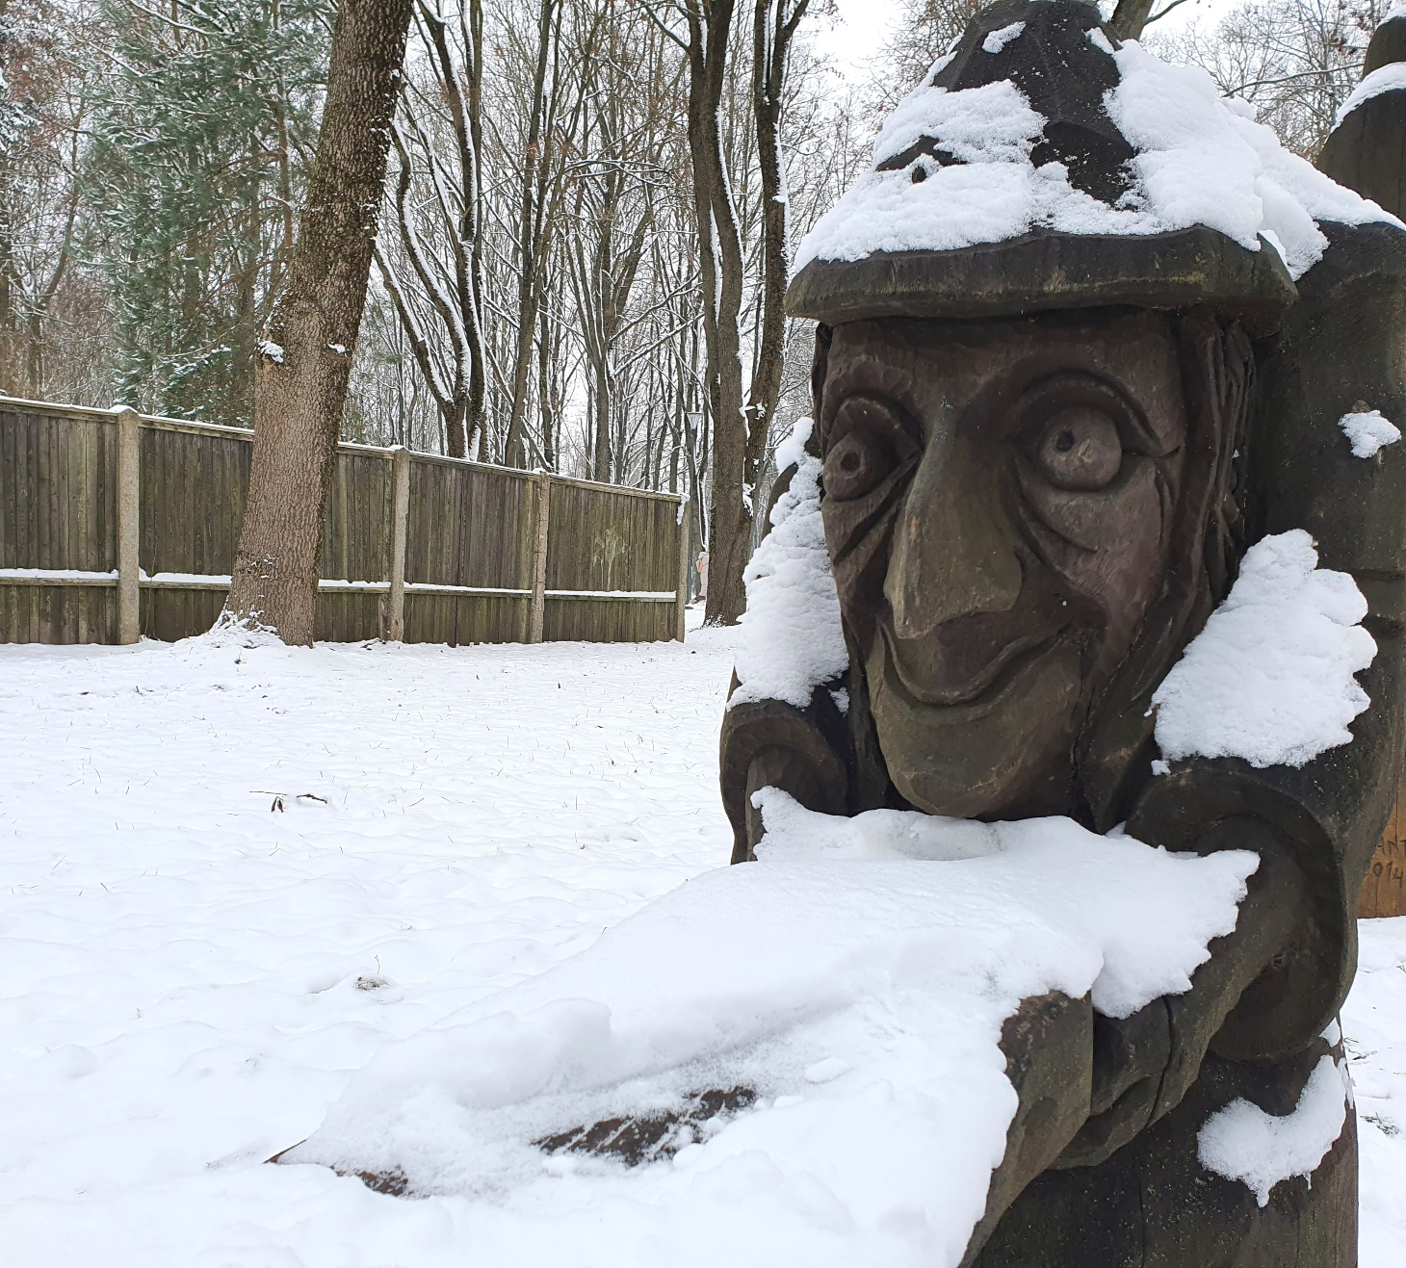
A fairy tale

Slide 19
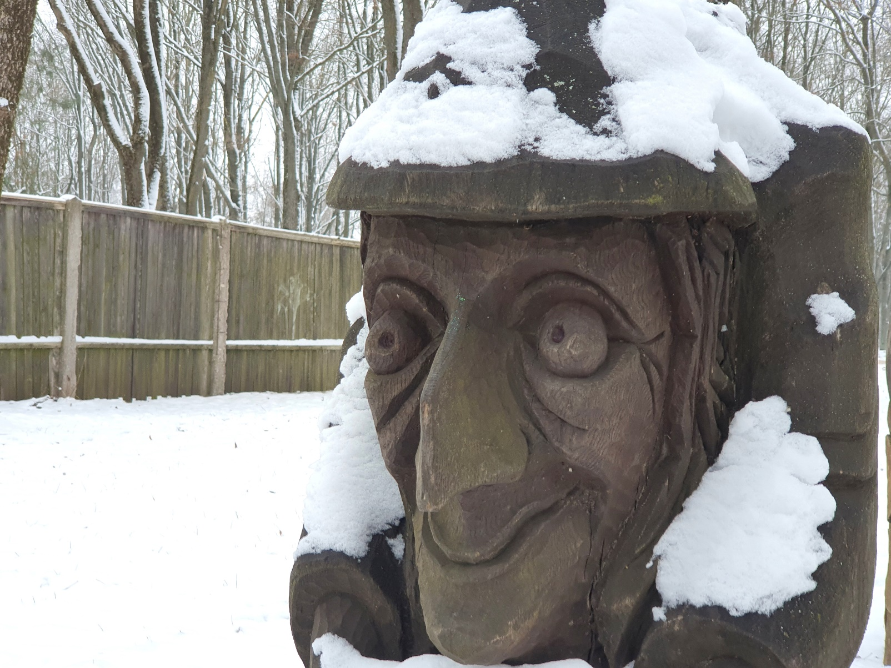
Hansel and Gretel

Slide 20
