Slide 1
the incandescent light bulb
Nathan Le VERGE
Eugénie Besso PERES

Slide 2
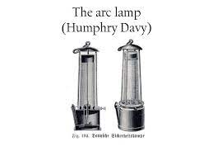

History
The arc carbon lamp
Candle
~1800s
Michel-Eugène Chevreul
1820

Slide 3
Thomas Edison
Birth
His job
invention
Death
1841
An inventor & business man
Incandescent light bulb
Phonograph
Motion picture camera
Telegraph
telephon
1931

Slide 4
How it's work ?
Ignition overload
Dilatation
Luminous efficiency
Longevity

Slide 5
Conclusion
This invention contributed to the improvement of the condition of human life

Slide 6


