Slide 1
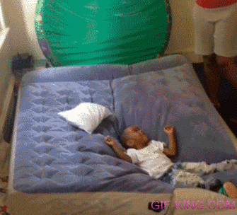
Innovation - Air matress
Notes:
the invention of air mattresses and their impact on society

Slide 2

Innovator
- Patent : 1940
- Unknow inventor
Notes:
Did you know that
Patent filed by unknow inventor
one thousand nine hundred forty

Slide 3
you can carry it anywhere For example :

Slide 4
AT A PARTY
Before
- Sleep on the floor
- Fight to get a bed
- Do not drink
After
- Infalte
- Place
- Settle in
Notes:
At a party : before you had to sleep on the floor or fight to get a bed or do not drink and go home.
Now just inflate the mattress, place it in any room of the house and settle in

Slide 5
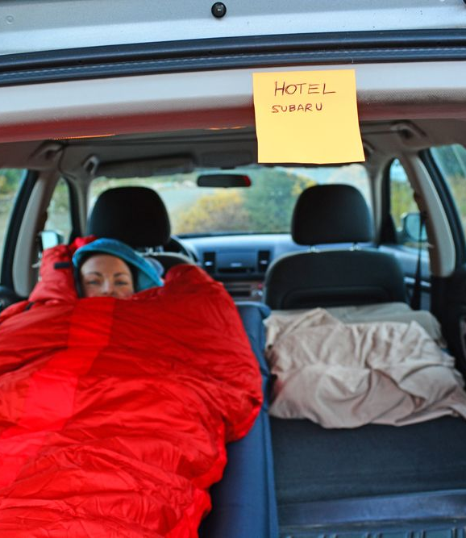
In a car
Before
- Rent a hotel room
- Rent a house
- In the seat of the car
After
- Comfortably in the trunk or car
Notes:
During a trip you have to rent a hotel room, a house to sleep or sleep in an awkward position in your car.
Now you can only take your car and sleep comfortably in the trunk

Slide 6

In a campsite
Before
- Transport classic mattress
- Rent a mobile home
After
- Cheaper
- More pratical
- Less space
Notes:
During your holidays you have to transport classic mattresses or rent a mobile home.
Now sleeping in a tent is cheaper, more practical and takes up less space
Before we had to
Afer you can sleep confortably in ...

Slide 7
To conclude
Changed lives and parties
Comfort
Notes:
Of course, it is essential to remember that the invention of the air mattress has changed lives and parties.
It has made life easier in many cases and increased the comfort of people when they are not at home.

