Slide 1
My favourite wild animal- tiger

Slide 2
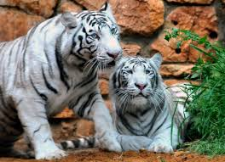
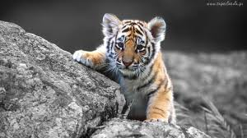
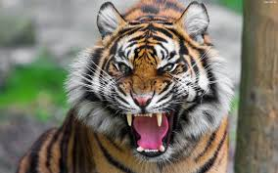
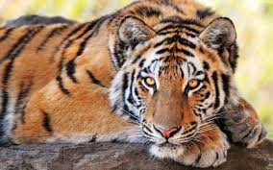
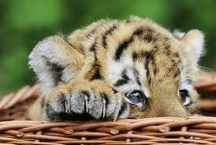
Tiger - photos

Slide 3
Kinds of tiger.
Azjatic
African
Bengali
Siberian
Malay

Slide 4
Information about tiger.
Tiger is dangerous, beautiful. It can run very fast and climb the trees. Tiger is very strong. Tiger’s legs is very powered.

