Slide 1
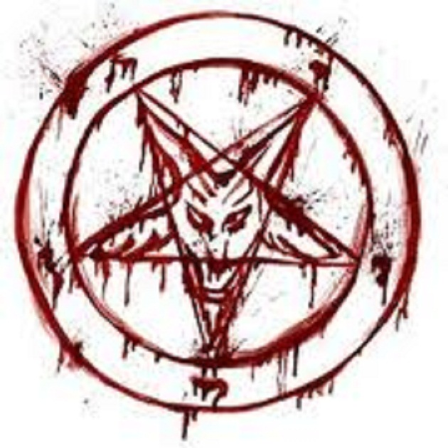
Witchcraft Spell
See more about protection spells and witchcraft. We have thousands of satisfied customers!

Slide 2
Love Spell
Love spells can help repair your relationship and Voodoo spell are among the deadliest form of occultism known to exist.

Slide 3
Voodoo Spell
Voodoo spell is the extraordinary spell for expedient result from the objective person. This spell was planned by the popular specialty of dark enchantment and today this well known workmanship for individual advantage is being utilized as a part of diverse bit of the world. This spell is exceptionally beneficial for oust the each issues from to individual life. It is use the power of the loa to kill any classification of obstacles from the course of affection. Voodoo spell is extremely useful and used to accomplish longing affection in life.

Slide 4
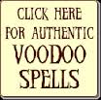

Slide 5
Thanks For Visiting

