Slide 1
Vashikaran Mantra
Vashikaran is technique which is used for got control over a person and for own selfish purposes. There are lots of Islamic mantras or spells which are used for vashikaran. We have the specialist in this same; they can easily got vashikaran over a person which you want. Our Islamic mantras experts have lots of vashikaran mantra by using these they can easily solve your problems like love marriage, love affairs, attraction, spells. They having so many spells by using them they can easily solve your problem.

Slide 2
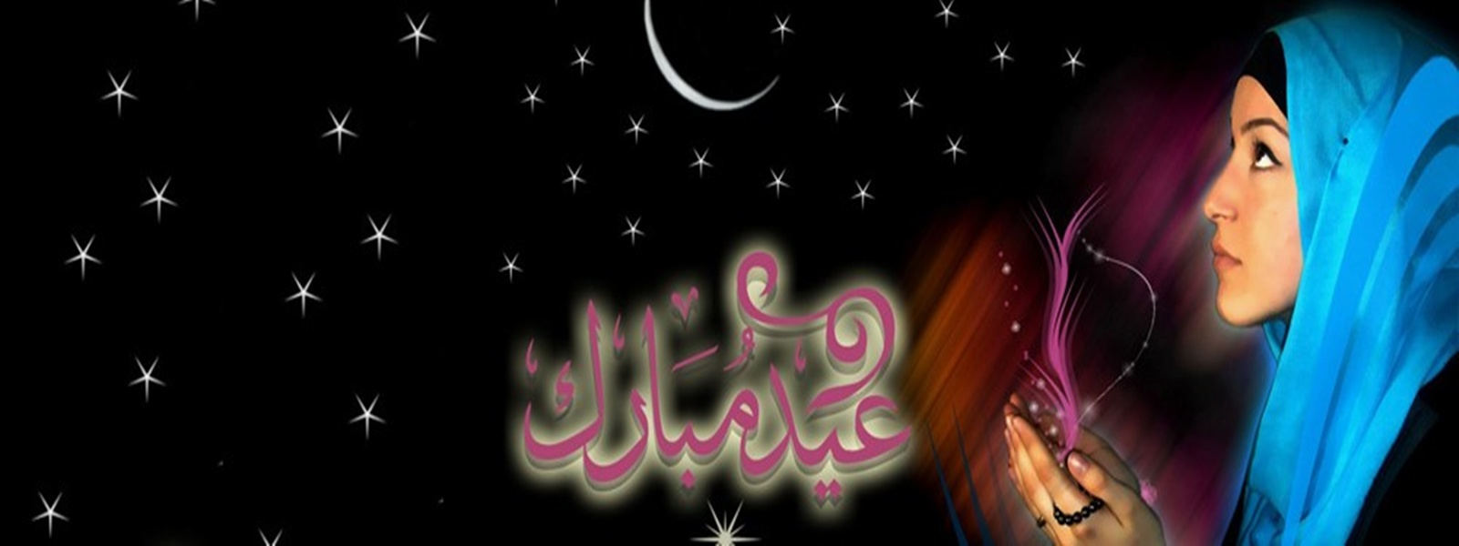
At very past vashikaran and spells are used for solving problems of people for example if a lady does not have any baby then the priests or baba by using worship and spells they solve these kinds of problems. As same now in young generation there are so many youngsters having lost their love and they want to get back them so at that case our specialists can solve this problem. We have best Love vashikaran Mantra specialist they can easily solve your problem they having some set of mantras which you have to read regularly so that you can get back your love. There are most of people are not aware from the vashikaran technique. They have lots of misunderstanding regarding vashikaran and spells.

Slide 3

Here we discuss some of Vashikaran mantras which are for vashikaran or love vashikaran, by using these mantras you can gain control over a person and can do from that person whatever you want to do. Let’s discuss one of the Islamic mantras used for vashikaran.
बिस्मिल्लाहिर्रहमानिर्रहीम ! अल्लाहुम्मा या मुसख़्हिरो स्खहली मन फस्समावाती वल अर्जी मुस्खिलरली लिल्हाहि तआला अल्लाहुम्मा बेईनली बजललहुल्ली वसखिर्लि व् आलिफ मुहबत्ती फि कालबिहि वजफहु रउफन मुहिबन्न बिहकिक या अल्लाहु या रेह्मानो या रहीम |

Slide 4
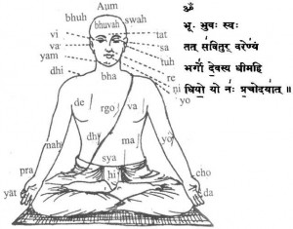
This is Islamic vashikaran mantra by using this mantra you can get control over a person which you want. But there is a way how to use this mantra so oil of Chameli and read this mantra at 678 times. When you use this mantra regularly and do smell that oil to that person which you want to get control over that person. After a week you will see that the person is in under you control. These Islamic mantras are very powerful to use and they need cleanness when you read these mantras. Like this vashikaran mantra there are lots of similar mantras that are used to vashikaran of for love vashikaran. We have the Islamic mantras specialist they had so much study and write thesis for vashikaran they can easily solve you problems.

Slide 5


