Slide 1

The Birth of Aphrodite

Slide 2
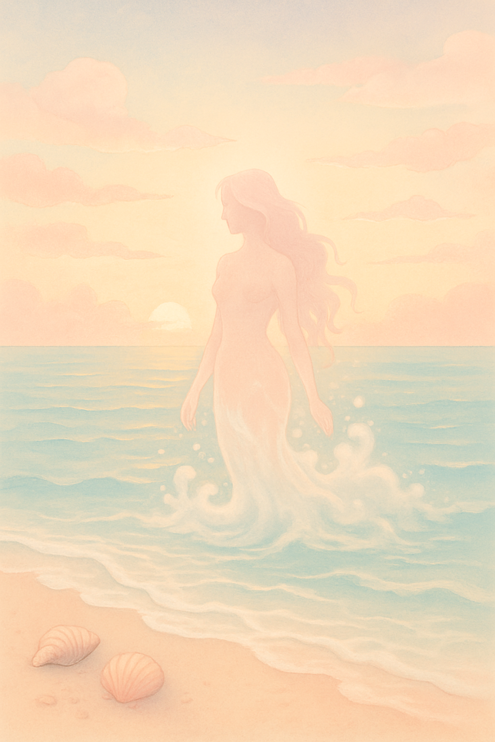
Once upon a time, where the sea embraces the sky,
a goddess unlike any other was born.
She was not born in a palace, nor upon a great mountain,
but out of the foam of the waves!

Slide 3

One morning, the wind blew gently and the waves began to dance…
Out of their foam emerged a beautiful woman
with golden hair
and eyes that shone like sunlight.
She was Aphrodite, the goddess of beauty and love.

Slide 4

A large white shell became her boat,
and Zephyr, the wind, blew strong yet gently,
guiding her to the coast of Cyprus.

Slide 5

There the Hores, the goddesses of the seasons,
were waiting for her.
They dressed her in beautiful garments
and crowned her with a wreath of colorful flowers.

Slide 6

From then on, wherever Aphrodite walked,
the earth filled with roses and fragrant flowers.
People loved and honored her,
for she brought love and joy to all.
And so, the goddess born from the waves
became a symbol of beauty and love forever.

