Slide 1
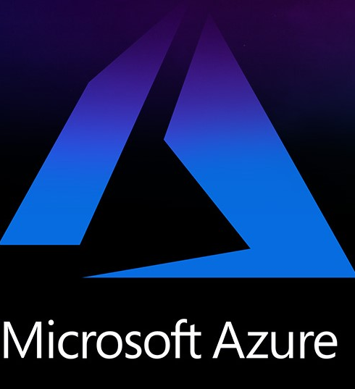

Microsoft Azure Cloud Hosting Services for AI Infrastructure

Slide 2
Overview of Microsoft Azure Cloud Hosting
Microsoft Azure is a cloud computing platform that provides a wide range of services to individuals and organizations.
Azure offers a variety of services, including virtual machines, storage, databases, analytics, and machine learning, among others.
These services can be used to develop, deploy, and manage applications and services on the cloud.
Overall, Microsoft Azure cloud hosting services provide an efficient, secure, and cost-effective way for businesses to run their applications and services on the cloud.
With its flexible and scalable infrastructure, Azure is an ideal choice for businesses of all sizes and industries, from startups to large enterprises.

Slide 3
Here’s how Microsoft Azure enables AI:
Bot Service :- Make bots and link them across channels.
Form Recognizer:- Documents can be converted into functional data. Faster and with fewer expenses.
Cognitive Search:- Bring AI-powered cloud search to your web and mobile apps.
Metrics:- Actively manage metrics and troubleshoot problems.
Video Indexer:- Using media AI, you can easily obtain actionable insights from video and audio files.
Immersive Reader:- Azure Immersive Reader assists users in reading and comprehending text.

Slide 4
Web Synergies and Microsoft Azure cloud hosting services for innovative AI services
Web Synergies is a leading technology solutions provider that offers innovative AI services to businesses of all sizes.
Web Synergies and Microsoft Azure cloud hosting services provide an ideal platform for businesses that want to innovate and create value through AI services.
With their combined expertise and cutting-edge infrastructure, businesses can unlock the potential of AI and gain a competitive advantage in their industry.

Slide 5





Thank You

