Slide 1

Driving Sustainability Through Supply Chain Optimization

Slide 2

The Path to Sustainable Supply Chain Optimization
Implementing Supply Chain Optimization (SCO) is essential for enhancing efficiency, reducing costs, and gaining a competitive edge in the manufacturing sector. At Web Synergies, our approach integrates advanced Supply Chain Management (SCM) systems with ERP, MES, and WMS to streamline operations, enabling sustainable practices.

Slide 3
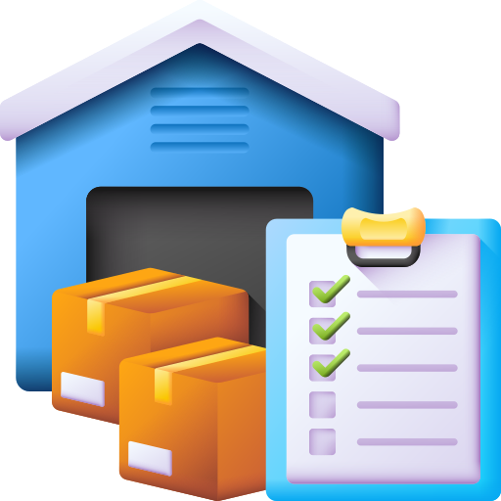
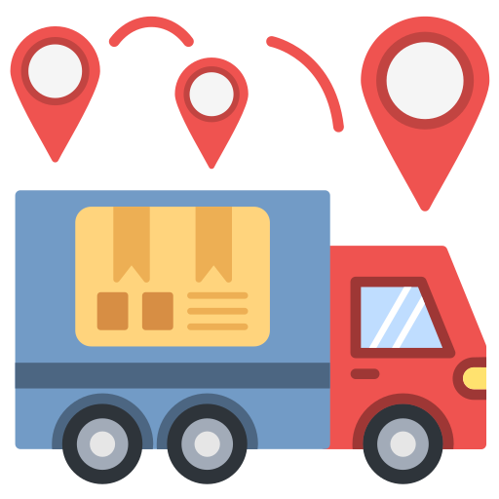

Key Operational Flows for Optimization
Procurement
Accurate demand forecasting.
Production Planning and Control
Market demand-based production planning.
Efficient scheduling and quality control.
Supplier selection and cost negotiation.
Material receipt and inspection.
Warehousing and Inventory Management
Strategic material storage.
Just-In-Time (JIT) inventory strategies.
Distribution and Logistics
Customer Service and Support
Distribution planning and logistics partner selection.
Transportation monitoring and management.
Order processing and delivery.
After-sales service and CRM integration.

Slide 4
SCM Management Modules
Demand Planning and Forecasting
Advanced analytics for precise demand prediction.
Supplier Relationship Management (SRM)
Strengthened supplier collaboration and evaluation.
Inventory Optimization
Intelligent systems for cost-effective inventory control.
Logistics and Transportation Management
Optimised routes and delivery accuracy.

Slide 5
Integration Approach
ERP Integration
Real-time data flow across finance, HR, sales, and operations for informed decision-making.
MES Integration
Detailed visibility into manufacturing processes and schedule optimisation.
WMS Integration
Enhanced inventory accuracy and order fulfilment efficiency.

Slide 6
Sustainable Supply Chain Practices
Eco-Friendly Procurement
Partnering with ESG-conscious suppliers.
Resource Efficiency in Production
Minimising resource consumption and waste.
Green Logistics
Eco-friendly transportation and reduced carbon footprint.
Product Lifecycle Management
Designing recyclable and sustainable products.

Slide 7
Execution Process & Business Value
Execution Process
Conduct supply chain audits
Integrate SCM with ERP, MES, and WMS
Implement sustainable practices
Business Value
Enhanced efficiency
Cost reduction
Improved customer satisfaction
Stronger market position

Slide 8
Conclusion
Web Synergies empowers manufacturing clients to optimise their supply chains, ensuring competitiveness while achieving environmental goals. With continuous improvement and innovation, we drive sustainable supply chain practices that deliver long-term value.

Slide 9





THANK YOU
www.websynergies.com

