Slide 1
Allegory in the Novel by William Golding
Lord of the Flies
This work is performed by
Yegor Misuraguin (Form 7 “C”)
Research supervisor:
Iryna Kastsiuchenka

Slide 2
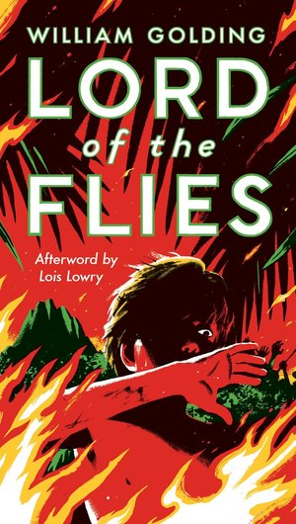
The importance of work is in comparison of linguistic means used to build the images of evil and good

Slide 3
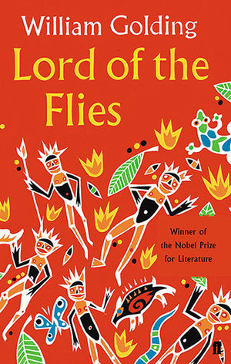
Aim: to define the parts of speech and linguistic means which are used to describe the notion of evil and good
Goals pursued:
to define “allegory” and the dominant one in the text;
-to find examples of allegories in the novel;
-to pick out stylistic devices and parts of speech describing allegories;
-to compare the linguistic means used to describe evil and good.

Slide 4
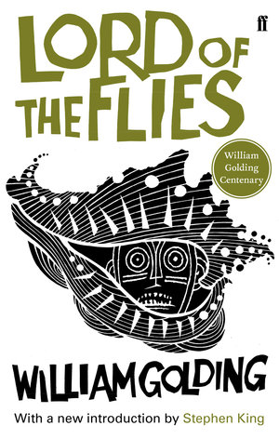
Hypothesis:
allegories as they are depicted in the novel are formed
by means of verbs.
Methods:
statistics;
comparison.

Slide 5
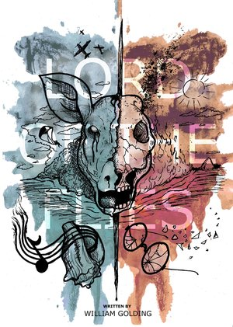
Allegory

Slide 6
Democracy and Civility

Slide 7
Emotional Colour

Slide 8
Autocratic Leadership

Slide 9
Emotional Colour

Slide 10
Rationality

Slide 11
Inner Human Morality

Slide 12
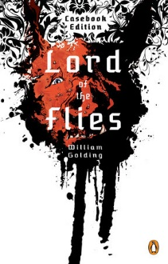
Conclusion
2 main allegories;
2 minor allegories;
original presumption is incorrect (the role of the verb is insignificant);
Democracy is regarded as good thanks to the choice of nouns and adjectives;
Authoritarianism is considered to be evil due to the amount of parts of speech with negative connotation.

Slide 13
Allegory in the Novel by William Golding
Lord of the Flies
This work is performed by
Yegor Misuraguin (Form 7 “C”)
Research supervisor:
Iryna Kastsiuchenka

