Slide 1



School
Improvement
Pilot
Key Findings and Enhancements

Slide 2
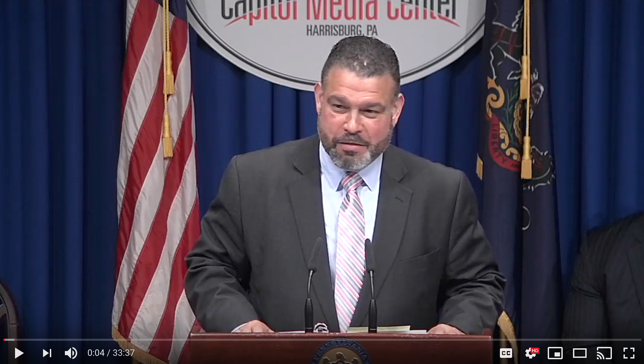
Defining Success in Phase 2

Slide 3
REFLECT:
What did you hear?
In your own words, how do you think we define success for Phase 2?

