Slide 1

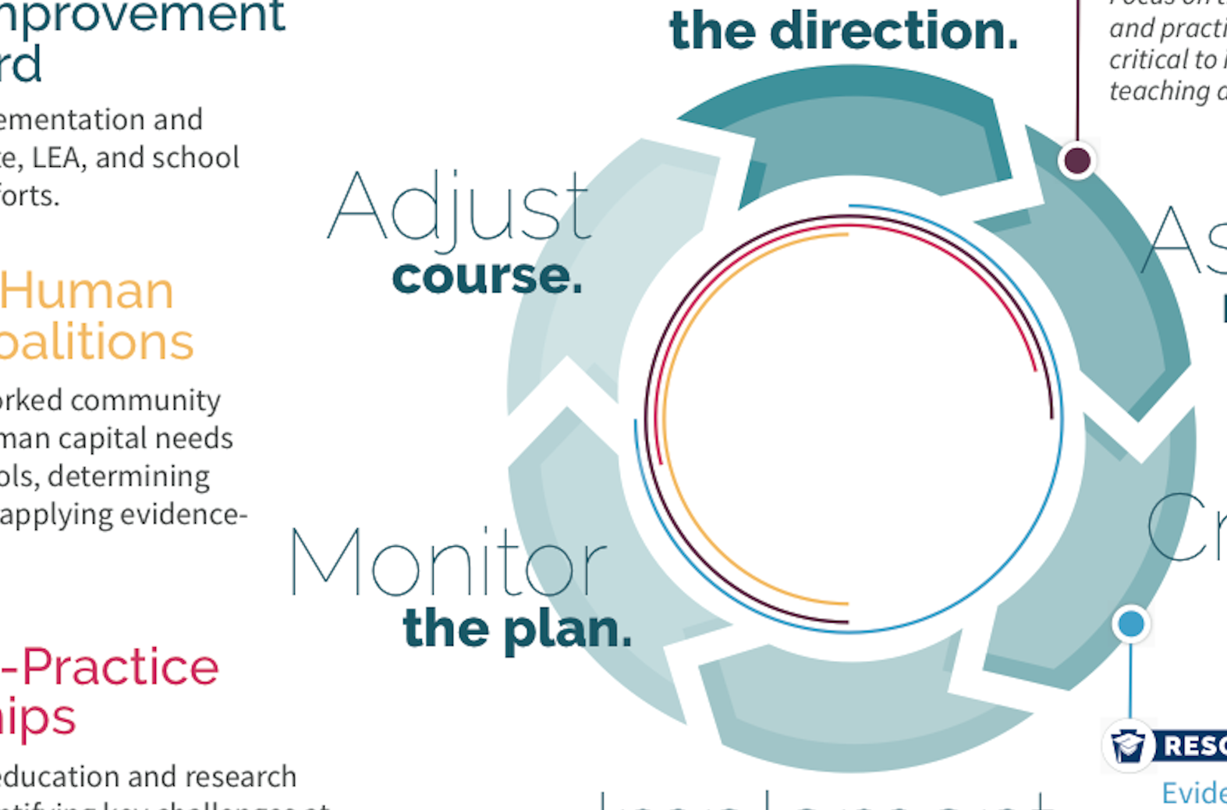
PA System for
LEA and
School
Improvement

Slide 2

School Improvement:
Ensuring all Students are College, Career, and Community Ready

Slide 3

How do you define equity?
Image source: familyfutures.net
Notes:
The purpose of school improvement is to improve achievement and outcomes for every student by working to eliminate the ability to predict achievement based on socioeconomic status, race, and ethnicity.
We do this by collaboratively and continuously analyzing data and making decisions considering the unique needs of the learning community and the district's strategic plan.

Slide 4
What is equity?
Every student has access to the educational resources and rigor they need at the right moment in their education across race, gender, ethnicity, language, disability, sexual orientation, family background and/or family income.
Educational equity
www.aspeninstitute.org/education
www.ccsso.org

Slide 5

Improvement through an equity lens

Slide 6

Conditions impact needs and opportunities
Image source: familyfutures.net
Notes:
You can not decouple the needs of students and communities from the success of schools.

Slide 7

School Improvement:
It Takes a Community

Slide 8

Discussion topics
What does “meaningful stakeholder engagement” mean?
Why is stakeholder engagement in the improvement process important?
Which stakeholders should we engage?
How do the guiding principles for stakeholder engagement apply to our work?

Slide 9
Activate your thinking
From your previous experience, how do you engage stakeholders?
  What were the key considerations?
  What strategies were successful?
  What barriers did you experience?

Slide 10
Defining meaningful stakeholder engagement
Stakeholders: community members who are involved and invested in LEAs, schools, programs, and outcomes for students
Engagement: process of communicating to, learning from, and partnering with stakeholders
Meaningful: inclusive, clear, effective and ongoing in order to best support educational equity and excellence
Meaningful local engagement under ESSA: A handbook for LEA and school leaders

Slide 11
The power of meaningful stakeholder engagement
Engaging stakeholders is not only required under the law but is a strong best practice to effectively improve schools.
  Making decisions on education policy in an inclusive and transparent way leads to better decisions and encourages stakeholders to contribute and become partners in achieving the goals in the state and local community.
  Communities will support improvement strategies that they help to develop.
  Partnerships with a diversity of stakeholders, including parents, philanthropy, community-based organizations, and others will build local capacity to implement innovative and ambitious strategies for meeting the needs of all students.
Meaningful local engagement under ESSA: A handbook for LEA and school leaders

Slide 12
Stakeholder groups to engage
Think about the student group(s) of focus. Who would you engage?
  Students (current and alumni)
  Parents/guardians, families, and communities
  District-level educators
  School-level educators (including support staff)
  Elected officials
  Agencies and governmental bodies
  Advocacy organizations
  Civil/human rights organizations
  Early learning leaders
Meaningful local engagement under ESSA: A handbook for LEA and school leaders
Notes:
See “Stakeholders to Engage” in Part 4: Reference for helpful details
It is important to make extra efforts to engage with underrepresented and historically marginalized stakeholders. It is important to include voices representing students whose needs are not currently being met.

Slide 13
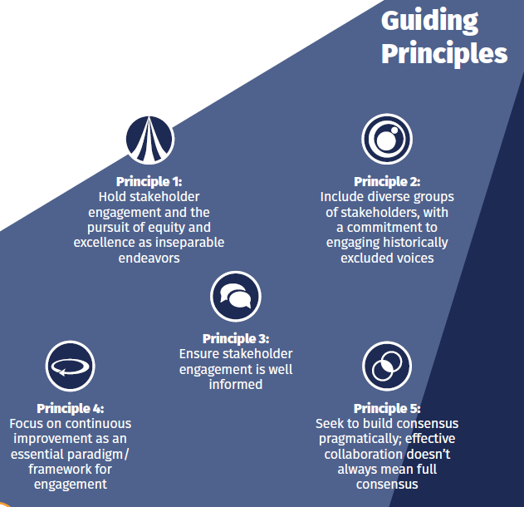
Guiding principles
Meaningful local engagement under ESSA: A handbook for LEA and school leaders

Slide 14
Let’s reflect for a moment:
Why do you think stakeholder engagement matters?
What makes it hard to accomplish?
How have you made it work?
Notes:
Sherri

Slide 15
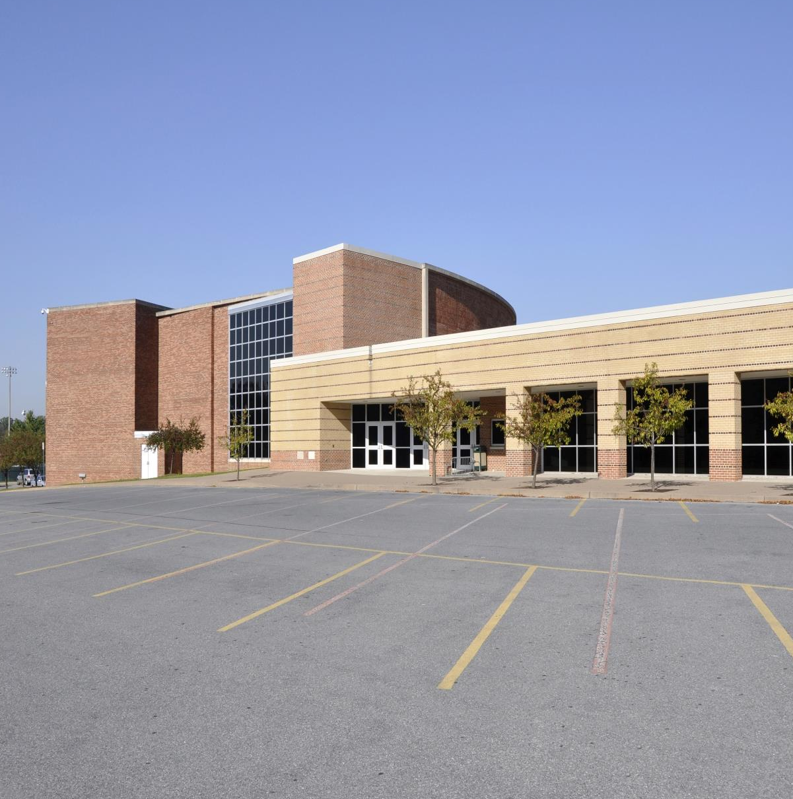
What will be expected of LEAs and schools designated for A-TSI?
Q:

Slide 16

Federal Requirements – A-TSI
In partnership with stakeholders, develop and implement an improvement plan that:
Is informed by all indicators in the state accountability system;
Includes evidence-based interventions;
Identifies resource inequities to be addressed through implementation of the plan;
Is approved by the LEA prior to implementation;
Is monitored by the LEA; and
Results in additional action following unsuccessful implementation after a number of years determined by the LEA.

Slide 17

Role of the LEA in School Improvement
Establish a culture that supports continuous improvement.
Adopt a clear, transparent focus on student achievement as the bottom line.
Prioritize instructional support and coherence.
Allocate resources and supports equitably, as informed by school needs.
Invest in leader and teacher development.
Invest in collection, analysis, and use of data to identify effective and ineffective practices.
Effectively engage and communicate, building a strong constituency for reform.

Slide 18

What are the most important levers for improvement?
Q:

Slide 19
What Works in School Improvement?
Comprehensive Review
Literature review
Consultation
Gaps in PA’s Prior School Improvement Initiatives
Superficial consideration of root causes
Key Levers for Improvement in PA
Focus on Essential Practices
Limited collaboration at the district level
Local reflection
Lacked human capital focus
Full-scale roll out without small-scale pilots
Collaborate closely with LEAs
Differentiate supports
Engage stakeholders
Prioritize human capital systems
Notes:
Key Levers for Improvement in PA:
Explicit focus on fundamental practices associated with rapid and sustained improvements in student outcomes
Empowering LEAs to create the conditions that make it possible for principals to lead school improvement effectively
Differentiating resources and supports based on the needs and context of each LEA and school
Prioritizing human capital to support improvement efforts in LEAs and schools
IF PDE establishes the necessary conditions AND LEAs:
Are accountable and empowered to serve schools identified for support and improvement
THEN schools and their communities:
Are accountable and empowered to provide effective, engaging instruction within a supportive culture
AND ALL students are:
Engaged, healthy, safe and college . career . community ready

Slide 20

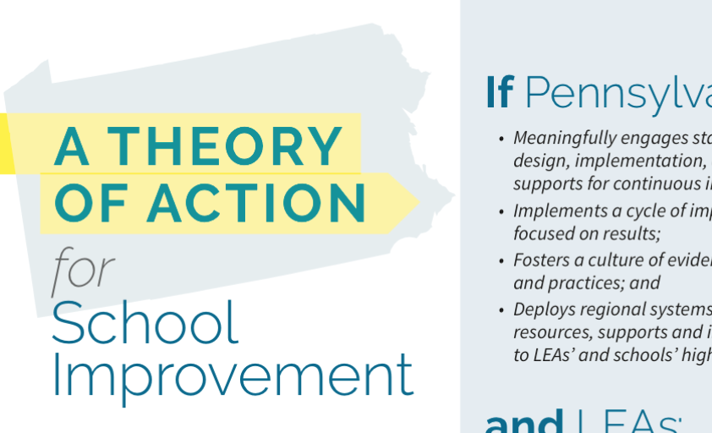
Theory
Of Action

Slide 21
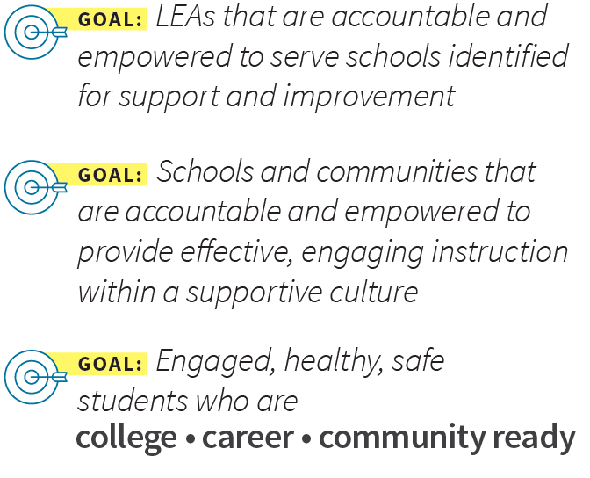
Continuous Improvement Goals
PDE is committed to supporting and monitoring the improvement efforts of LEAs, schools and their communities.
With a shared vision for the future of education in PA, we will work together to ensure:
Notes:
It’s one thing to boost test scores in individual schools from year to year. But as districts work to improve under the Every Student Succeeds Act, many are finding that boosting longer-term outcomes for students demands more systemic—and sustainable—change.
The Every Student Succeeds Act does not explicitly mention continuous improvement, implementation science, or other frameworks, but it does put a strong emphasis on districts devising their own plans for school improvement, rather than following federally prescribed strategies.
Continuous school improvement is a cyclical process intended to help groups of people in a system—from a class to a school district or even a network of many districts—set goals, identify ways to improve, and evaluate change.
The most common approaches seem to share a few concepts, such as: looking at problems as part of a system rather than as isolated episodes; working to improve policies and processes within that system; repeatedly testing assumptions about the causes of problems and their possible solutions; and involving those most affected by changes—like teachers and students—in deciding what tweaks to make.

Slide 22
High Expectations, Responsive Support
Accountability
Support

Slide 23
Authentic Collaboration and Empowerment
Use a hands-on, collaborative approach that places LEA and school leaders front and center in driving their own improvement.
Provide on-site facilitation and support to LEAs and schools using the cycle of improvement as a guide.
Notes:
Build LEA and school capacity and empower them to lead their systems in continuous improvement.

Slide 24
Differentiated Supports
Intermediate Units: Build LEA and school capacity and empower them to lead their systems in continuous improvement.
Provide on-site technical assistance to LEAs and A-TSI schools based on cycle of improvement.
Facilitate networked learning communities to foster collaborative learning and problem solving across schools.

Slide 25
A Deeper Look:
Cycle of
Improvement

Slide 26
Effective Plans
Articulate an overarching goal, but then distill this to a small set of the most important levers that can be integrated and incorporated into all district or school activities to drive improvement.

Slide 27
Effective Plans
Focus attention on the most important levers for improving performance
Align all stakeholders on a clear path forward
Guide allocation of limited resources (financial, human capital, etc.)
Bring a greater degree of coherence between leadership and the governance body

Slide 28
Cycle of Improvement
A key aspect of ESSA is its commitment to the use of evidence-based approaches and continuous improvement to drive better outcomes for students.
Implemented well, a cycle of improvement ground in evidence-based approaches can improve student outcomes and increase the return on education investments.

Slide 29
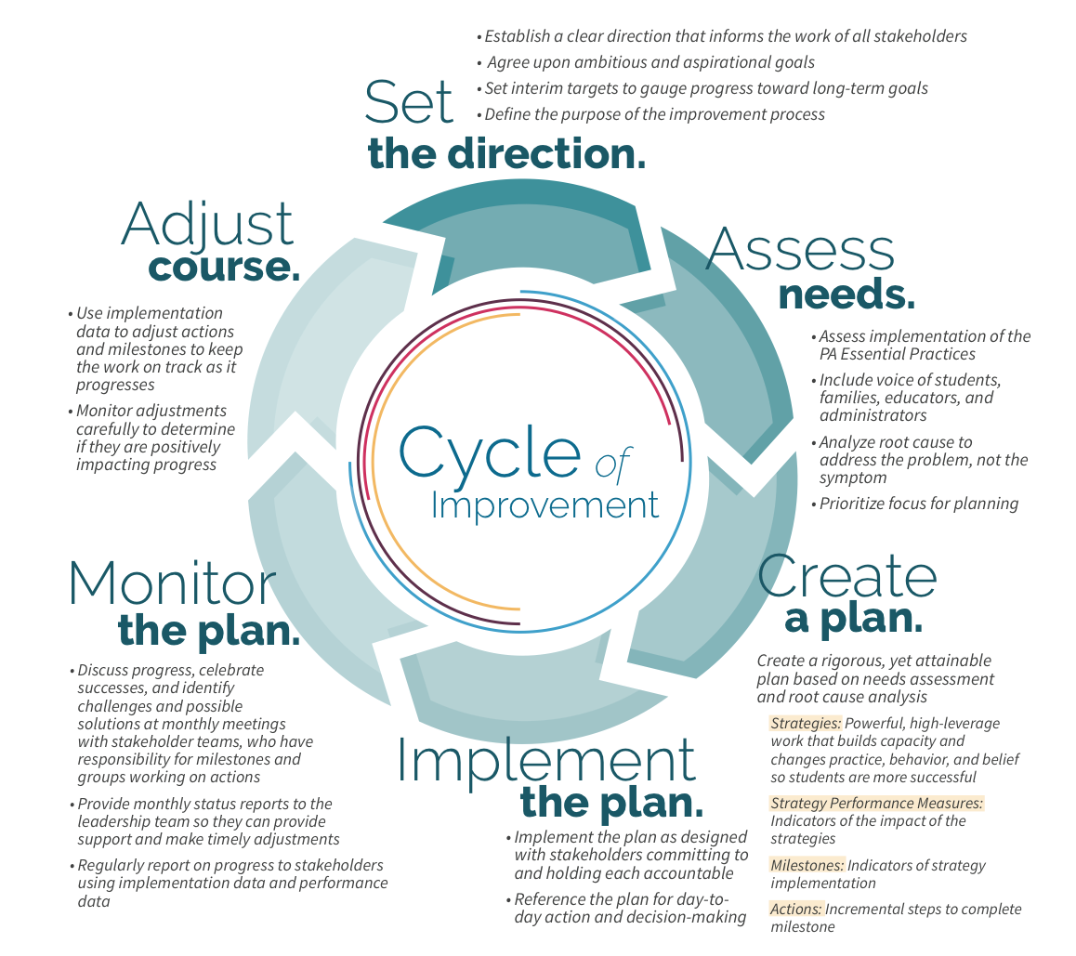

Slide 30
Form a Steering Committee
Ensure the appropriate people are involved and there is an accurate and shared understanding of the district or school’s current status
      Broad enough to reflect the various interests of the district, but not meant to be a “representative” body
      Group size of approximately 10-12
What representatives would you suggest?
Notes:
Example Steering Committee from one District:
Superintendent
School board member
Elementary school principal
High school principal
Teacher (President of Teachers’ Association)
Director of Special Education
Director of Teaching and Learning
Program Supervisor, ELL Services
Business Manager
Head of Communications
Parent

Slide 31
Set the Direction
The direction for an SEA, LEA, or school includes, at a minimum, a mission statement, student-focused goals, and goal performance measures.
  Articulate a long-term vision and mission that all stakeholders can embrace.
  Gain a commitment to a cycle of continuous improvement.
Notes:
Begin by articulating a long-term vision and mission and commitment to continuous improvement.
Long-Term Vision for Students
What will students know and be able to demonstrate upon leaving the school?
Measures of Success
How will you know you are on track to achieving your vision or students?

Slide 32
Notes:
Once the direction with a sharp focus on improvement is set, a needs assessment is conducted.
A needs assessment is a systematic process that is used to identify strengths and weaknesses within the context and constraints of the organization and dig deeper into root causes.

Slide 33
Purpose of a Needs Assessment
Why do program planners in education, health, business, industry, government, etc. conduct needs assessments?
Current State
Desired State
Notes:
Reinforce the need to align selection of data with the vision
Assess the gap or discrepancy between a present state (what is) and a desired state (what should be)

Slide 34
Go Beyond Student Data
A common fact base grounded in rigorous research and analysis provides common understanding from which to launch the planning process.
Gather data from a variety of sources
  Quantitative
  Qualitative (surveys, focus groups, interviews, documents, observations/walkthroughs)
Notes:
The needs assessment goes beyond student data to include data on the prevalence of effective practices. (program quality, educator knowledge and skills, policies and procedures)

Slide 35
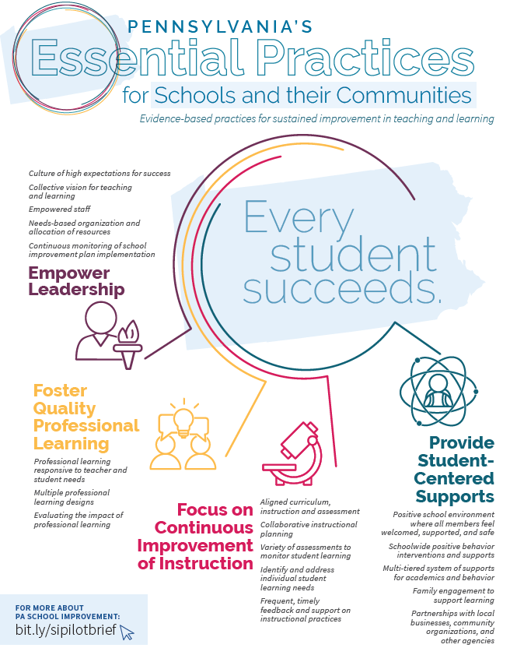
PA Essential Practices
  Improving our capacity to diagnose and correct the systemic issues that undergird performance challenges in individual schools
  Increasing the efficiency and efficacy of school improvement efforts and sustain progress over time
Notes:
Drawing on decades of school improvement research, lessons from leading states and reflections on Pennsylvania’s prior school improvement efforts, Pennsylvania’s school improvement efforts will increase focus on. . .
improving our capacity to diagnose and correct the systemic issues that undergird performance challenges in individual schools
increasing the efficiency and efficacy of school improvement efforts and sustain progress over time
Substantive evidence base identifying explicit conditions and practices that are most critical for improved teaching and learning for all students
Promote collaboration and shared leadership within schools while focusing on what matters most: improving success for all students

Slide 36
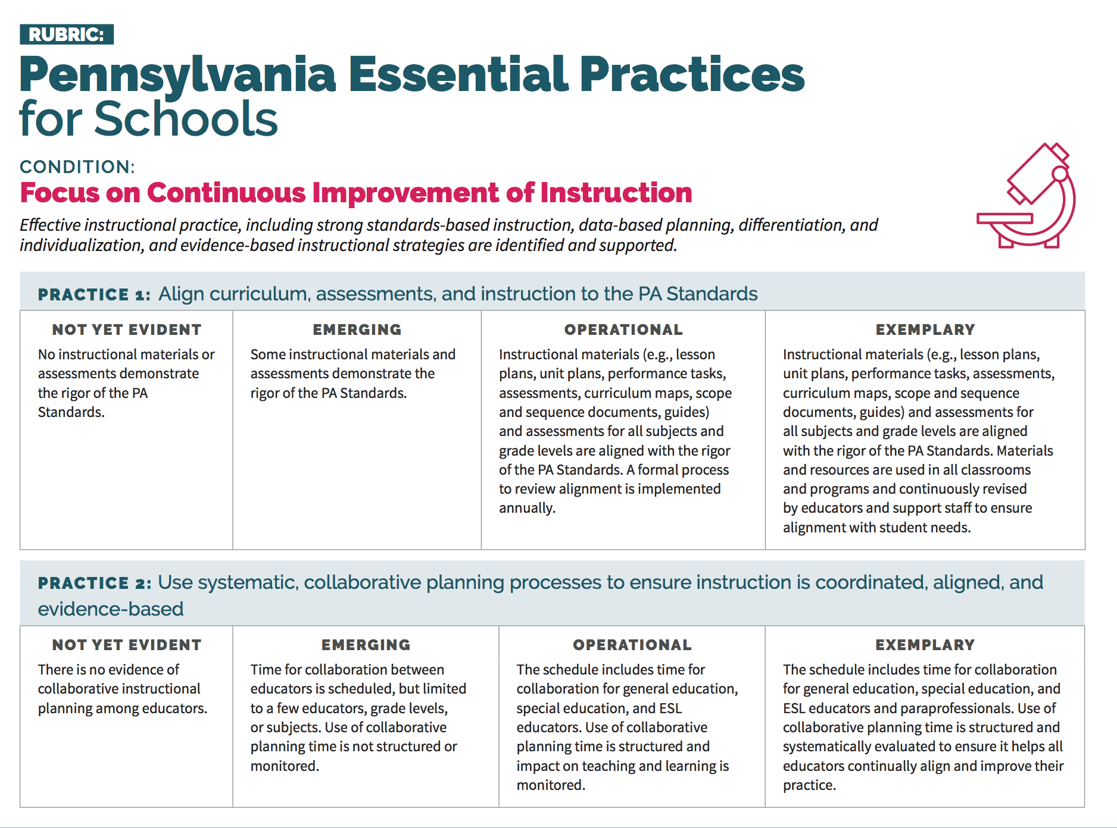
Rubric

Slide 37
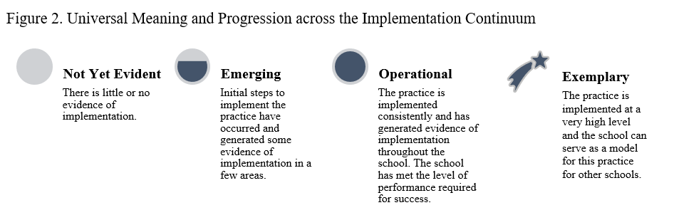
PA Essential Practices Rubric
Notes:
Not Yet Evident: The practice has not been implemented, or the implementation has generated little or no evidence of progress.
Emerging: Initial steps to implement the practice have occurred; implementation has generated some early evidence of progress.
Operational: The practice is implemented. The implementation has generated considerable evidence of progress and the school has met the level of performance required for success.
Exemplary: The practice has been implemented to a very high level, and the school can serve as a model for this practice for other schools.

Slide 38
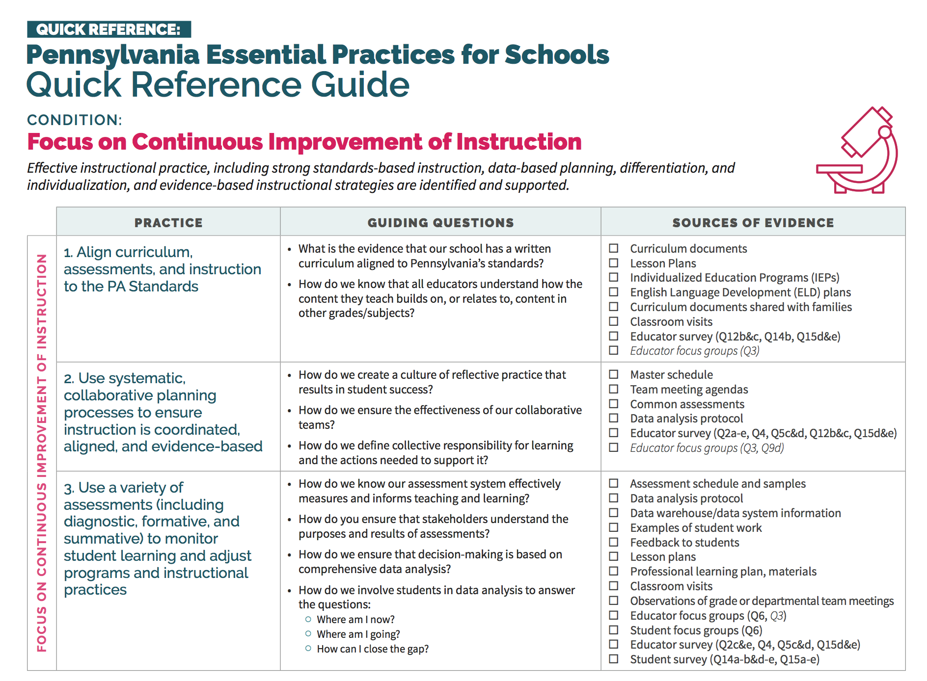
Essential Practice
Quick Reference Guide

Slide 39
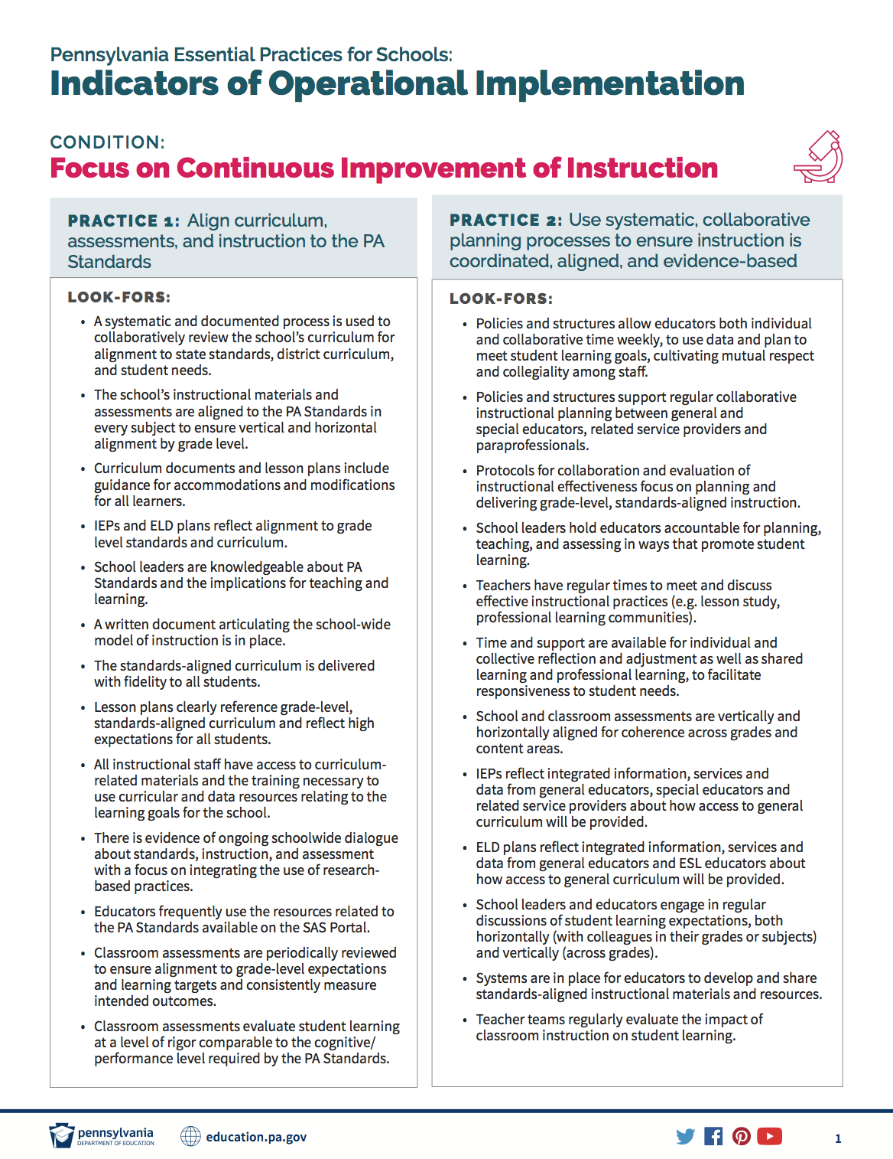
“Look-Fors”: Indicators of Operational Implementation

Slide 40
Essential Practices Self-Assessment Process
Diagnostic Review
Performance Analysis
Root Cause Analysis
Notes:
Step 1. Diagnostic Review
Surveys of educators, students and parents/guardians
Document review
Building and classroom walks
Focus groups with school leadership teams and educators
Step 2: Performance Analysis
Analyze the current status of implementation of the PA Essential Practices for Schools
Prioritize foci for improvement
Step 3: Root Cause Analysis
Root cause is defined as “the deepest underlying cause or causes of positive or negative symptoms within any process that, if dissolved, would result in elimination or substantial reduction of the symptom” (Preuss, 2003, p. 3). A root cause analysis addresses the problem (weak demonstration of an effective professional practice), rather than the symptom (low student achievement), eliminates wasted effort, conserves resources, and informs strategy selection (Preuss, 2003).

Slide 41
Prioritize Needs
A short list (no more than five) of broad thematic areas of focus that will propel the SEA, LEA, or school to achieving its vision and mission.
Sample Techniques
  2x2 Matrix
  R.E.A.L.
Notes:
Using the R.E.A.L. criteria (Readiness, Endurance, Assessed, and Leverage), work as a steering committee to identify which of the PA Essential Practices are the greatest concern (barriers) to achievement of your vision and should be considered a priority in your plan. For each practice that is listed as “Not Yet Evident” or” Emerging” in the table above, apply the R.E.A.L. criteria below.

Slide 42
Root Cause Analysis
Ask thoughtful, root-cause questions to take a deeper dive into the data.
If needed, go back to collect any missing data or clarifications to the findings.
Sample Techniques:
  5 Whys
  Fishbone Diagram
Notes:
it is important to work to identify the underlying causes
Root Cause Analysis: A School Leader’s Guide to Using Data to Dissolve Problems (Preuss, 2013)

Slide 43
Notes:
The plan includes strategies (effective practices), milestones (implementation indicators), actions (steps to the milestone), outputs (produced in completing actions), and a timeline (for completion actions and meeting of milestones).
At the SEA level, the focus is on supporting LEAs in their own improvement and in supporting the improvement of their schools. At the LEA level, the focus is on determining and providing responsive support to schools. At the school level, the focus is on implementing effective practices to rapidly improve results for students as specified in their goals and goal performance measures.

Slide 44
New Plan Template
Schools that are designated for CSI will be the first to use the new plan format this school year.
New plan incorporates the Essential Practices and is set up in a new simple format for ease of plan development, monitoring and revision.
Online tool and resources are to be developed for rollout for the start of the 2019-2020 school year.
Notes:
Develop Measurable Goals:
SMART = specific, measurable, achievable, relevant, time-bound
Establish 2-3 measurable goals for each priority
Include lagging and leading indicators
Minimize measures that track processes
Define Initiatives
Develop an Attainable Action Plan:
What will occur (i.e., specific tasks to be performed)?
How much, how often, or to what extent these actions will occur?
Who will carry out these tasks, including identifying specific school or central office members?
When will these actions take place and for how long?
What are the key milestones to achieve as part of the process?
What resources are needed to carry out the tasks?

Slide 45
Evidence-Based Strategies
Evidence Resource Center – providing tools and technical assistance in selecting evidence-based interventions that PA, LEAs, and schools have the capacity to implement
Notes:
SEAs should provide transparent information to LEAs/schools whether particular evidence-based interventions were proven to have positive impacts with similar students as the focus of any particular TSI plan. Similar populations and settings are not an absolute requirement when considering an intervention, but they are important indicia to consider.

Slide 46
Review the Plan with Stakeholders
Before finalizing the plan, a series of facilitated meetings with various stakeholders should be held.
  Provide essential insight into different perspectives
  Can highlight details that may have been overlooked
  Create broader understanding and buy-in

Slide 48
Implement the plan
The plan should guide day-to-day activities in the LEA or school.
The plan should be part of the school’s daily culture; stakeholders should be thinking and talking about implementation every day.

Slide 49
Notes:
In a performance cycle, the organization regularly examines progress on actions and outputs leading to completion of strategy-aligned milestones.
Staff meets monthly in teams that have been assigned responsibility for milestones and in groups working on actions to discuss progress, celebrate successes, and identify challenges and possible solutions.
Monthly status reports are provided to the leadership team so they can provide support and make timely adjustments.
Monitoring is a critical part of a successful improvement process and occurs at all levels of the system.

Slide 50
Monitor the Plan
Set up a monitoring system to regularly measure progress.
Make time to review progress monitoring information.
Assign specific individuals to gather and interpret data, track progress, keep teams informed.

Slide 51
Notes:
As work progresses, implementation data are used to adjust actions and milestones to keep the work on track. The adjustments are monitored carefully to determine if they are positively impacting progress. Leadership teams at each organization make the final decisions regarding adjustments to the plan, but their decisions are not made in isolation.

Slide 52
Refine the Plan (as needed)
Extend or enhance implementation
Scale up to other sites
Modify the strategy
Replace the strategy with something else
Notes:
Remember, it’s a plan

Slide 53
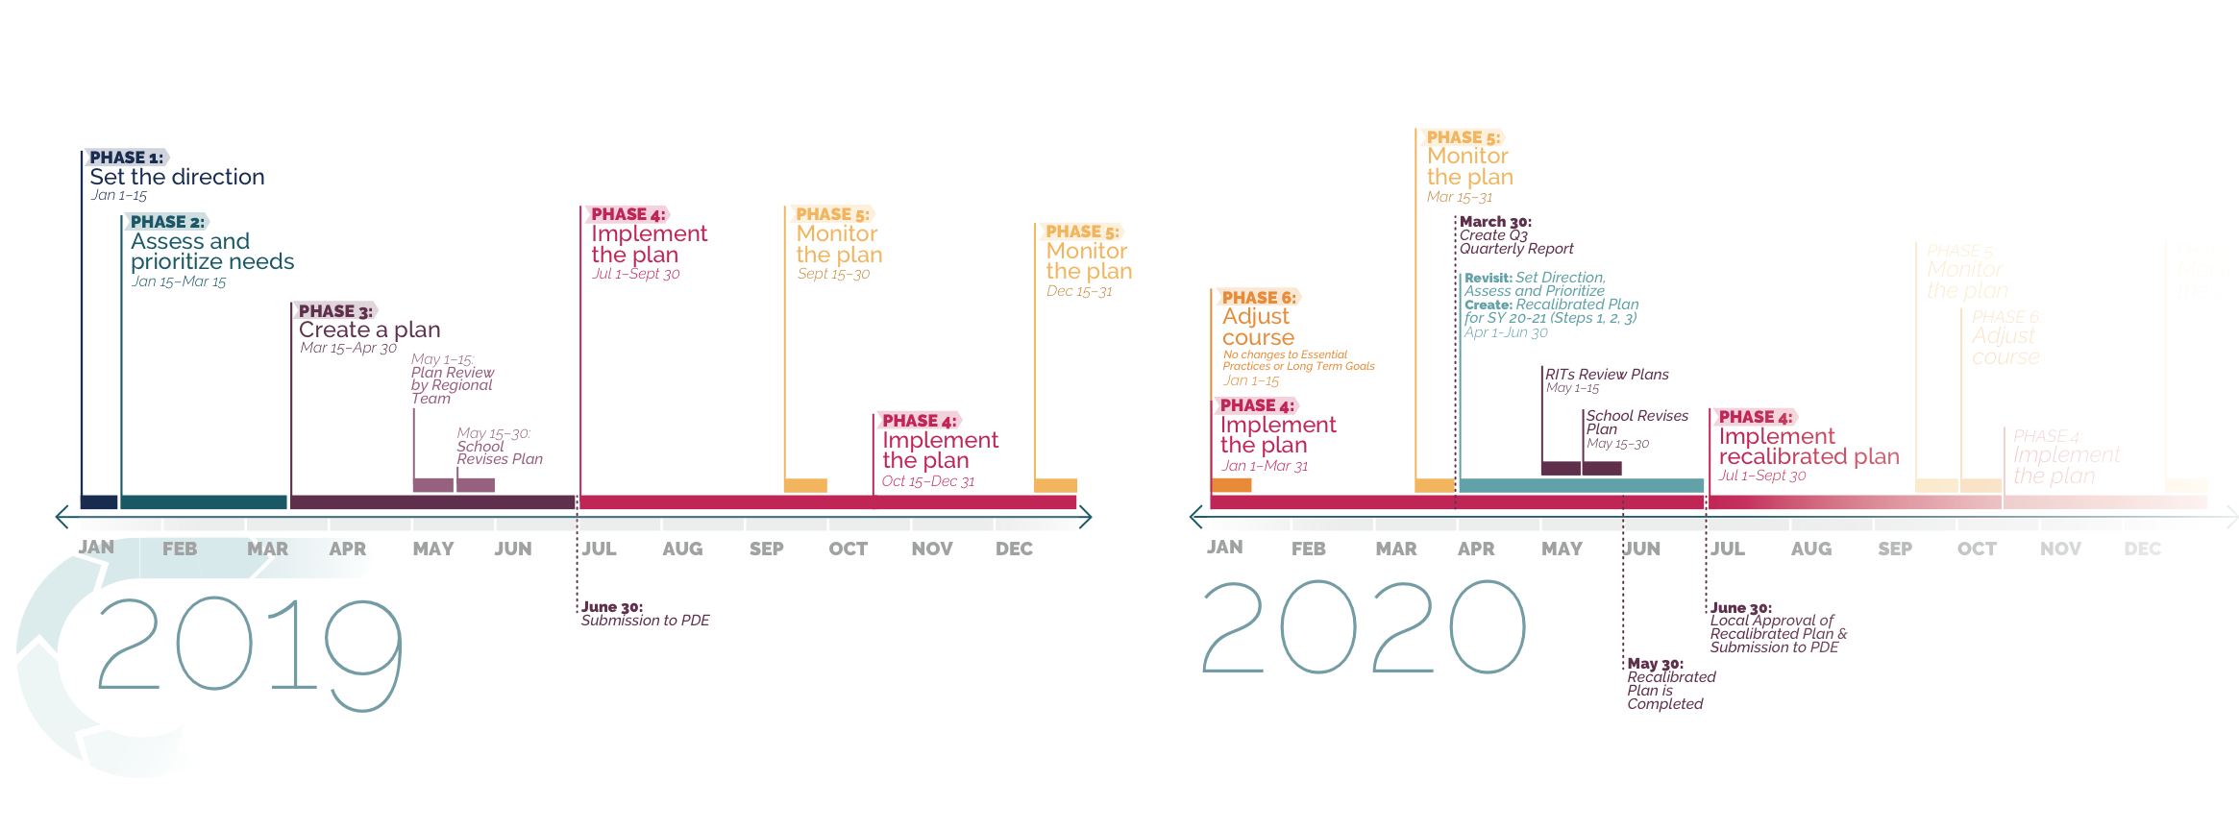
Timeline
of the
Cycle of Improvement

Slide 54
Estimated Timeline

Slide 55

Questions?

Slide 56
Thank You!

