Slide 1

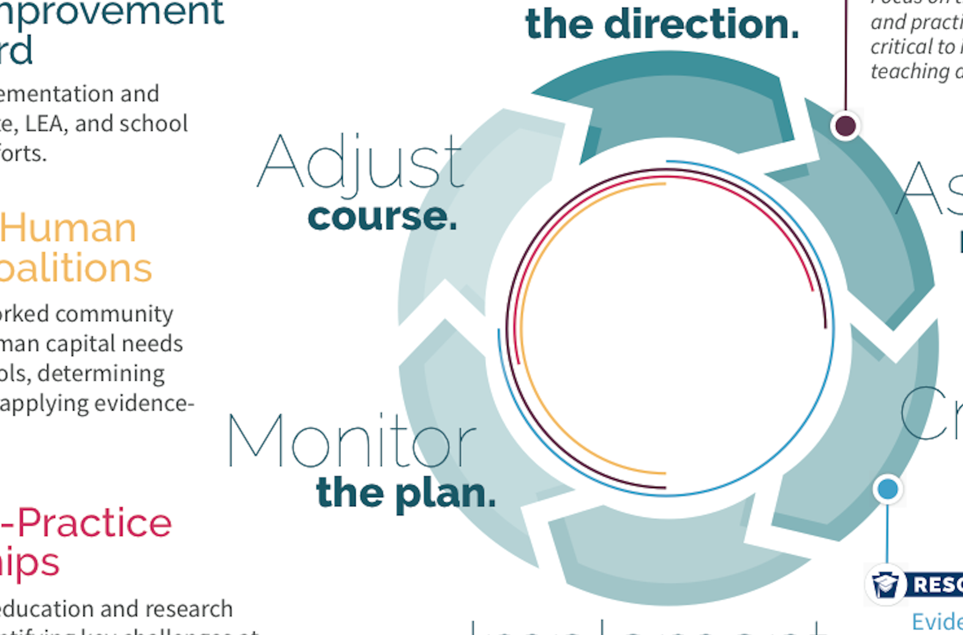
PA System for
LEA and
School
Improvement

Slide 2

Activate your thinking
Write three characteristics/skills have been critical in your work in A-TSI schools.

Slide 3
Characteristics of a Change Agent
Clear vision
Patient yet persistent
Asks tough questions
Knowledgeable and leads by example
Strong relationships built on trust

Slide 4

What does the work in Phase 2 actually look like?
Q:
Notes:
Under the No Child Left Behind (NCLB) Act, the federal government assigned state education agencies a standard playbook for intervening in schools that needed support. However, the federally-prescribed policies didn’t account for local context or conditions, build on evidence-based practices, or involve educator voice.
Now, under the Every Student Succeeds Act (ESSA), which replaced NCLB, states have flexibility to rethink their approach for supporting schools.
When crafting its new plan for school improvement, the Pennsylvania Department of Education (PDE) started with an evaluation of prior efforts and determined NCLB-era initiatives didn’t consider the root causes of achievement and other challenges.
Following that analysis, as well as a review of school improvement efforts in other states and existing research, PDE believes a better approach to school improvement emphasizes four key conditions:
Focusing on continuous improvement of instruction,
Empowering leadership,
Providing student-centered support systems, and
Fostering high-quality professional learning for leaders, educators, and support staff
As a result, in its new school improvement process, Pennsylvania has set conditions for school improvement that:
Incentivize the right practices for teaching and learning,
Ensure educators have meaningful voice in the formulation, implementation, and evaluation of policies, and
Support the agency’s overarching goals of equity, innovation, and transparency in every school, and across all zip codes.

Slide 5
Where do we go from here?
Q:

Slide 6
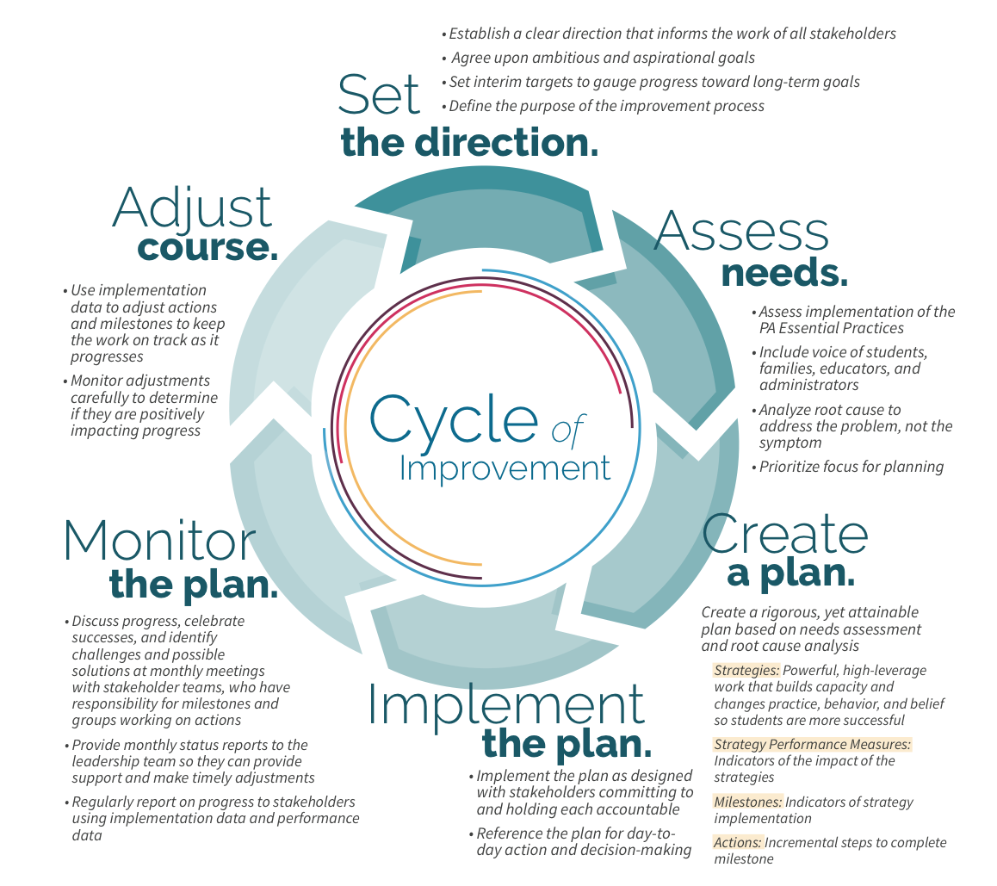
Notes:
The plan includes strategies (effective practices), milestones (implementation indicators), actions (steps to the milestone), outputs (produced in completing actions), and a timeline (for completion actions and meeting of milestones).
At the SEA level, the focus is on supporting LEAs in their own improvement and in supporting the improvement of their schools.
At the LEA level, the focus is on determining and providing responsive support to schools.
At the school level, the focus is on implementing effective practices to rapidly improve results for students as specified in their goals and goal performance measures.

Slide 7
Let’s start with the purpose of this work
Current State
Desired State
Where are we now?
Where do we want to go?
How will we get there?
Who is responsible?
How will we know we are making progress?
Notes:
Articulate an overarching goal, but then distills this to a small set of the most important levers that can be integrated and incorporated into all district or school activities to drive improvement.

Slide 8
Components of effective plans
List the components of effective plans.
Based on your list, identify the two components where you see schools struggle the most.

Slide 9
Where might LEAs and schools struggle?
Source: District Management Council study of approximately 400 strategic plans

Slide 10
2x2 Matrix
Low Comfort,
High Anxiety
High Comfort,
High Anxiety
Anxiety
Low Comfort,
Low Anxiety
High Comfort,
Low Anxiety
Comfort

Slide 11
2x2 Matrix – COMPLETED SAMPLE
II.D.
III.
IV.A.
II.B.
II.C.
Anxiety
IV.B.
V.
I.A.
I.B.
II.A.
Comfort

Slide 12
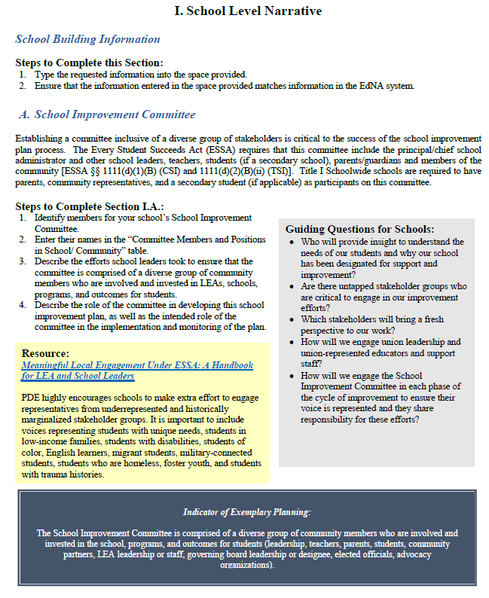
Notes:
Let’s start with the layout of the Guidelines and Process document . . .

Slide 13
Dig into the Template
Section I (Guidelines pages 2-3; Template pages 1-2)
  What phase of the cycle is represented here?
  What questions do you have about this section?

Slide 14
Sample: School Level Vision for Learning
Long-Term Vision for Students What will students know and be able to demonstrate upon leaving the school? | Measures of Success How will you know you are on track to achieving your vision for students?
Sample Elementary School ensures every student has access to grade level instruction daily, using a rigorous and high-quality curriculum that every teacher has been trained to use. | By 2030, 72% of students will score Proficient or Advanced on the Mathematics PSSA, in each grade level and student group. By 2030, 100% of educators will demonstrate Proficient or Distinguished practices in the classroom. By 2030, 100% of students will be engaged in programs and services aligned with their academic, behavioral, social-emotional, and health needs.

Slide 15
Sample: School Level Vision for Learning
Long-Term Vision for Students What will students know and be able to demonstrate upon leaving the school? | Measures of Success How will you know you are on track to achieving your vision for students?
Sample Middle School prepares students to be socially responsible and academically successful as they encounter challenges in school and beyond. | All students are on-track for success in 9th grade. All students demonstrate mastery of the eleven career readiness skills. All students demonstrate personal and social responsibility in school, at home, and in the community.

Slide 16
Sample: School Level Vision for Learning
Long-Term Vision for Students What will students know and be able to demonstrate upon leaving the school? | Measures of Success How will you know you are on track to achieving your vision for students?
Sample High School prepares all students for college, career, and community by providing a challenging curriculum (RIGOR) that connects students’ lives and their future (RELEVANCE) in a safe, supportive, and nurturing environment (RELATIONSHIPS). | By 2023, 100% of students in grades 9-11 will be on-track for post-secondary training or employment. By 2030, 100% of graduates will be connected to post-secondary training or employment by the Fall immediately following graduation.

Slide 17
Dig into the Template
Section II (Guidelines pages 4-5; Template pages 3-4)
  Take a few minutes to review the components of section II. Based on your work with A-TSI schools to date, what are some examples of how the school might respond to these prompts?
  What questions do you have about this section?

Slide 18
Sample: Strengths
Strengths | Supporting Evidence from Needs Assessment
Mathematics (grades 3-5) | 60% of students in each grade, 3 through 5, scored Proficient or Advanced on the Mathematics PSSA. This is a 20-percentage point increase from SY 2014-15; showing consistently increasing trend each of the last three years. 80% of educators in grades 3 through 5 endorsed the most positive response option on items related to opportunities for collaborative planning, use of variety of assessments to monitor student learning and inform instruction, timely and useful feedback on instructional practice, and regular engagement with families focused on strategies to support learning at home. Although school-wide we are currently Emerging in Essential Practices 2, 3, 5, and 14; the evidence consulted in the Essential Practices self-assessment indicate these practices are Operational in grades 3-5
Notes:
What stands out for you?

Slide 19
Sample: Challenges
Challenges | Supporting Evidence from Needs Assessment | Priority for Planning
Mathematics in grades 6-8 | 20% of students in grade 6, 15% of students in grade 7, and 10% of students in grade 8 scored Proficient or Advanced on the Math PSSA. These data have been relatively stagnant over the last three years. Proficiency in math is lower among students with disabilities, as compared to their peers. Educator focus groups highlighted fewer opportunities for collaborative planning, use of variety of assessments to monitor student learning and inform instruction, timely and useful feedback on instructional practice, and regular engagement with families focused on strategies to support learning at home in math compared to literacy. | Yes
Notes:
What stands out for you?

Slide 20
Sample: Established Priorities
Priority Statement | Rationale | Outcome Category
Use systematic, collaborative planning processes to ensure instruction is coordinated, aligned, and evidence-based in mathematics in grades 6 through 8. | If we engage cross-disciplinary instructional teams in developing standards-aligned units of instruction and example lesson plans that tailor instruction to individual student needs, then teachers will plan and deliver standards-based personalized instruction, and each student will meet his or her growth targets in Math each quarter. | Essential Practices Condition 1: Focus on Continuous Instruction
Notes:
What stands out for you?

Slide 21
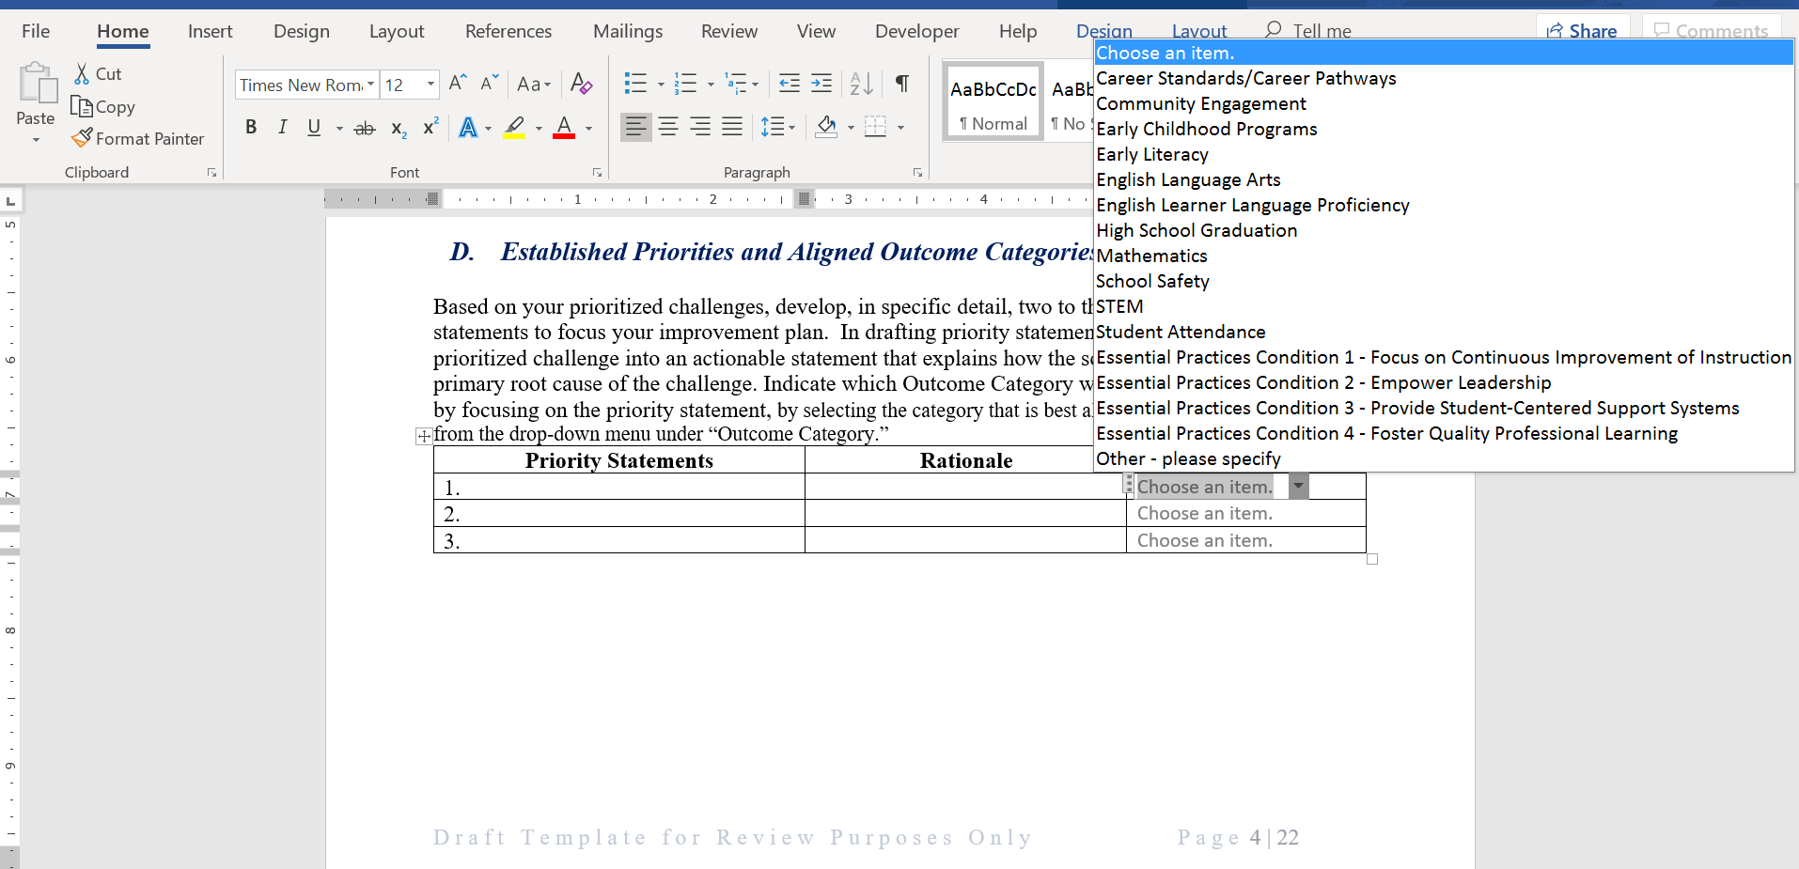
Outcome Categories

Slide 22
Dig into the Template
Section III (Guidelines page 6; Template page 5)
  What key shifts in mindset do you anticipate as you support schools in developing measurable goal statements?
  What questions do you have about this section?

Slide 23
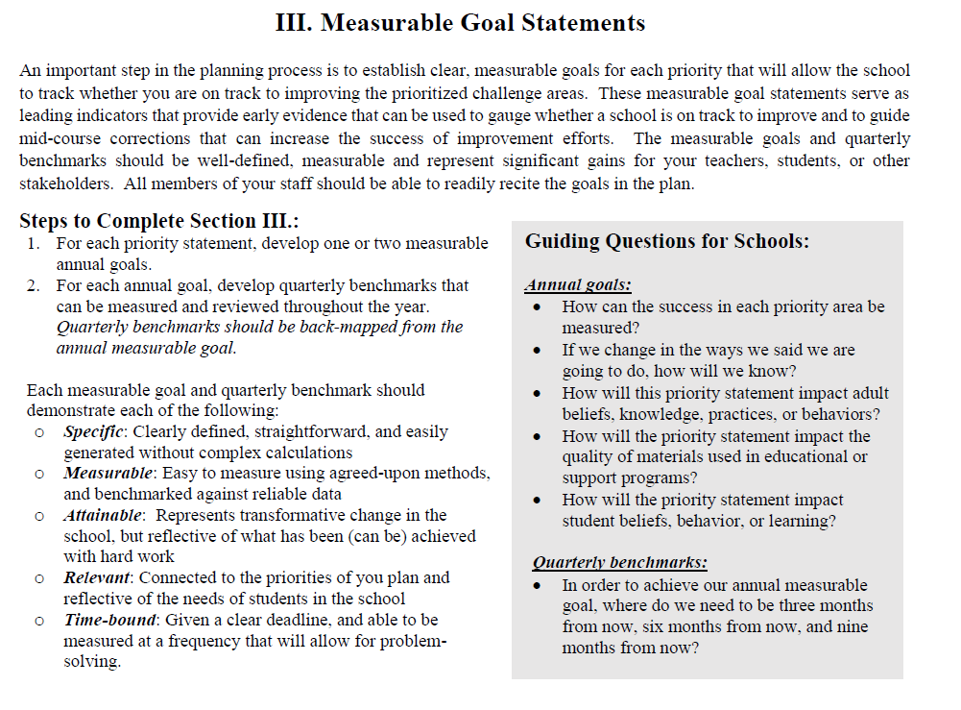
Key Shifts: Measurable Goal Statements

Slide 24
Sample: Measurable Goal Statements
Priority Statement #1: Use systematic, collaborative planning processes to ensure instruction is coordinated, aligned, and evidence-based in mathematics in grades 6 - 8.
Measurable Goals | Quarterly Benchmark #1 | Quarterly Benchmark #2 | Quarterly Benchmark #3
100% of teacher lesson plans for math in grades 6 – 8 will be standards-based and include at least one enhancement to personalize instruction by June 30, 2020. | 66% of teacher lesson plans for math in grades 6 – 8 will be standards-based and include at least one enhancement to personalize instruction by September 30, 2019. | 76% of teacher lesson plans for math in grades 6 – 8 will be standards-based and include at least one enhancement to personalize instruction by December 31, 2019. | 86% of teacher lesson plans for math in grades 6 – 8 will be standards-based and include at least one enhancement to personalize instruction by March 30, 2020.
37% of students in grades 6-8 will score Proficient or Advanced on the Mathematics PSSA by June 30, 2020. | 45% of students in grades 6-8 will score Proficient or Advanced on the Mathematics Fall benchmark assessment. | 45% of students in grades 6-8 will score Proficient or Advanced on the Mathematics Winter benchmark assessment. | 45% of students in grades 6-8 will score Proficient or Advanced on the Mathematics Spring benchmark assessment.

Slide 25
Dig into the Template
Section IV (Guidelines pages 7-9; Template pages 6-19)
  Let’s start with section IV.A.
    Where do you think LEAs and schools are in their understanding of “evidence-based” strategies?
    Where can LEAs and schools look for evidence-based strategies?
    How might the PA Evidence Resource Center assist LEAs and schools in selecting evidence-based strategies?

Slide 26
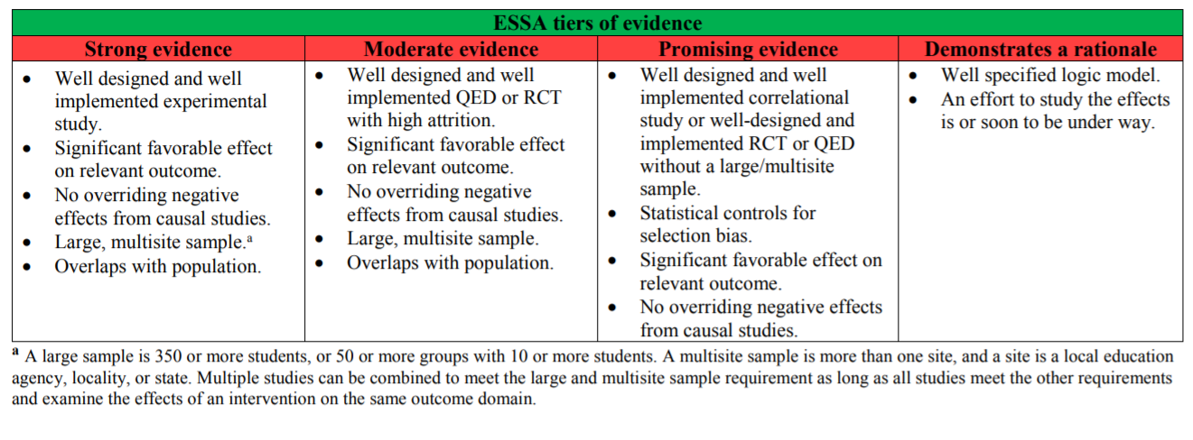
Understanding ESSA’s Evidence Provisions
SOURCE: Midwest Regional Education Laboratory at American Institutes for Research (2018). Aligning Evidence-based Clearinghouses with the ESSA Tiers of Evidence
Notes:
ESSA’s evidence provisions create requirements and opportunities for states to both use and build evidence. When implemented well, these provisions can improve student outcomes and increase the return on education investments.
ESSA’s new, tiered definition of “evidence-based” includes four levels of evidence, the top three of which require findings of a statistically significant effect on improving student outcomes or other relevant outcomes based on Strong, Moderate, or Promising evidence, as defined by the statute.
The fourth level is designed for ideas that hold promise but do not yet have an evidence base qualifying for the top three levels, as long as those approaches are coupled with “ongoing efforts to examine the effects” of the approach. Given this requirement to evaluate the impact of approaches that are not supported by evidence meeting the top three levels, level four can be referred to as “evidence-building.”

Slide 27
Evidence-based strategy clearinghouses: General
What Works Clearinghouse
Social Programs that Work
National Dropout Prevention Center
National Center for Systemic Improvement
National Center for School Leadership
IDEAs That Work
Collaboration for Effective Educator Development
Center on Instruction
Synthesis of Information on Evidence-Based Practices for School Improvement: 20 Studies and Tools Focused on Evidence-Based Practices in School Improvement

Slide 28
Evidence-based strategy clearinghouses:
Continuous Improvement of Instruction
GENERAL
Evidence for ESSA
Visible Learning Plus 250+ Influences on Student Achievement
CAST: Universal Design for Learning
Achieve
National Institute for Direct Instruction
IDEAs That Work
University of Kansas Direct Instruction
LITERACY
National Center on Improving Literacy
Reading Rockets
Word Generation
Florida Center for Reading Research
The Reading League
RAND: Education and Literacy
Writing Next
Collaborative Strategic Reading
Literacy How
MATH
US Department of Education
American Psychological Association
Evidence-Based Intervention Network
Strategic Education Research Partnerships
Achieve the Core

Slide 29
Evidence-based strategy clearinghouses:
Continuous Improvement of Instruction
ENGLISH LEARNERS
IDEAs that Work
Colorin Colorado
WIDA
Effective Literacy and English Language Instruction for English Learners in the Elementary Grades
STUDENTS with DISABILITIES
IDEAs That Work
National Instructional Materials Access Center
National Technical Assistance Center on Transition
RENEW

Slide 30
Evidence-based strategy clearinghouses:
Provide Student-Centered Supports
GENERAL
National Center for School Engagement
Blueprints for Healthy Youth Development
SAMHSA Evidence-Based Practices Resource Center
Attendance Works
SOCIAL EMOTIONAL LEARNING
CASEL
MTSS
National Center on Intensive Intervention
Consortium on Reading Excellence in Education
RTI Action Network
IDEAs That Work

Slide 31
Additional resources
National Implementation Research Network
Evidence-Based Improvement: A Guide for States to Strengthen Their Frameworks and Supports Aligned to the Evidence Requirements of ESSA
Selecting Evidence-Based Programs
A Framework for Effectively Implementing Evidence-Based Programs and Practices (EBPs)

Slide 32
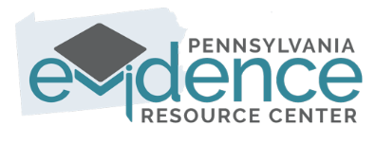
ERC Sneak Peek

Slide 33
Dig into the Template
Section IV (Guidelines pages 7-9; Template pages 6-19)
  Explore the contents of this section IV.B.
    What key shifts do you anticipate supporting as schools develop their action plans?
    What questions do you have about this section?

Slide 34
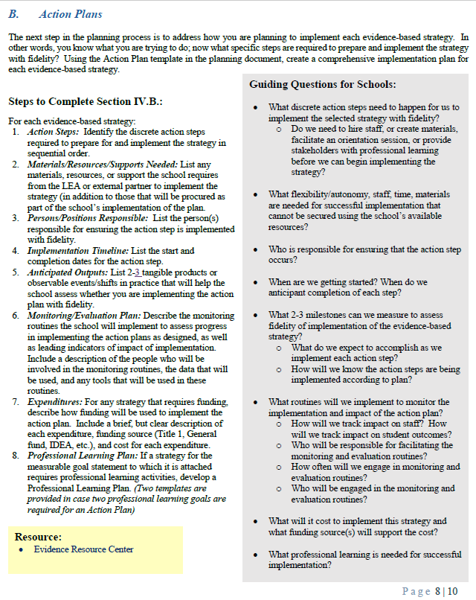
Key Shifts: Action Plans

Slide 35
Dig into the Template
Section V (Guidelines page 10; Template page 20)
  Explore the contents of this section.
  What questions do you have?

Slide 36
Key Shifts: School Improvement Plan Review and Feedback
To ensure that the broader school community is provided an opportunity to review and provide feedback on the School Improvement Plan, LEAs and schools may choose between two options:
  Option 1: Post the complete, pre-approved School Improvement Plan for 28 days on the LEA or school website, offering an opportunity for the general public to review all contents of the plan and provide feedback
  Option 2: Meaningfully engage the broader school community in review and feedback on the completed, pre-approved plan through focus groups, surveys, or community meeting
LEAs must provide evidence of engagement of stakeholders providing them an opportunity to review the School Improvement plan(s) and provide feedback, as well as demonstration that the feedback was considered in finalizing the School Improvement Plan(s).

Slide 37
Dissemination of Links to Fillable Template
In the next two weeks, you will receive a link providing you access to a fillable version of the School Improvement Plan through Microsoft OneDrive. This is the process you will use to complete and submit your final plan. The email will be sent from Carrie Anderson (carranders@pa.gov) on the following timeline:
  Monday, March 4 – non-Title I A-TSI schools
  Wednesday, March 6 – Title I A-TSI schools
  Friday, March 8 – LEAs with both A-TSI and CSI schools
  Tuesday, March 12 – CSI schools

Slide 38
Plan Submission and Required Approvals
Final, fully approved School Improvement Plans for all designated schools are due to PDE no later than close of business on June 30, 2019.
 | School Leader | Superintendent/Chief Charter School Administrator | Board President* | CSI School Improvement Facilitator | IU A-TSI Designee
Non-Title I A-TSI Schools | X | X | X
Title I A-TSI Schools | X | X | X |  | X
CSI Schools | X | X | X | X
*LEAs must consult with their Board to determine whether the full board must review and approve the A-TSI and/or CSI School Improvement Plan(s) or whether the Board President may act on behalf of the School Board

Slide 39
Closing Thoughts:
How would you describe your role in the planning process?

Slide 40

Questions?

Slide 41
Thank You!

