Slide 1

45 Printable cards
+ sample questions
Rules
Put on a headband.
Give out three chips to each player.
Grab a card from the pile.
Put the card on your headband AND DON'T LOOK AT THE CARD.
The youngest player goes first. Then, play passes to the left.
Flip over the timer and ask other players questions about your card.
You can use any question except, "What am I? "
If you guess the picture before the timer runs out, take another card.
Continue asking questions until the timer runs out.
For each picture you guess correctly, put one of your chips in the bank.
At any point during your turn, you can give up trying to guess.
If you do, you must collect one chip from the bank.

Slide 2
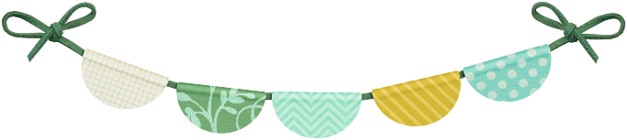

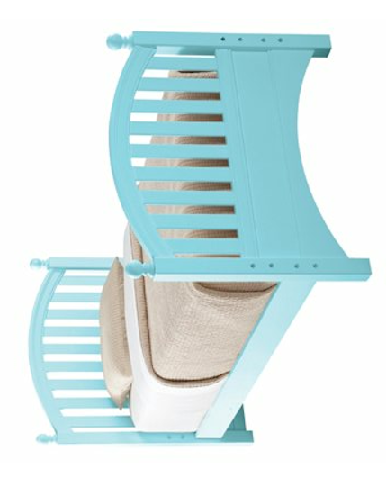

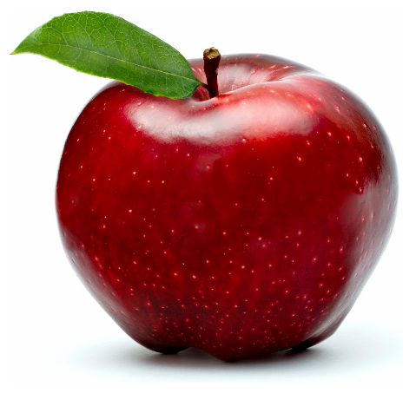
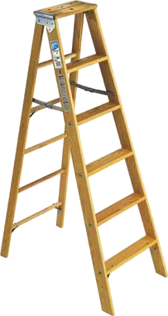
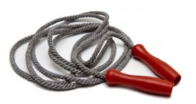
I am a bed
I am a light
bulb
Я кровать
Я лампочка
I am an apple
Я яблоко
I am a jumping
rope
I am a ladder
Я скакалка
Я лестница

Slide 3
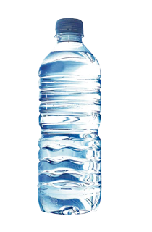
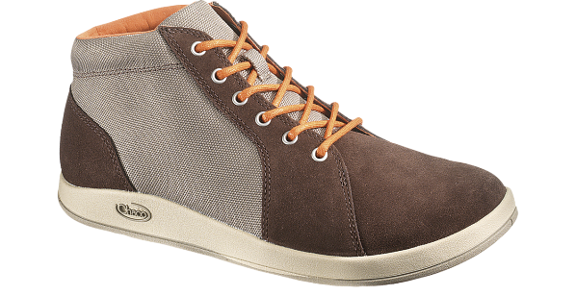
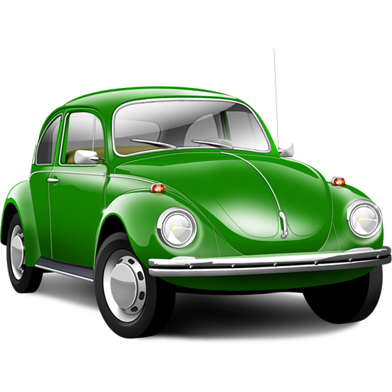
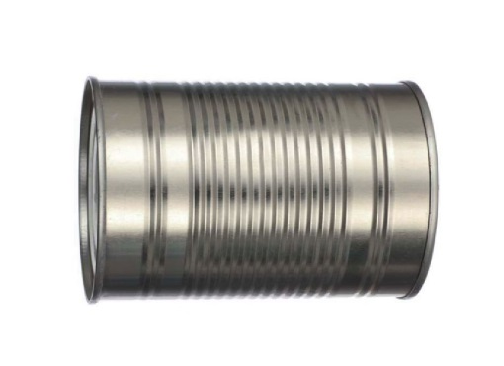

I am a shoe
I am a bottle
Я ботинок
Я бутылка
I am a car
Я автомобиль
I am a can
I am money
Я консервная
банка
Я деньги

Slide 4

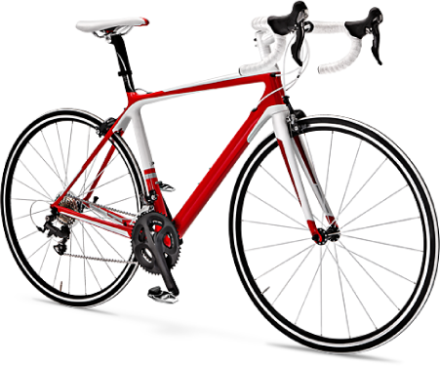
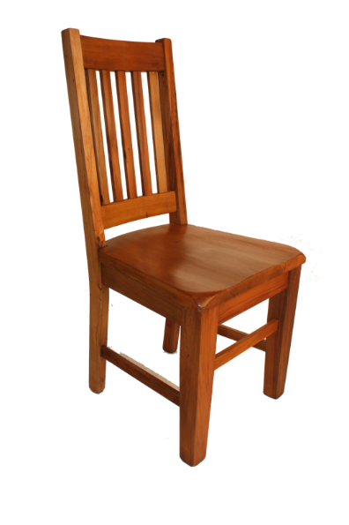
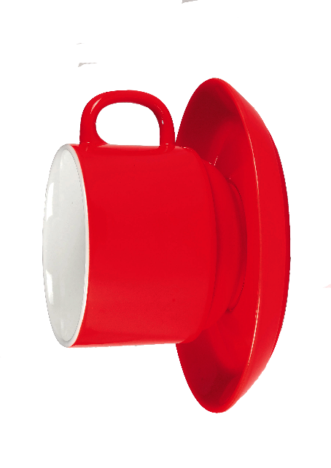
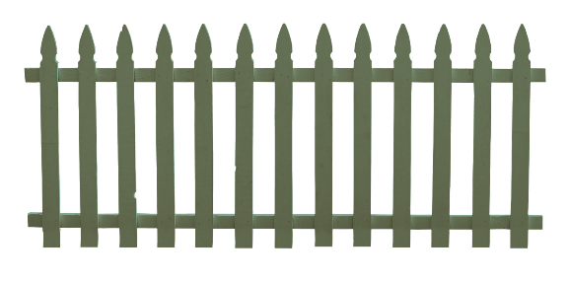
I am a cap
I am a bicycle
Я кепка
Я велосипед
I am a chair
Я стул
I am a fence
I am a cup
Я забор
Я чашка

Slide 5
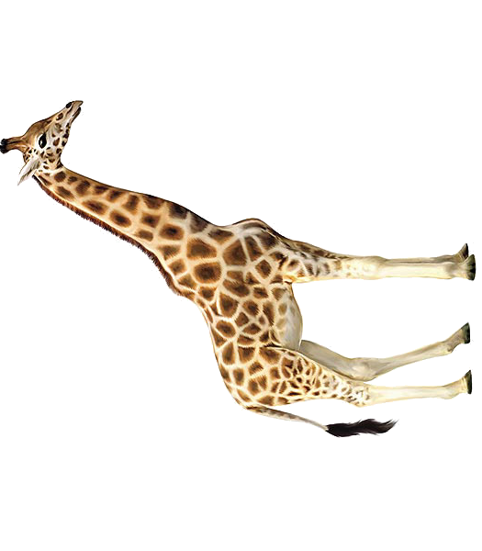
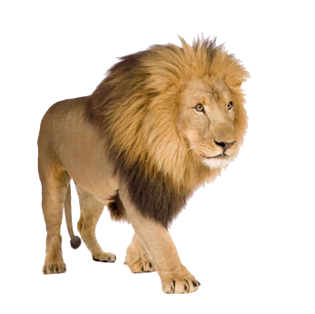
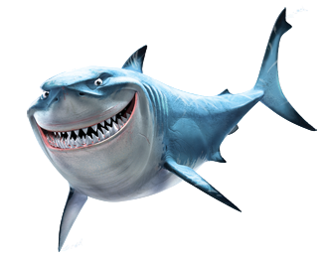
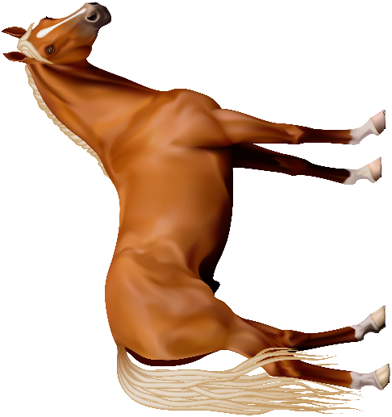
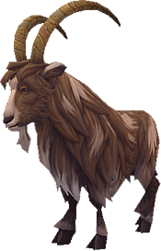
I am a giraffe
I am a lion
Я жираф
Я лев
I am a shark
Я акула
I am a horse
I am a goat
Я лошадь
Я козёл

Slide 6
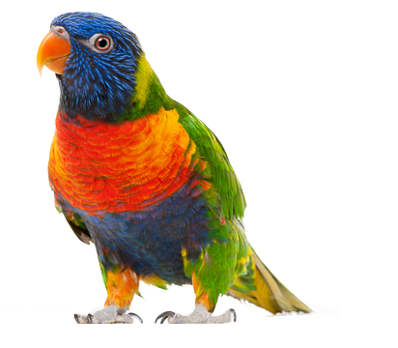
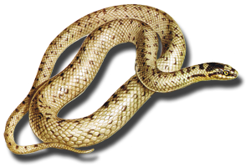
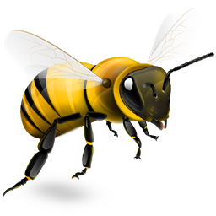
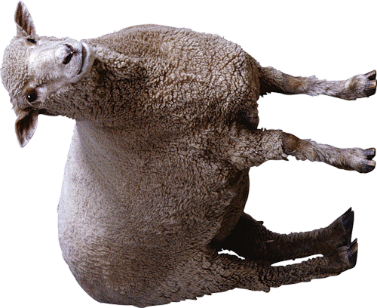
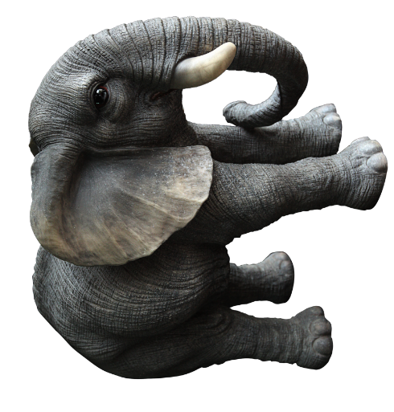
I am a parrot
I am a snake
Я попугай
Я змея
I am a bee
Я пчела
I am a sheep
I am an
elephant
Я овца
Я слон

Slide 7
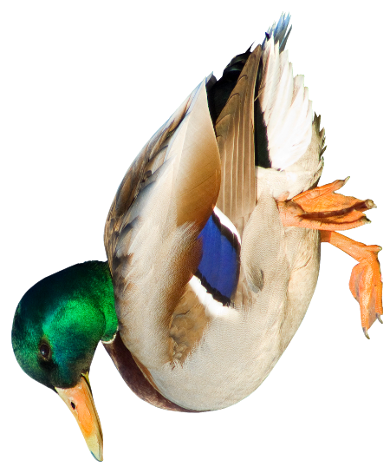
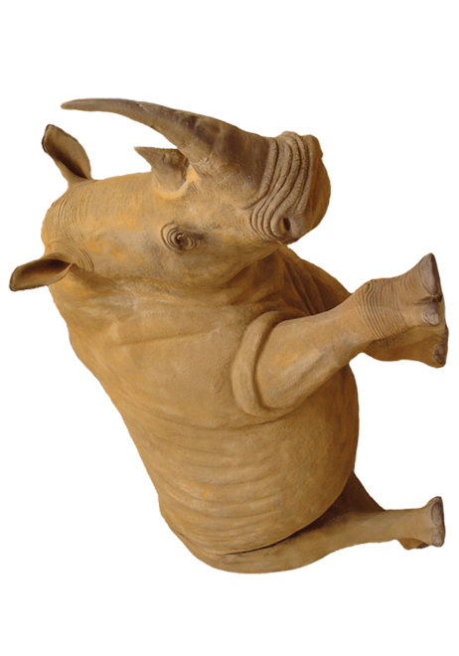
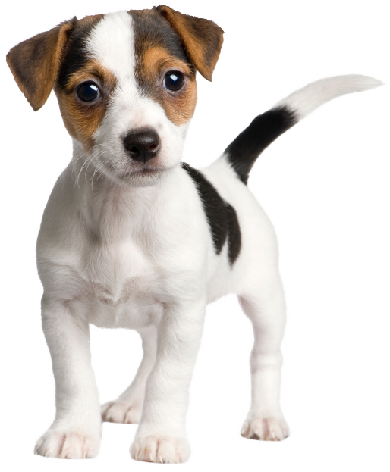
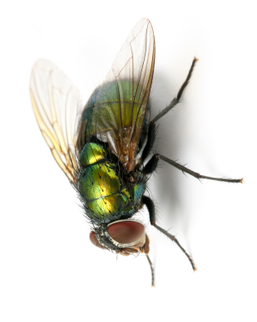
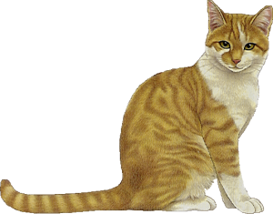
I am a duck
I am a rhino
Я утка
Я носорог
I am a puppy
Я щенок
I am a fly
I am a cat
Я муха
Я кошка

Slide 8
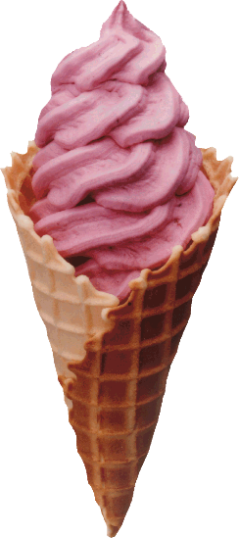
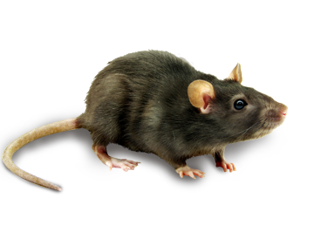

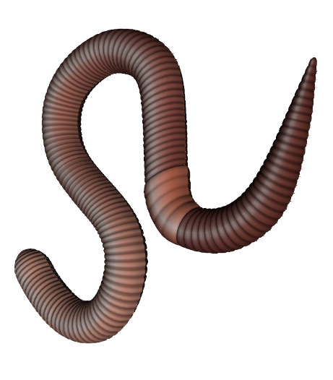
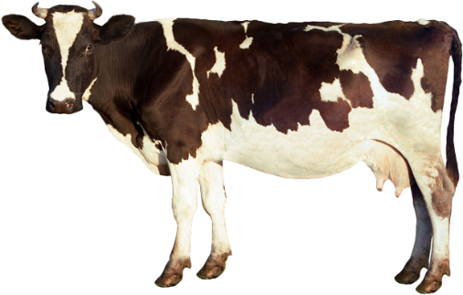
I am a mouse
I am ice cream
Я мышь
Я мороженое
I am
French fries
Я картошка фри
I am a cow
I am a worm
Я корова
Я червяк

Slide 9
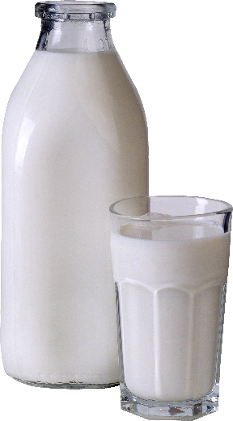
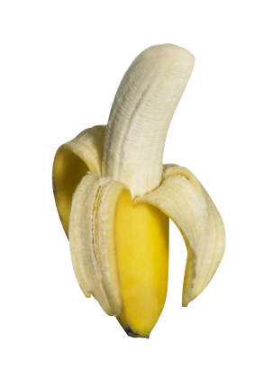
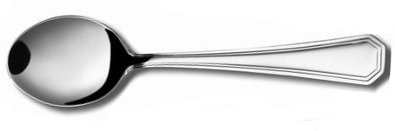
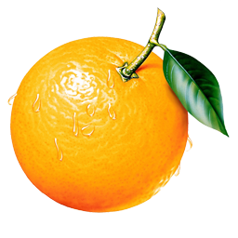
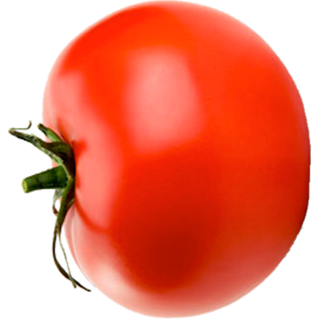
I am milk
I am a banana
Я молоко
Я банан
I am a spoon
Я ложка
I am a tomato
I am an orange
Я помидор
Я апельсин

Slide 10

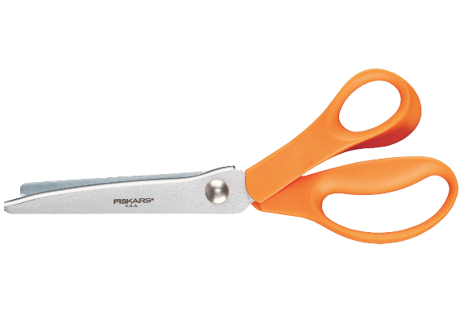

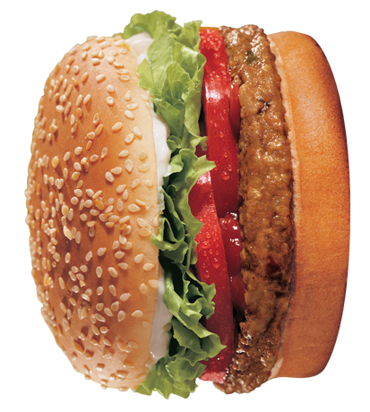
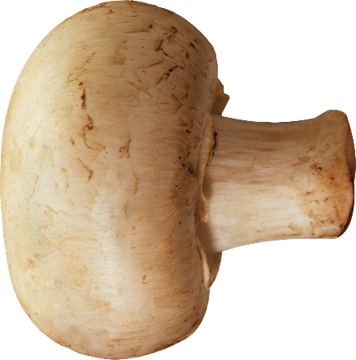
I am scissors
I am a cake
Я ножницы
Я торт
I am a fork
Я вилка
I am a
mushroom
I am a burger
Я гамбургер
Я гриб

Slide 11
Sample Questions
Do I have legs? Could I be a pet? Am I an animal?
Can I swim? Do I make noise? Can I be eaten? Do I have fur? Am I a person? Can I fly? Am I a vegetable? Am I heavy? Am I alive?
Sample Questions
Do I have legs? Could I be a pet? Am I an animal?
Can I swim? Do I make noise? Can I be eaten? Do I have fur? Am I a person? Can I fly? Am I a vegetable? Am I heavy? Am I alive?
Sample Questions
Do I have legs? Could I be a pet? Am I an animal?
Can I swim? Do I make noise? Can I be eaten? Do I have fur? Am I a person? Can I fly? Am I a vegetable? Am I heavy? Am I alive?
Sample Questions
Do I have legs? Could I be a pet? Am I an animal?
Can I swim? Do I make noise? Can I be eaten? Do I have fur? Am I a person? Can I fly? Am I a vegetable? Am I heavy? Am I alive?
Sample Questions
Do I have legs? Could I be a pet? Am I an animal?
Can I swim? Do I make noise? Can I be eaten? Do I have fur? Am I a person? Can I fly? Am I a vegetable? Am I heavy? Am I alive?

