Slide 1
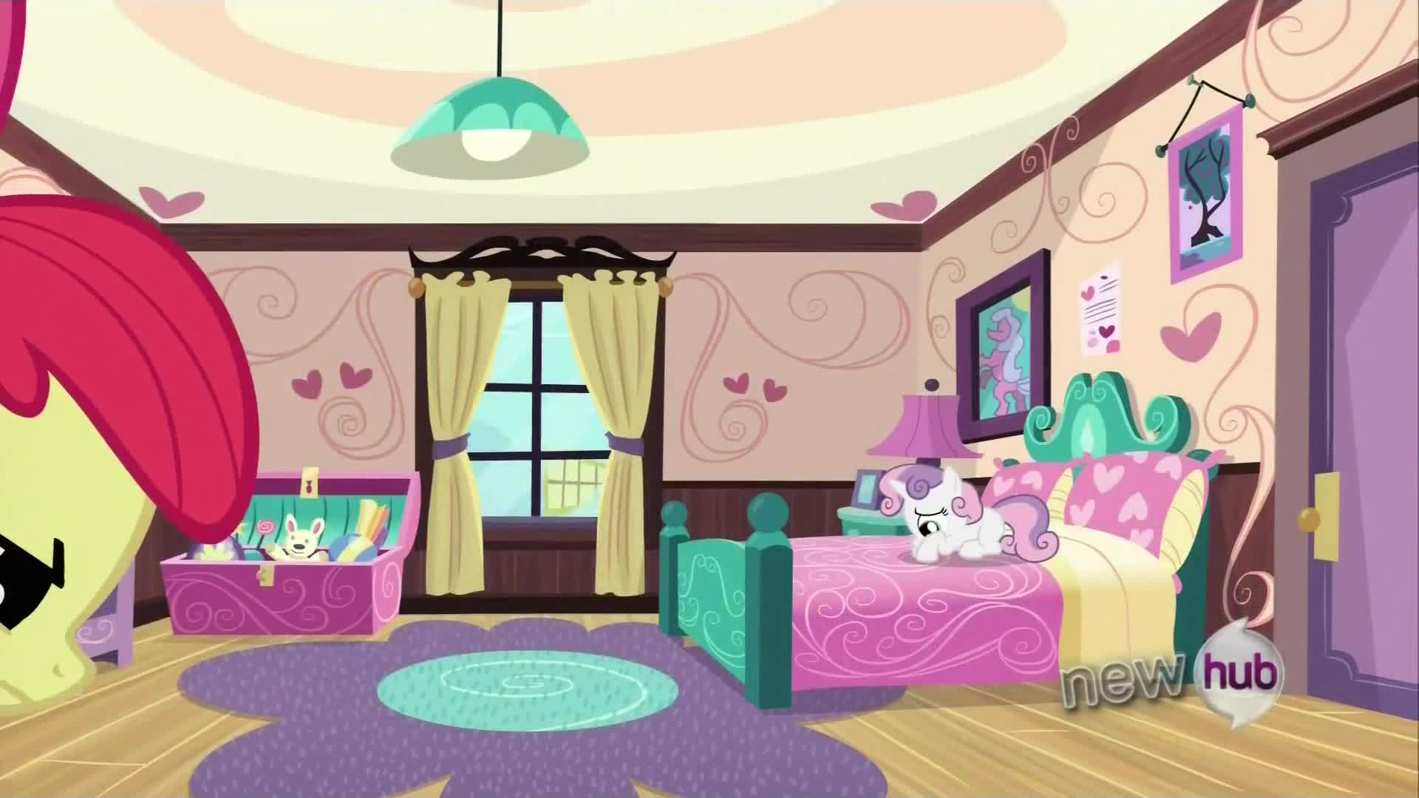

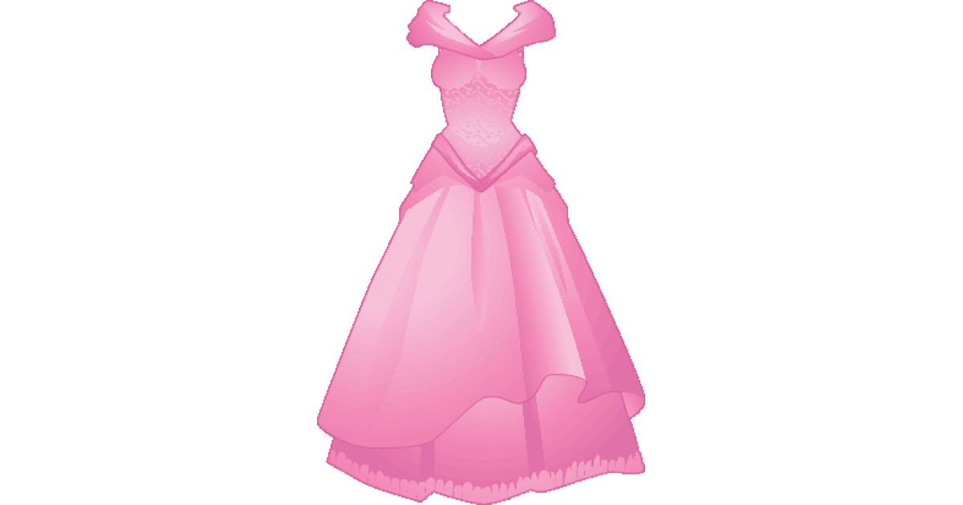
What is she wearing?
She is wearing …
https://vk.com/teachvs

Slide 2
What is she wearing?
She is wearing …

Slide 3
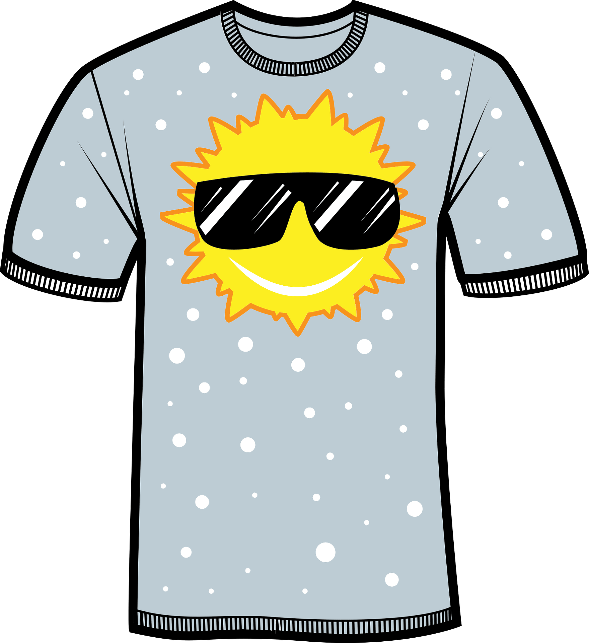
What is she wearing?
She is wearing …

Slide 4
What is she wearing?
She is wearing …

Slide 5
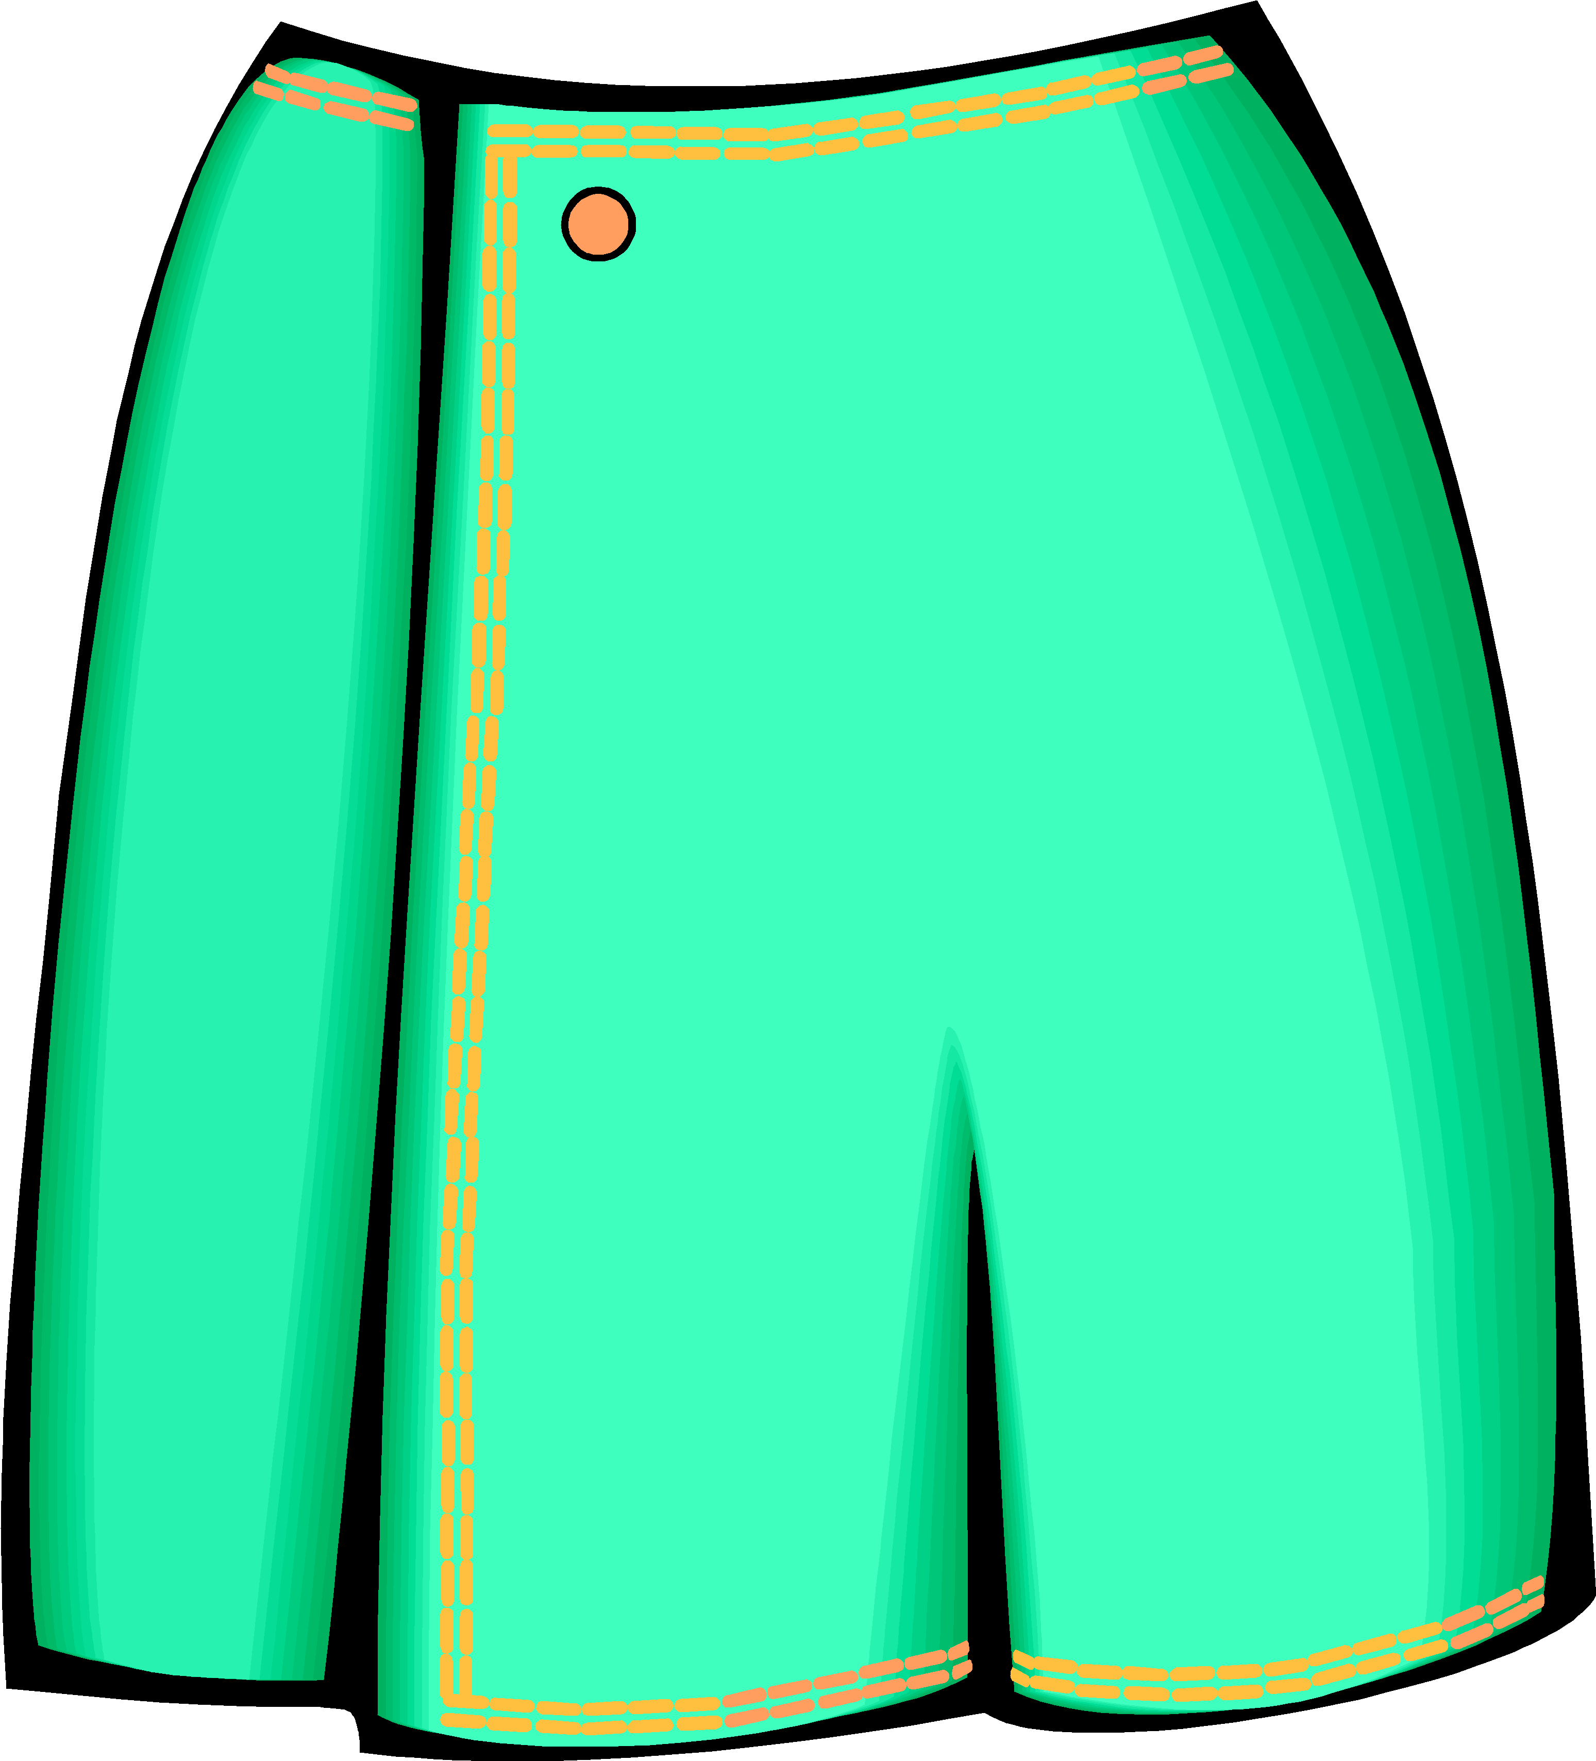
What is she wearing?
She is wearing …

Slide 6
What is she wearing?
She is wearing …

Slide 7
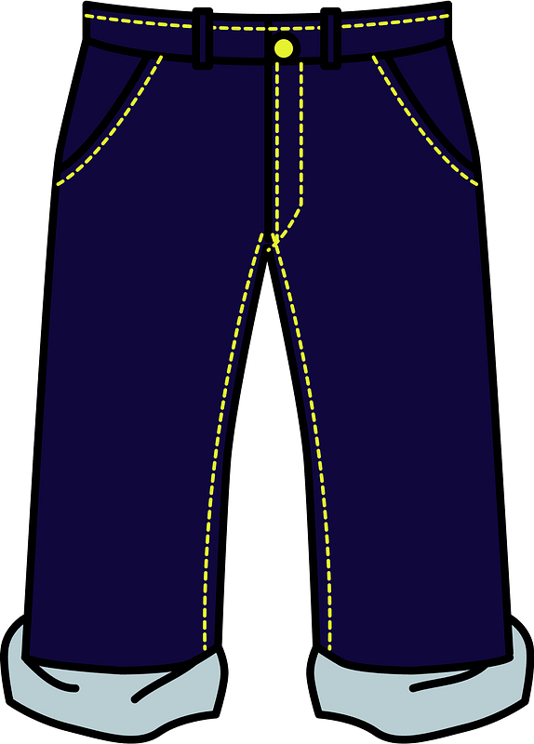
What is she wearing?
She is wearing …

Slide 8
What is she wearing?
She is wearing …

Slide 9
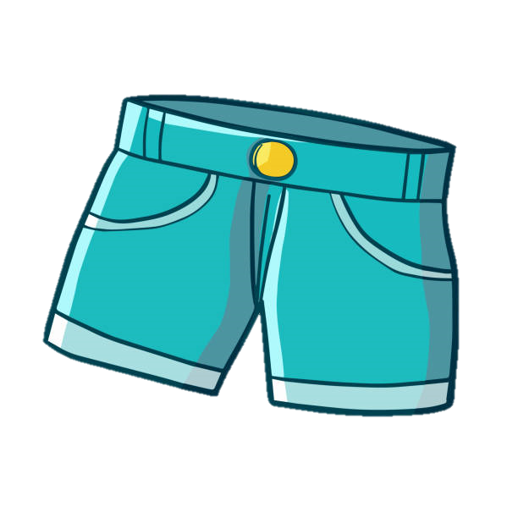
What is she wearing?
She is wearing …

Slide 10
What is she wearing?
She is wearing …

Slide 11
What is she wearing?
She is wearing …

Slide 12
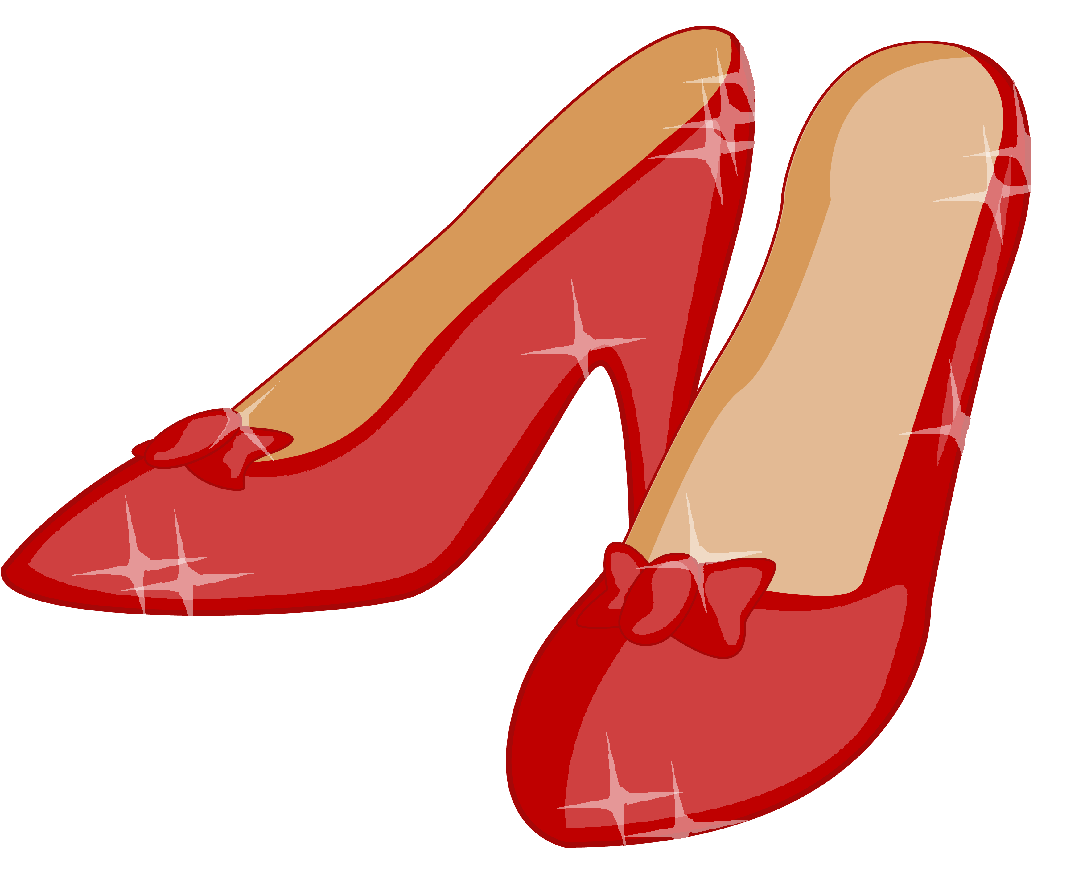
What is she wearing?
She is wearing …

Slide 13
What is she wearing?
She is wearing …

Slide 14
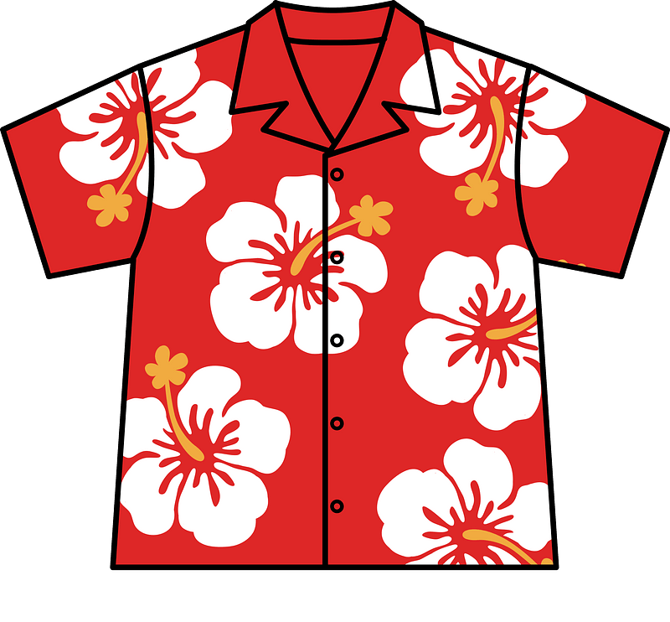
What is she wearing?
She is wearing …

Slide 15
What is she wearing?
She is wearing …

Slide 16
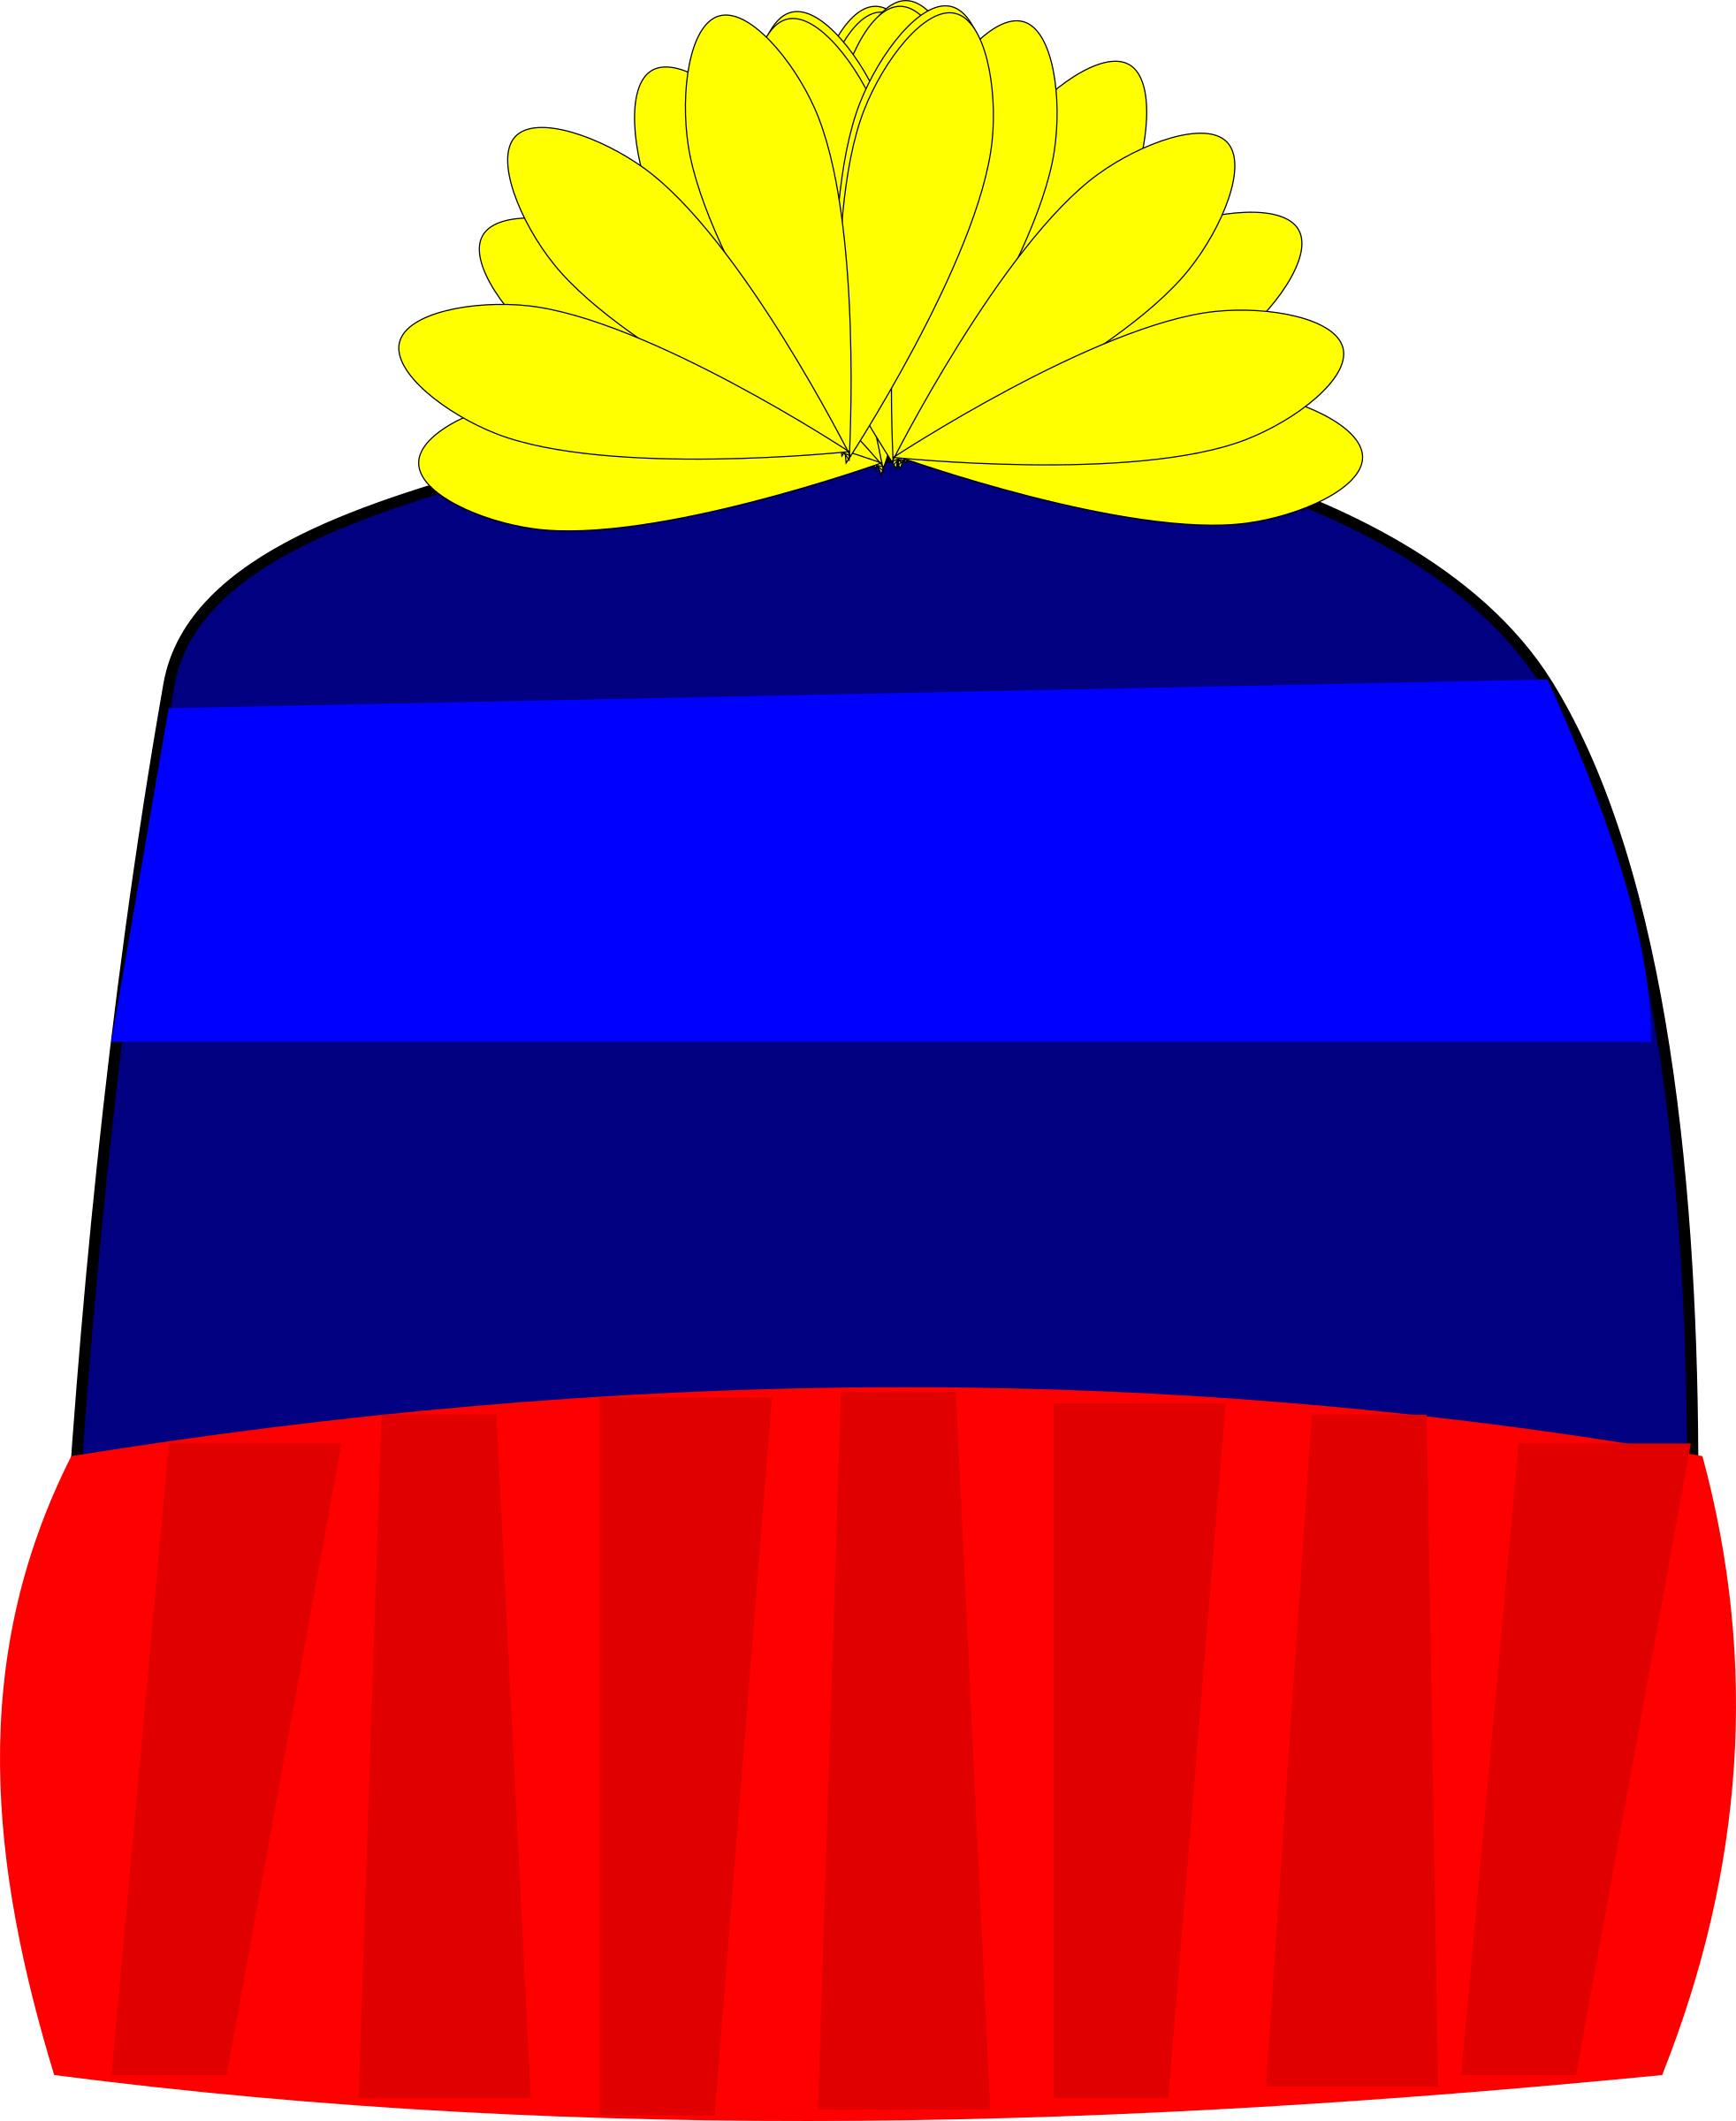
What is she wearing?
She is wearing …

Slide 17
What is she wearing?
She is wearing …

Slide 18

What is she wearing?
She is wearing …

Slide 19
What is she wearing?
She is wearing …

Slide 20
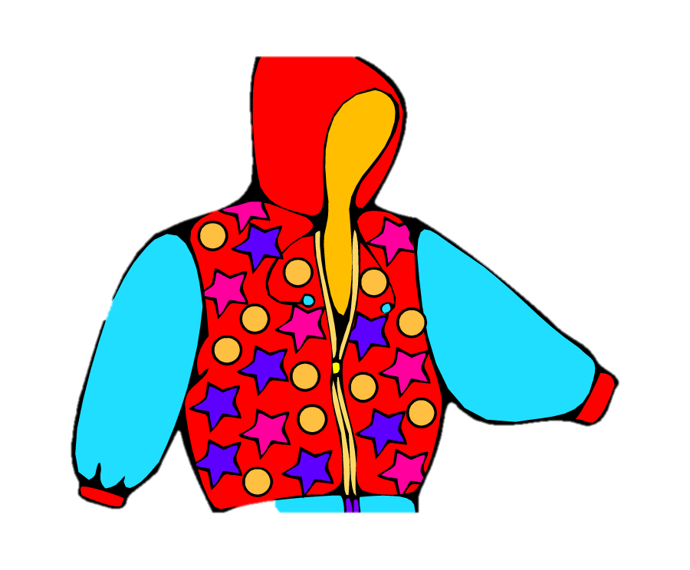
What is she wearing?
She is wearing …

Slide 21
What is she wearing?
She is wearing …

Slide 22

What is she wearing?
She is wearing …

Slide 23
What is she wearing?
She is wearing …
https://vk.com/teachvs

