Slide 1

milk

Slide 2
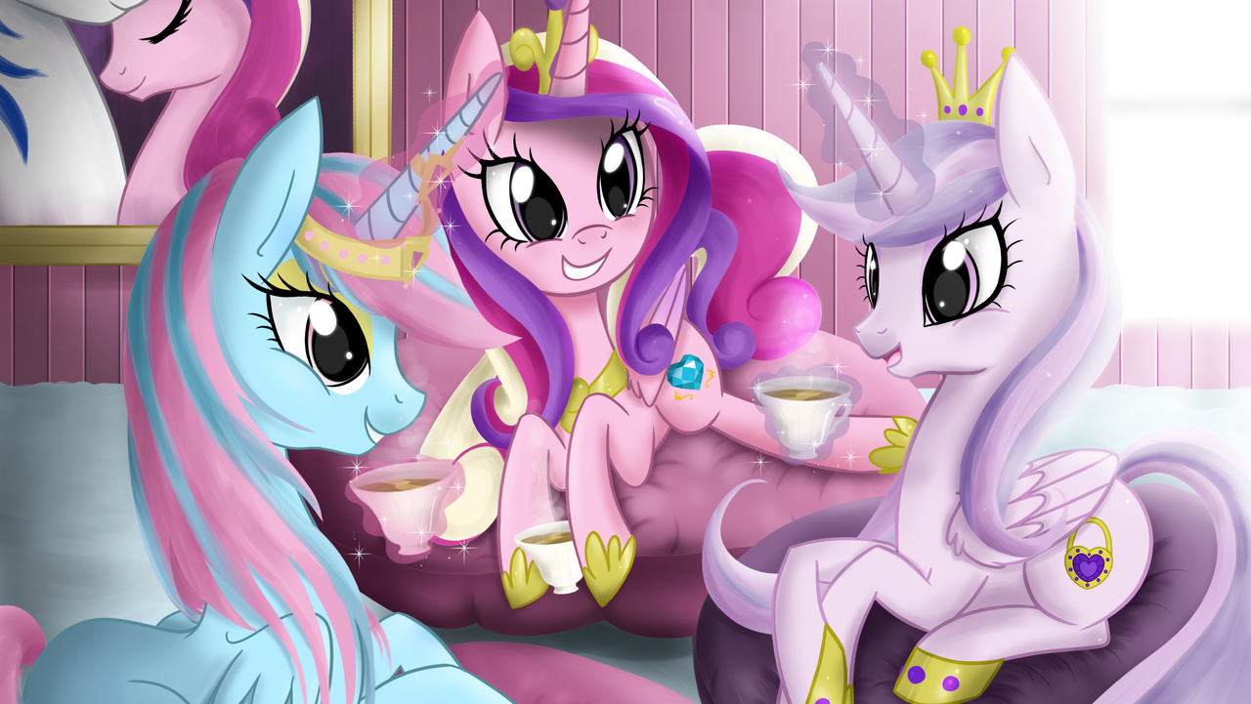
flag

Slide 3
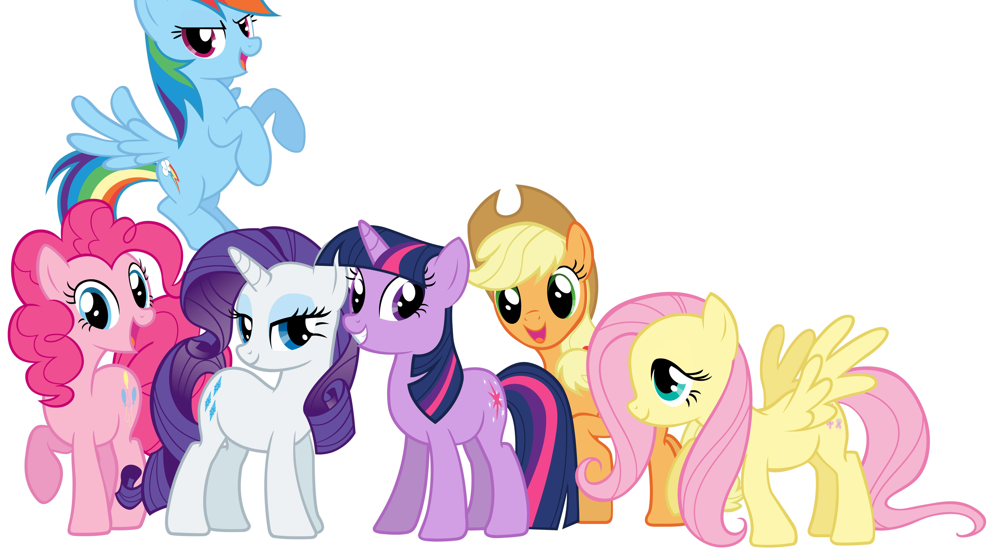
lemon

Slide 4

cup

Slide 5
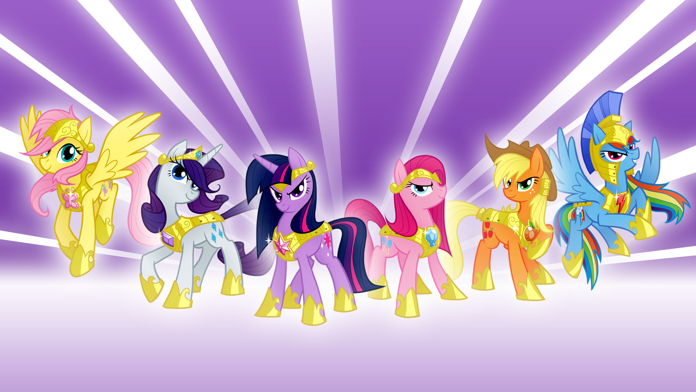
windy

Slide 6
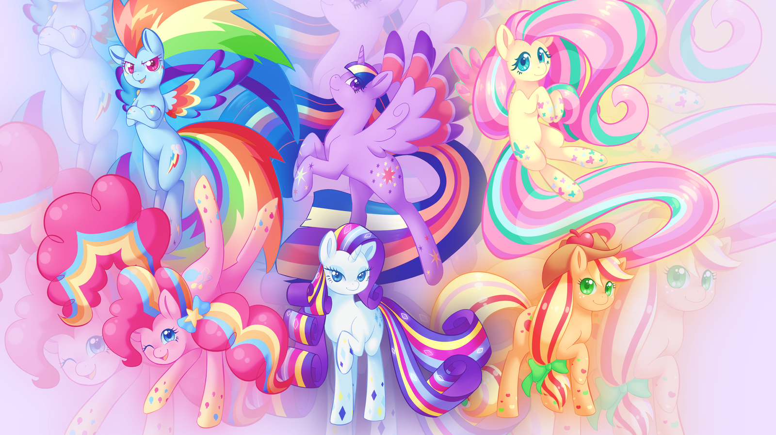
gold

Slide 7
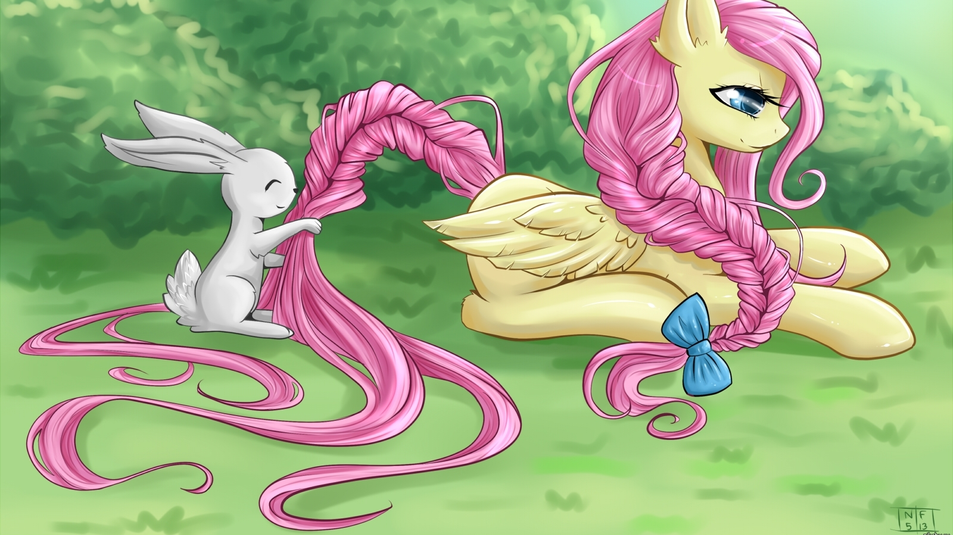
has

Slide 8
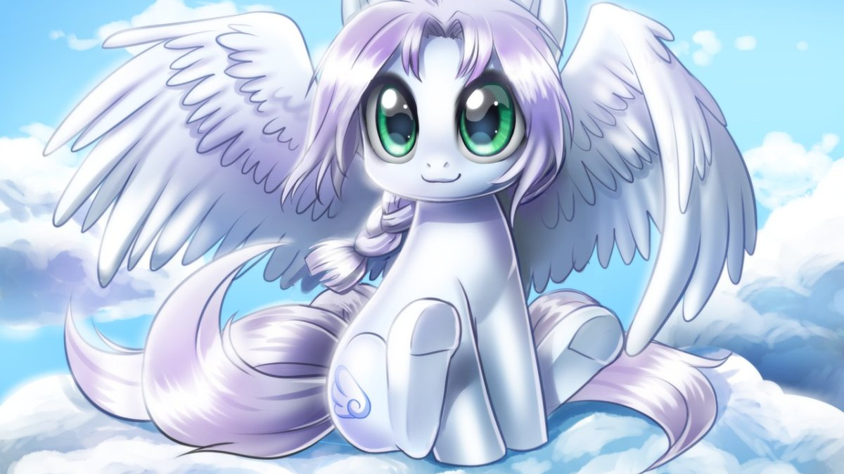
melon

Slide 9
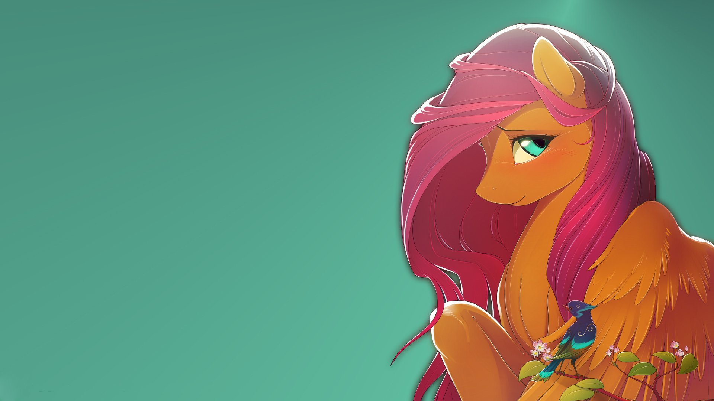
rabbit

Slide 10
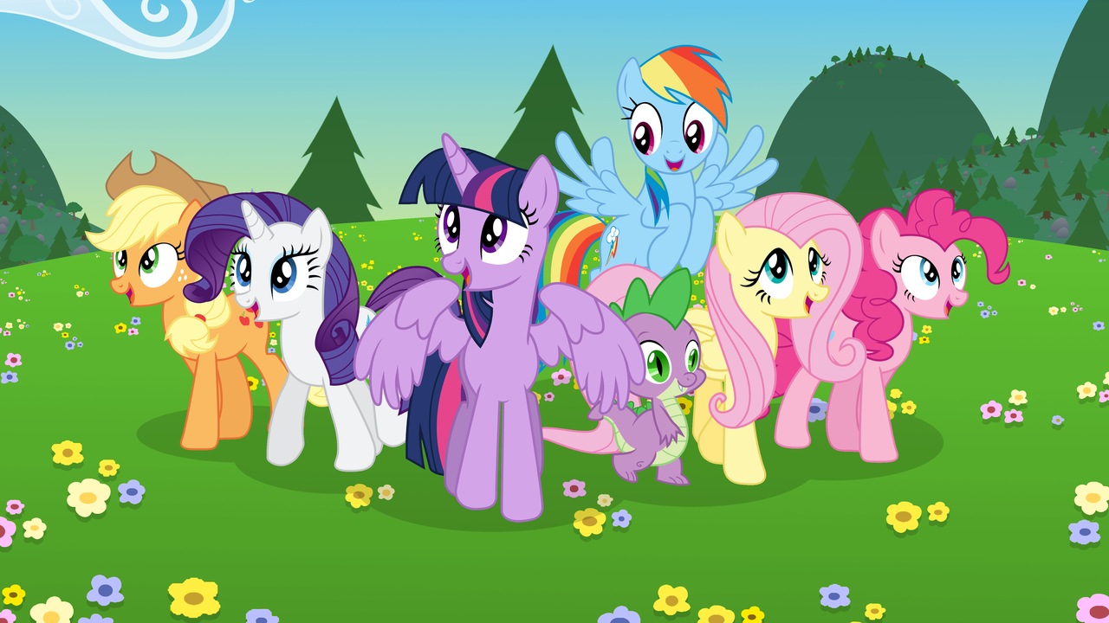
sunny

Slide 11

robot

Slide 12
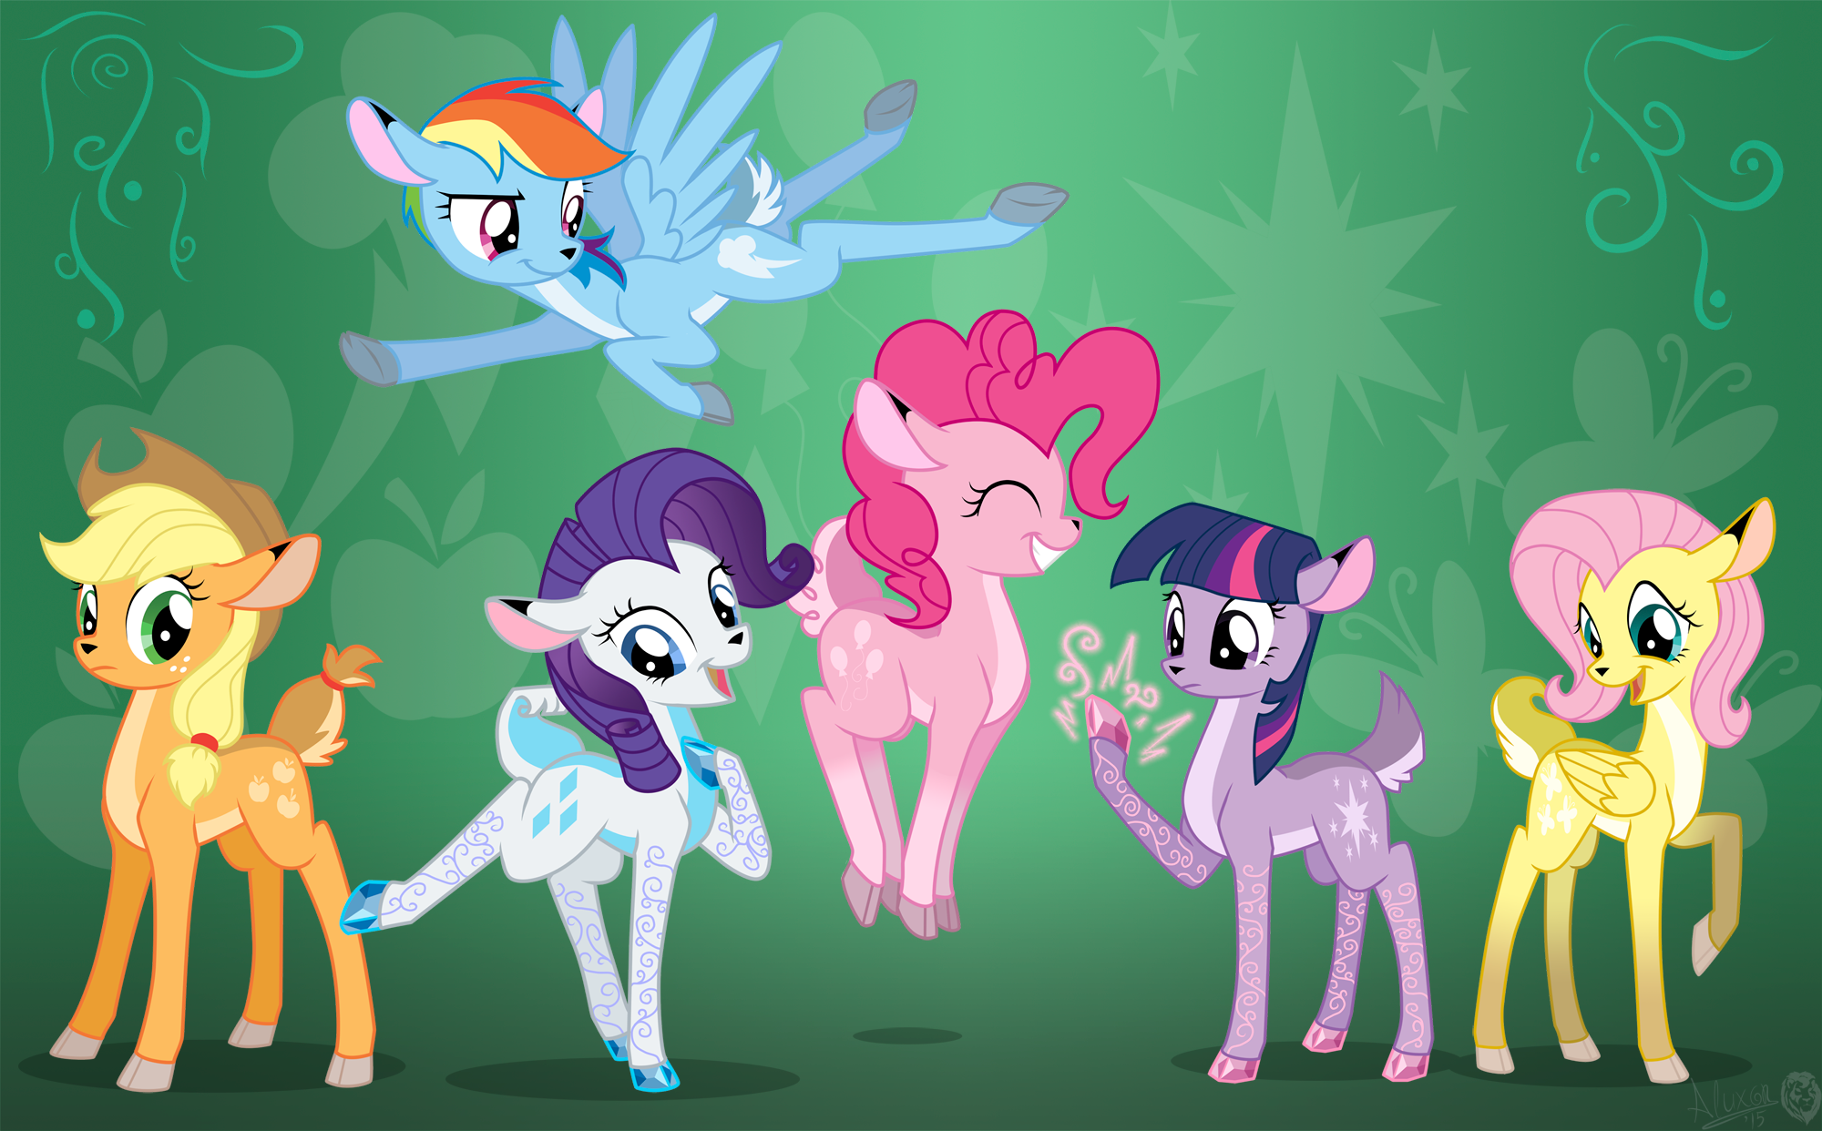
lamp

Slide 13
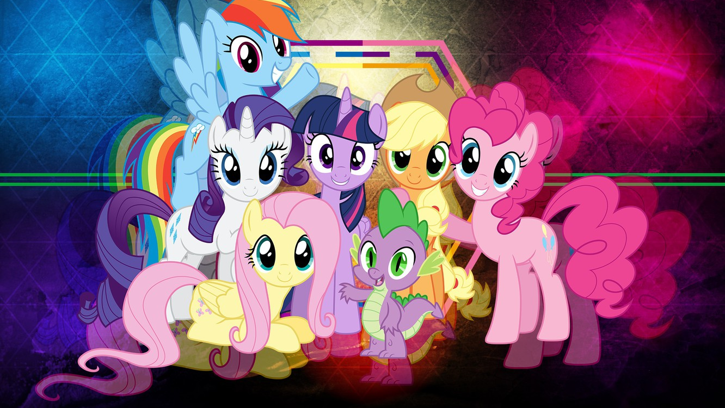
rubber

Slide 14

clock

Slide 15

window

Slide 16
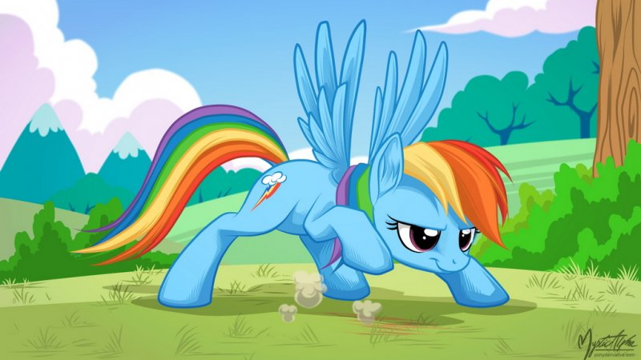
Rex

Slide 17

vest

Slide 18

pen

Slide 19

nest

Slide 20
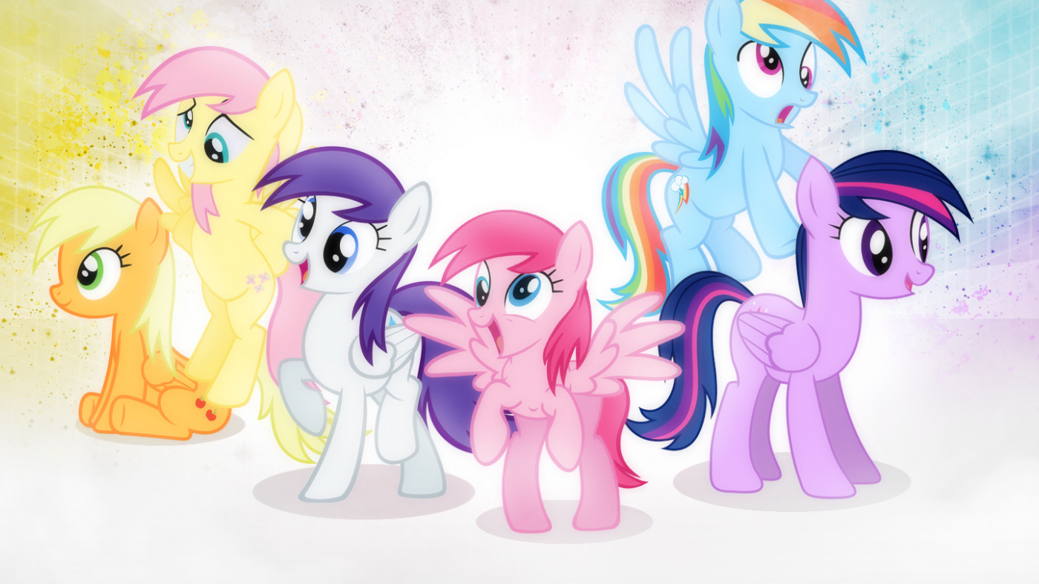
dress

