Slide 1
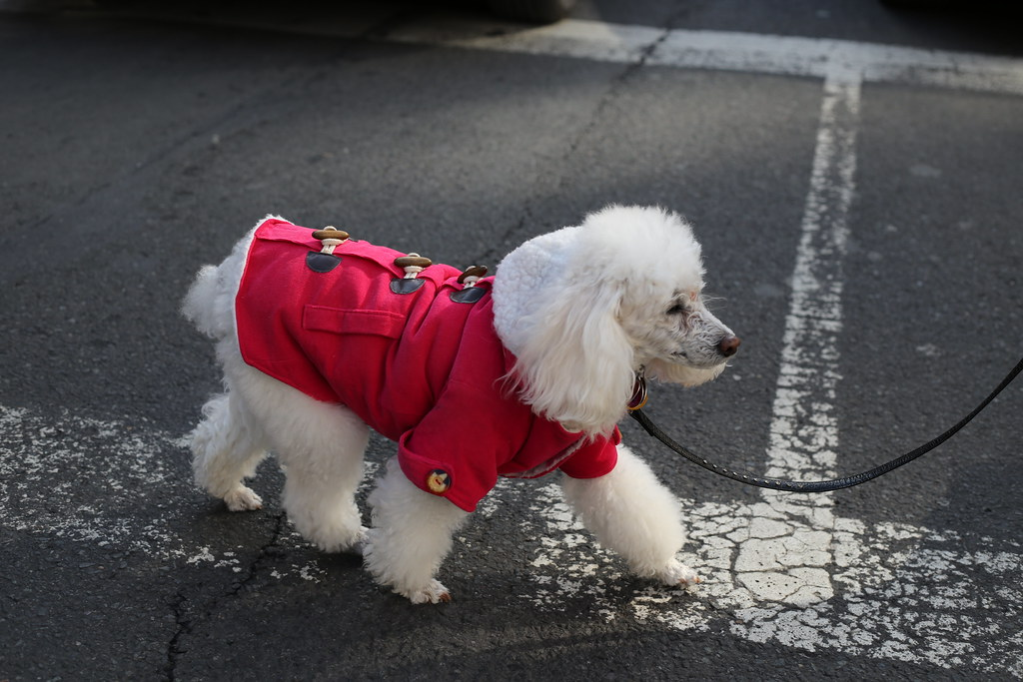
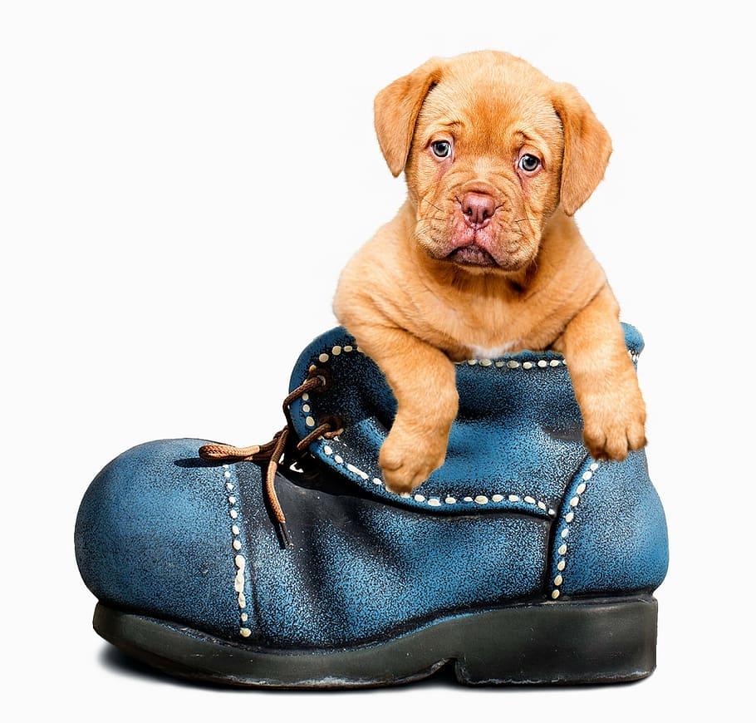
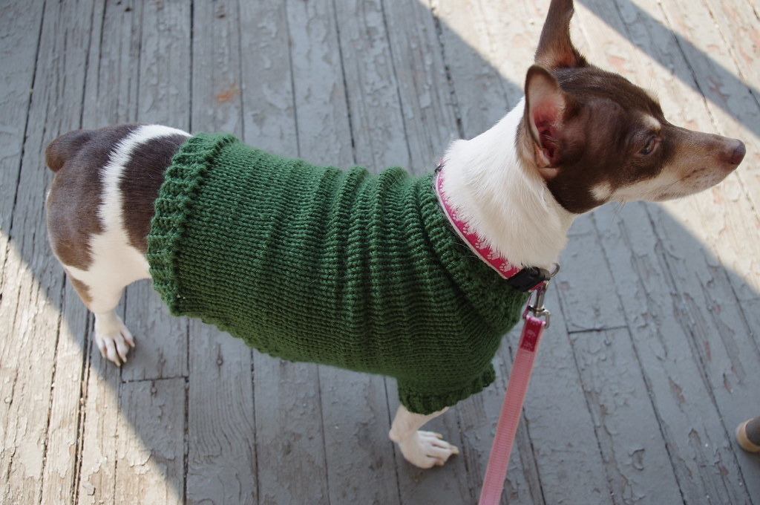
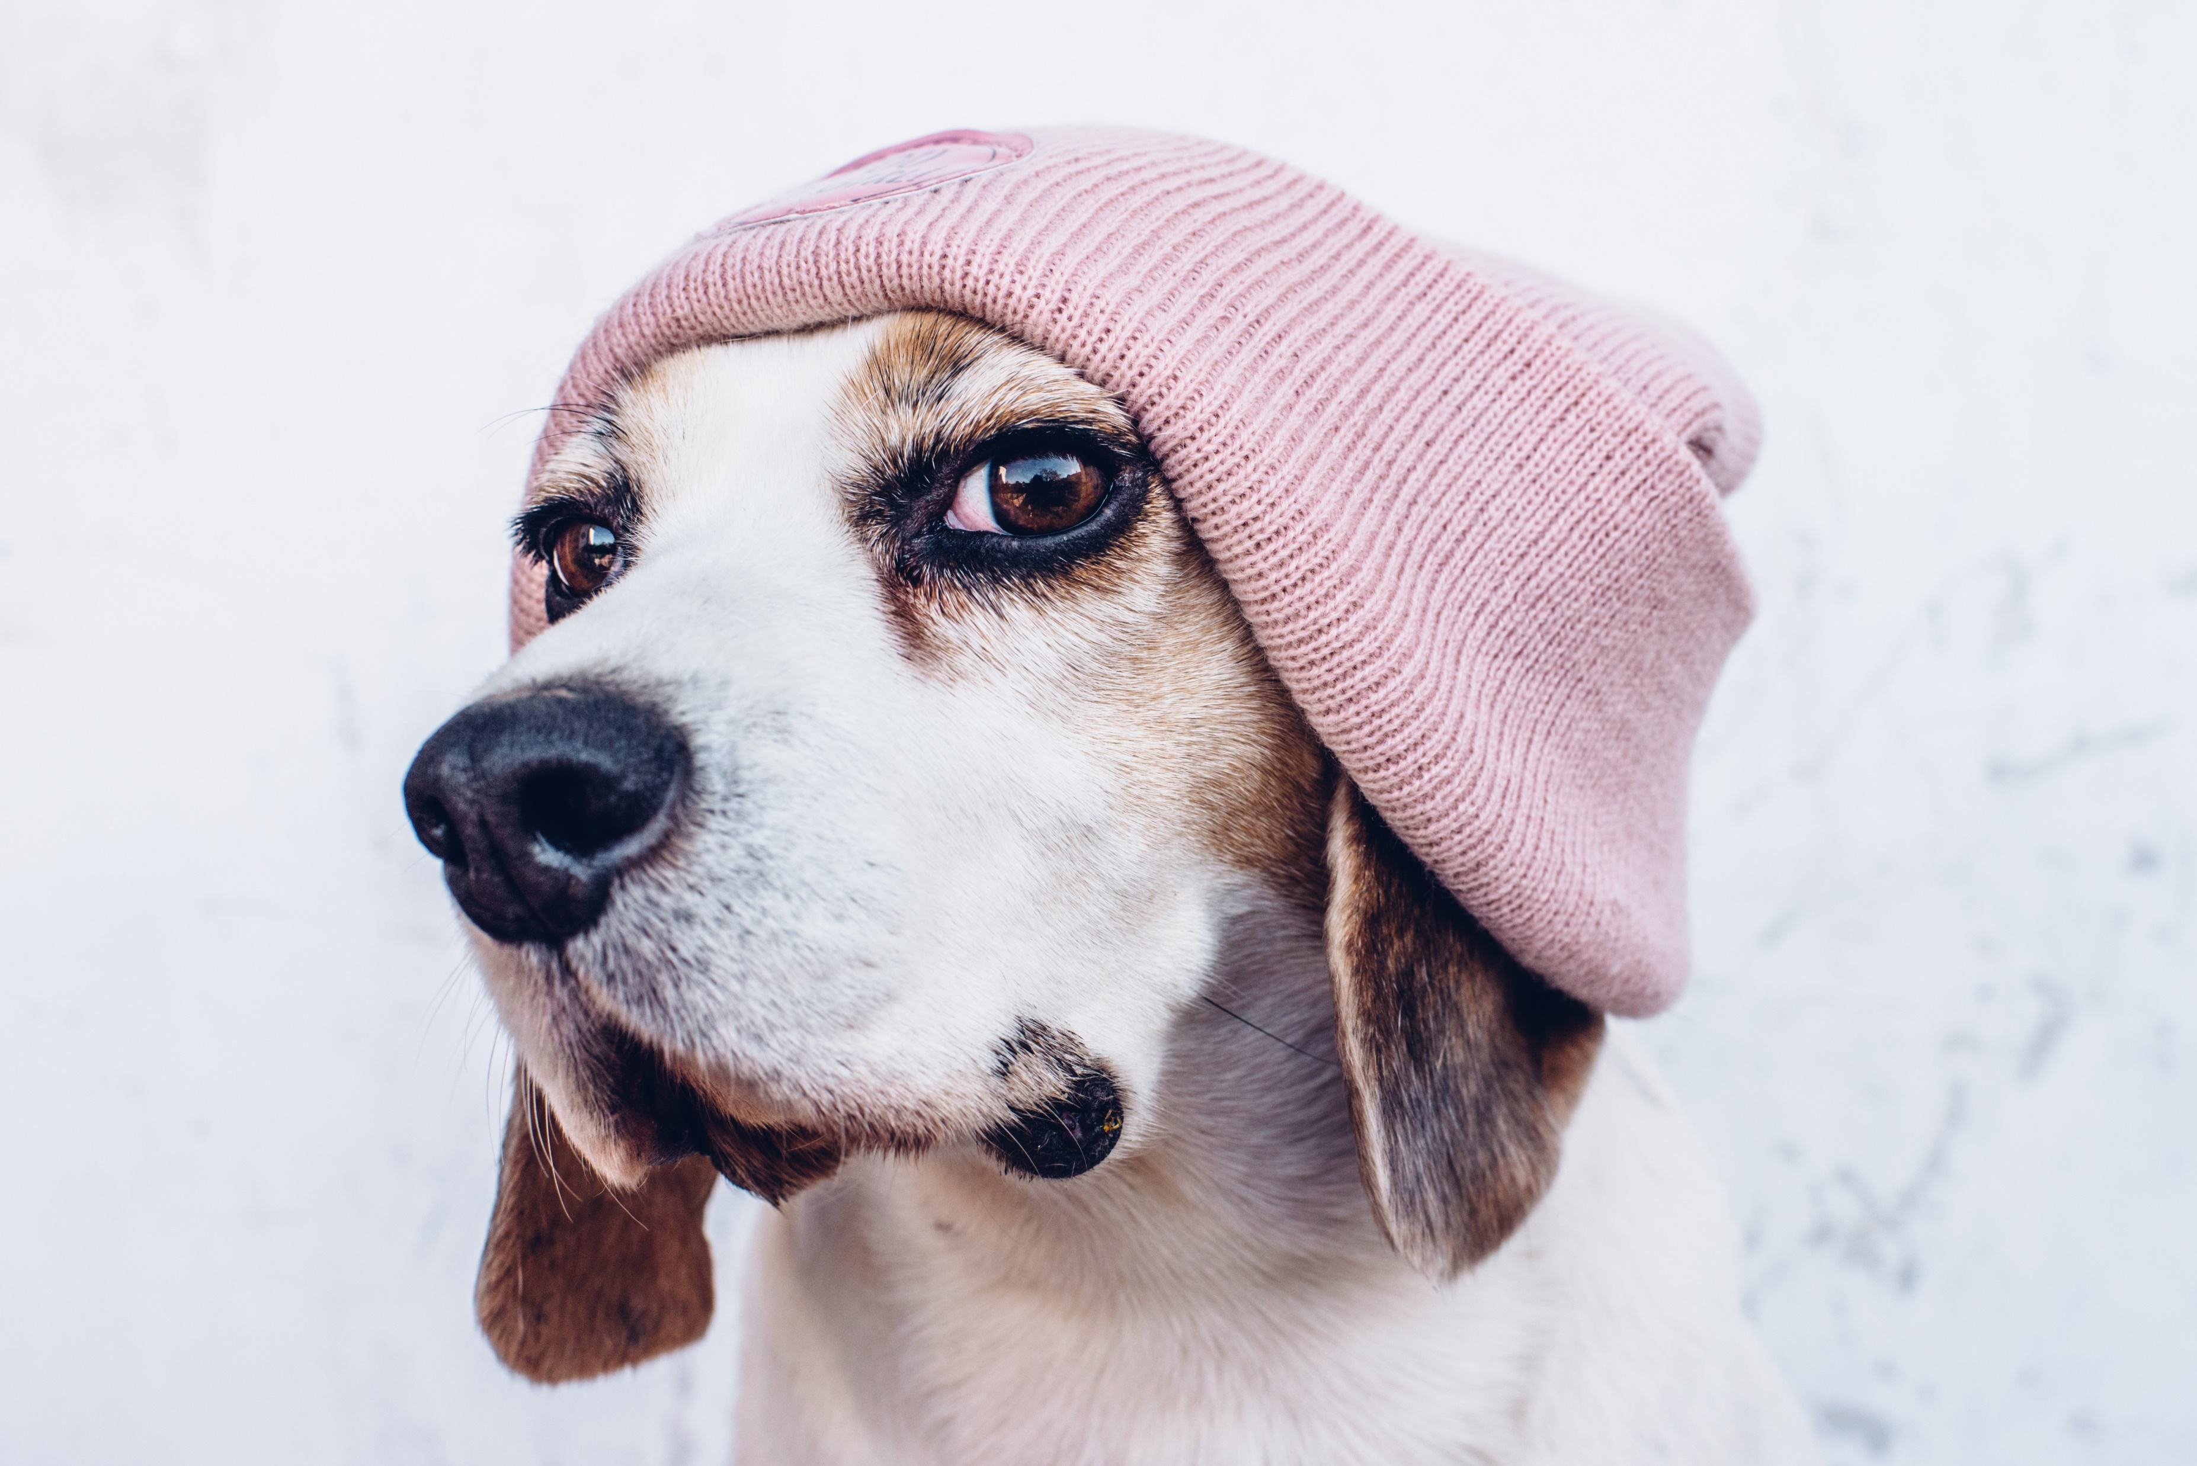
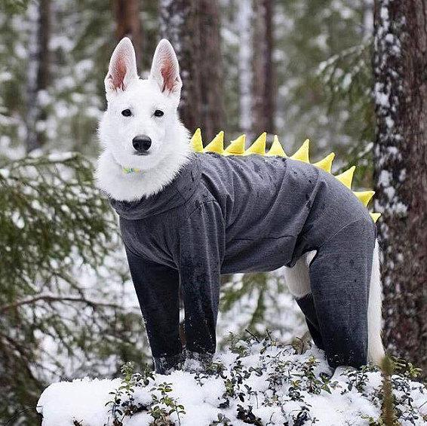
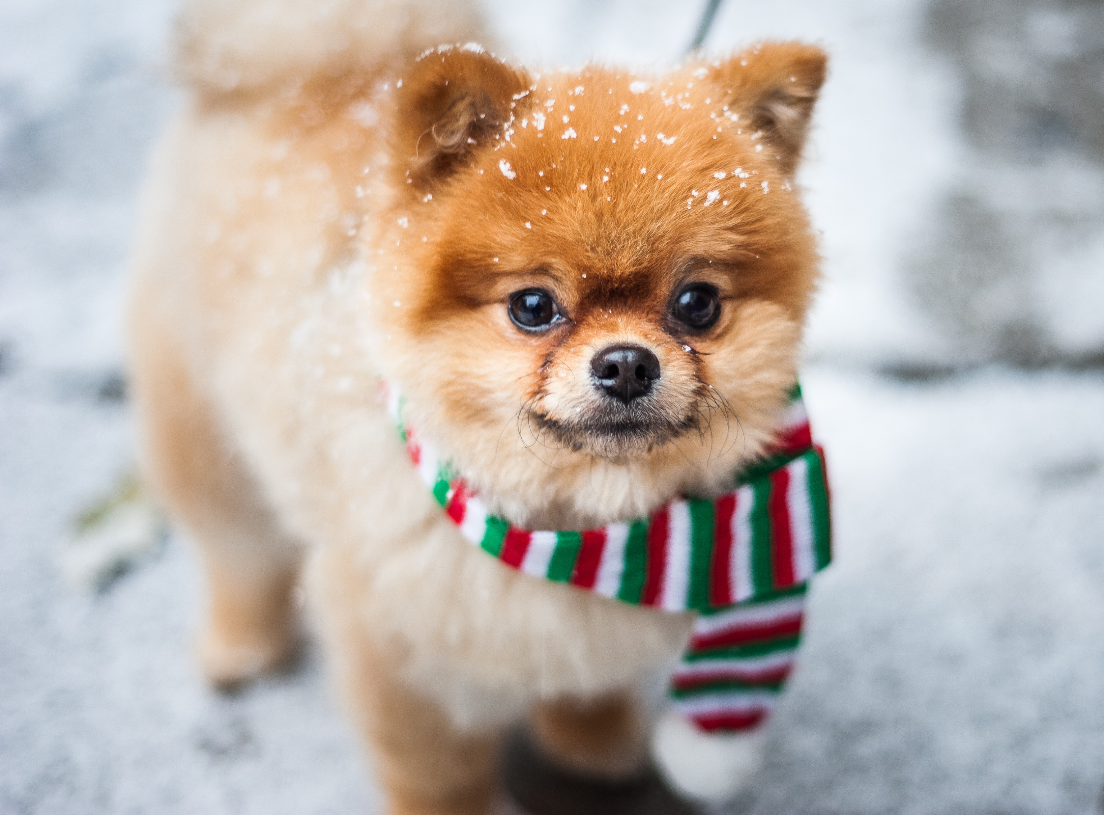
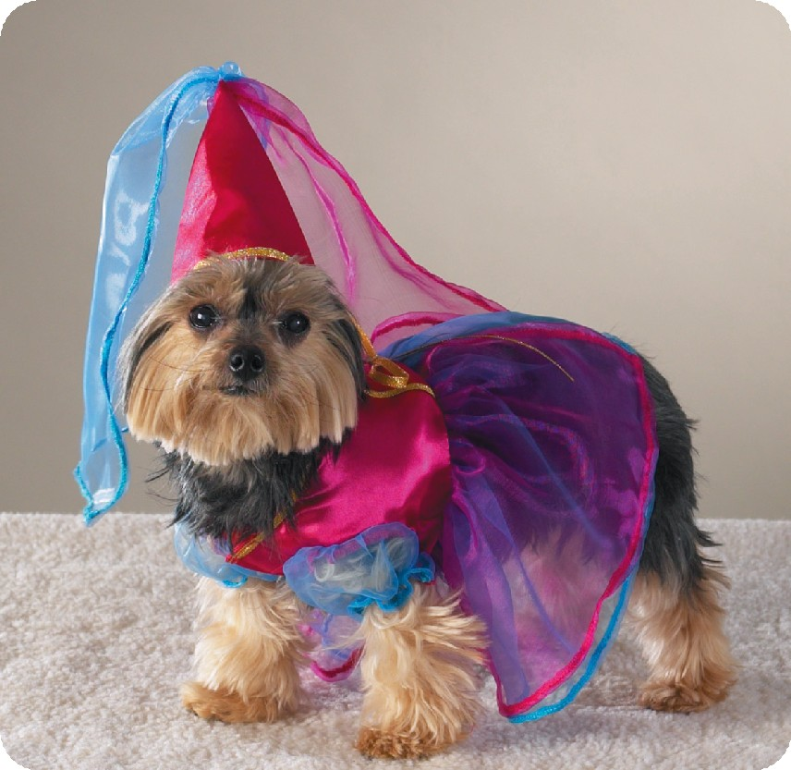
What is the dog wearing?
https://vk.com/teachvs

Slide 2
This dog is wearing…

Slide 3


a suit

Slide 4
jacket
sweater
hat
shoes
suit
dress
This dog is wearing…
scarf

Slide 5
jacket
sweater
hat
shoes
suit
dress
a scarf

Slide 6
jacket
sweater
hat
shoes
suit
dress
This dog is wearing…
scarf

Slide 7
jacket
sweater
hat
shoes
suit
a dress
scarf

Slide 8
jacket
sweater
hat
shoes
suit
This dog is wearing…
scarf
dress

Slide 9
jacket
sweater
hat
suit
shoes
scarf
dress

Slide 10
sweater
hat
shoes
suit
This dog is wearing…
scarf
dress

Slide 11
hat
shoes
suit
a jacket
scarf
sweater
dress

Slide 12
jacket
hat
shoes
suit
This dog is wearing…
scarf
dress

Slide 13
jacket
hat
shoes
suit
a sweater
scarf
dress

Slide 14
jacket
hat
shoes
suit
sweater
This dog is wearing…
scarf
dress
sweater

Slide 15
jacket
shoes
suit
sweater
a hat
scarf
dress

Slide 16
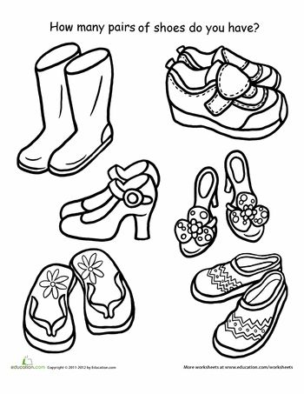

jacket
sweater
hat
shoes
suit
scarf
dress

Slide 17
jacket
shoes
boots
suit
They are boots
scarf
dress

Slide 18
jacket
shoes
suit
scarf
dress

Slide 19
jacket
shoes
shoes
suit
They are shoes
scarf
dress

Slide 20
jacket
shoes
suit
scarf
dress

Slide 21
jacket
shoes
trainers
suit
They are trainers
scarf
dress

Slide 22
jacket
shoes
suit
scarf
dress

Slide 23
jacket
shoes
suit
flip-flops
They are flip-flops
scarf
dress

