Slide 1
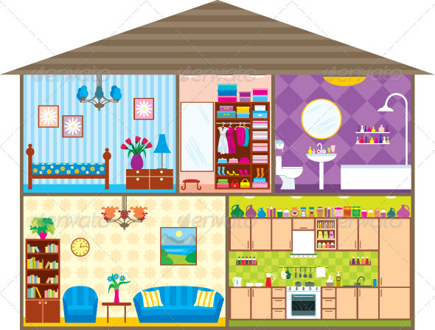


house
bedroom
bathroom
living room
kitchen

