Slide 1
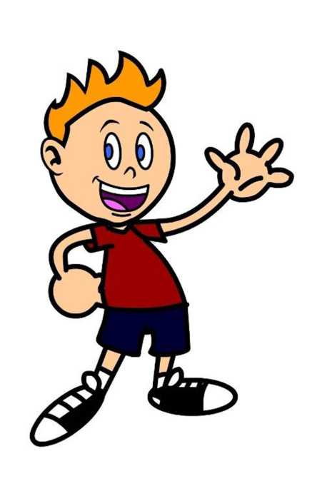
Hello! My name is ______.
Yesterday I _____________.

Slide 2
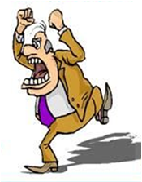
Yesterday
I screamed / I didn’t scream.

Slide 3
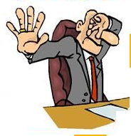
Yesterday
I showed / I didn’t show my dad an ugly rat.

Slide 4
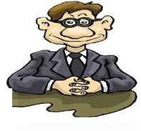
Yesterday I smiled / I didn’t smile at my friends.

Slide 5
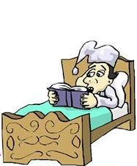
Yesterday I stayed / I didn’t stay in bed all day.

Slide 6
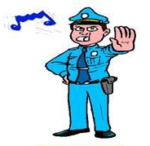
Yesterday the policeman stopped / didn’t stop our car.

Slide 7
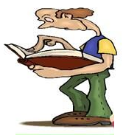
Yesterday
I studied / I didn’t study maths all day.

Slide 8
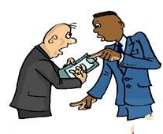
Yesterday I talked / I didn’t talk to my uncle.

Slide 9
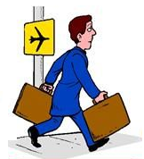
Last year I travelled / I didn’t travel to London.

Slide 10
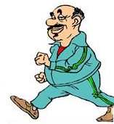
Yesterday I walked / I didn’t walk in the park.

Slide 11
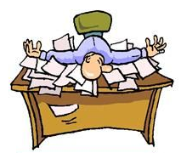
Last week my dad worked / didn’t work every day.

Slide 12
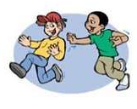
Yesterday I chased / I didn’t chase after my cousin in the park.

Slide 13
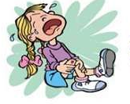
Yesterday I cried / I didn’t cry loudly in the park.

Slide 14
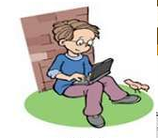
Yesterday I surfed / I didn’t surf the Internet all night.

Slide 15
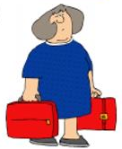
Yesterday I carried / I didn’t carry two heavy bags.

Slide 16
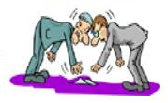
Yesterday I picked up / I didn’t pick up the money in the street.

Slide 17
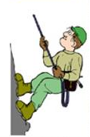
Yesterday I climbed / I didn’t climb a tree.

Slide 18
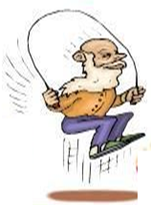
Yesterday I skipped / I didn’t skip one hundred times.

Slide 19
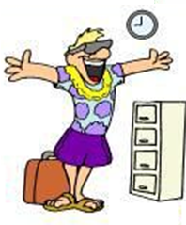
Yesterday I returned / I didn’t return from London.

Slide 20
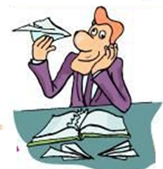
Yesterday my dad played / didn’t play with paper planes at work.

Slide 21
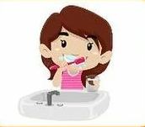
Yesterday morning I brushed / I didn’t brush my teeth.

